Slide 1
TSKS14 Multiple Antenna Communications
Lecture 3, 2020
Emil Björnson

Slide 2
Outline of this lecture
Multipath propagation and Rayleigh fading
Slow fading
Outage probability
Outage capacity
Spatial diversity
Fast fading
Ergodic capacity
Channel hardening

Slide 3
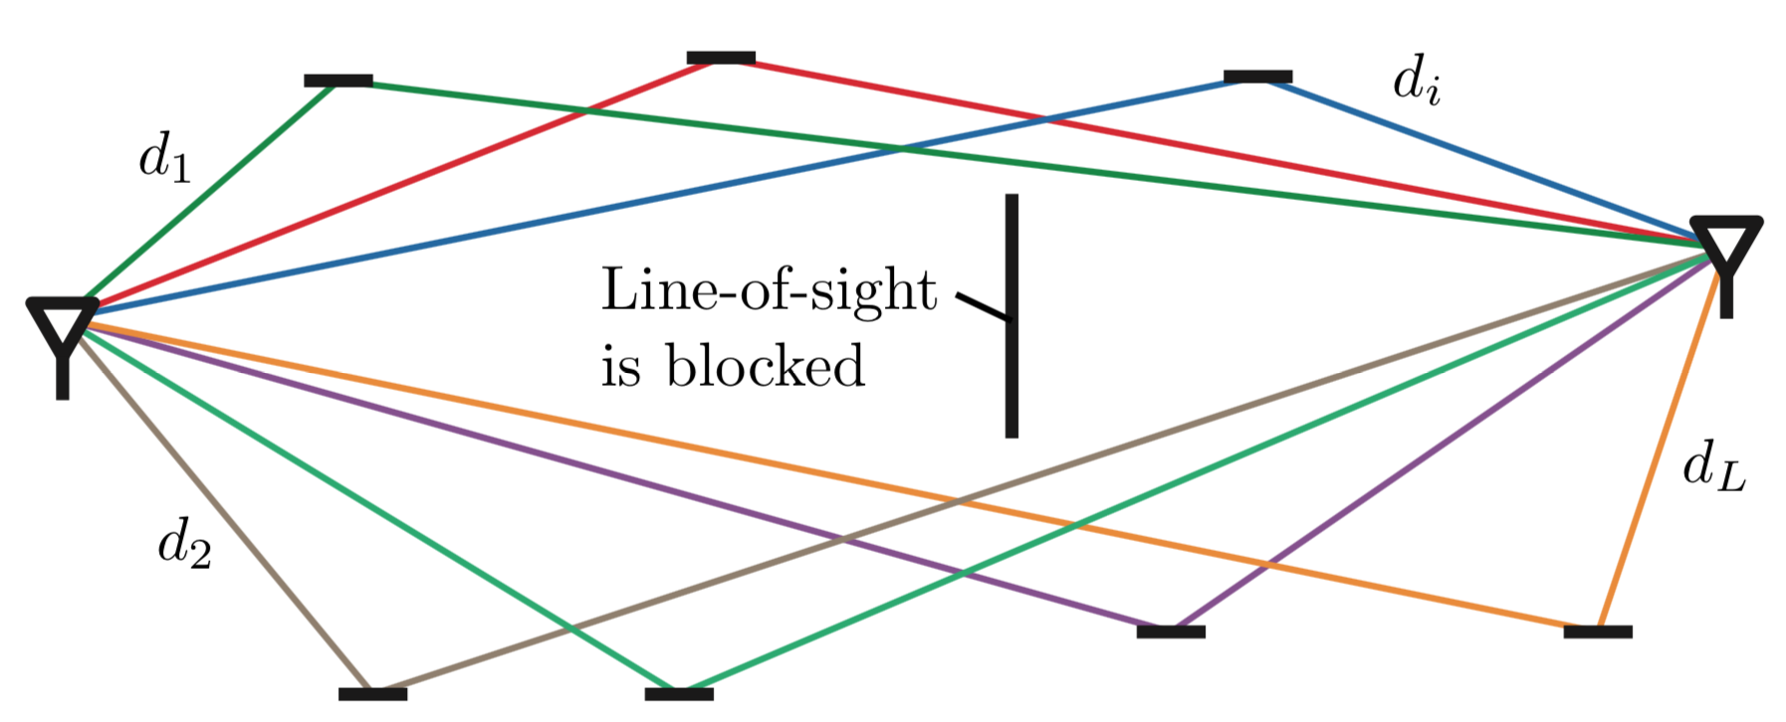
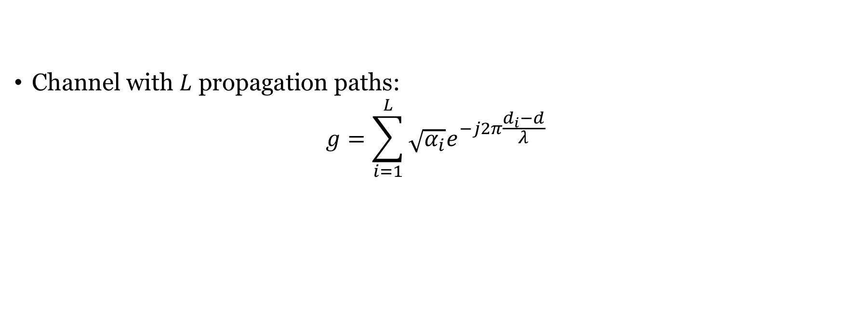
Multipath propagation
Non-line-of-sight channel:
Scattering
Channel with $L$ propagation paths:
$$g=\sum_{i=1}^{L}{\sqrt{α_{i}}e^{−j2π\frac{d_{i}−d}{λ}}}$$
Reference distance
Channel gain
Wavelength

Slide 4
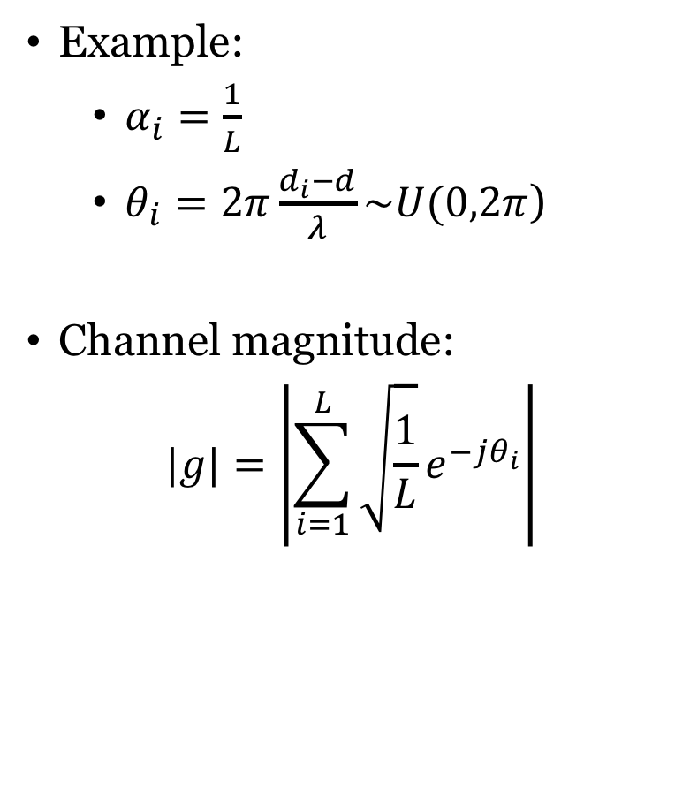



Multipath fading
Example:
$α_{i}=\frac{1}{L}$
$θ_{i}=2π\frac{d_{i}−d}{λ}\sim U(0,2π$)
Channel magnitude:
$$|g|=\left|\sum_{i=1}^{L}{\sqrt{\frac{1}{L}}e^{−jθ_{i}}}\right|$$
Approximation:
$$g\sim CN\left(0,1\right)$$
$$Pr⁡\{\left|g\right|<x\}$$
$$x$$

Slide 5
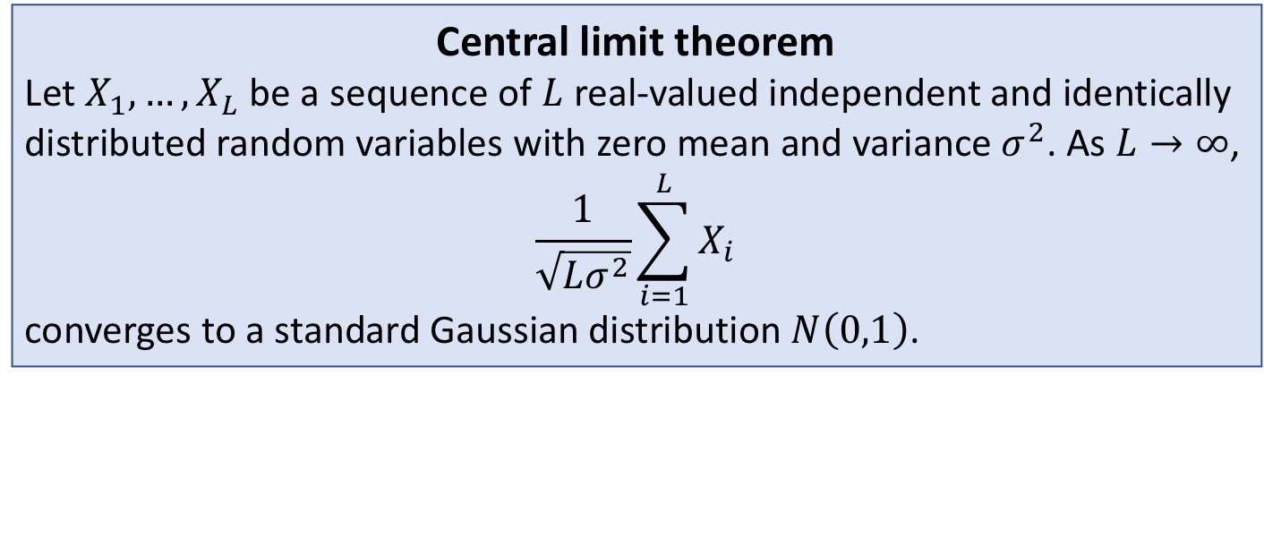
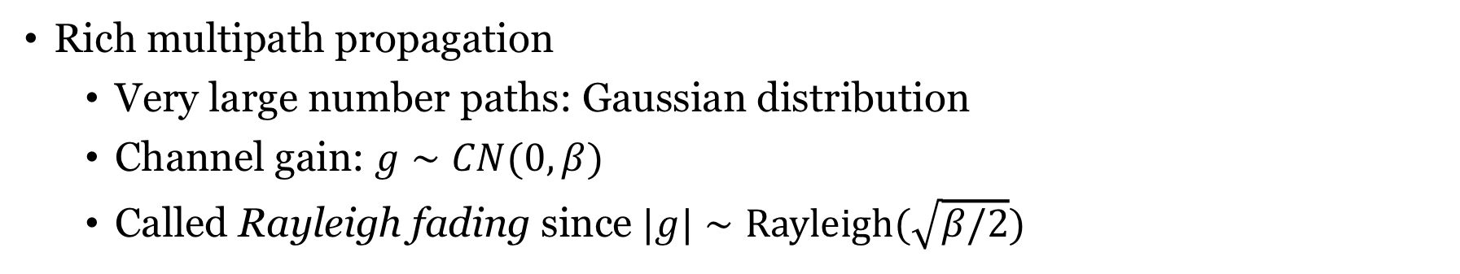
Rich scattering: Rayleigh fading
Central limit theorem
Let $X_{1},…,X_{L}$ be a sequence of $L$ real-valued independent and identically distributed random variables with zero mean and variance $σ^{2}$. As $L→∞$,
$$\frac{1}{\sqrt{Lσ^{2}}}\sum_{i=1}^{L}{X_{i}}$$
converges to a standard Gaussian distribution $N\left(0,1\right)$.
Rich multipath propagation
Very large number paths: Gaussian distribution
Channel gain: $g∼CN(0,β)$
Called Rayleigh fading since $|g|∼Rayleigh(\sqrt{β/2})$

Slide 6

Rayleigh fading, $|g|∼Rayleigh(1/\sqrt{2})$
Channel gain changes over time
In this case: $g\sim CN(0,1)$

Slide 7
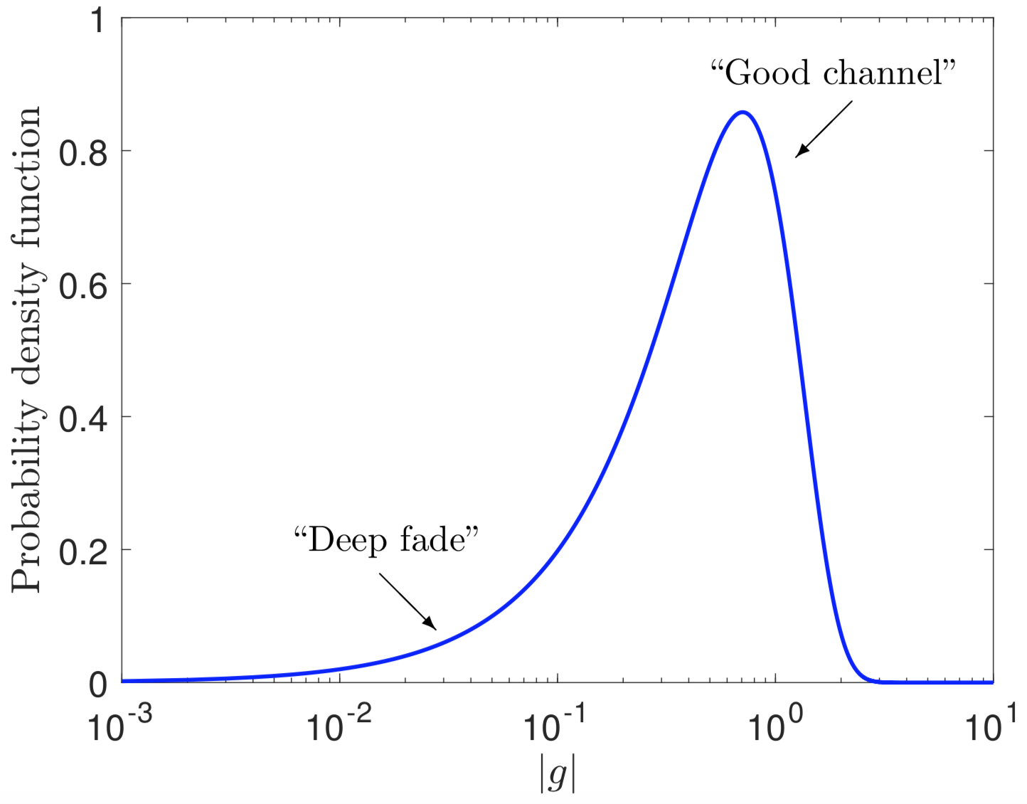
Rayleigh fading, zooming in on tail
Risk of very small channel gain
Two issues:
Variations in channel quality
Unpredictable

Slide 8
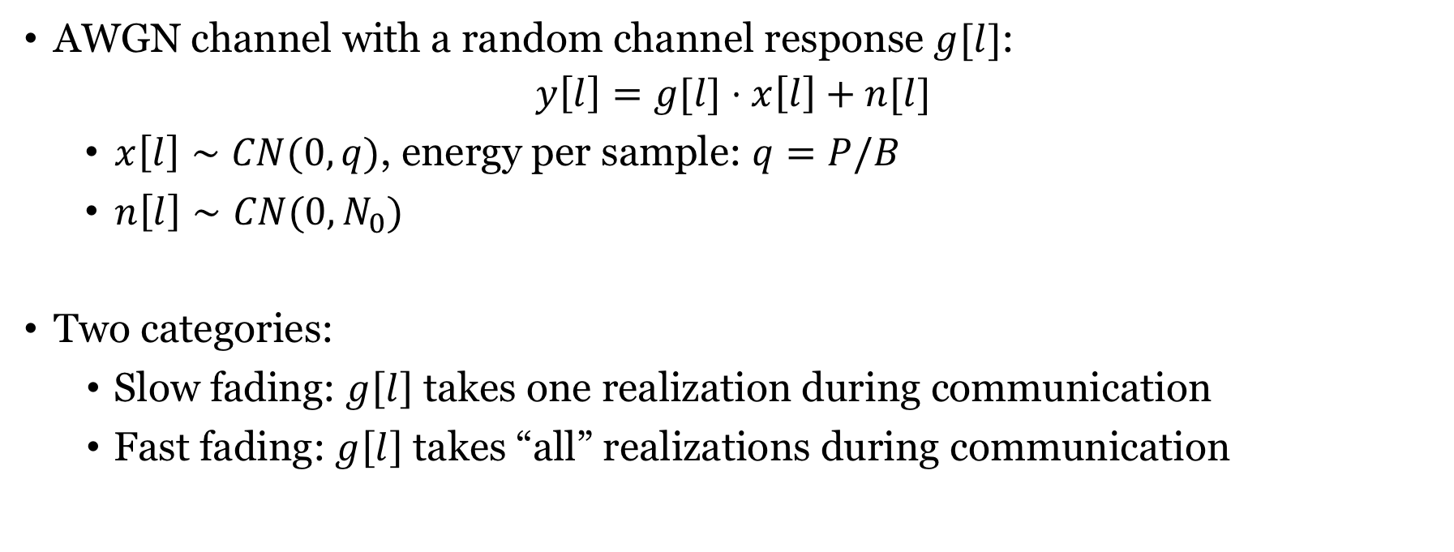
Capacity of fading channel
AWGN channel with a random channel response $g[l]$:
$$y\left[l\right]=g[l]⋅x\left[l\right]+n[l]$$
$x\left[l\right]∼CN(0,q)$, energy per sample: $q=P/B$
$n\left[l\right]∼CN(0,N_{0})$
Two categories:
Slow fading: $g\left[l\right]$ takes one realization during communication
Fast fading: $g\left[l\right]$ takes “all” realizations during communication
Reality might be somewhere in between

Slide 9
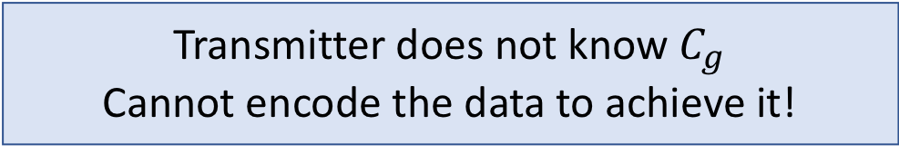
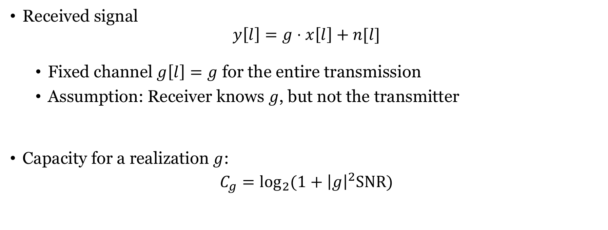

Slow fading
Received signal
$$y\left[l\right]=g⋅x\left[l\right]+n[l]$$
Fixed channel $g\left[l\right]=g$ for the entire transmission
Assumption: Receiver knows $g$, but not the transmitter
Capacity for a realization $g$:
$$C_{g}=\log_{2}{(1+{\left|g\right|}^{2}SNR)}$$
$$q/N_{0}$$
Transmitter does not know $C_{g}$
Cannot encode the data to achieve it!

Slide 10
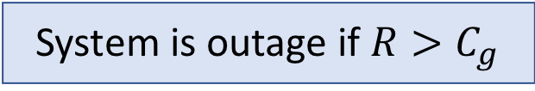
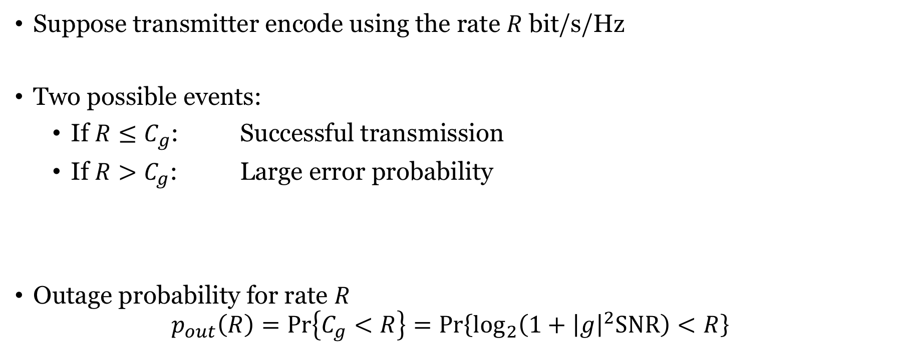
Opportunistic transmission
Suppose transmitter encode using the rate $R$ bit/s/Hz
Two possible events:
If ${R≤C}_{g}$: Successful transmission
If ${R>C}_{g}$: Large error probability
Outage probability for rate $R$
$$p_{out}\left(R\right)=\operatorname{Pr}\left\{C_{g}<R\right\}=\operatorname{Pr}\left\{\log_{2}\left(1+{\left|g\right|}^{2}SNR\right)<R\right\}$$
System is outage if ${R>C}_{g}$

Slide 11
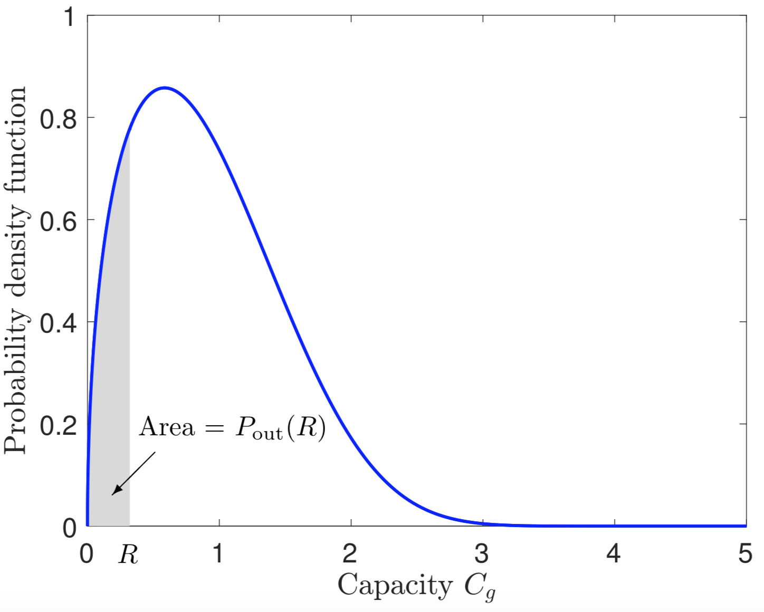


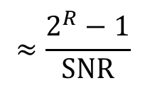
Outage probability with $g\sim CN\left(0,1\right)$
High SNR
Outage probability for rate $R: p_{out}\left(R\right)=\operatorname{Pr}\left\{C_{g}<R\right\}=1−e^{− \frac{2^{R}−1}{SNR}}$
$$≈\frac{2^{R}−1}{SNR}$$
Outage probability decays with $SNR=q/N_{0}$
as ${SNR}^{−1}$

Slide 12
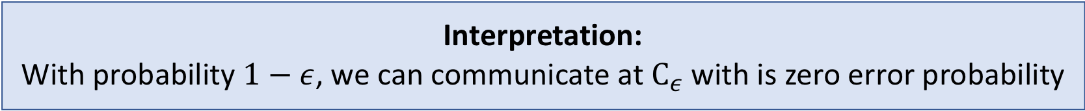
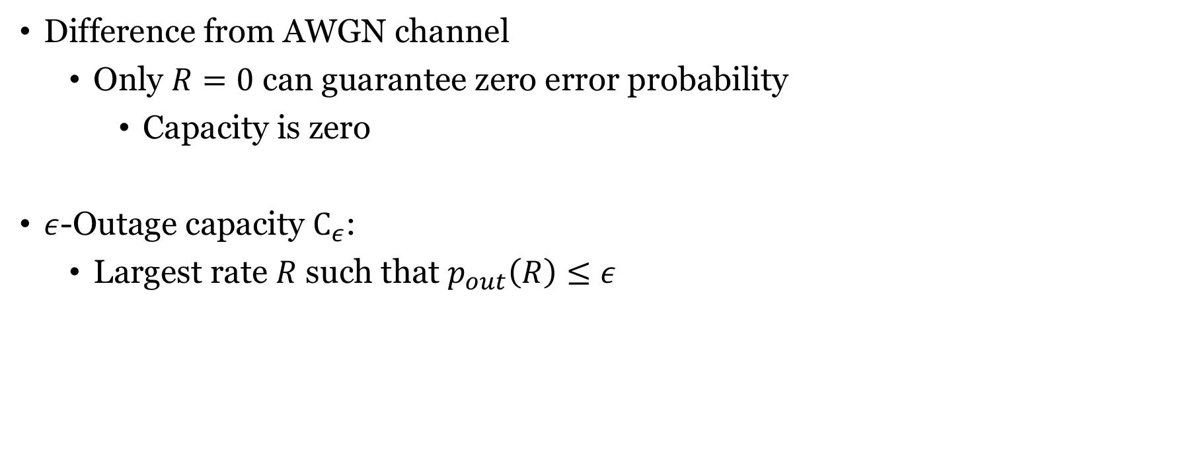
Outage capacity
Difference from AWGN channel
Only $R=0$ can guarantee zero error probability
Capacity is zero
$ε$-Outage capacity $C_{ε}$:
Largest rate $R$ such that $p_{out}\left(R\right)≤ε$
Interpretation: With probability $1−ε$, we can communicate at $C_{ε}$ with is zero error probability

Slide 13
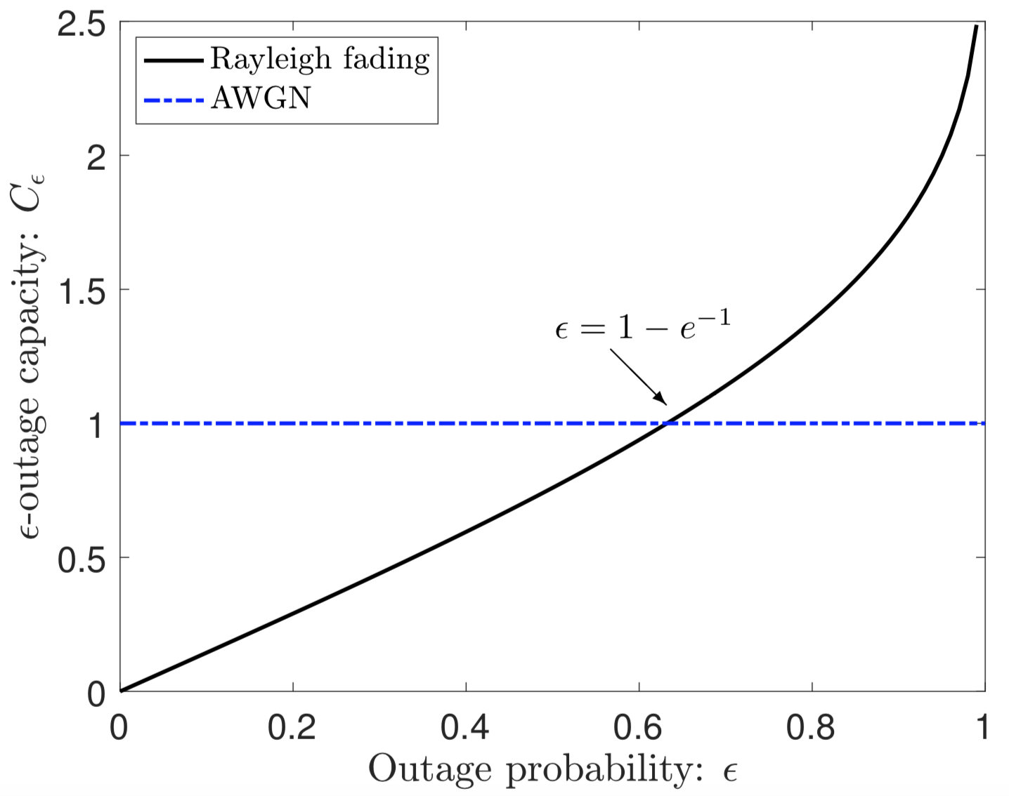
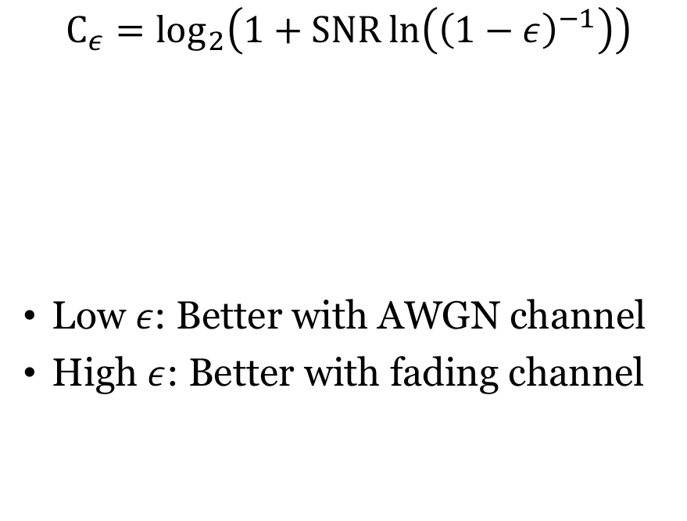
Outage capacity with $g\sim CN\left(0,1\right)$
$$C_{ε}=\log_{2}\left(1+SNR\ln\left({\left(1−ε\right)}^{−1}\right)\right)$$
Low $ε$: Better with AWGN channel
High $ε$: Better with fading channel
Difference from AWGN channel
SNR is 0 dB

Slide 14
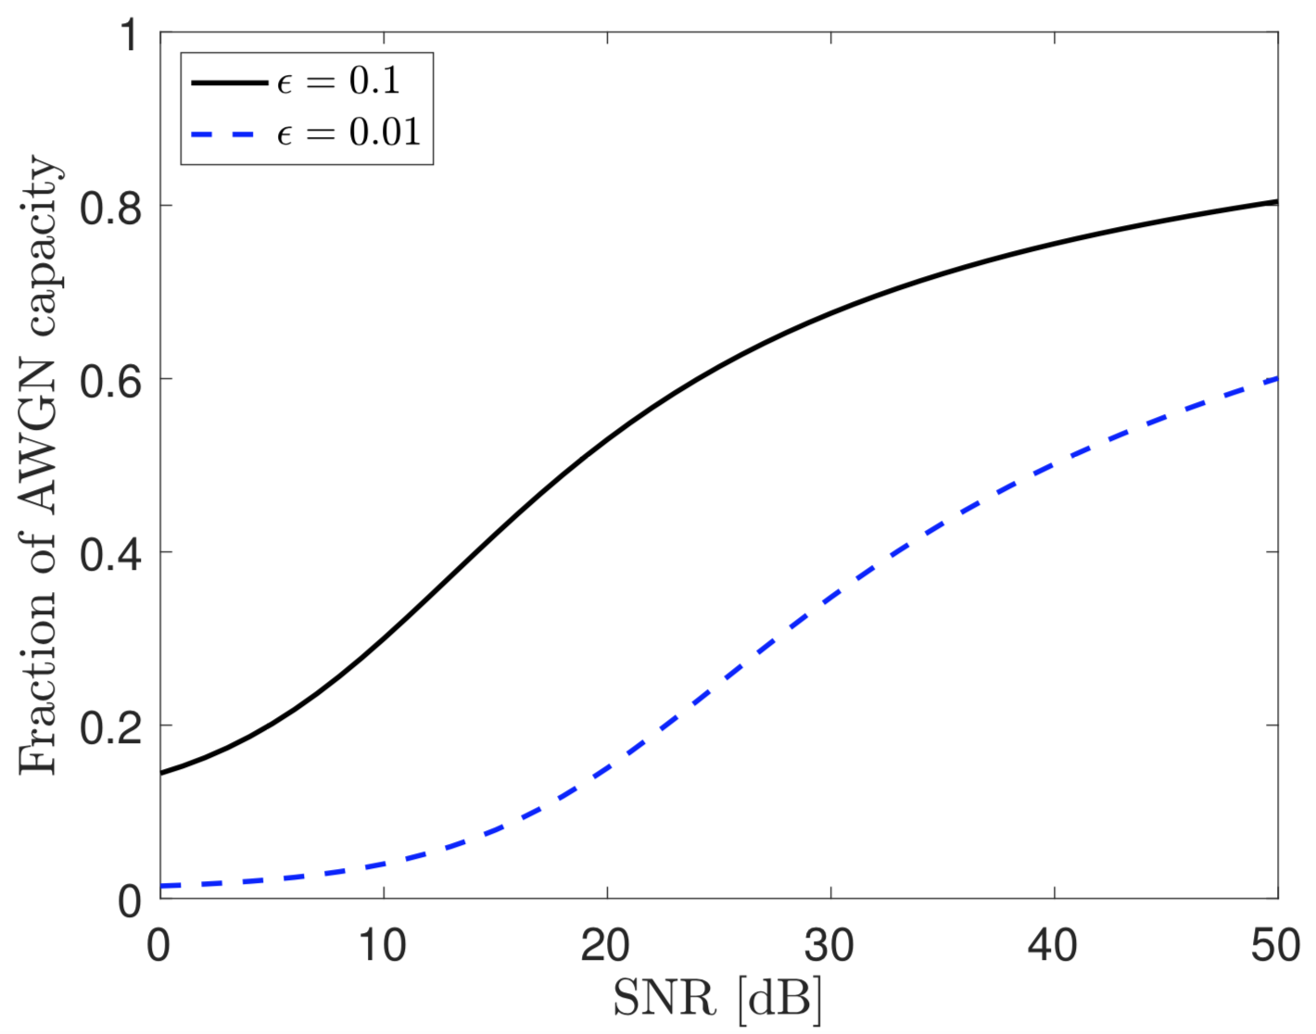
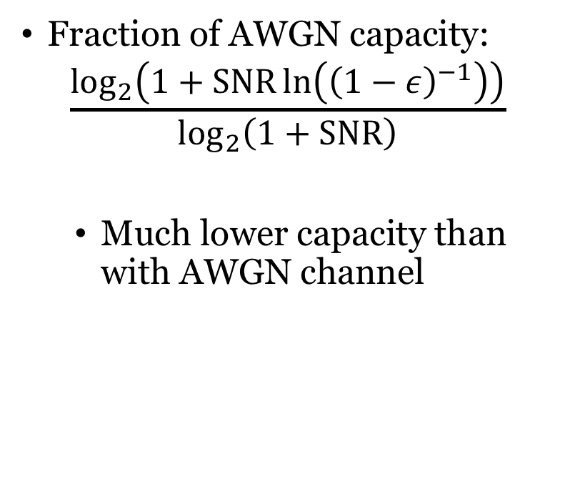
Outage capacity with small outage probability
Fraction of AWGN capacity:
$$\frac{\log_{2}\left(1+SNR\ln\left({\left(1−ε\right)}^{−1}\right)\right)}{\log_{2}\left(1+SNR\right)}$$
Much lower capacity than with AWGN channel
Can we improve the situation?

Slide 15
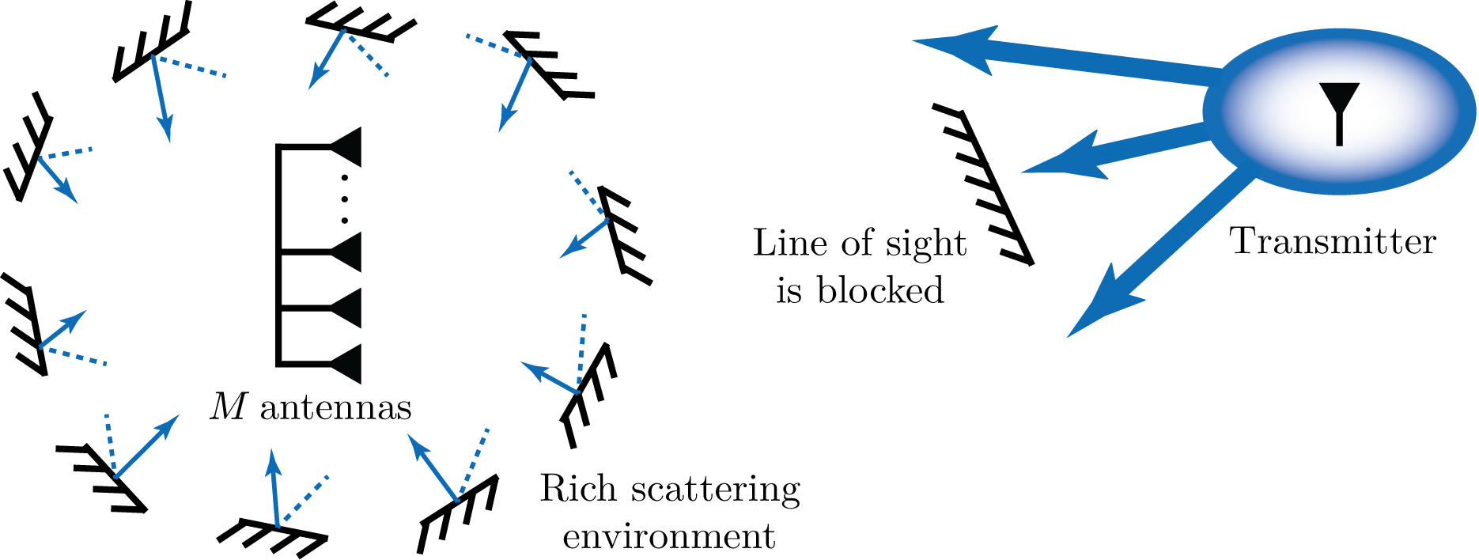
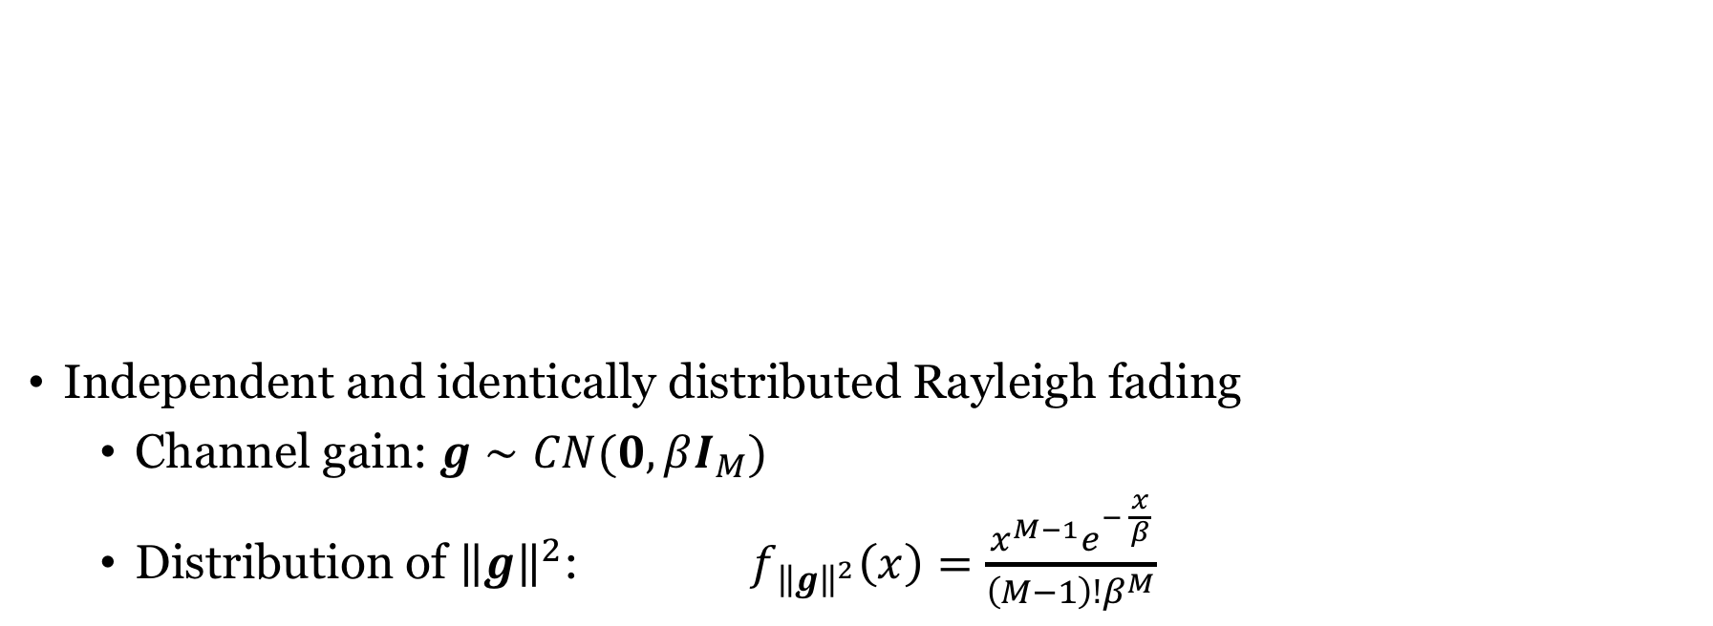
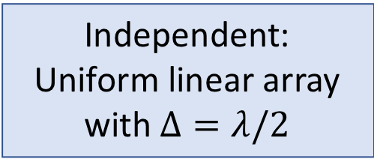
Fading multiple antenna channels
Independent and identically distributed Rayleigh fading
Channel gain: $g∼CN(0,βI_{M})$
Distribution of ${\left\|g\right\|}^{2}$: $f_{{\left\|g\right\|}^{2}}\left(x\right)=\frac{x^{M−1}e^{− \frac{x}{β}}}{\left(M−1\right)!β^{M}}$
Independent:
Uniform linear array
with $Δ=λ/2$

Slide 16
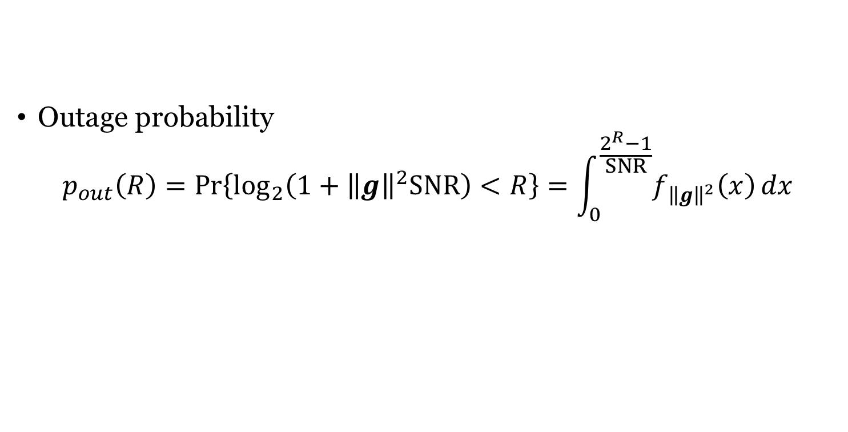
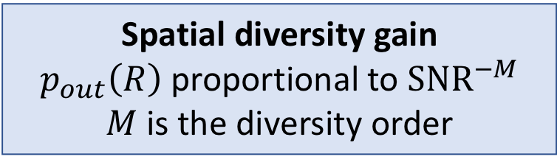
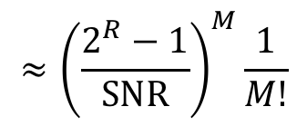
$M$ receive antennas and i.i.d. Rayleigh fading
High SNR
Outage probability
$$p_{out}\left(R\right)=\operatorname{Pr}\left\{\log_{2}\left(1+{\left\|g\right\|}^{2}SNR\right)<R\right\}=\int_{0}^{\frac{2^{R}−1}{SNR}}{f_{{\left\|g\right\|}^{2}}\left(x\right)}dx$$
$$≈{\left(\frac{2^{R}−1}{SNR}\right)}^{M}\frac{1}{M!}$$
Spatial diversity gain
$p_{out}\left(R\right)$proportional to $SNR^{−M}$
$M$ is the diversity order

Slide 17
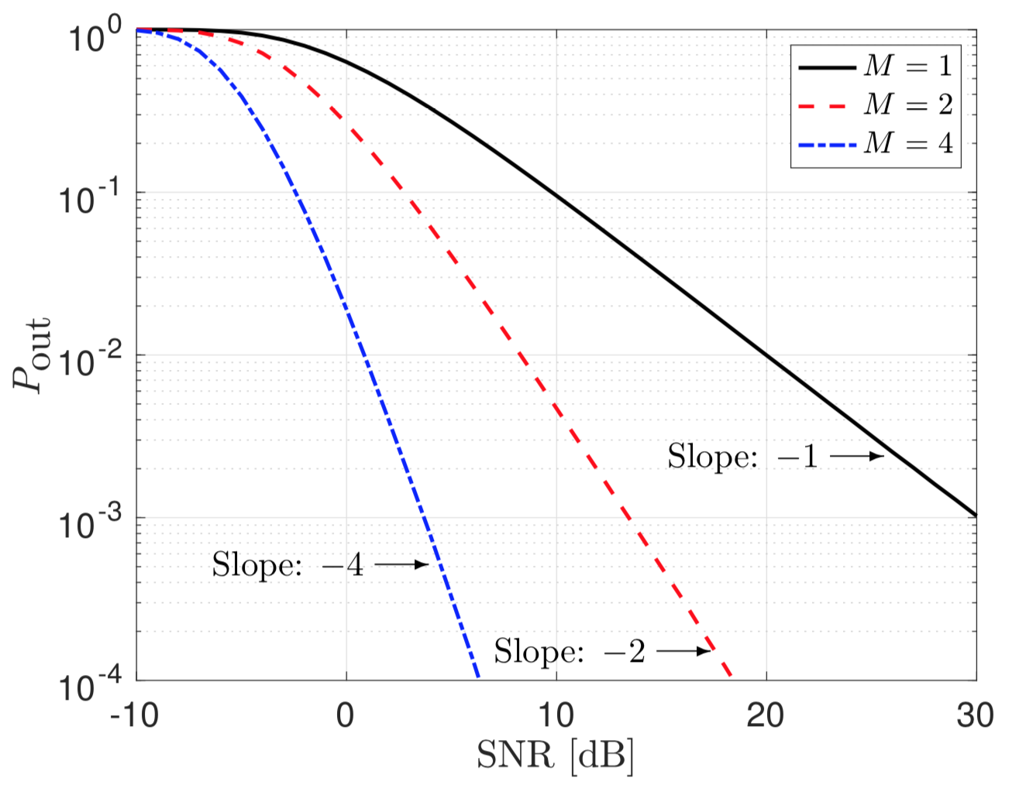

Outage probability with $M$ receive antennas
Outage probability decays as
$$SNR^{−M}$$
Makes a huge difference!
Multiple receive antennas gives:
Beamforming gain
Diversity gain

Slide 18
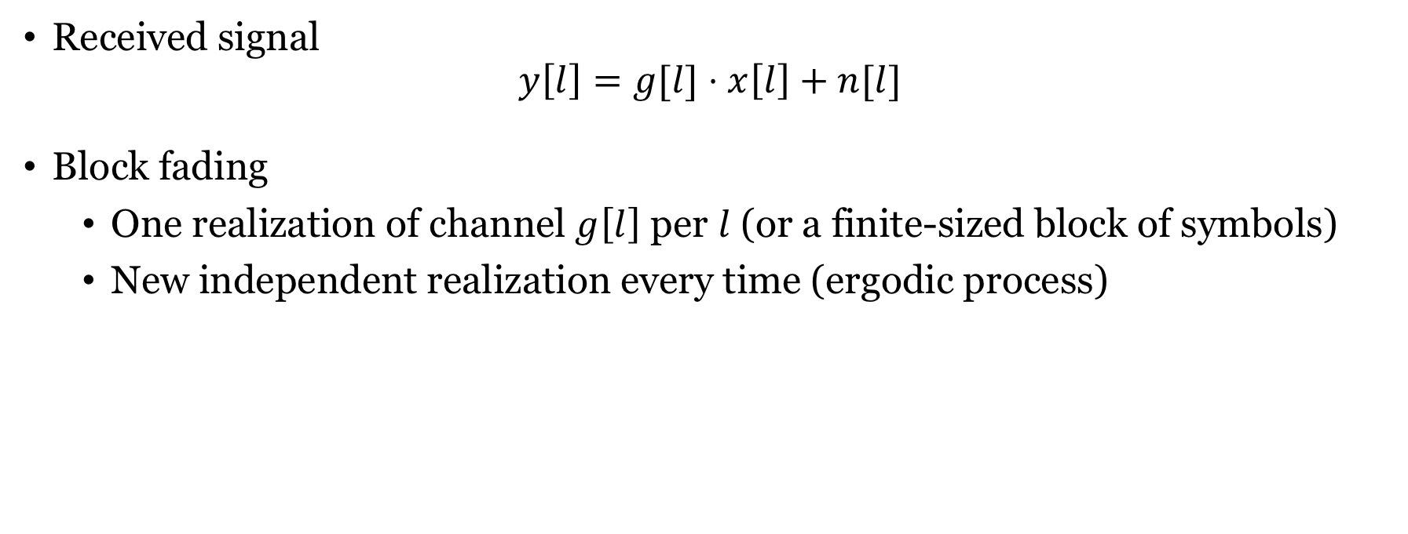
Fast fading
Received signal
$$y\left[l\right]=g[l]⋅x\left[l\right]+n[l]$$
Block fading
One realization of channel $g\left[l\right]$ per $l$ (or a finite-sized block of symbols)
New independent realization every time (ergodic process)

Slide 19

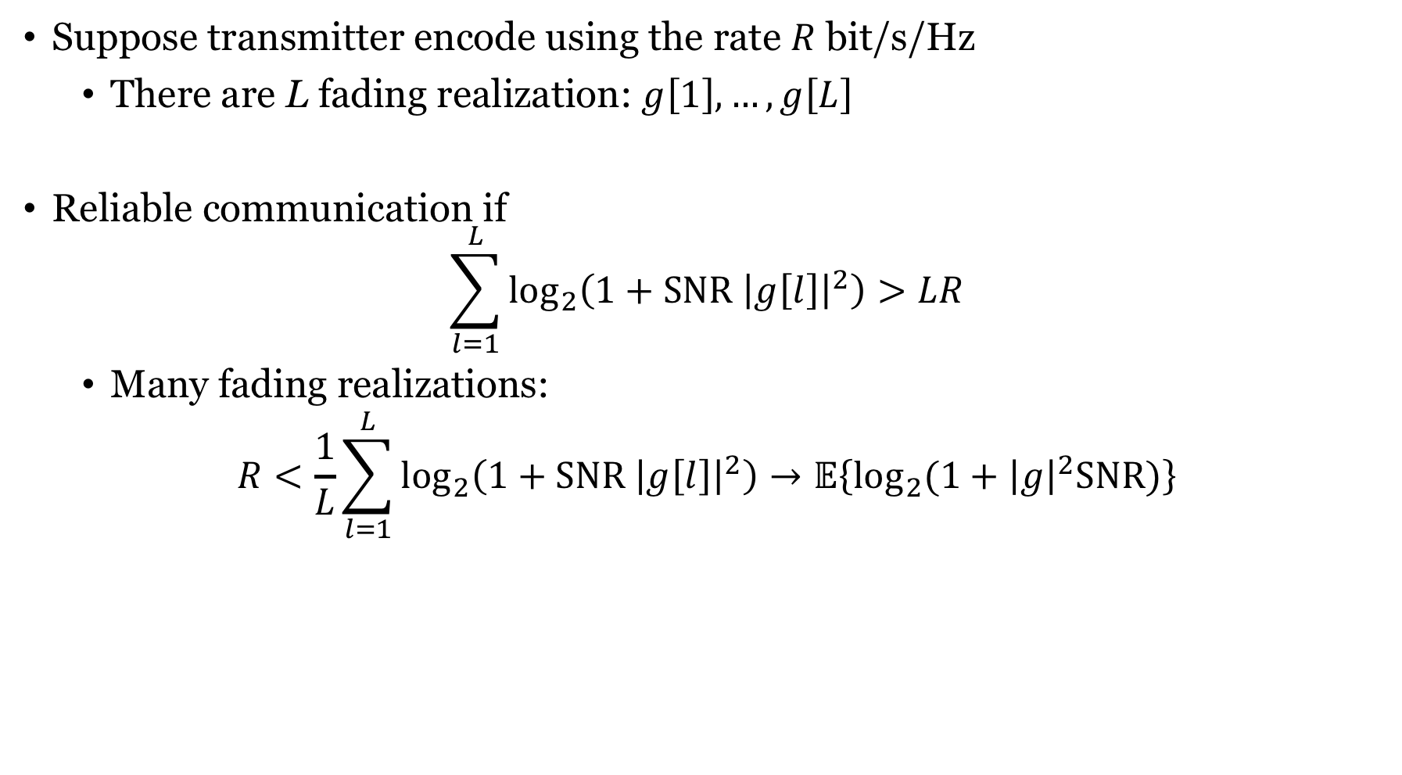
Opportunistic transmission
Suppose transmitter encode using the rate $R$ bit/s/Hz
There are L fading realization: $g\left[1\right],…,g\left[L\right]$
Reliable communication if
$$\sum_{l=1}^{L}{\log_{2}\left(1+SNR {\left|g\left[l\right]\right|}^{2}\right)}>LR$$
Many fading realizations:
$$R<\frac{1}{L}\sum_{l=1}^{L}{\log_{2}\left(1+SNR {\left|g\left[l\right]\right|}^{2}\right)}→𝔼\left\{\log_{2}{(1+{\left|g\right|}^{2}SNR)}\right\}$$
Mean value with respect to channel fading
As $L→∞$

Slide 20
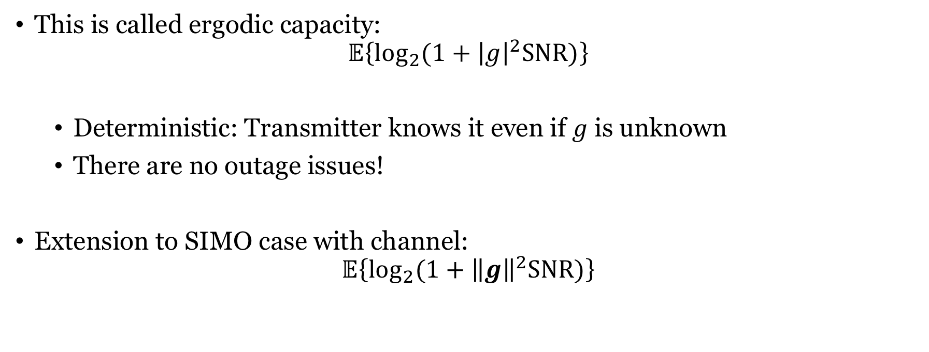
Ergodic capacity
This is called ergodic capacity:
$$𝔼\left\{\log_{2}{(1+{\left|g\right|}^{2}SNR)}\right\}$$
Deterministic: Transmitter knows it even if $g$ is unknown
There are no outage issues!
Extension to SIMO case with channel:
$$𝔼\left\{\log_{2}{(1+{\left\|g\right\|}^{2}SNR)}\right\}$$

Slide 21
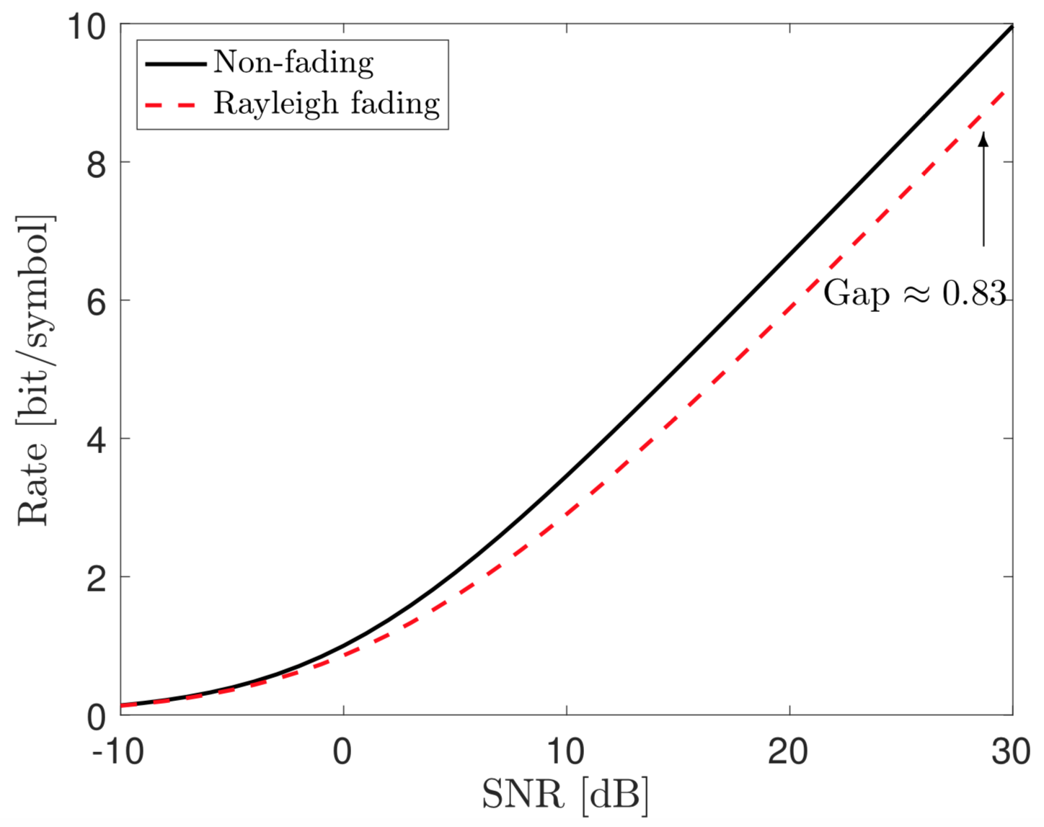
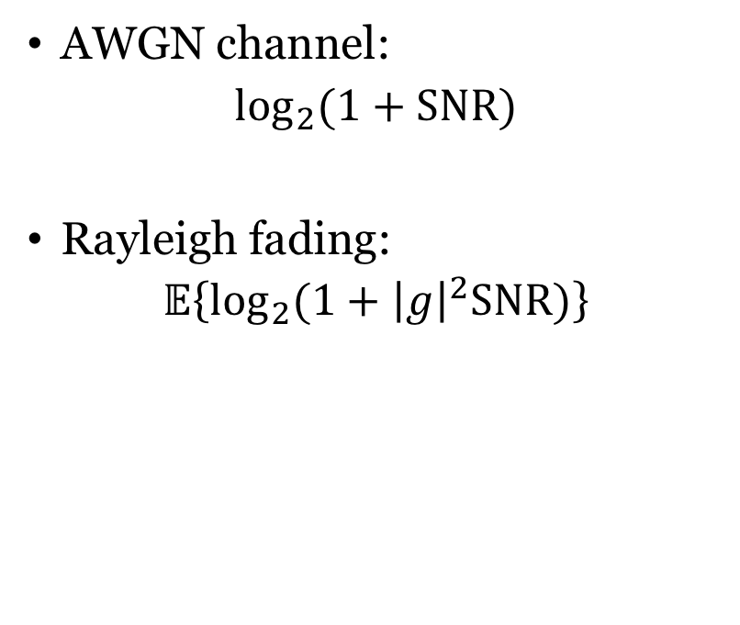
Comparison with AWGN channel
AWGN channel:
$$\log_{2}{(1+SNR)}$$
Rayleigh fading:
$$𝔼\left\{\log_{2}{(1+{\left|g\right|}^{2}SNR)}\right\}$$
Low SNR: Little difference
High SNR: Ergodic capacity is lower

Slide 22
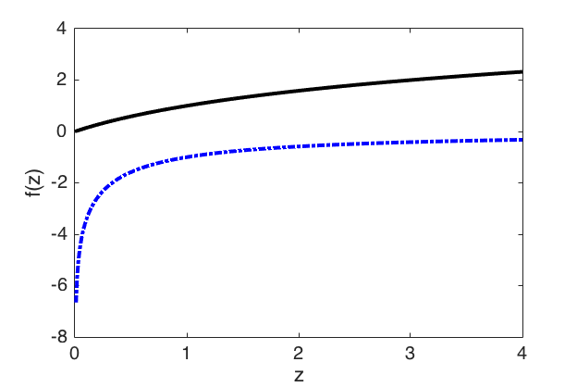



Jensen’s inequality and concave functions
For any random variable $z$ and concave function $f(⋅)$,
$$𝔼\left\{f(z)\right\}≤f\left(𝔼\left\{z\right\}\right)$$
A function is concave if
Any line between two points on the curve is below the curve
Second derivative is negative
$$f\left(z\right)=\log_{2}\left(1+z\right)$$
$$f\left(z\right)={−log}_{2}\left(1+1/z\right)$$

Slide 23

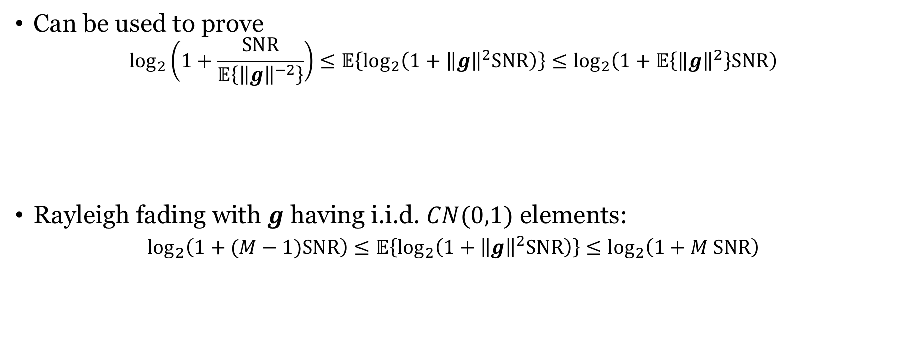
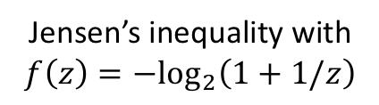
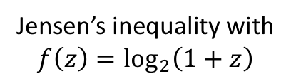

Ergodic capacity with SIMO channel
Can be used to prove
$$\log_{2}\left(1+\frac{SNR}{𝔼\left\{{\left\|g\right\|}^{−2}\right\}}\right)≤𝔼\left\{\log_{2}\left(1+{\left\|g\right\|}^{2}SNR\right)\right\}≤\log_{2}\left(1+𝔼\left\{{\left\|g\right\|}^{2}\right\}SNR\right)$$
Rayleigh fading with $g$ having i.i.d. $CN(0,1)$ elements:
$$\log_{2}\left(1+(M−1)SNR\right)≤𝔼\left\{\log_{2}\left(1+{\left\|g\right\|}^{2}SNR\right)\right\}≤\log_{2}\left(1+M SNR\right)$$
Jensen’s inequality with
$$f\left(z\right)={−log}_{2}\left(1+1/z\right)$$
Jensen’s inequality with
$$f\left(z\right)=\log_{2}\left(1+z\right)$$
Non-fading channel with ${\left\|g\right\|}^{2}=M−1$
Non-fading channel with ${\left\|g\right\|}^{2}=M$

Slide 24
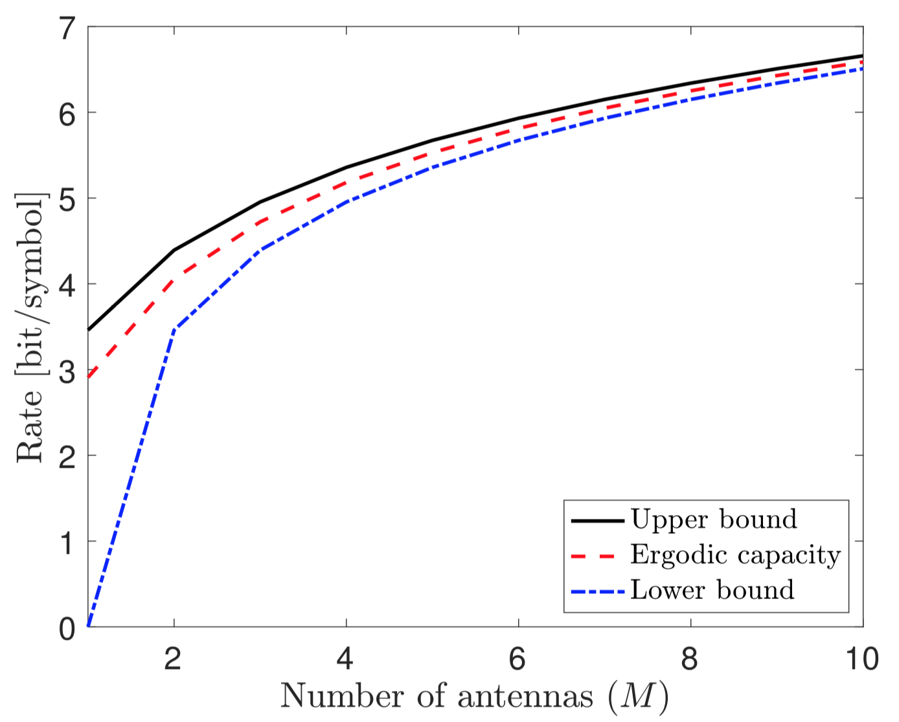
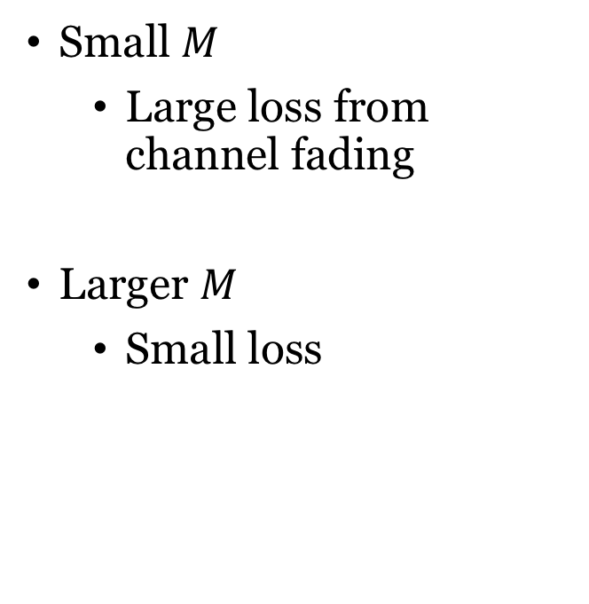

Comparison
Small $M$
Large loss from channel fading
Larger $M$
Small loss
Channel hardening:
When $M$ is large, no penalty from channel fading

Slide 25
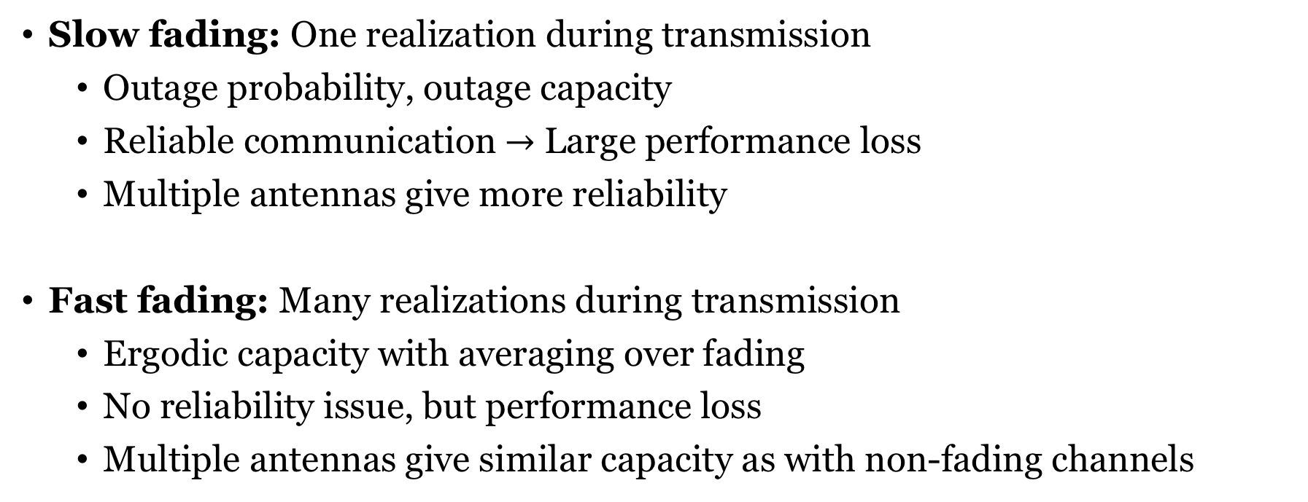
Summary
Slow fading: One realization during transmission
Outage probability, outage capacity
Reliable communication $→$ Large performance loss
Multiple antennas give more reliability
Fast fading: Many realizations during transmission
Ergodic capacity with averaging over fading
No reliability issue, but performance loss
Multiple antennas give similar capacity as with non-fading channels

Slide 26
End of Lecture 3
TSKS14 Multiple Antenna Communications

