Slide 1
TSKS14 Multiple Antenna Communications
Lecture 7, 2020
Emil Björnson

Slide 2
Outline of this lecture
Uplink Massive MIMO
Pilot transmission
Channel estimation
Capacity lower bound
Computation using channel estimates
Maximization

Slide 3
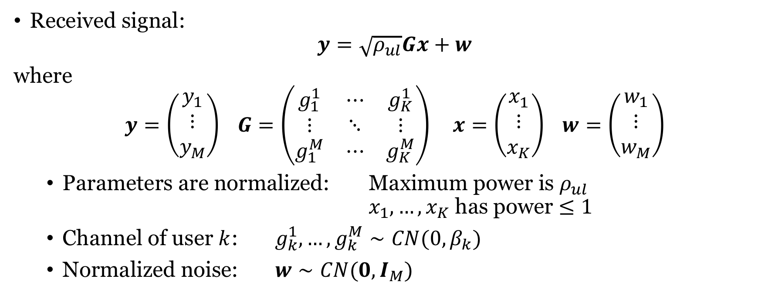
Recall: Uplink Massive MIMO system model
Received signal:
$$y=\sqrt{ρ_{ul}}Gx+w$$
where
$$y=\left(\begin{matrix}y_{1} \\ ⋮ \\ y_{M}\end{matrix}\right) G=\left(\begin{matrix}g_{1}^{1} & ⋯ & g_{K}^{1} \\ ⋮ & ⋱ & ⋮ \\ g_{1}^{M} & ⋯ & g_{K}^{M}\end{matrix}\right) x=\left(\begin{matrix}x_{1} \\ ⋮ \\ x_{K}\end{matrix}\right) w=\left(\begin{matrix}w_{1} \\ ⋮ \\ w_{M}\end{matrix}\right)$$
Parameters are normalized: Maximum power is $ρ_{ul}$ $x_{1},…,x_{K}$ has power $≤1$
Channel of user $k$: $g_{k}^{1},…,g_{k}^{M}∼CN(0,β_{k})$
Normalized noise: $w∼CN(0,I_{M})$
Large-scale fading coefficient

Slide 4


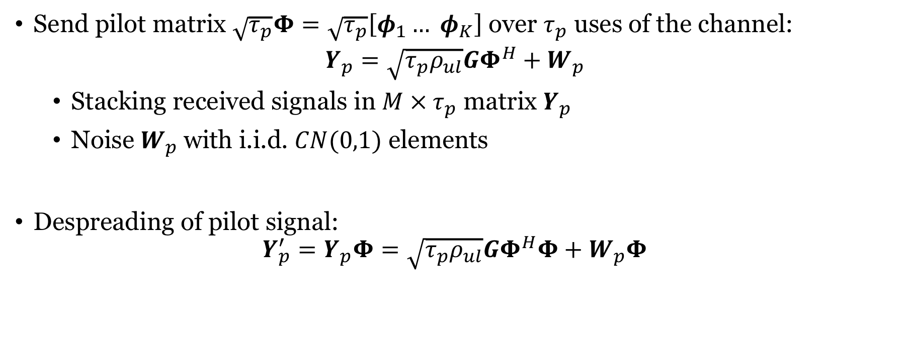

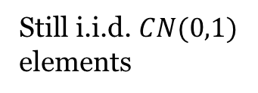
Sending pilot sequences
Send pilot matrix $\sqrt{τ_{p}}Φ=\sqrt{τ_{p}}\left[φ_{1}… φ_{K}\right]$ over $τ_{p}$ uses of the channel:
$$Y_{p}=\sqrt{τ_{p}ρ_{ul}}GΦ^{H}+W_{p}$$
Stacking received signals in $M × τ_{p}$ matrix $Y_{p}$
Noise $W_{p}$with i.i.d. $CN(0,1)$ elements
Despreading of pilot signal:
$$Y_{p}^{′}=Y_{p}Φ=\sqrt{τ_{p}ρ_{ul}}GΦ^{H}Φ+W_{p}Φ$$
$${\sqrt{τ_{p}}φ}_{2}$$
$${\sqrt{τ_{p}}φ}_{1}$$
$$=I_{K}$$
Still i.i.d. $CN(0,1)$
elements

Slide 5
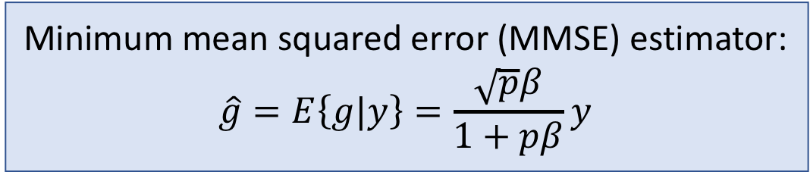
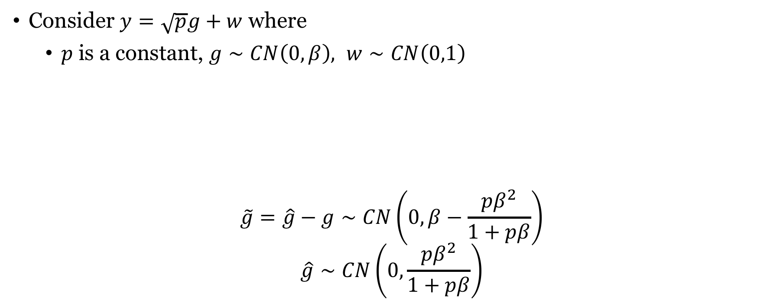
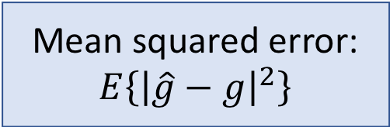
Estimating Gaussian variable in noise
Consider $y=\sqrt{p}g+w$ where
$p$is a constant, $g∼CN\left(0,β\right), w∼CN\left(0,1\right)$
$$\tilde{g}=\hat{g}−g∼CN\left(0, β−\frac{pβ^{2}}{1+pβ}\right)$$
$$\hat{g}∼CN\left(0,\frac{pβ^{2}}{1+pβ}\right)$$
Minimum mean squared error (MMSE) estimator:
$$\hat{g}=E\left\{g|y\right\}=\frac{\sqrt{p}β}{1+pβ}y$$
Mean squared error:
$$E\left\{{\left|\hat{g}−g\right|}^{2}\right\}$$
Estimation error:
Independent
random variables
Estimate:

Slide 6
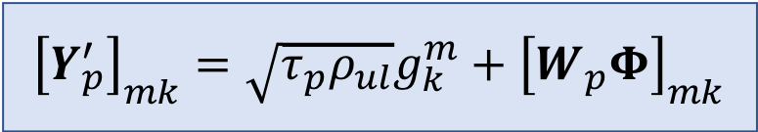
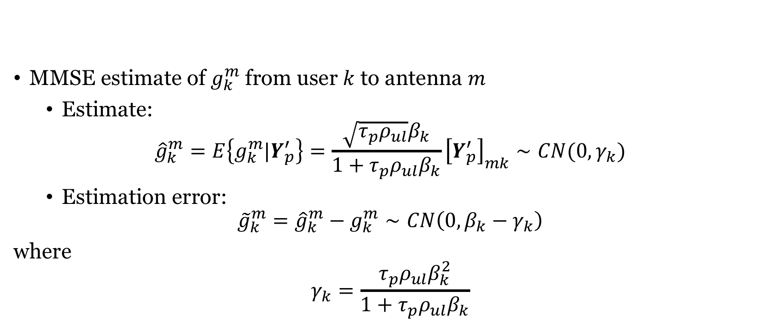
Estimates of the channels
$${\left[Y_{p}^{′}\right]}_{mk}=\sqrt{τ_{p}ρ_{ul}}g_{k}^{m}+{\left[W_{p}Φ\right]}_{mk}$$
MMSE estimate of $g_{k}^{m}$ from user $k$ to antenna $m$
Estimate:
$${\hat{g}}_{k}^{m}=E\left\{g_{k}^{m}|Y_{p}^{′}\right\}=\frac{\sqrt{τ_{p}ρ_{ul}}β_{k}}{1+τ_{p}ρ_{ul}β_{k}}{\left[Y_{p}^{′}\right]}_{mk}∼CN(0, γ_{k})$$
Estimation error:
$${\tilde{g}}_{k}^{m}={\hat{g}}_{k}^{m}−g_{k}^{m}∼CN\left(0,{β_{k}−γ}_{k}\right)$$
where
$$γ_{k}=\frac{τ_{p}ρ_{ul}β_{k}^{2}}{1+τ_{p}ρ_{ul}β_{k}}$$

Slide 7
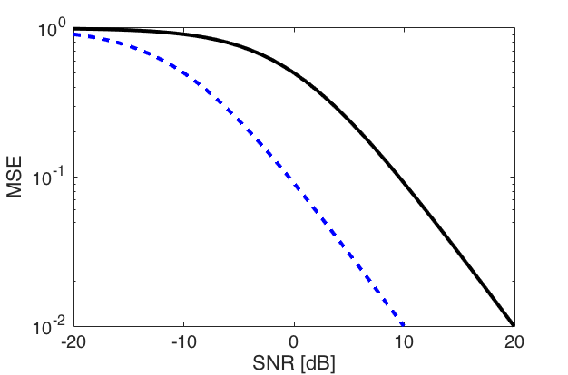




How good is the channel estimate?
Mean squared error (MSE):
$$E\left\{{\left|{\hat{g}}_{k}^{m}−g_{k}^{m}\right|}^{2}\right\}=E\left\{{\left|{\tilde{g}}_{k}^{m}\right|}^{2}\right\}=β_{k}−γ_{k}=β_{k}−\frac{τ_{p}ρ_{ul}β_{k}^{2}}{1+τ_{p}ρ_{ul}β_{k}}$$
Goes to zero as $ρ_{ul}→∞$ or $τ_{p}→∞$ (perfect estimate)
$$τ_{p}=10$$
$$τ_{p}=1$$
Simulation:
$$β_{k}=1$$
$$SNR=ρ_{ul}β_{k}=ρ_{ul}$$
10% error

Slide 8

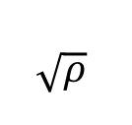

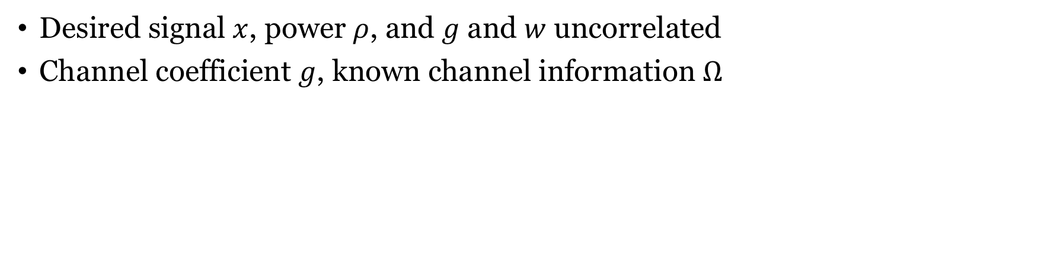

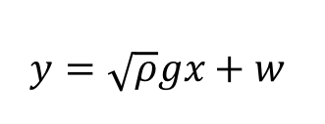
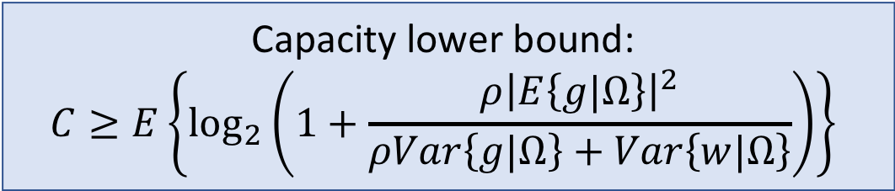


A capacity lower bound
Channel information $Ω$
$$w$$
$$x$$
$$\sqrt{ρ}$$
$$g$$
+
Receiver
$$\hat{x}$$
$$y=\sqrt{ρ}gx+w$$
Desired signal $x$, power $ρ$, and $g$ and $w$ uncorrelated
Channel coefficient $g$, known channel information $Ω$
Capacity lower bound:
$$C≥E\left\{\log_{2}\left(1+\frac{ρ{\left|E\left\{g|Ω\right\}\right|}^{2}}{ρVar\left\{g|Ω\right\}+Var\left\{w|Ω\right\}}\right)\right\}$$

Slide 9
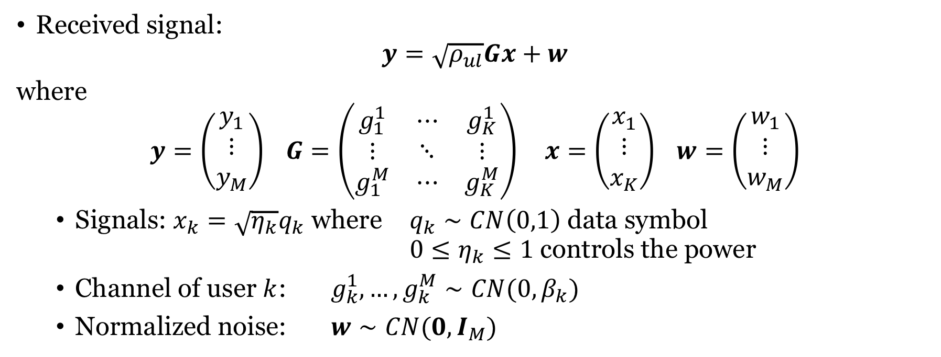
Uplink data transmission
Received signal:
$$y=\sqrt{ρ_{ul}}Gx+w$$
where
$$y=\left(\begin{matrix}y_{1} \\ ⋮ \\ y_{M}\end{matrix}\right) G=\left(\begin{matrix}g_{1}^{1} & ⋯ & g_{K}^{1} \\ ⋮ & ⋱ & ⋮ \\ g_{1}^{M} & ⋯ & g_{K}^{M}\end{matrix}\right) x=\left(\begin{matrix}x_{1} \\ ⋮ \\ x_{K}\end{matrix}\right) w=\left(\begin{matrix}w_{1} \\ ⋮ \\ w_{M}\end{matrix}\right)$$
Signals: $x_{k}=\sqrt{η_{k}}q_{k}$ where $q_{k}∼CN\left(0,1\right)$ data symbol $0≤η_{k}≤1$ controls the power
Channel of user $k$: $g_{k}^{1},…,g_{k}^{M}∼CN(0,β_{k})$
Normalized noise: $w∼CN(0,I_{M})$
Large-scale fading coefficient

Slide 10
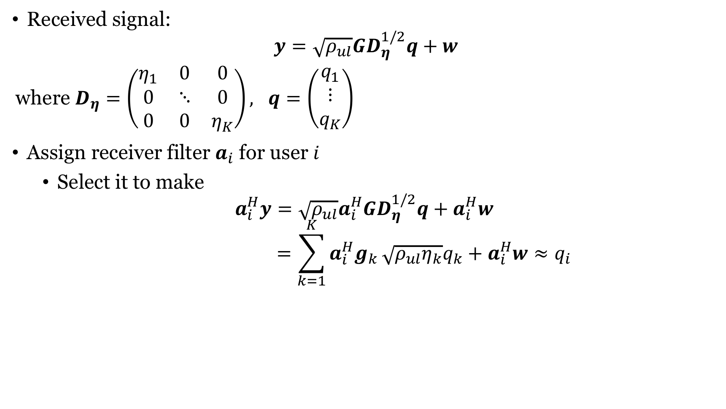
Linear receiver processing
Received signal:
$$y=\sqrt{ρ_{ul}}GD_{η}^{1/2}q+w$$
where $D_{η}=\left(\begin{matrix}η_{1} & 0 & 0 \\ 0 & ⋱ & 0 \\ 0 & 0 & η_{K}\end{matrix}\right), q=\left(\begin{matrix}q_{1} \\ ⋮ \\ q_{K}\end{matrix}\right)$
Assign receiver filter $a_{i}$ for user $i$
Select it to make
$$a_{i}^{H}y=\sqrt{ρ_{ul}}a_{i}^{H}GD_{η}^{1/2}q+a_{i}^{H}w$$
$$=\sum_{k=1}^{K}{a_{i}^{H}g_{k}}\sqrt{ρ_{ul}η_{k}}q_{k}+a_{i}^{H}w≈q_{i}$$
No successive interference cancelation
In some “good” sense

Slide 11
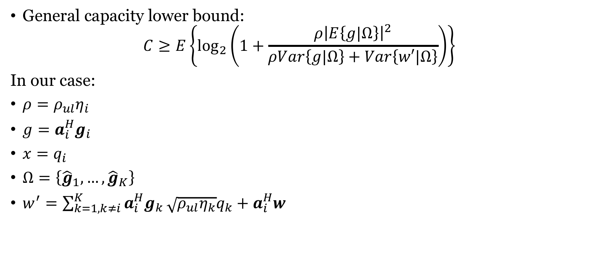
Capacity bound for User $i$ using Channel Estimates
General capacity lower bound:
$$C≥E\left\{\log_{2}\left(1+\frac{ρ{\left|E\left\{g|Ω\right\}\right|}^{2}}{ρVar\left\{g|Ω\right\}+Var\left\{w′|Ω\right\}}\right)\right\}$$
In our case:
$ρ=ρ_{ul}η_{i}$
$g=a_{i}^{H}g_{i}$
$x=q_{i}$
$Ω=\left\{{\hat{g}}_{1},…,{\hat{g}}_{K}\right\}$
$w^{′}=\sum_{k=1,k≠i}^{K}{a_{i}^{H}g_{k}}\sqrt{ρ_{ul}η_{k}}q_{k}+a_{i}^{H}w$
We need to compute each term!

Slide 12
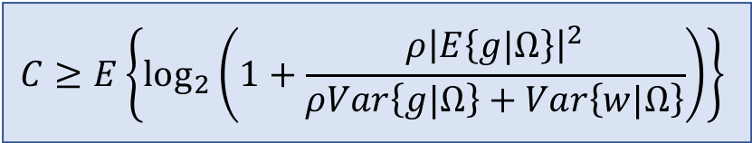
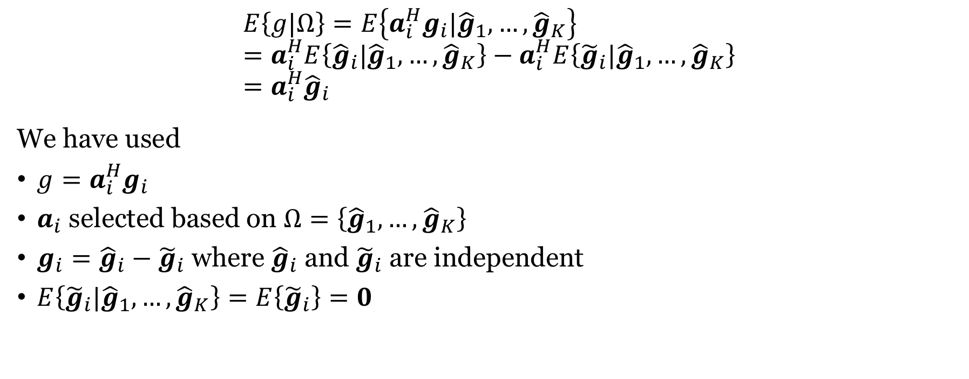
Computing the expectation in the numerator
$$E\left\{g|Ω\right\}=E\left\{a_{i}^{H}g_{i}|{\hat{g}}_{1},…,{\hat{g}}_{K}\right\} \\ =a_{i}^{H}E\left\{{\hat{g}}_{i}|{\hat{g}}_{1},…,{\hat{g}}_{K}\right\}−a_{i}^{H}E\left\{{\tilde{g}}_{i}|{\hat{g}}_{1},…,{\hat{g}}_{K}\right\} \\ =a_{i}^{H}{\hat{g}}_{i}$$
We have used
$g=a_{i}^{H}g_{i}$
$a_{i}$ selected based on $Ω=\left\{{\hat{g}}_{1},…,{\hat{g}}_{K}\right\}$
$g_{i}={\hat{g}}_{i}−{\tilde{g}}_{i}$ where ${\hat{g}}_{i}$ and ${\tilde{g}}_{i}$ are independent
$E\left\{{\tilde{g}}_{i}|{\hat{g}}_{1},…,{\hat{g}}_{K}\right\}=E\left\{{\tilde{g}}_{i}\right\}=0$
$$C≥E\left\{\log_{2}\left(1+\frac{ρ{\left|E\left\{g|Ω\right\}\right|}^{2}}{ρVar\left\{g|Ω\right\}+Var\left\{w|Ω\right\}}\right)\right\}$$

Slide 13
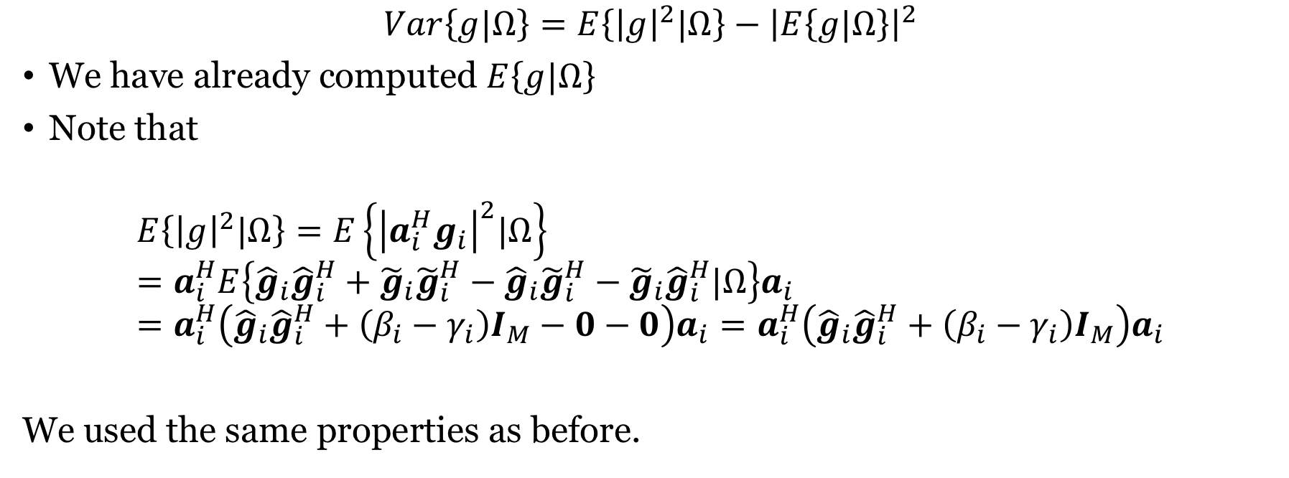
Computing the first term in the denominator
$$Var\left\{g|Ω\right\}=E\left\{{\left|g\right|}^{2}|Ω\right\}−{\left|E\left\{g|Ω\right\}\right|}^{2}$$
We have already computed $E\left\{g|Ω\right\}$
Note that
$$E\left\{{\left|g\right|}^{2}|Ω\right\}=E\left\{{\left|a_{i}^{H}g_{i}\right|}^{2}|Ω\right\} \\ =a_{i}^{H}E\left\{{\hat{g}}_{i}{\hat{g}}_{i}^{H}+{\tilde{g}}_{i}{\tilde{g}}_{i}^{H}−{\hat{g}}_{i}{\tilde{g}}_{i}^{H}−{\tilde{g}}_{i}{\hat{g}}_{i}^{H}|Ω\right\}a_{i} \\ =a_{i}^{H}\left({\hat{g}}_{i}{\hat{g}}_{i}^{H}+\left(β_{i}−γ_{i}\right)I_{M}−0−0\right)a_{i}=a_{i}^{H}\left({\hat{g}}_{i}{\hat{g}}_{i}^{H}+\left(β_{i}−γ_{i}\right)I_{M}\right)a_{i}$$
We used the same properties as before.
$$C≥E\left\{\log_{2}\left(1+\frac{ρ{\left|E\left\{g|Ω\right\}\right|}^{2}}{ρVar\left\{g|Ω\right\}+Var\left\{w|Ω\right\}}\right)\right\}$$

Slide 14
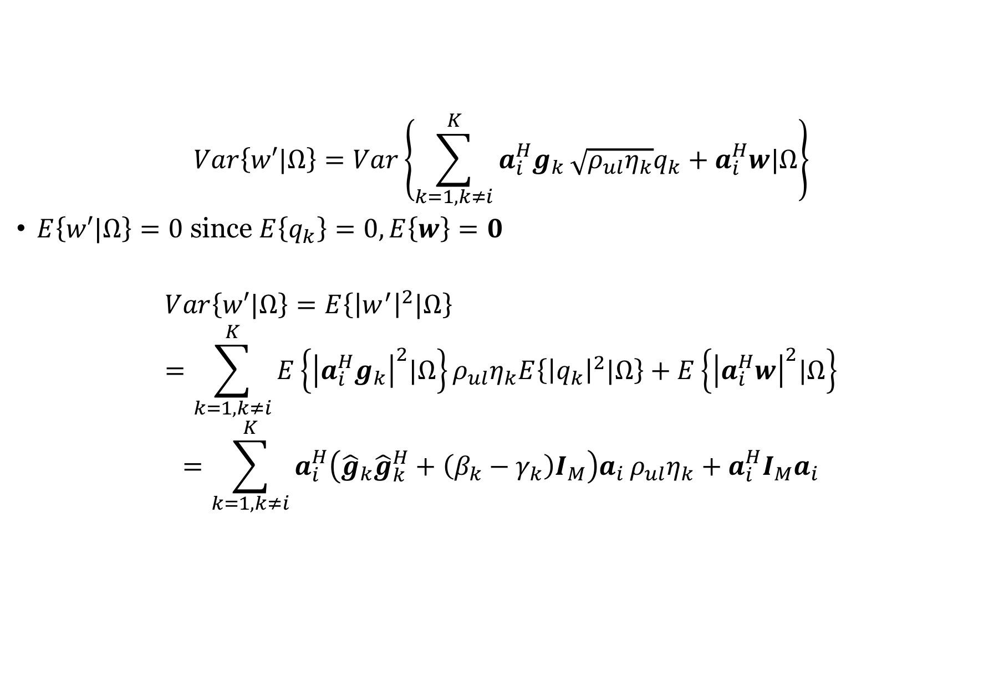
Computing the second term in the denominator
$$Var\left\{w′|Ω\right\}=Var\left\{\sum_{k=1,k≠i}^{K}{a_{i}^{H}g_{k}}\sqrt{ρ_{ul}η_{k}}q_{k}+a_{i}^{H}w|Ω\right\}$$
$E\left\{w′|Ω\right\}=0$ since $E\left\{q_{k}\right\}=0, E\left\{w\right\}=0$
$$Var\left\{w′|Ω\right\}=E\left\{{\left|w^{′}\right|}^{2}|Ω\right\} \\ =\sum_{k=1,k≠i}^{K}{E\left\{{\left|a_{i}^{H}g_{k}\right|}^{2}|Ω\right\}}ρ_{ul}η_{k}E\left\{{\left|q_{k}\right|}^{2}|Ω\right\}+E\left\{{\left|a_{i}^{H}w\right|}^{2}|Ω\right\}$$
$$=\sum_{k=1,k≠i}^{K}{a_{i}^{H}\left({\hat{g}}_{k}{\hat{g}}_{k}^{H}+\left(β_{k}−γ_{k}\right)I_{M}\right)a_{i}}ρ_{ul}η_{k}+a_{i}^{H}{I_{M}a}_{i}$$

Slide 15


Result: Capacity lower bound of User $i$
$$C≥E\left\{\log_{2}\left(1+\frac{ρ_{ul}η_{i}{\left|a_{i}^{H}{\hat{g}}_{i}\right|}^{2}}{a_{i}^{H}B_{i}a_{i}}\right)\right\}$$
where
$$B_{i}=\sum_{k=1,k≠i}^{K}{ρ_{ul}η_{k}{\hat{g}}_{k}{\hat{g}}_{k}^{H}}+\sum_{k=1 }^{K}{ρ_{ul}η_{k}\left(β_{k}−γ_{k}\right)I_{M}}+I_{M}$$
How to pick $a_{i}$?

Slide 16
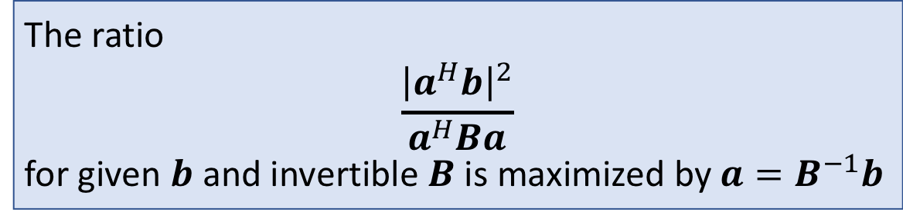

Generalized Rayleigh Quotient
Intuition:
The ratio $\frac{{\left|a^{H}b\right|}^{2}}{a^{H}a}$ is maximized by $a=b$
The extra term $B^{−1}$ is “whitening”
The ratio
$$\frac{{\left|a^{H}b\right|}^{2}}{a^{H}Ba}$$
for given $b$ and invertible $B$ is maximized by $a=B^{−1}b$
Extension of maximum ratio combining

Slide 17
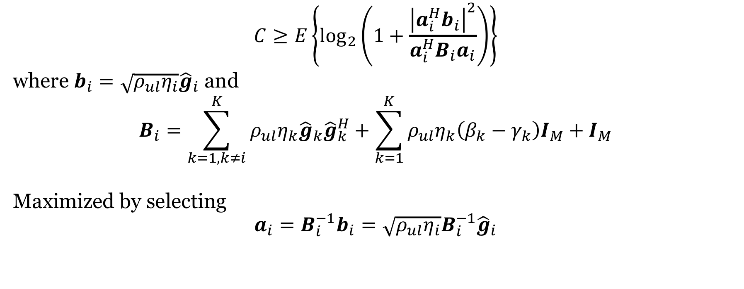
Maximizing the capacity lower bound
$$C≥E\left\{\log_{2}\left(1+\frac{{\left|a_{i}^{H}b_{i}\right|}^{2}}{a_{i}^{H}B_{i}a_{i}}\right)\right\}$$
where $b_{i}=\sqrt{ρ_{ul}η_{i}}{\hat{g}}_{i}$ and
$$B_{i}=\sum_{k=1,k≠i}^{K}{ρ_{ul}η_{k}{\hat{g}}_{k}{\hat{g}}_{k}^{H}}+\sum_{k=1}^{K}{ρ_{ul}η_{k}\left(β_{k}−γ_{k}\right)I_{M}}+I_{M}$$
Maximized by selecting
$$a_{i}=B_{i}^{−1}b_{i}=\sqrt{ρ_{ul}η_{i}}B_{i}^{−1}{\hat{g}}_{i}$$
Called MMSE combining

Slide 18
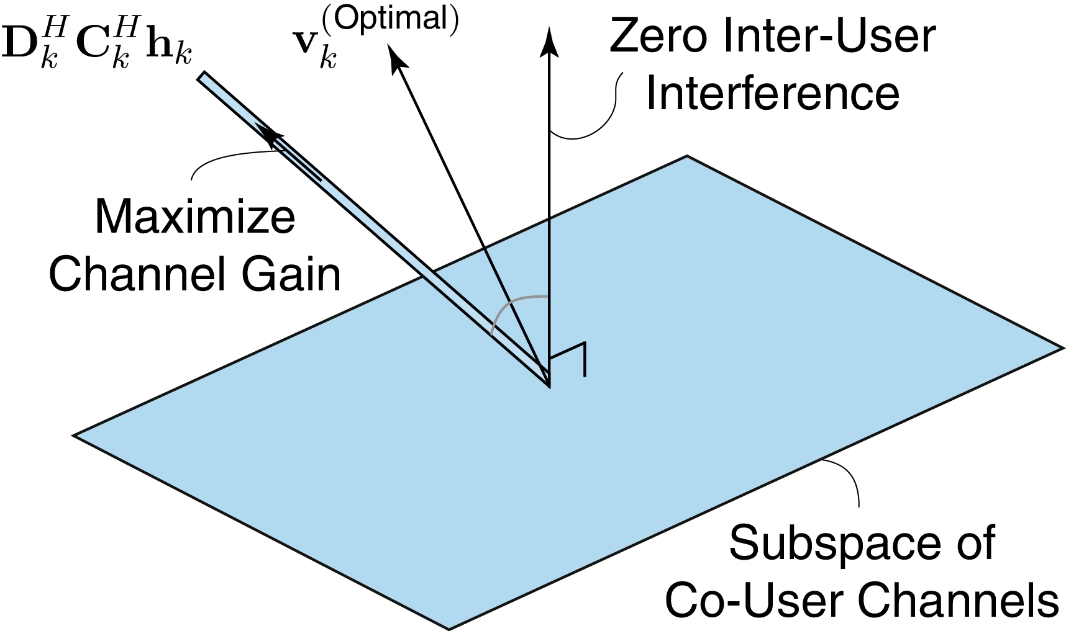
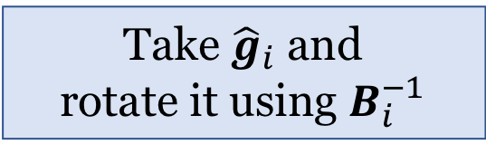



Interpretation of $a_{i}=\sqrt{ρ_{ul}η_{i}}B_{i}^{−1}{\hat{g}}_{i}$ (whitening)
$${\hat{g}}_{i}$$
$a_{i}$
Take ${\hat{g}}_{i}$ and rotate it using $B_{i}^{−1}$
$${\hat{g}}_{1},{\hat{g}}_{i−1},{\hat{g}}_{i+1},{\hat{g}}_{K}$$

Slide 19
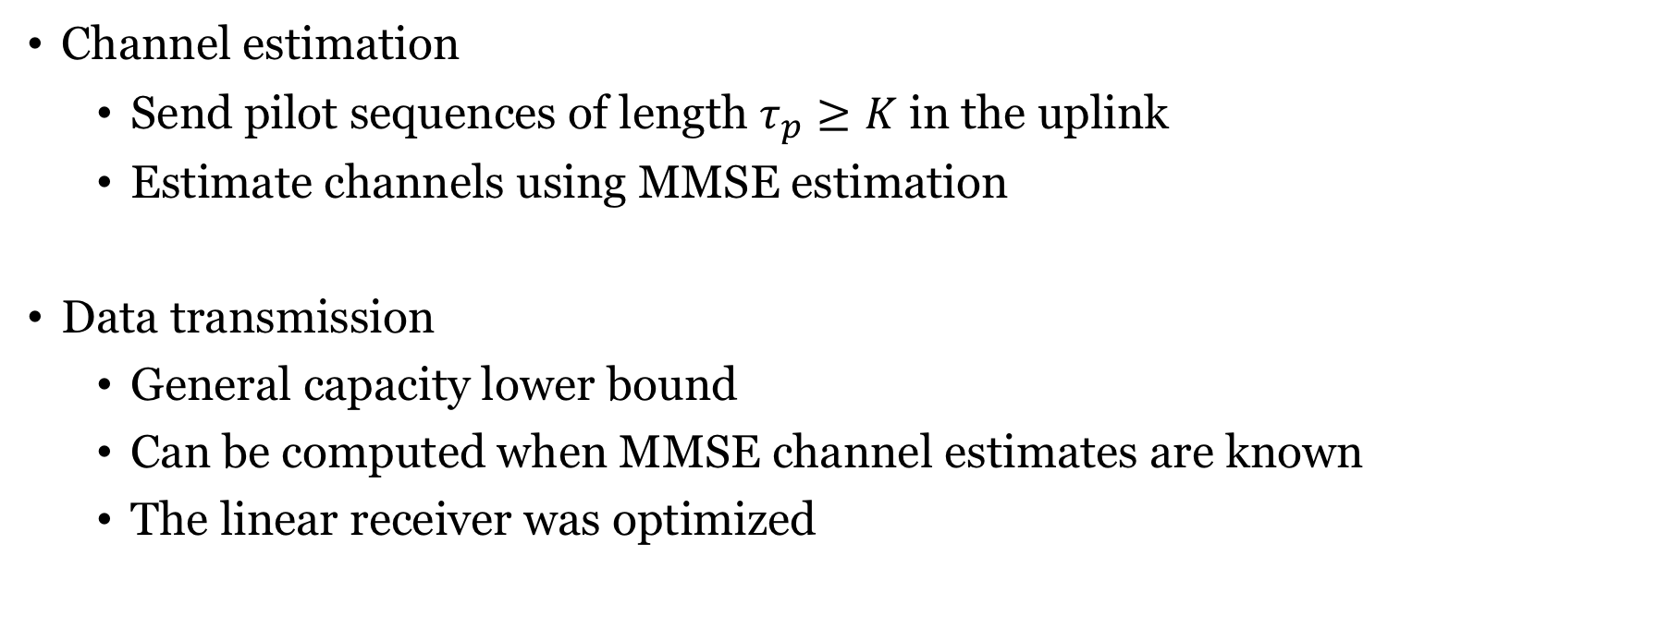
Summary
Channel estimation
Send pilot sequences of length $τ_{p}≥K$ in the uplink
Estimate channels using MMSE estimation
Data transmission
General capacity lower bound
Can be computed when MMSE channel estimates are known
The linear receiver was optimized

Slide 20
End of Lecture 7
TSKS14 Multiple Antenna Communications

