Slide 1
UDAPeople
Continuous Integration & Continuous Delivery

Slide 2
Agenda
What is CI/CD ?
CI/CD Benefits

Slide 3
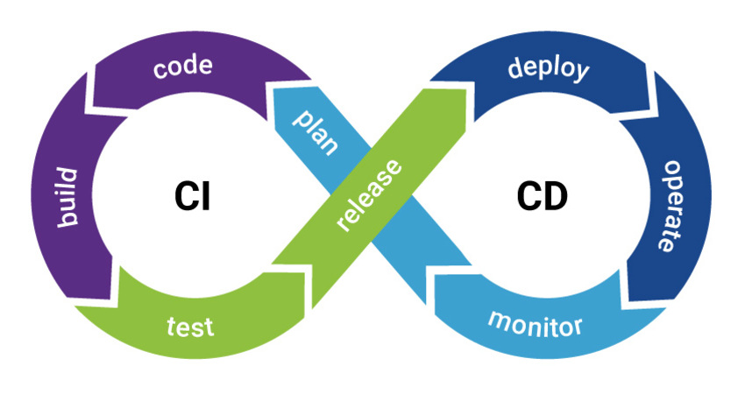
What is CI/CD ?

Slide 4

CI/CD Benefits
Smaller Code Changes
Fault Isolations
Phase1
Phase2
Phase3

Slide 5


CI/CD Benefits (cont.)
Faster Mean Time To Resolution (MTTR)
More Test Reliability

Slide 6


CI/CD Benefits (cont.)
Faster Release Rate
Customer Satisfaction

Slide 7

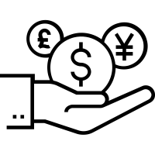
CI/CD Benefits (cont.)
Reduce Costs
Increase Revenue

