Slide 1
Data Mining
Assignment -1

Slide 2
Problem Formulation

Slide 3
Problem Prerequisites
Ĭ = Set of all Itineraries
Ł = Set of all Flight legs
Each flight leg L ϵ Ł maps to multiple (at least one) Itineraries I_{L}¹ , I_{L}² ,… such that I_{L}¹ ϵ Ł , I_{L}² ϵ Ł,…by a function given as Ψ: Ł →{Ĭ}
For a specific Itinerary I ϵ Ĭ we have following information:
f_{I} = fare paid by passenger for Itinerary I
d_{I} = demand of a specific Itinerary I
X_{I} = portion of d_{I} which is actually used
For a specific flight leg L ϵ Ł we have following information:
C_{L} = Capacity of Flight Leg L ϵ Ł

Slide 4
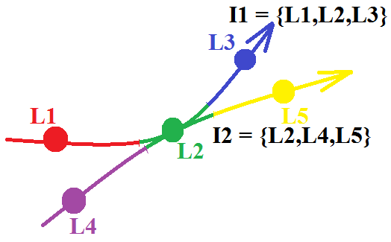
Problem Prerequisites
Ψ(L1) = {I1}, Ψ(L2) = {I1,I2}, Ψ(L3) = {I1}, Ψ(L4) = {I2}, Ψ(L5) = {I2}

Slide 5
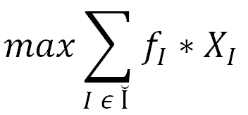
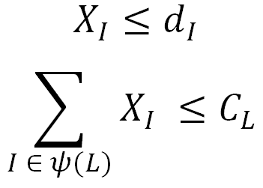
Problem Statement
Maximize the overall revenue given as:
Subject to Following Conditions ( applying to all Itineraries I ϵ Ĭ and Flight Legs L ϵ Ł ):

Slide 6
Converting Problem in to LP:AX ≤ b
Let | I | = n , | L | = m , n > m
Max f_{I} * X_{I} where f_{I} = [f_{I1} f_{I2} f_{I3} … f_{In}]
X = X_{I} , | X | = | I | = n, X = [X_{I1} X_{I2} X_{I3} … X_{In}]^{T}
b = [ d_{I1} d_{I2} d_{I3 …} d_{In} c_{L1} c_{L2} c_{L3 …} c_{Lm} ]
A = n+m by n size decision matrix with entries either 1 or 0 such that:
First n row entries are like diagonal matrix
Last m row entries correspond to legs. They are 1 corresponding to the Itineraries which use that specific leg

Slide 7
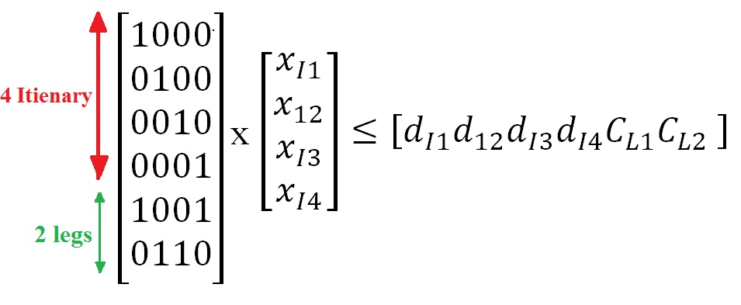
Example with 4 Itinerary and 2 Legs

Slide 8
Converting Problem to Standard LP Format as used by scipy.optimize.linprog()

Slide 9
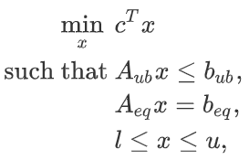
scipy.optimize.linprog()
Returns: res = {x, fun, slack, success}

Slide 10
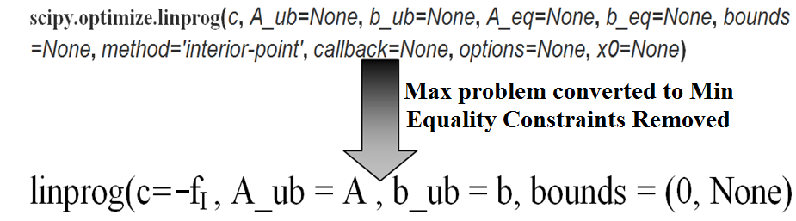
Applying linprog() in given context
Given problem is a maximization problem with only inequality constraints.
But linprog() minimizes the objective function for both inequality and equality constraints for the given decision variables.
Max f_{I} * X_{I} is equivalent to Min (-f_{I}) * X_{I}

Slide 11
Creating the Matrices A, b and c in Python

Slide 12
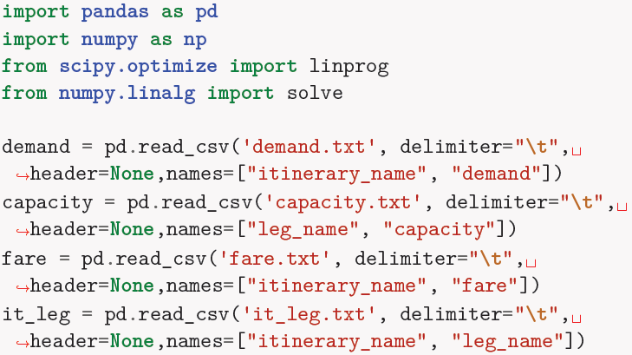
Reading Text File
Pandas was used to read the 4 text files.

Slide 13
Algorithm for Creating A
Matrix A has first n row entries corresponding to Itineraries and next m entries corresponding to Legs using Itineraries.
Itineraries and Legs must be mapped to Integers from 0,1,2…,n and 0,1,2 … ,m respectively.
Python Dictionary Data structure was used for the mapping using it_leg.txt file (file which maps itineraries to legs).

Slide 14
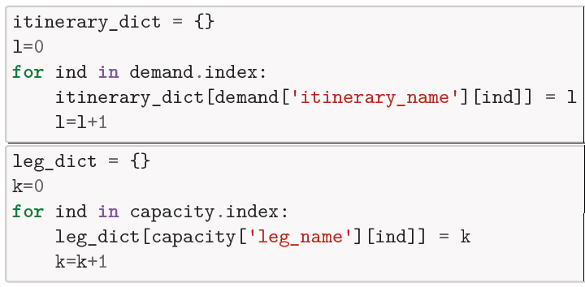
Code for Mapping

Slide 15
Algorithm for Creating A
For first n entries a diagonal matrix is created.
For the remaining m entries:
For each entry in it_leg (itinerary-leg mapping):
The index i ϵ {1,2,…,n} of Itenary is determined
The index j ϵ {1,2,…,m} of the corresponding leg is determine
The value A_{i,j} = 1
The code for the same is shown in next slide.

Slide 16
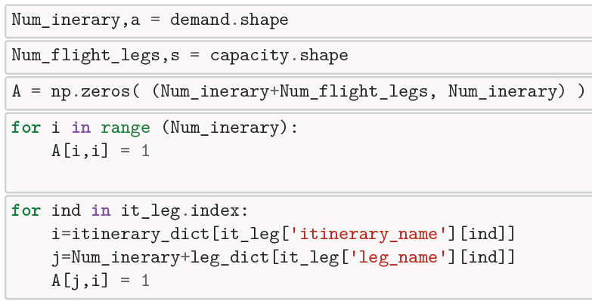
Code for Creating A

Slide 17
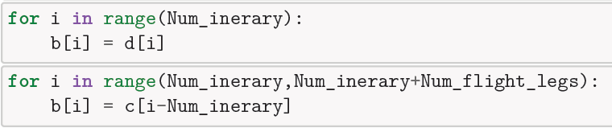
Creating matrices b and c
Demand, fare and Capacity are read from the files directly.
First n entries in b equals corresponding demand d_{I} read from the second column of the demand file.
Next m entries in b equals the demand values for each flight leg.

