Slide 1
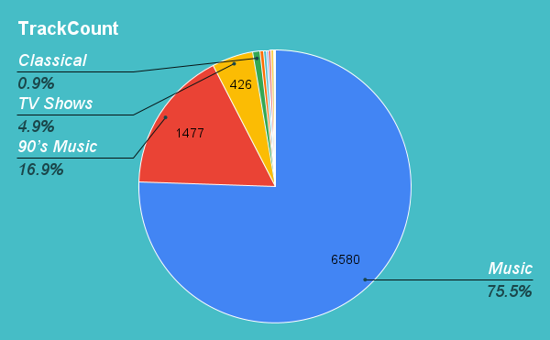
Playlist track precentage
This shows that the Music playlist contains the largest share of our tracks with 75% followed by the
90’s Music playlist

Slide 2
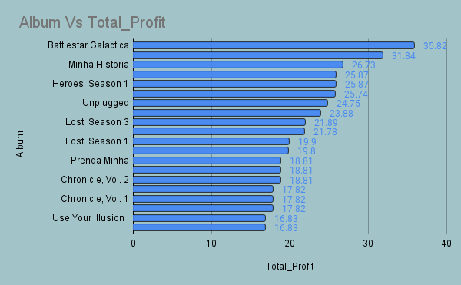
Albums Profit Chart
The First 20 Albums on the profit chart with “BattleStar Galactica” being the most sold album.

Slide 3
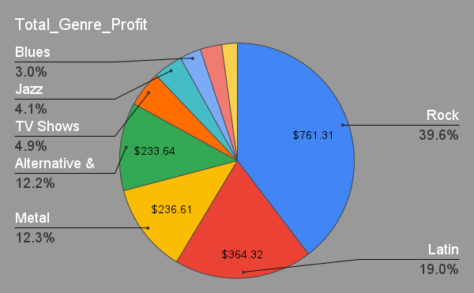
Genre Profit Chart
The Rock Genre gives the largest profit for the store with almost 40%.
Followed by the Latin genre with almost 20 %.

Slide 4
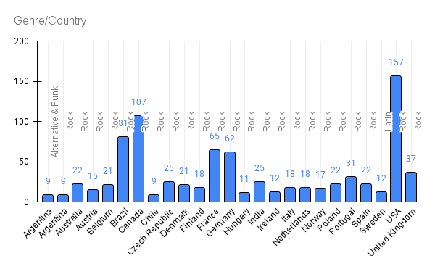
Genre Purchases per country
We can see that the “Rock” genre dominates the purchases in all countrys except sweden.
We can also see that the USA has the highest purchases per genre with 157 purchases in the “Rock” genre.

