Slide 1
Text Classification
Supervised by
Dr. Hesham Hassan
TA. Dalia Maher
Implemented by
ID | Name
20170022 | Ahmed Sayed Mansour
20170021 | Ahmed Sayed Ibrahim
20170136 | Atef Magdy Mitwally
20170053 | Ashraf Samir Ali
20170002 | Ibrahim Ramadan Abdou
Graduation Project
Academic Year 2020-2021
Mid-year Short Documentation

Slide 2
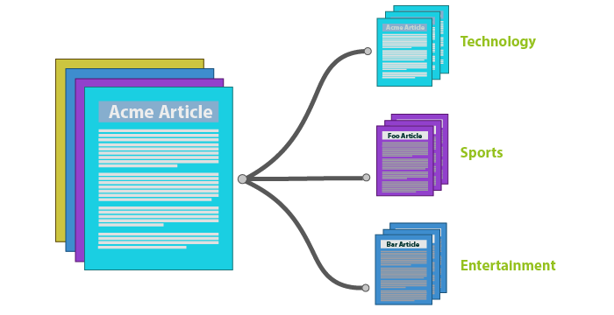
Project Idea
Developing AI models that able to classify texts/documents into categories to solve the problem of high growth in unlabeled textual data specially research papers.

Slide 3

Project Idea
Domain :
Artificial Intelligence
Web Software

Slide 4
Problem Significance
Our problem:
Categorizing a text into Single/Multi organized groups.
Prepare a research Paper in Text Classification.
Achieving accuracy that is better than most of existing models.
Why Text Classification?
Around 80% of all information is unstructured and takes so much time and effort to organize.
Highly required in many organizations.

Slide 5
Problem Significance
How to solve the problem?
Building single/multi label text classification models.
Trying different techniques for classification models and differentiate between each technique to choose the best.
Building web application to upload our solution.
Posting our research on the web app to be public for developers and who is interested in text classification techniques.

Slide 6
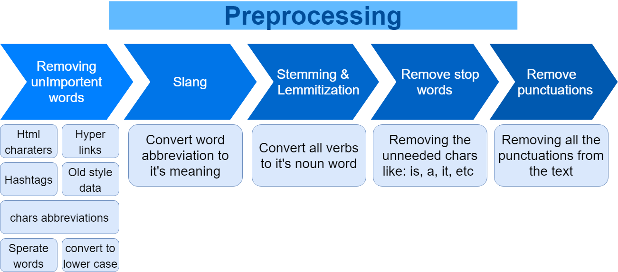
Problem Significance
Workflow
Preprocessing data

Slide 7
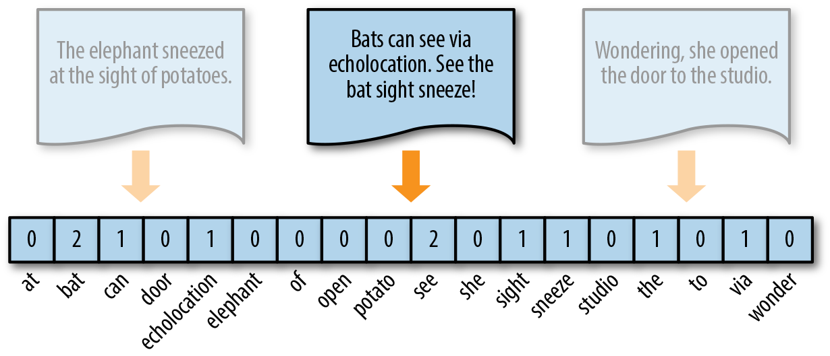
Problem Significance
Workflow
2. Natural Language Processing
2.1. Text Vectorization

Slide 8
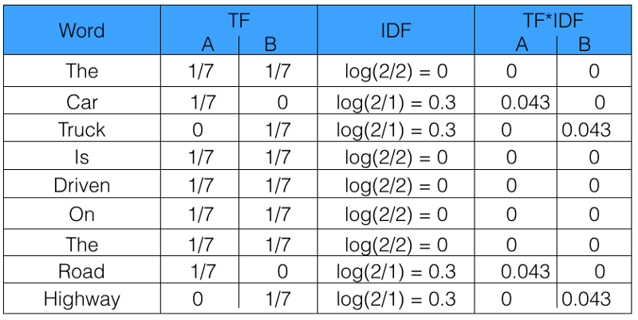
Problem Significance
Workflow
2. Natural Language Processing
2.2. TF-IDF Normalization

Slide 9
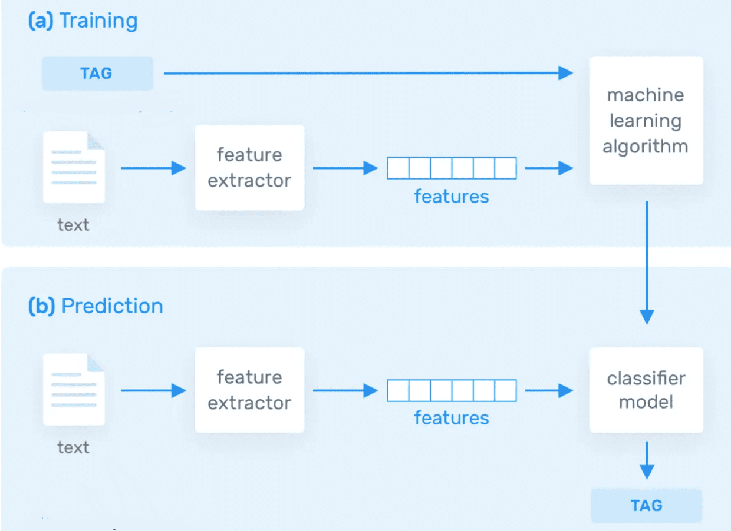
Problem Significance
Workflow
3. Training and Prediction

Slide 10
Problem Significance
Previous and Related Work:
Binary classification on The 20 Newsgroups data set.
Solution:
Building the model using Naive Bayes algorithm with accuracy of 69% and using SVM with accuracy of 68%.
Advantages:
Using different algorithms from the sklearn library.
Explaining all steps and reporting information on each experiment.
Disadvantages:
The data set is small and only covers a little number of classes.
Not removing all unimportant data like headers and footers.
Not using the new trends of text classification like Neural Networks algorithms.

Slide 11
Problem Significance
Previous and Related Work:
2) Discussing best pre trained models for text Classification.
Solution:
Using pre trained models like (XLNet, ERNIE, T5…) on different datasets.
Advantages:
The datasets meet industry-accepted standards.
The pre trained models have already been vetted on the quality aspect.
Reporting a summary on each model using different datasets.
Disadvantages:
It will take large amount of resources(time and computation power) to train big models from scratch.

Slide 12
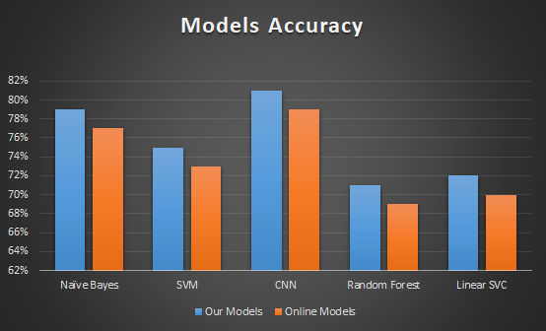
Problem Significance
Comparison

Slide 13





Project Specifications
Methodology
Agile (Extreme Programming)
Technologies
Machine Learning (Python – Sklearn – NumPy – TensorFlow – Keras - Pickle).
Natural Language Processing (Python – NLTK).
Front-End (Web standard W3C – REACT).
Back-End (Python – Node JS – Flask).
Testing (Jest - Pandas).

Slide 14
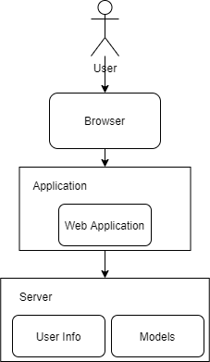
Project Specifications
System Architecture

Slide 15
Project Specifications
Functional requirements
Users can classify their document by uploading it as a text file or writing it directly.
System takes the file and parses its text to sentences, paragraphs and words.
System uses a classifier or multi-classifiers to classify the document.
System output class or multi-classes of the document.

Slide 16

Project Specifications
Non-Functional requirements
Performance
Usability
Reliability
Scalability

Slide 17
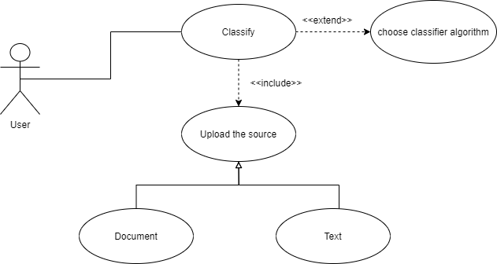
Project Specifications
Use-Case Diagram

Slide 18
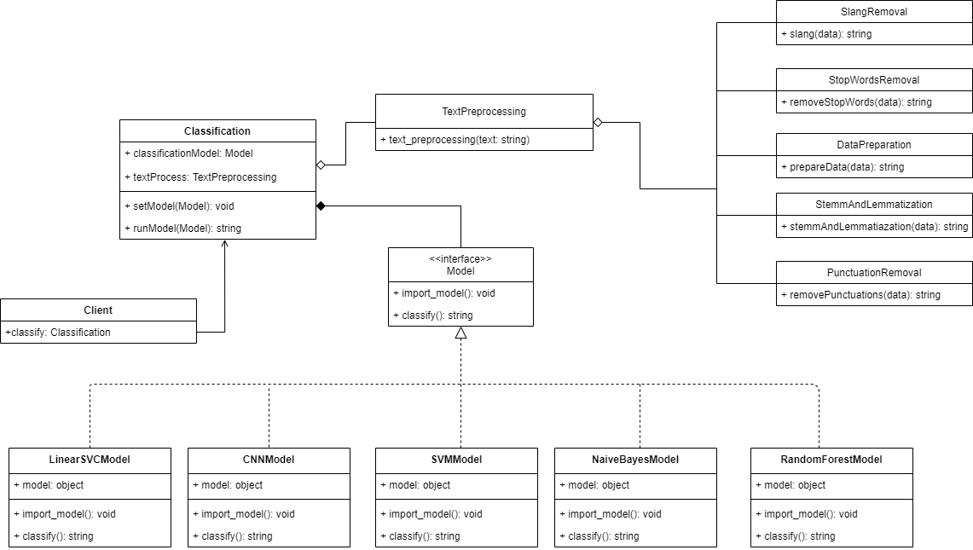
Project Specifications
Class diagram

Slide 19
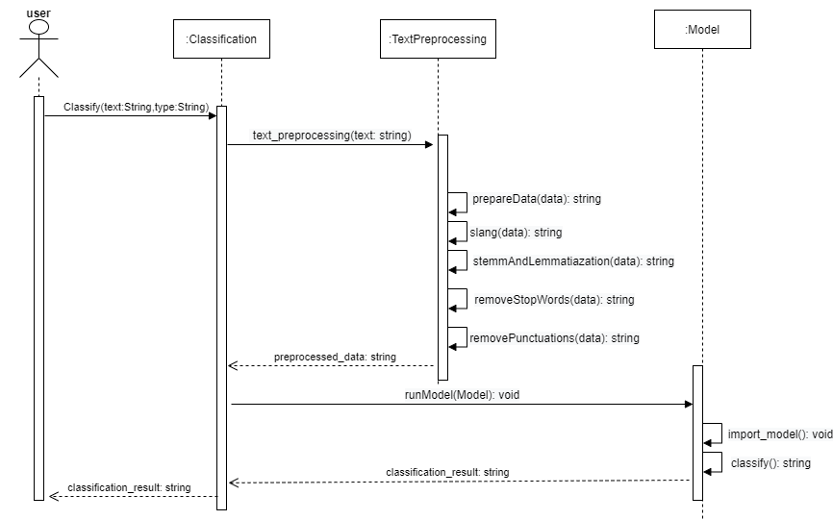
Project Specifications
Sequence diagram

Slide 20
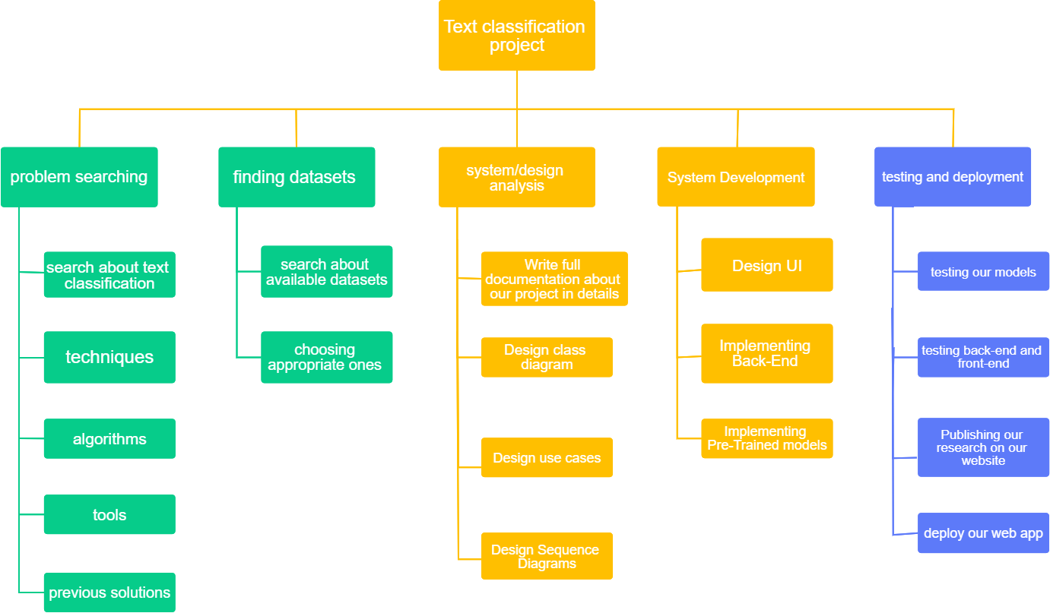
Time Plan

Slide 21
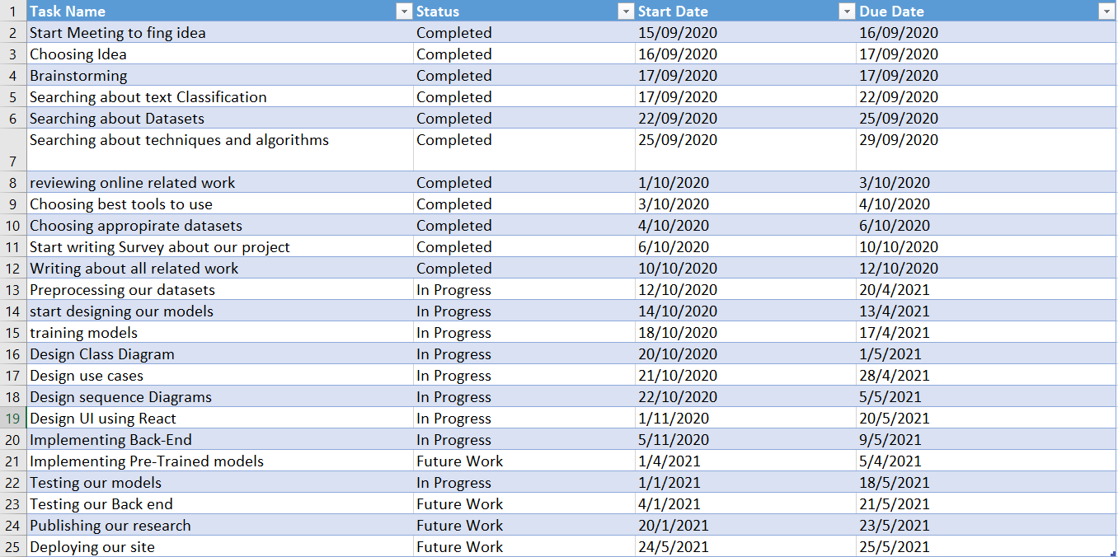
Time Plan

Slide 22
Conclusion
Text classification is a mature area of research by the increase of information flow available.
It has seen large attention especially due to the high growth rate of Internet and the importance of Internet search engines and generic classification of content on the Web.
Design of text classification systems is still more of an art than exact science.

Slide 23
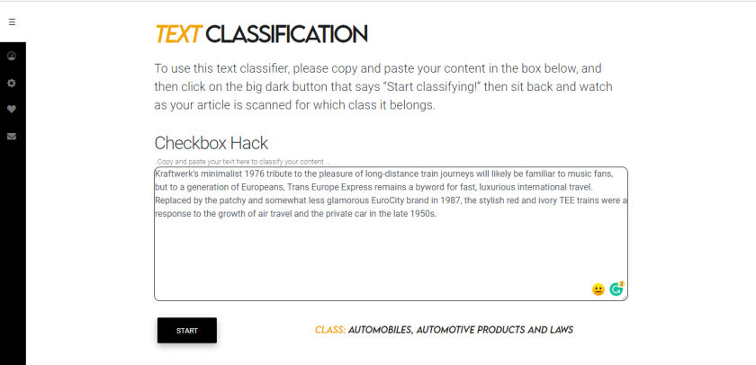
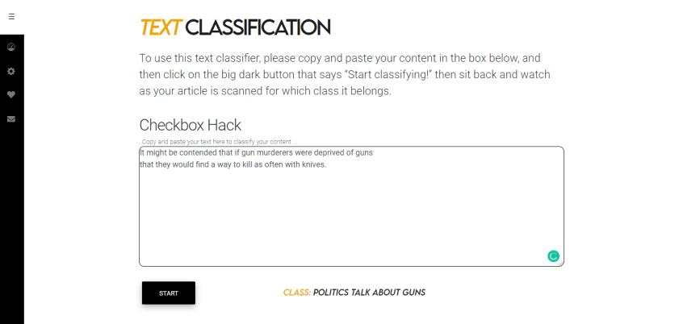
Demo

Slide 24
Questions ?

