Slide 1

FINGERPRINT ACTIVATED
GATE CONTROL SYSTEM
Enhancing Security with Fingerprint Recognition Technology"

Slide 2

03
Introduction
04
Applications
05
Advantages
06
Components
Contents
07
How It Works
Implementation
08
Conclusion
09
Team Members
10

Slide 3


INTRODUCTION
Our project is a fingerprint-activated gate control system that allows authorized users to enter a secured area with the use of their unique fingerprint. The system uses an Arduino Uno board to control a servo motor that operates the gate.

Slide 4
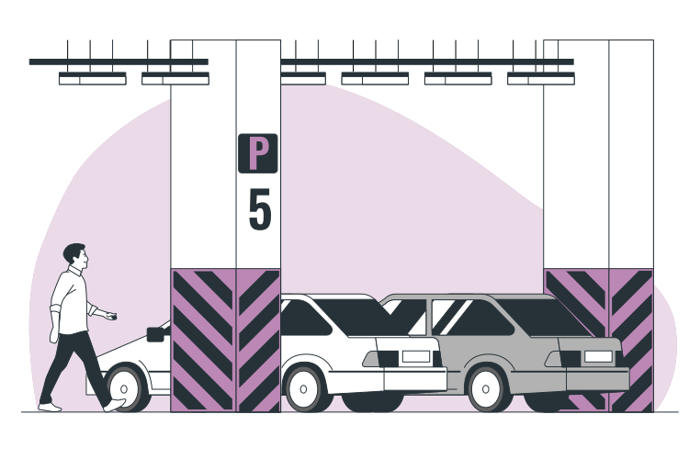
APPLICATIONS
This project has several potential applications. It can be used to control access to restricted areas such as laboratories, offices, and data centers. It can also be used in parking garages, where authorized vehicles can enter and exit with ease, without the need for a physical ticket. Additionally, the system can be used in homes as a secure method of access control, replacing traditional keys or access codes.

Slide 5

ADVANTAGES
07
The fingerprint-activated gate control system offers multiple advantages over traditional access control methods.
01
02
03
04
The system is highly secure since each person's fingerprint is unique, making it difficult to forge or replicate.
It is user-friendly as it removes the necessity for traditional keys or access cards, making access quick and easy.
The technology is cost-effective since it eliminates the need for physical keys or access cards, which can be lost or stolen, resulting in additional costs to replace them.
The fingerprint-activated gate control system is scalable and can be integrated into existing security systems, making it an ideal solution for both residential and commercial use.

Slide 6
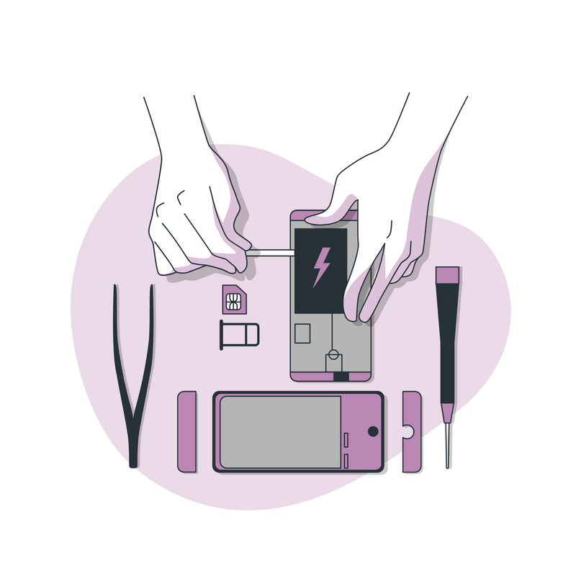
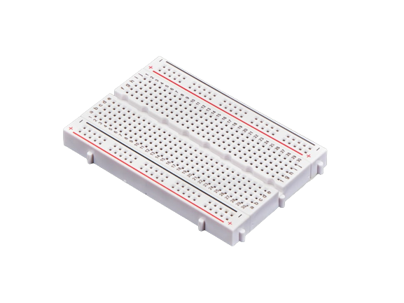
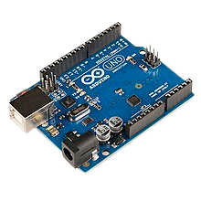
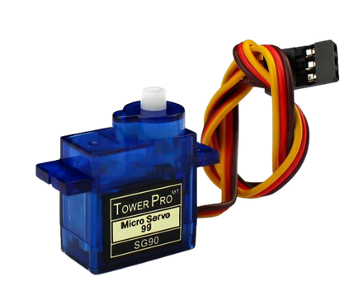
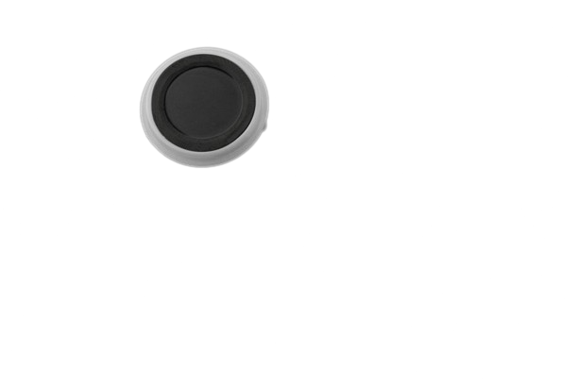
COMPONENTS
07
The project makes use of the following components:
SERVO MOTOR
CAPACITIVE FINGERPRINT SENSOR
This is the motor that controls the opening and closing of the gate.
This is the primary component of the project. It captures the fingerprint of the user and sends it to the Arduino board for verification.
ARDUINO UNO
BREADBOARD
This is the microcontroller that controls the servo motor and processes the fingerprint data.
This is the board that connects all the components and wires.

Slide 7

11
HOW IT WORKS
The user approaches the gate and places their finger on the capacitive fingerprint sensor. The sensor captures the fingerprint and sends it to the Arduino board for processing. The Arduino board then compares the fingerprint with the authorized fingerprints stored in its memory. If the fingerprint matches, the board sends a signal to the servo motor, which opens the gate to allow the user to enter. If the fingerprint does not match, the gate remains closed.

Slide 8

11
IMPLEMENTATION
To implement the project, we first connected the capacitive fingerprint sensor to the Arduino Uno board. We then uploaded the code to the board, which included the fingerprint verification algorithm and the servo motor control. We connected the servo motor to the board using a breadboard and wrote code to control the motor's movement. Finally, we mounted the motor onto the gate and tested the system.

Slide 9

CONCLUSION
The fingerprint-activated gate control system is a reliable and secure way to control access to restricted areas. It eliminates the need for traditional keys or access cards, which can be lost or stolen. By using a unique biometric identifier, such as a fingerprint, the system ensures that only authorized individuals can enter the secured area. With the use of easily available components such as a capacitive fingerprint sensor, an Arduino Uno board, a servo motor, and a breadboard, this project can be implemented with ease.

Slide 10
سكشن : 13 ، جروب : 4
طارق وجيه ممدوح ابوزيد
01
سكشن : 13 ، جروب : 4
عادل تامر عادل أبو الخير
02
سكشن : 17، جروب : 5
عمر هاني عفيفي امام
03
سكشن : 12، جروب : 3
شعبان السيد احمد النشار
04
Team Mbmbers
سكشن : 26، جروب : 7
محمود هشام احمد مراد
05
سكشن : 15، جروب : 5
عبدالله وليد عبد المنعم عبد المعطي
06
سكشن : 21، جروب: 6
محمد جودت السيد عوض
07
سكشن : 18، جروب: 5
فارس محمد زكي الشرشابي
08
سكشن : 17، جروب: 5
عمرو السيد احمد النشار
09
سكشن : 2، جروب: 1
احمد حسن ابراهيم سليم
10

