Slide 1
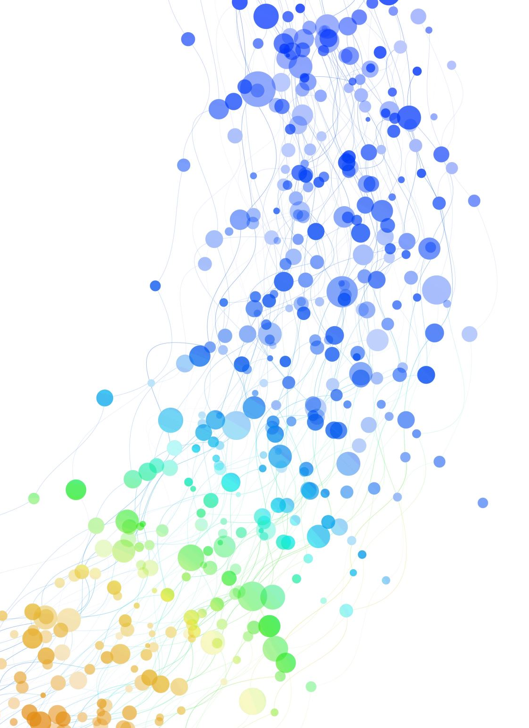
Object Oriented Design and Programming

Slide 2

What is Object Oriented Design?
Object-oriented design (OOD) is the process of planning a system of interacting objects to solve a software problem. It is a method for software design.

Slide 3
What is Object Oriented Programming?
Object-Oriented Programming (OOP) is a programming paradigm in computer science that relies on the concept of classes and objects. It is used to structure a software program into simple, reusable pieces of code blueprints (usually called classes), which are used to create individual instances of objects.

Slide 4
Reason?
The OOP concept was basically designed to overcome the drawback of the above programming methodologies, which were not so close to real-world applications. The demand was increased, but still, conventional methods were used. This new approach brought a revolution in the programming methodology field.

