Slide 1
Polynomial Linear Regression

Slide 2
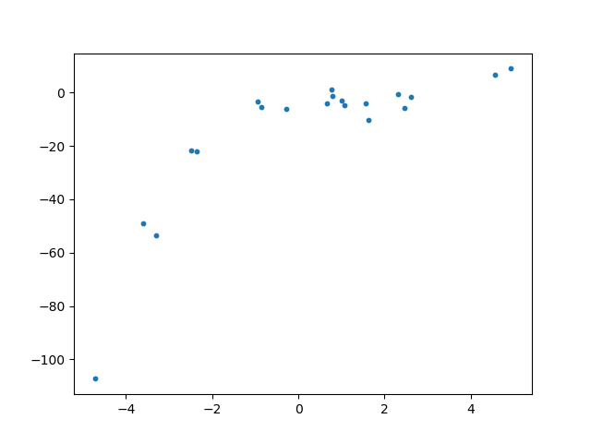
Why polynomial linear regression?
To understand the need for polynomial regression, let’s consider some random dataset first.

Slide 3
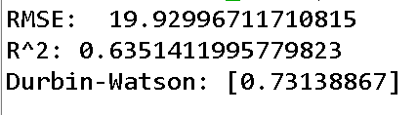
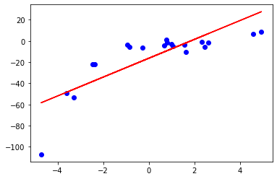
Why polynomial linear regression?
The plot of the best fit line is
We can see that the straight line is unable to capture the patterns in the data.
This is an example of under-fitting

Slide 4
Why polynomial linear regression?
To overcome under-fitting, we need to increase the complexity of the model.
To generate a higher order equation, we can add powers of the original features as new features. The linear model,
Sometimes the polynomial regression works better e.g. predicting the spread of pandemics or diseases etc.

Slide 5
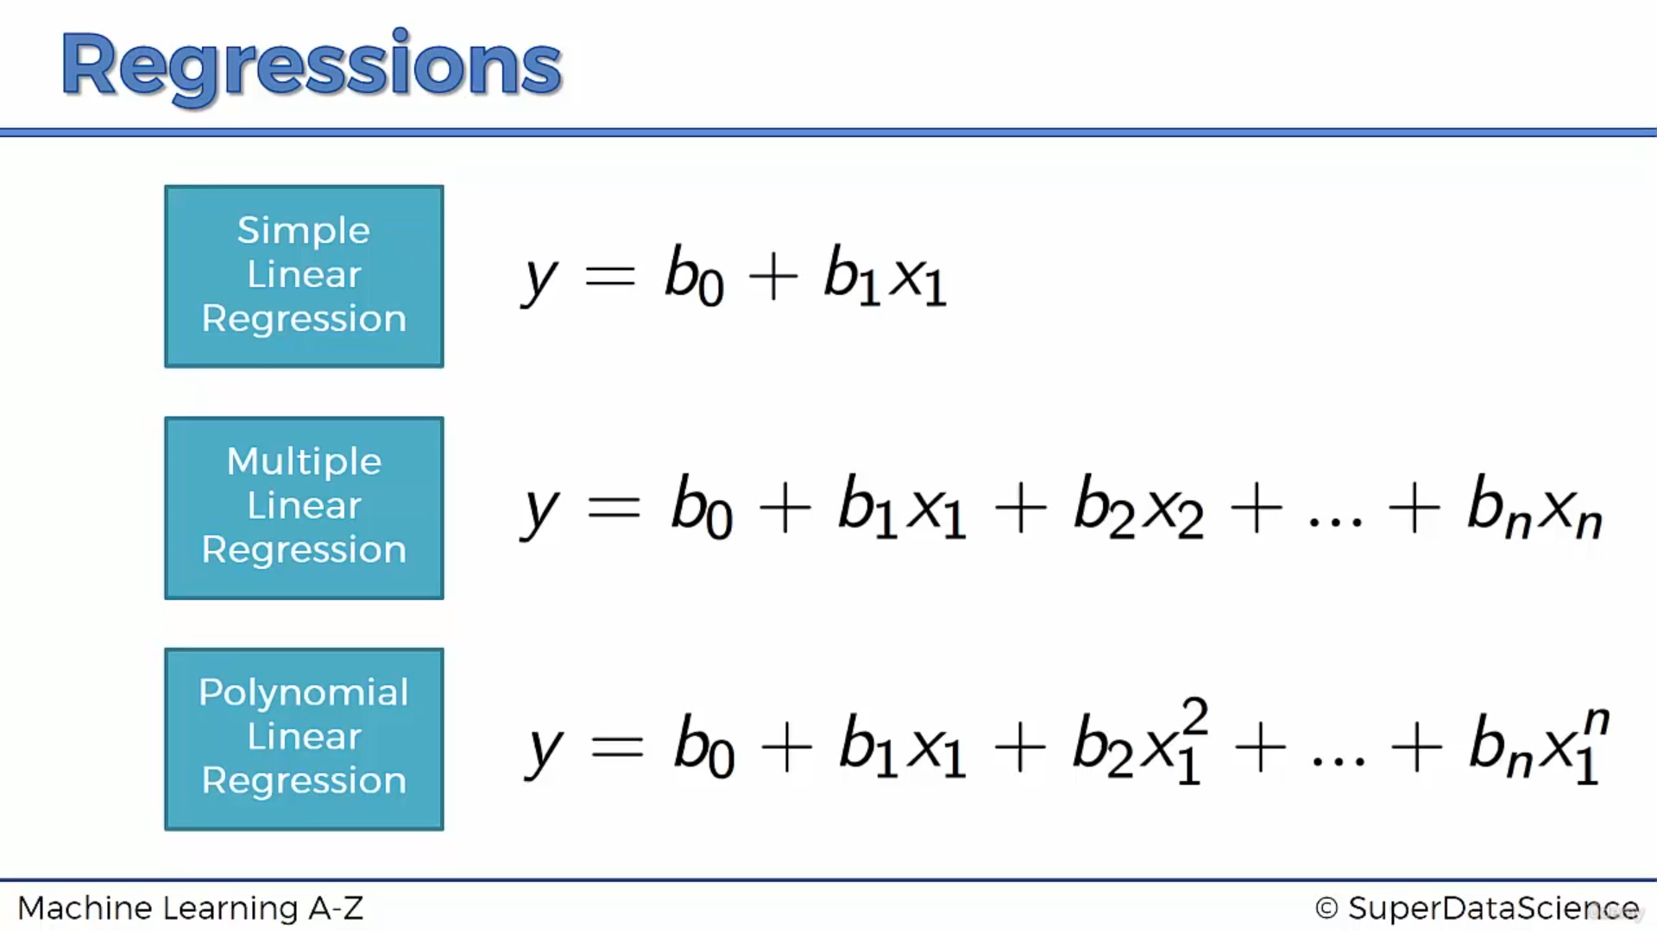
Mathematical Model

Slide 6
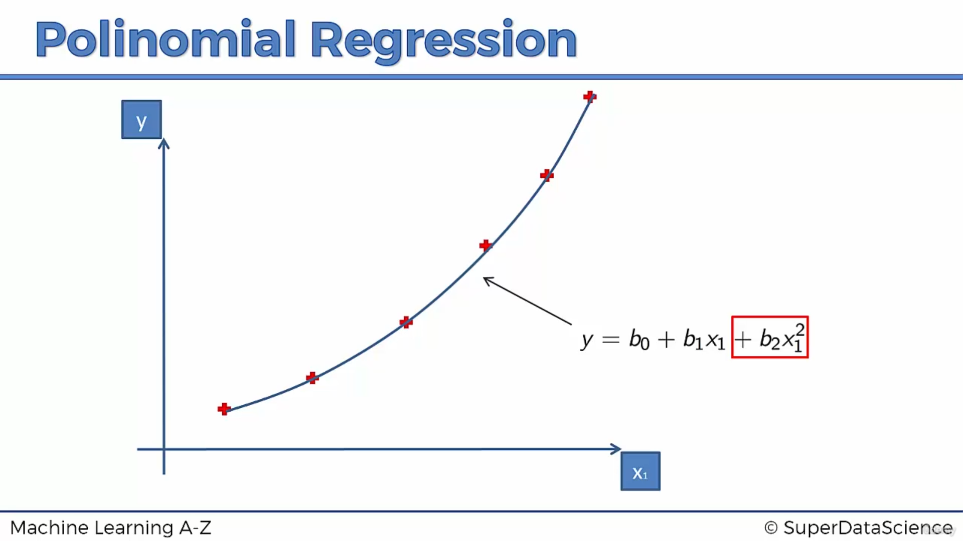
Polynomial Curve

Slide 7
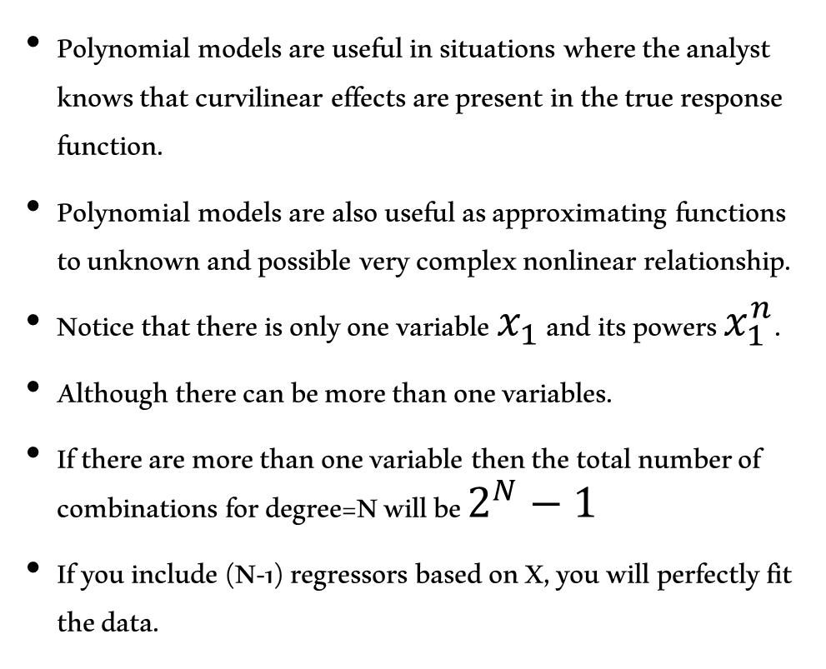
Benefits
Polynomial models are useful in situations where the analyst knows that curvilinear effects are present in the true response function.
Polynomial models are also useful as approximating functions to unknown and possible very complex nonlinear relationship.
Notice that there is only one variable $x_{1}$ and its powers $x_{1}^{n}$.
Although there can be more than one variables.
If there are more than one variable then the total number of combinations for degree=N will be $2^{N}−1$
If you include (N-1) regressors based on X, you will perfectly fit the data.

Slide 8
Polynomial regression with more then one independent variable Y = β0 + β1X1 + β2X2 + β3*(X1^2) + β4*(X2^2) + β5X1X2
Y represents the dependent variable (the target you want to predict).
X1 and X2 are the two independent variables (the features).
β0 is the intercept or constant term.
β1 and β2 are the coefficients for X1 and X2, respectively (linear terms).
β3 and β4 are the coefficients for the squared terms of X1 and X2, capturing the curvature in the relationship.
β5 represents the coefficient for the interaction term between X1 and X2 if you want to account for their joint effect.

Slide 9
Several important conditions:
Order of the model:
The order (k) should be as low as possible.
The high-order polynomials (k > 2) should be avoided unless they can be justified.
In an extreme case it is always possible to pass a polynomial of order n-1 through n point so that a polynomial of sufficiently high degree can always be found that provides a “good” fit to the data.
Model Building Strategy:
Various strategies for choosing the order of an approximating polynomial have been suggested.
Three methods:
forward selection
backward elimination.
Forward-backward elimination

Slide 10
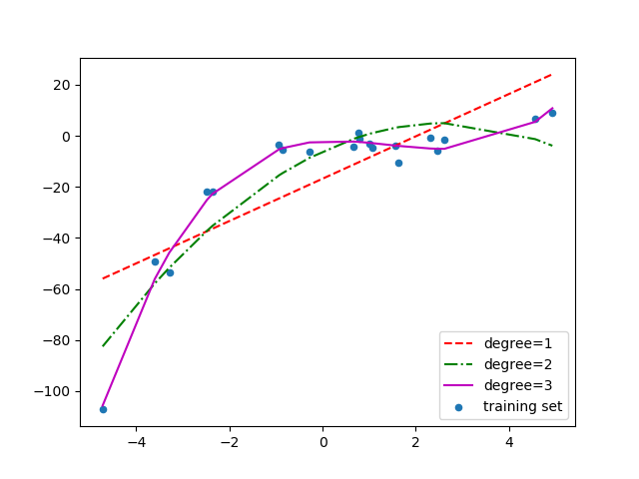
Comparison of model estimation with varying order of degree
Figure shows a comparison of fitting linear, quadratic and cubic curves on the dataset

Slide 11
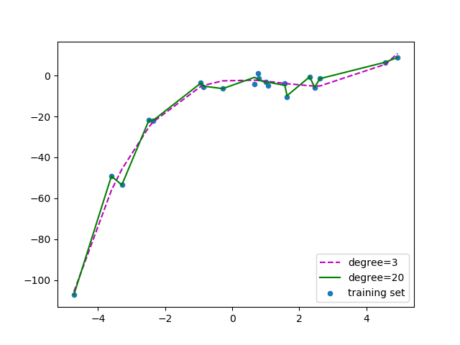
Comparison of model estimation with varying order of degree
If we further increase the degree to 20, we can see that the curve passes through more data points. Figure shows a comparison of curves for degree 3 and 20.

Slide 12
Some points to ponder
To prevent over-fitting, we can add more training samples so that the algorithm doesn’t learn the noise in the system or be affected by outliers and can become more generalized.
How do we choose an optimal model? To answer this question we need to understand the bias vs variance trade-off.
The Bias vs Variance trade-off
Bias
Bias refers to the error due to the model’s simplistic assumptions in fitting the data.
A high bias means that the model is unable to capture the patterns in the data and this results in under-fitting.
Variance
Variance refers to the error due to the complex model trying to fit the data.
High variance means the model passes through most of the data points and it results in over-fitting the data.

Slide 13
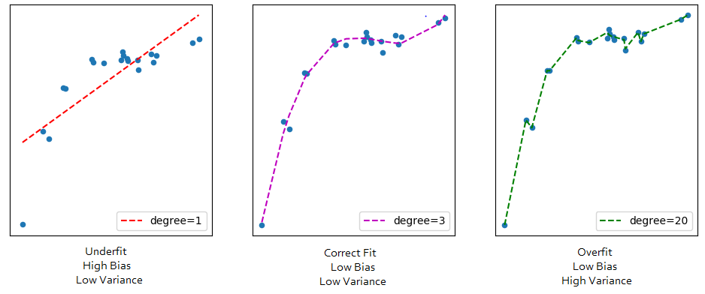

Slide 14
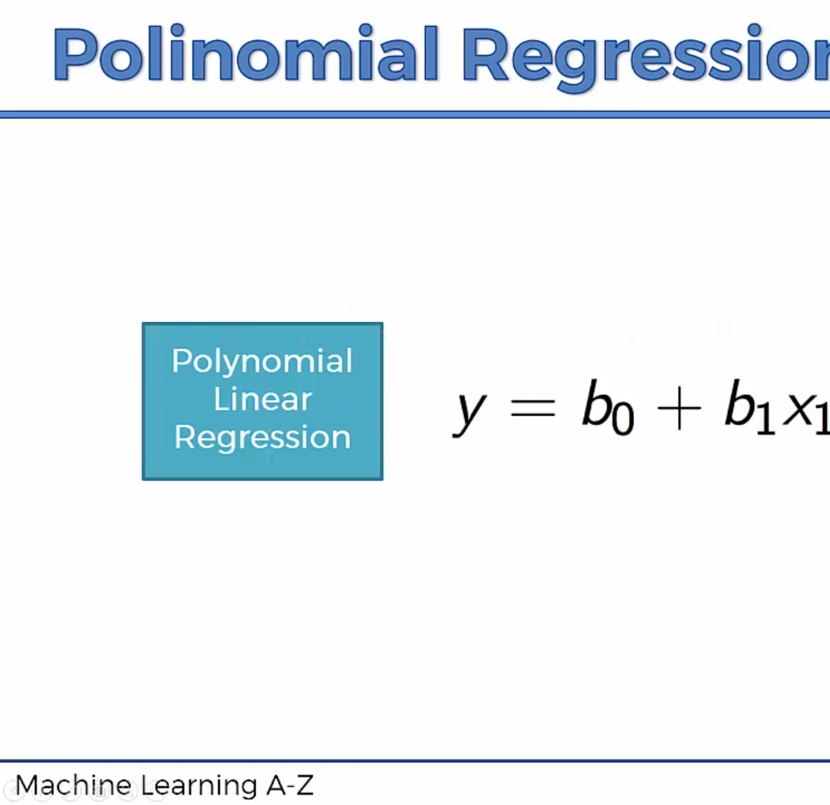
When we are talking about linear and non linear regression models
We are not talking about the relationship between y and xn’s
But we are talking about the relationship between y and bn’s , which is linear as there are no b^2 or B^3 there

Slide 15
Python implementation

Slide 16
Define the problem
We are an HR department and we want to hire someone
We found someone who is a great fit for this job
We want to offer a position to this person in our company
Let us assume he says yes and his requested salary is $160,000 per year, as he is very advanced in his career.
We asked why are you asking this number
He replies that is what I earned at my position in the last company I worked at
Is that a bluff or truth? We are going to figure this out using our polynomial regression model and estimate his salary at his previous company

Slide 17

Building a polynomial linear regression model
We are going to build a multiple linear regression model with independent variables as $x_{1}^{},x_{1}^{2}$etc.
Polynomial regression model is a non-linear model since, it can learn non-linear relationships, but it is called linear because of the linear combination of the variables involved

Slide 18
Thank you

Slide 19
