Slide 1


Match-3 Puzzle Game using
AI Search Algorithms
Inspired by Candy Crush
AI Course Project

Slide 2


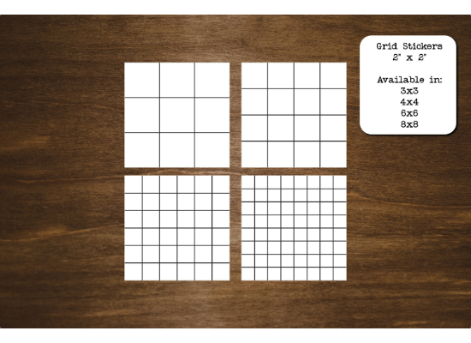

Game Overview
Board: 8×8 grid
Candies: 5 colors (Red, Green, Blue, Yellow, Purple)
Valid Moves: Swap two adjacent candies to form a match of 3+
End Condition: Target score reached or all moves used
Scoring Rules:
3 candies → +30 points
4 candies → +50 points
5 candies → +80 points

Slide 3
Project Objective
Reach a target score of 600 in 15 moves
Apply different AI search algorithms and compare performance.
Comparison Metrics
Final Score
Moves Used
Nodes Explored
Execution Time
Success Rate

Slide 4


State & Actions
State Space
Action Space
Definition: Board configuration, current score, remaining moves.
Actions: Valid swaps producing matches.
Transitions: Swap → Match detection → Replace → Score update → Move decrement.
Initial State: Random board, Score = 0, Moves = 15.
Goal: Score ≥ 600.
Cost: Each move = 1.

Slide 5
Algorithms Implemented
Breadth-First Search (BFS): Explores level by level, ensures shortest solution.
Depth-First Search (DFS): Explores depth first, sometimes faster, may not be optimal.
A* Search: Uses heuristic for efficient search.
Hill Climbing: Improves current state, may get stuck in local optima.
Genetic Algorithm: Population-based, crossover & mutation, highest score & success.

Slide 6














Algorithm Highlights
BFS
DFS
A*
Complete, explores many nodes.
Fast, but may miss optimal solution.
Efficient, balances speed & quality.
Hill Climbing
Genetic Algo
Quick, may fail to reach optimal.
Achieves highest score & consistently.

Slide 7

Visualization

Slide 8
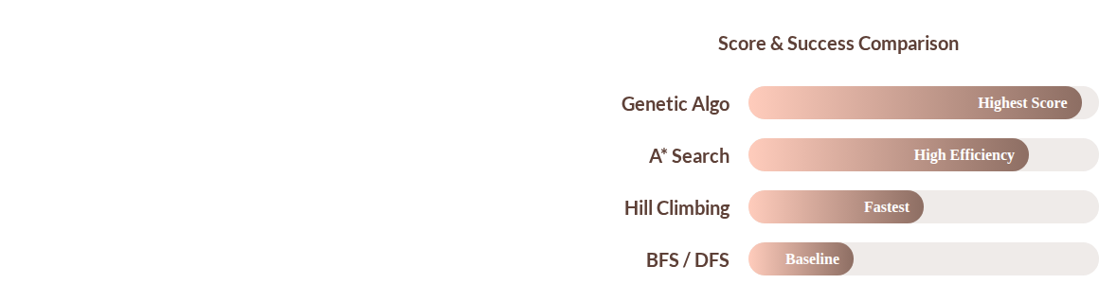
Evaluation Summary
BFS & DFS: Explore many nodes, BFS guarantees solution.
A*: Most efficient for small boards.
Hill Climbing: Fast, may not reach optimal.
Genetic Algorithm: Highest score & success consistently.

Slide 9


Conclusion & Recommendations
Best Algorithm
Genetic Algorithm
(Highest score & success rate)
BFS/DFS: Guaranteed, slower.
Hill Climbing: Fast, may miss optimum.
A*: Good balance of efficiency & solution quality.
Recommendation: Use Genetic or A* for larger boards or optimization problems.

Slide 10
Thank You🤎

