Slide 1

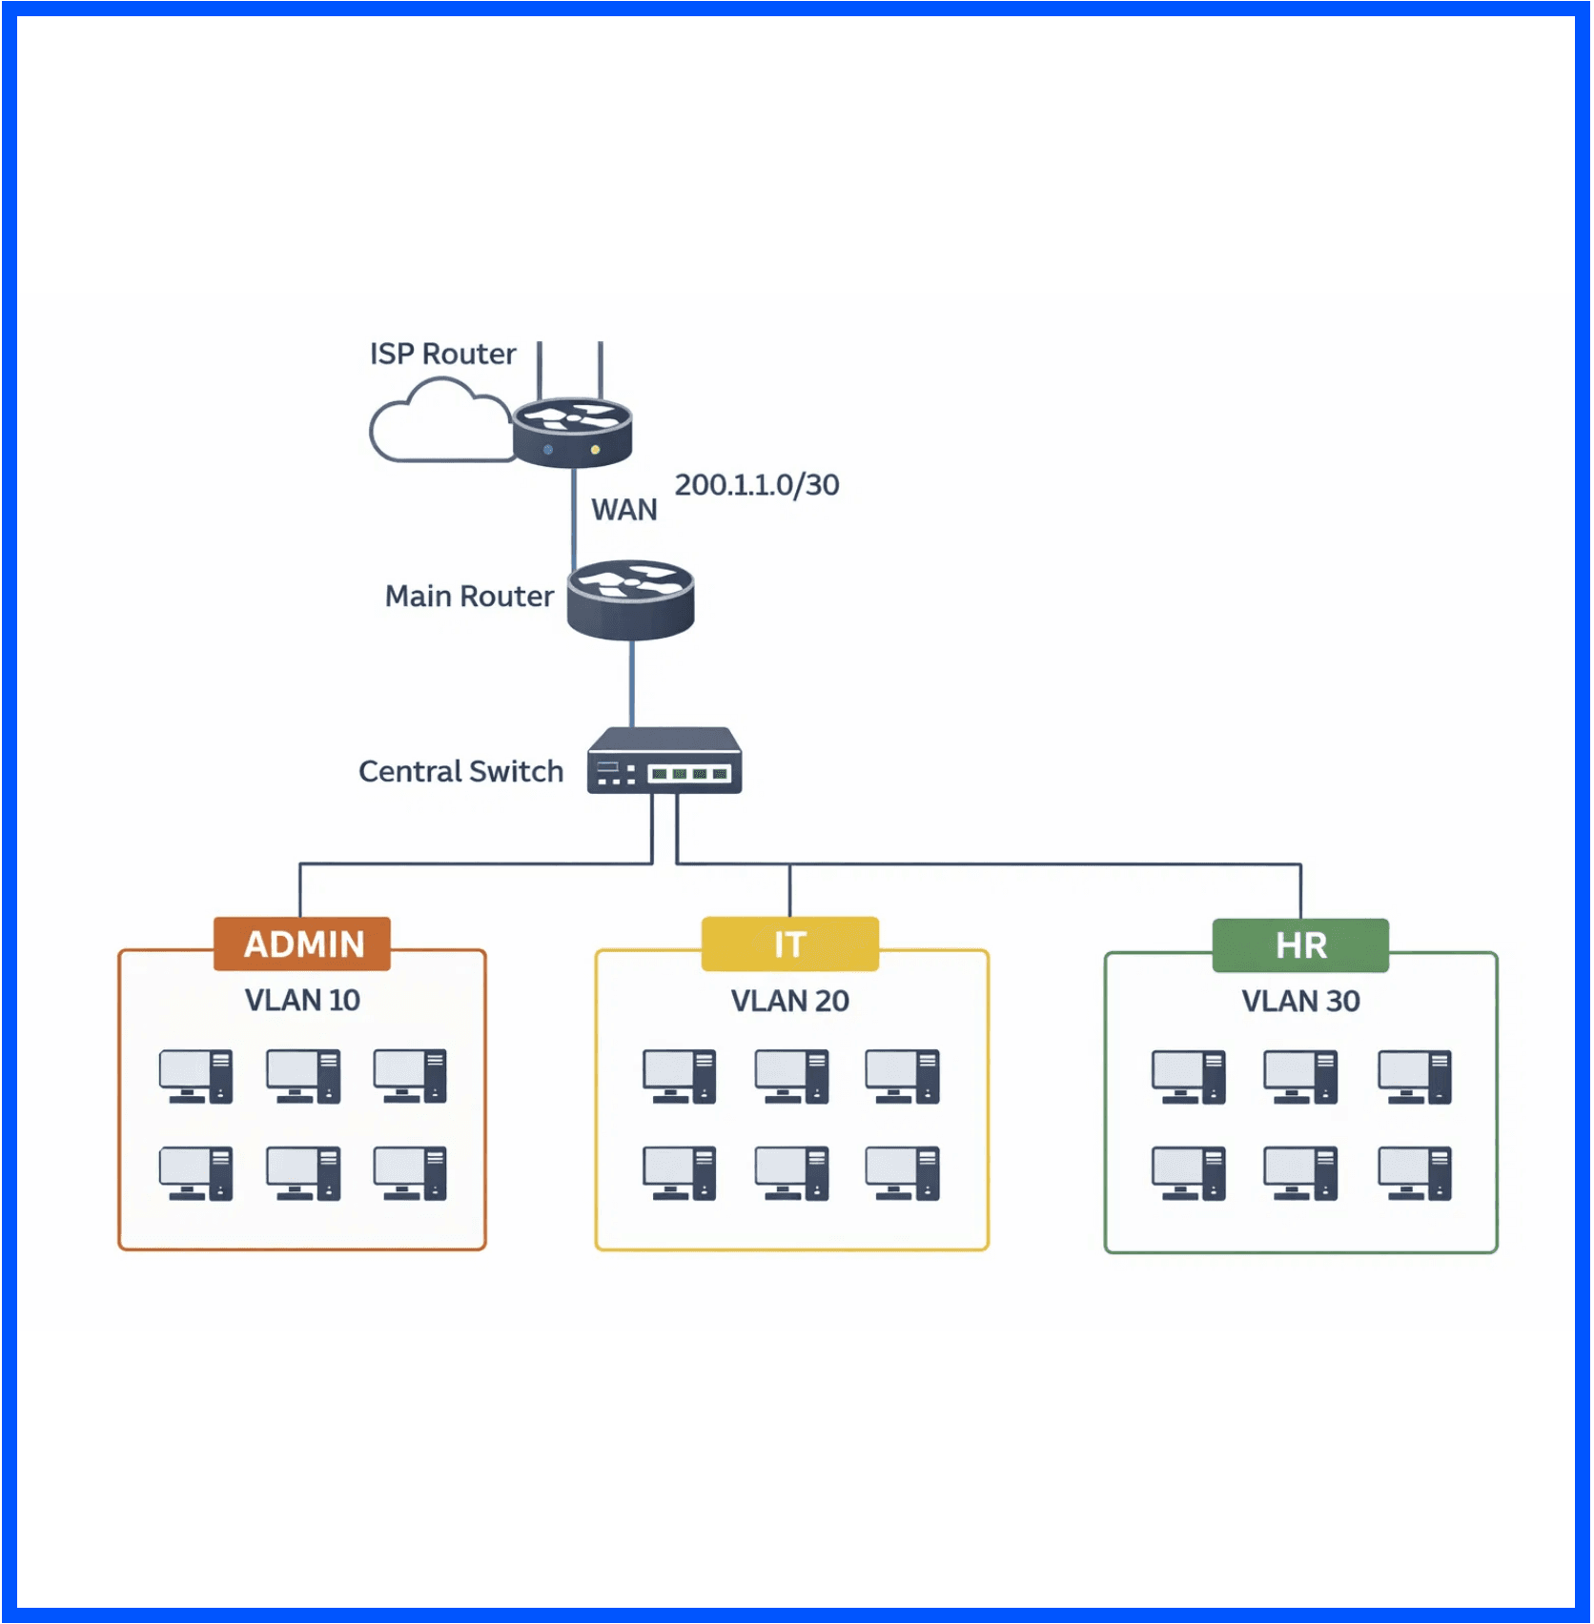
Building a Small Office Network in Packet Tracer
A Complete Guide to VLAN Segmentation & Routing
Kingsley Mmadubugwu
Support Engineer | Swifttalk LTD

Slide 2

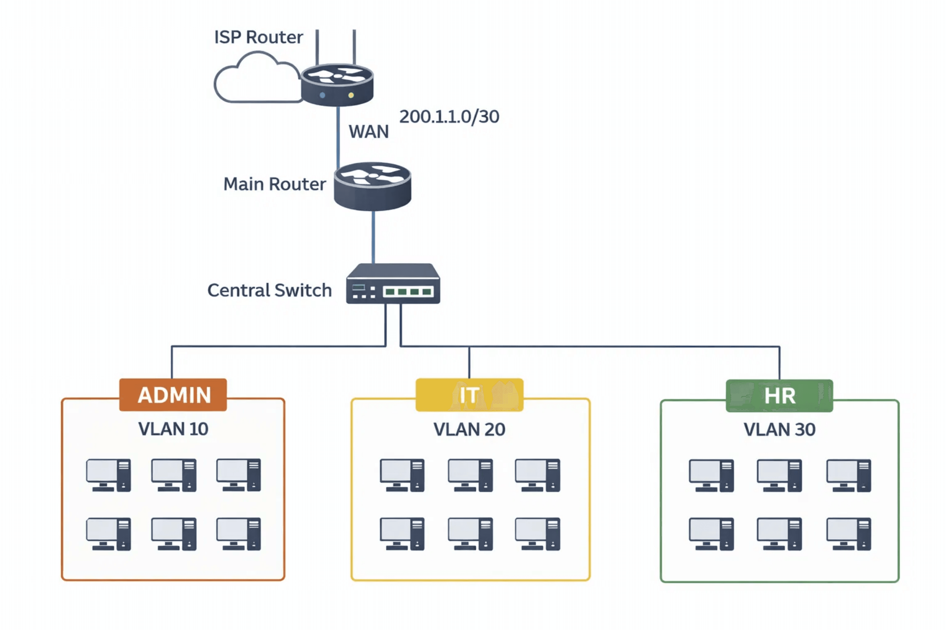
Network Topology Overview

Slide 3

Physical Topology
01
Devices Used
• Main Router (Customer Edge Router)
• Layer 2 Switch (Central connectivity)
Phase One
• 20 PCs (3 Departments: VLAN 10, 20, 30)
• ISP Router (Internet connectivity)
Connections
• PCs → Switch (Access ports)
• Switch → Main Router (Trunk link)
• Main Router → ISP Router (WAN link)

Slide 4
Switch Configuration
02
VLANs Created
• VLAN 10 — ADMIN (6 PCs)
• VLAN 20 — IT (8 PCs)
Phase Two
• VLAN 30 — HR (6 PCs)
Port Assignments
• Ports fa0/2–fa0/7 → VLAN 10 (Access mode)
• Ports fa0/8–fa0/15 → VLAN 20 (Access mode)
• Ports fa0/16–fa0/21 → VLAN 30 (Access mode)
Trunk Configuration
• Port fa0/1 → Trunk mode (connects to Main Router)
• Carries all VLAN traffic (802.1Q tagging)

Slide 5
Router-on-a-Stick
03
Physical Interface
• FastEthernet1/0 — Enable (no shutdown)
Sub-interfaces (One Per VLAN)
Phase Three
• FastEthernet1/0.10 — VLAN 10 (802.1Q tagging)
• FastEthernet1/0.20 — VLAN 20 (802.1Q tagging)
• FastEthernet1/0.30 — VLAN 30 (802.1Q tagging)
Gateway IPs
• VLAN 10 Gateway: 192.168.10.1 /24
• VLAN 20 Gateway: 192.168.20.1 /24
• VLAN 30 Gateway: 192.168.30.1 /24

Slide 6
DHCP Configuration
04
Excluded Addresses
• 192.168.10.1 (VLAN 10 gateway)
• 192.168.20.1 (VLAN 20 gateway)
Phase Four
• 192.168.30.1 (VLAN 30 gateway)
DHCP Pools
• VLAN10 Pool — 192.168.10.0/24 → Gateway 192.168.10.1
• VLAN20 Pool — 192.168.20.0/24 → Gateway 192.168.20.1
• VLAN30 Pool — 192.168.30.0/24 → Gateway 192.168.30.1

Slide 7
Local Testing
05
Each PC is configured to use DHCP, and upon connection, it automatically receives an IP address from the appropriate VLAN pool. Testing includes verifying that PCs within the same VLAN can ping each other and that PCs in different VLANs can ping the router's gateway IP for their VLAN. This phase confirms that VLAN segmentation and DHCP are working correctly. Successful pings indicate that the router is properly routing traffic between VLANs and that all devices have valid IP addresses.
Phase Five

Slide 8
ISP Router Configuration
06
The ISP Router simulates the Internet Service Provider's equipment. It is configured with a WAN interface (200.1.1.1/30) that connects to the Main Router. A loopback interface (8.8.8.8) simulates the internet. A static route is configured on the ISP Router to route traffic destined for the internal network (192.168.0.0/16) back to the Main Router. This setup allows the office network to communicate with the simulated internet while the ISP Router maintains the return path for responses.
Phase Six

Slide 9
WAN Configuration
07
The WAN interface on the Main Router (200.1.1.2/30) is configured to connect to the ISP Router. A default route (0.0.0.0/0) is set to point to the ISP Router's IP address, ensuring that any traffic destined for external networks is forwarded to the ISP. This configuration establishes the path for all outbound internet traffic. The Main Router now acts as the gateway between the internal office network and the external internet, managing all traffic flowing in and out of the organization.
Phase Seven

Slide 10
NAT Configuration
08
NAT allows all internal PCs to share a single public IP address (the WAN interface IP) when accessing the internet. All sub-interfaces (VLAN gateways) are marked as NAT inside interfaces, while the WAN interface is marked as NAT outside. An access control list (ACL) permits all internal network traffic (192.168.0.0/16) to be translated. The NAT rule uses PAT (Port Address Translation) with overload, allowing multiple internal devices to simultaneously access the internet using the same public IP. This configuration provides both network efficiency and security.
Phase Eight

Slide 11
Internet Testing
09
From any PC in any VLAN, a ping to 8.8.8.8 (the simulated internet) confirms end-to-end connectivity. The packet travels from the PC to its VLAN gateway, through the router's inter-VLAN routing, out the WAN interface with NAT translation, to the ISP Router, and to the loopback interface. The response follows the reverse path. Checking NAT statistics on the router shows active translations, confirming that NAT is functioning. This comprehensive test validates that all nine phases are working together correctly.
Phase Nine

Slide 12
Summary & Key Takeaways
Five Core Concepts Mastered
CCNA Certification Alignment
1. VLAN Segmentation — Logical isolation for security.
Exam Topics Covered — 802.1Q, static routing, NAT.
2. Trunk Configuration — Multi-VLAN transport over one link.
Real-World Skills — Enterprise design patterns.
3. Router-on-a-Stick — Inter-VLAN routing via sub-interfaces.
Portfolio Building — Simulation project evidence.
4. DHCP Automation — Automated IP assignment.
Career Readiness — Foundation for network roles.
5. NAT & Internet Access — PAT-based secure Internet access.
Continuous Learning — Path to advanced topics.
You are now ready for the next challenge.

