Slide 1
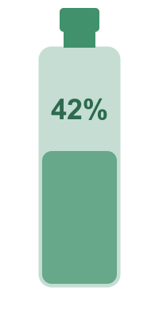
Safi Oil Tracker
AI-Powered Cooking Oil Tracking
SCAN. SNAP. KNOW.
February 27, 2026

Slide 2
The Problem
No practical way to track cooking oil consumption
!
Visual estimation is unreliable
~
Manual measuring is disruptive to cooking flow
X
No product bridges physical cooking and dietary tracking
0
Health-conscious users want awareness without effort
?
"Consumers have no way to know how much oil they've really used from a bottle."

Slide 3
Our Solution
QR Code
➔
Phone Camera
➔
AI Analysis
➔
Instant Results
on bottle
1 tap
3-5 seconds
ml, tbsp, cups
Zero Friction
AI + Math Hybrid
Self-Improving
$0 / Month
No download, no account, no onboarding. QR code to results.
AI estimates fill %. Math calculates precise volume.
Every scan trains the AI. Gets smarter with use.
100% free tier infrastructure. Zero cost.

Slide 4
How It Works
1
2
3
4
Scan QR Code
Take Photo
AI Analysis
Results
bottle here
AI
68%
fill level
QR on bottle
Alignment guide
3–5 seconds
Opens PWA with
bottle pre-loaded
Rear camera
1 tap capture
Gemini 2.5 Flash
analyzes fill level
340ml · 23 tbsp remaining
1,325 cal consumed
Under 8 Seconds
From bottle scan to full nutrition results

Slide 5
System Architecture
1
User Device — React 19 PWA
Request Flow
QR scan opens app · Camera captures 800px JPEG (~70KB) · Local volume/nutrition logic (no server round-trips)
POST /analyze
→ validate → AI call → store → respond
2
Cloudflare Worker — Edge Proxy
POST /feedback
Origin validation · Rate limit 10 req/min/IP · Payload guard <4MB · Routes to AI providers · Stores data
→ sanity check → update metadata
3
AI Vision Providers
Why This Architecture
Primary: Gemini 2.5 Flash · JSON mode · 500 req/day free · Fallback: Groq + Llama 4 Scout (online only, POC) → Fine-tuned model (post-POC)
✓ API keys never in browser
✓ Zero cold starts (V8 isolates)
Cloudflare R2 — Object Storage
✓ No DB server to manage
4
images/{scanId}.jpg + metadata/{scanId}.json · 10 GB free · ~140K scans · $0 egress · Training data
✓ Edge CDN globally fast
⚠ Requires credit card activation — deferred to post-POC
✓ R2 native binding (no HTTP)
Serverless · No infra to manage

Slide 6
Technology Stack
POC v1
Full Launch
FRONTEND
React 19 + TypeScript + Vite 7
FRONTEND
React 19 + TypeScript + Vite 7
PWA via vite-plugin-pwa
Same · + React Native option (Phase 4)
BACKEND
Cloudflare Worker (Hono.js)
BACKEND
Cloudflare Worker (Hono.js)
Edge proxy, zero cold starts
Same · + auth middleware, admin API
AI PRIMARY
Gemini 2.5 Flash
AI PRIMARY
Gemini 2.5 Flash (paid tier)
Free 500 req/day · JSON vision mode
$0.15/M tokens · scales infinitely
AI FALLBACK
Groq + Llama 4 Scout
AI FALLBACK
Fine-tuned Qwen2.5-VL 7B
Online only · Auto-failover · Free tier
After 500+ scans · offline capable · self-hosted
STORAGE
Local JSON / R2 TBD
STORAGE
Cloudflare R2 (activated)
Credit card required for R2 activation
10GB free + $0.015/GB · 140K+ scans
CI/CD
GitHub Actions
AUTH / DB
Cloudflare D1 + KV
Auto-deploy · 34 unit tests
User accounts · scan history (Phase 2)

Slide 7
PWA vs Native App
OUR CHOICE ✓
PHASE 4 OPTION
Progressive Web App (PWA)
Native Mobile App
Used for: POC v1 + Full Launch
React Native or Flutter · After 1000+ scans
✓
No App Store submission
✗
App Store review required
QR code → instant access in browser · No install required
Apple + Google review process · Days to weeks to publish
✓
Single codebase for iOS + Android
✗
Separate iOS + Android codebases
React + Vite · Deployed as static files on Cloudflare Pages
Or React Native (adds complexity vs current stack)
✓
Camera API available in browser
✓
Full camera + hardware access
getUserMedia() · Works on Chrome Android + Safari iOS
No iOS PWA limitation · Better UX for power users
✓
Offline shell via Service Worker
✓
Push notifications
App loads instantly from cache · Only scan needs network
Reminders to track oil · Engagement features (Phase 4)
!
iOS caveat: Use Safari browser mode
✗
Higher dev cost + time
Standalone PWA mode has a known iOS camera bug → "Open in Safari" prompt shown
Not justified until product-market fit is proven
Decision: PWA for POC + Full Launch. Native app considered only after 1,000+ real scans validate product-market fit.

Slide 8
User Experience Design
Design System
SAFI
Point at bottle
Analyzing...
Your Results
Oil Tracker
#2D6A4F
#40916C
#E9A820
#D64045
Surface
68%
9 screens designed
High confidence
QR · Camera · Preview · Analyzing · Results · Feedback · Errors · iOS
Remaining: 340ml · 23 tbsp
Mobile-first (375–430px)
Consumed: 160ml · 10 tbsp
WCAG 2.1 AA accessible
1,325 cal consumed
Animated fill gauge
149.8g fat
Smooth bottle fill visualization
Was this accurate?
Camera overlay guide
Filippo Berio
500ml
About right
Too high
Gold corner markers for alignment
Extra Virgin Olive
AI
Linear flow · no navigation
Start Scanning
Zero cognitive load — just scan + see
Gemini 2.5 Flash
estimating fill level
⊙ Capture
QR Landing
Camera View
Processing
Result Screen
4 Key Screens — HTML Mockup

Slide 9
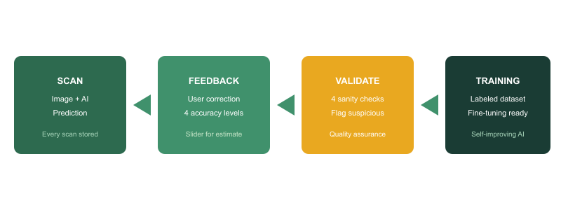
AI & Continuous Improvement
The product IS the data collection engine
Every scan generates a labeled training example automatically

Slide 10
Security & Privacy
1
Origin Validation — CORS Whitelist
What Data Is Stored (R2)
Only safi-oil-tracker.pages.dev + localhost allowed · All other origins rejected with 403
images/{scanId}.jpg — bottle photo only
metadata/{scanId}.json — fill %, confidence, timestamp, device type, feedback
2
Rate Limiting — 10 req/min per IP
Sliding window in Cloudflare KV · Prevents abuse & AI API cost spikes · Returns 429 on breach
No user ID. No location. No personal data.
3
API Key Protection — Worker Secrets Only
Feedback Validation (Layer 1 Sanity)
Gemini & Groq keys stored as Cloudflare Worker env secrets · Never in client bundle or git history
too_fast: response < 3s (random tap)
boundary_value: estimate = 0% or 100%
Payload Guard — Reject > 4MB
contradictory: "too low" but estimate < AI
4
Content-Length checked before processing · Prevents memory exhaustion & oversized AI payloads
extreme_delta: > 30% difference from AI
Post-POC Additions
5
Zero PII — No Accounts, No Identity
User auth: JWT tokens, secure session management
No names, emails, or phone numbers collected · R2 bucket is private (not web-accessible) · GDPR-safe by design
Admin dashboard: role-based access (Phase 3)
R2 bucket encryption at rest (enabled by default)
6
HTTPS Everywhere — Cloudflare Enforced
TLS 1.3 · HTTP→HTTPS redirect enforced at CDN edge · HSTS header on all responses

Slide 11
Success Criteria
CURRENT TARGETS
FUTURE TARGETS
POC v1
Full Launch
< 8s
Scan-to-Result Time
< 5s
Scan-to-Result Time
Photo capture to full nutrition results
Faster with optimized prompts + fine-tuned model
≥ 50
Real Scans (Month 1)
10K+
Monthly Active Scans
With usable training data (image + feedback)
With user accounts tracking repeat usage
≤ 15%
AI Fill-Level MAE
≤ 8%
AI Fill-Level MAE
Mean absolute error vs. user ground truth
After fine-tuning on 1,000+ labeled images
≥ 30%
Feedback Submission Rate
≥ 80%
Scan Completion Rate
Users who provide accuracy feedback
Initiated scans reaching result screen
$0
Monthly Cost
$3–30
Monthly Cost (10K–100K scans)
All services on free tiers
Gemini Flash tokens + R2 · 50+ bottle SKUs (Phase 4)
34/CI
Tests + CI/CD
All passing · Clean auto-deploy on every push

Slide 12
Product Roadmap
NOW
POST-POC VALIDATION
100+ LABELED SCANS
1,000+ SCANS
10,000+ SCANS
Phase 1: POC
Phase 2
Phase 3
Phase 4
Phase 5
2–4 weeks · 1 developer
After 50+ real scans
Model Intelligence
Platform Scale
Business Intelligence
QR → Scan → Result flow
Activate Cloudflare R2
Prompt refinement
Native mobile app
Analytics dashboard
3 bottle SKUs
User accounts (D1 + KV)
Few-shot examples
Barcode scanning
Regional patterns
AI vision (Gemini Flash)
Scan history per user
Fine-tune Qwen2.5-VL
Multi-brand registry
Size-based insights
User feedback loop
Custom starting level
Admin dashboard
Multi-language
Loyalty program
Training data pipeline
Push notifications
A/B accuracy testing
CI/CD auto-deploy
More bottle SKUs
$0/mo cost

Slide 13
Infrastructure Cost
Full Launch Estimate (10K–100K scans/mo)
POC v1 (Current)
Model
Input / 1M tkns
Output / 1M tkns
Free Tier
$0 / mo
Gemini 2.5 Flash
$0.15
$0.60
500 req/day
Gemini 2.5 Pro
$1.25
$10.00
50 req/day
Free tier · Up to ~15K scans/mo
~1,550 tokens/scan (1,500 input + 50 output) · Using Gemini 2.5 Flash
Cloudflare Pages
FREE
Volume
AI Tokens
R2 Storage
Total / mo
Cloudflare Worker
FREE
10,000 scans
$2.55
$0 (700MB)
~$3 / mo
Gemini 2.5 Flash
FREE
50,000 scans
$12.75
$0 (3.5GB)
~$13 / mo
Groq Fallback
FREE
100,000 scans
$25.50
~$3.50
~$30 / mo
GitHub Actions
FREE
R2 Storage
Deferred (CC req.)
Calculation (per scan · Gemini Flash)
Input: 1,500 tkns × $0.15/M = $0.000225 · Output: 50 tkns × $0.60/M = $0.000030 · Total: $0.000255/scan
10K = $2.55 · 50K = $12.75 · 100K = $25.50 (AI only)
If using Gemini Pro: Input $1.25/M + Output $10.00/M → $0.002375/scan → 10K scans = $23.75 · 100K = $237.50 (not recommended for this use case)

Slide 14
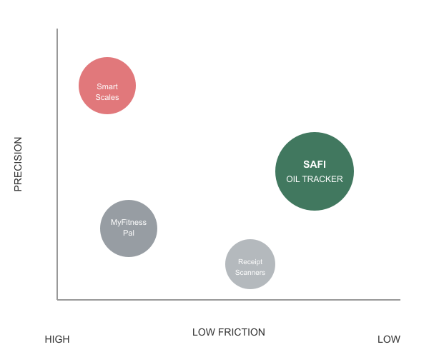
Competitive Advantage
No direct competitor exists
vs MyFitnessPal
High friction manual logging
vs Smart Scales
Requires hardware purchase
vs Receipt Scanning
Scans labels, not actual content
Safi Oil Tracker
Zero friction + Zero hardware + Self-improving AI

Slide 15

Implementation Status
READY FOR IMPLEMENTATION
All planning artifacts complete and verified
✓
PRD (39 FRs, 30 NFRs)
✓
Architecture (14 sections)
✓
UX Design (9 screens)
✓
Epics & Stories (38 stories)
✓
API Specification
✓
Data Schemas
✓
LLM Prompt Engineering
✓
Deployment Guide
38
5
34
100%
User Stories
Epics
Unit Tests
Complete

Slide 16
Next Steps
1
Test AI with Client-Provided Photos
Client sends bottle images directly (no barcode/QR step needed) — split into training set + held-out test set to measure baseline AI accuracy before any prompt tuning
2
Refine Prompts Using Feedback Loop
Use test results + user feedback to iteratively improve Gemini prompts — basic prompt-refinement loop works with sample data even without R2 bucket (no credit card needed)
3
Deploy + Validate QR Code Scan Flow
Push to Cloudflare Pages + Worker · Print QR codes for 3 SKUs · Verify end-to-end QR → Camera → Result flow (standard functionality, no innovation risk)
4
Collect 50+ Real-World Scans
Begin live scan collection with feedback submissions — each scan produces a labeled training pair (image + user-corrected fill level) for continuous improvement
5
Go / No-Go Decision: Scale Beyond POC
If AI accuracy hits ≤15% MAE and feedback rate ≥30% → greenlight Phase 2: activate R2 persistent storage, add user accounts, scan history, push notifications, more SKUs ($0–5/mo added). If not → iterate prompts or pivot approach before investing further.

Slide 17
Thank You
Safi Oil Tracker
SCAN. SNAP. KNOW.
Ahmed | February 2026

