Slide 1

Medicine Price Prediction System
AI-Powered Medicine Price Forecasting and Pharmaceutical Assistant
Final Graduation Project Presentation - DEPI
Team Members | Role | Responsibilities
Mohamed Ashraf | Machine Learning | Data preprocessing, Prophet forecasting
Anas Tarek | AI Engineer | RAG pipeline, Qwen chatbot
Haitham Mohamed | Backend Developer | FastAPI services, database, API integration
Asem Wael | Frontend Developer | Streamlit interface
Ahmed Tamer | Documentation & QA | UML, testing, reports, user manual

Slide 2


Project Overview
An intelligent healthcare platform combining drug data, machine learning, and AI to help patients and
professionals make informed decisions using historical medicine prices and AI-powered recommendations.
Machine Learning
Drug Database
Centralized clinical and price history for modeling.
Train models on historical trends and features.
Price Forecasting
AI Assistant
Generate short- and long-term price projections.
Deliver recommendations and insights to users.
The system integrates a centralized drug database, ML-based price forecasting, intelligent medicine search, and a conversational AI pharmacist assistant into one unified platform.

Slide 3

Problem Statement
Medicine prices frequently change due to inflation, supply shortages, market conditions, and government pricing updates. Current systems only display current prices — they do NOT predict future prices or provide intelligent assistance.
No Forecasting
No AI Assistant
Existing tools show only current prices, not future trends
No intelligent guidance for patients or healthcare professionals
No Centralized DB
No unified medicine database with historical price data

Slide 4






Project Objectives
Centralized Database
Price Prediction
Build a unified medicine database with historical price records
Predict future medicine prices using ML models
Intelligent Search
AI Pharmacist
Provide smart medicine search with historical price trends
Integrate an AI-powered pharmaceutical assistant
REST APIs
Simple UI
Expose REST APIs for external system integration
Deliver a clean, accessible user interface

Slide 5







Proposed Solution
End-to-end system flow from user interaction through AI-powered responses.
User
Streamlit Dashboard
FastAPI Backend
SQLite Database
Machine Learning
Qwen AI Assistant
External Drug API

Slide 6
Technology Stack
Frontend
Backend
Streamlit · Plotly
FastAPI · Python · REST
Database
ML / AI
SQLite · FAISS
Prophet · Qwen 2.5 3B Instruct
Embeddings
Deployment
sentence-transformers
Cloudflare Tunnel · GitHub

Slide 7
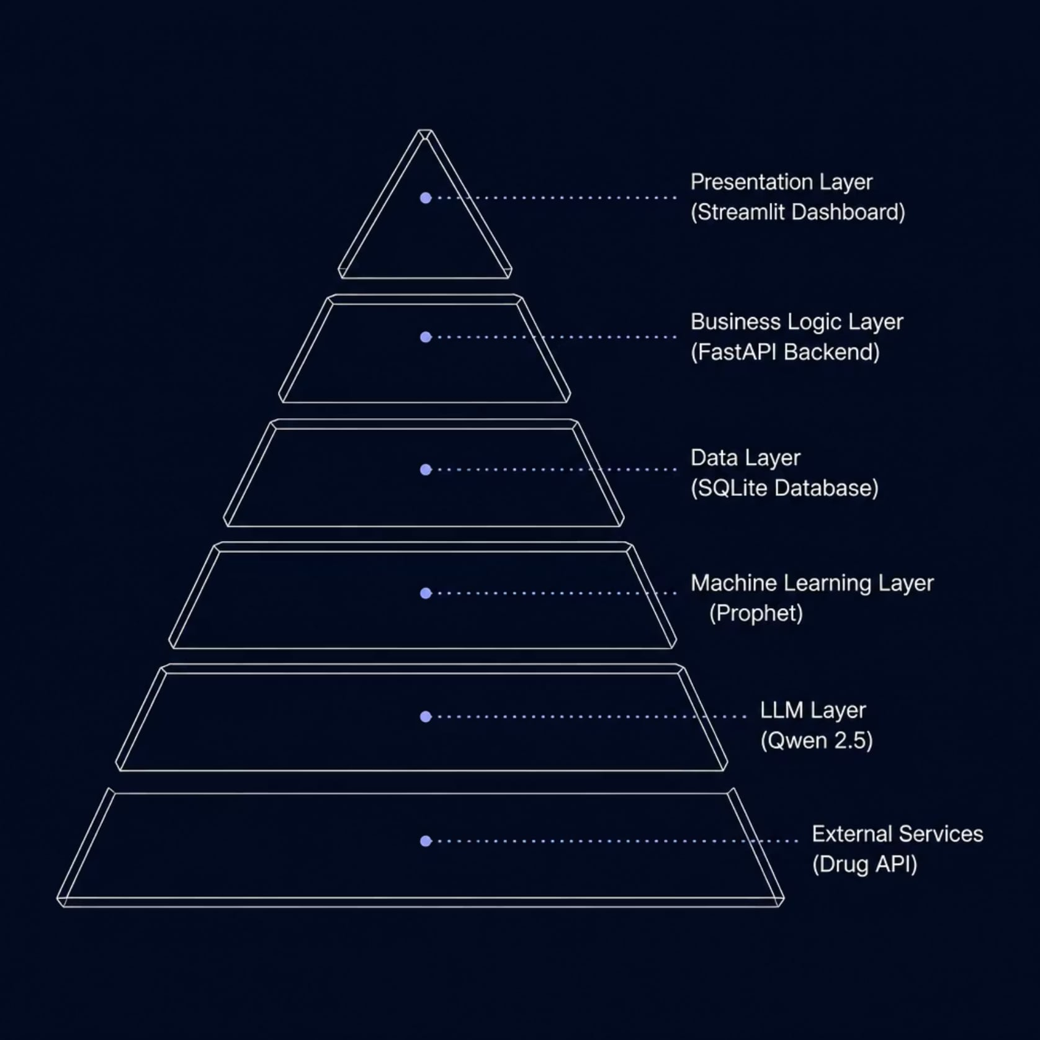
System Architecture
A clean layered architecture ensures separation of concerns, scalability, and maintainability across all system components.
Presentation Layer — Streamlit dashboard for user interaction
Business Logic Layer — FastAPI backend handling core operations
Data Layer — SQLite database with normalized schema
ML Layer — Prophet model for price forecasting
LLM Layer — Qwen 2.5 AI assistant
External Services — Drug API integration

Slide 8
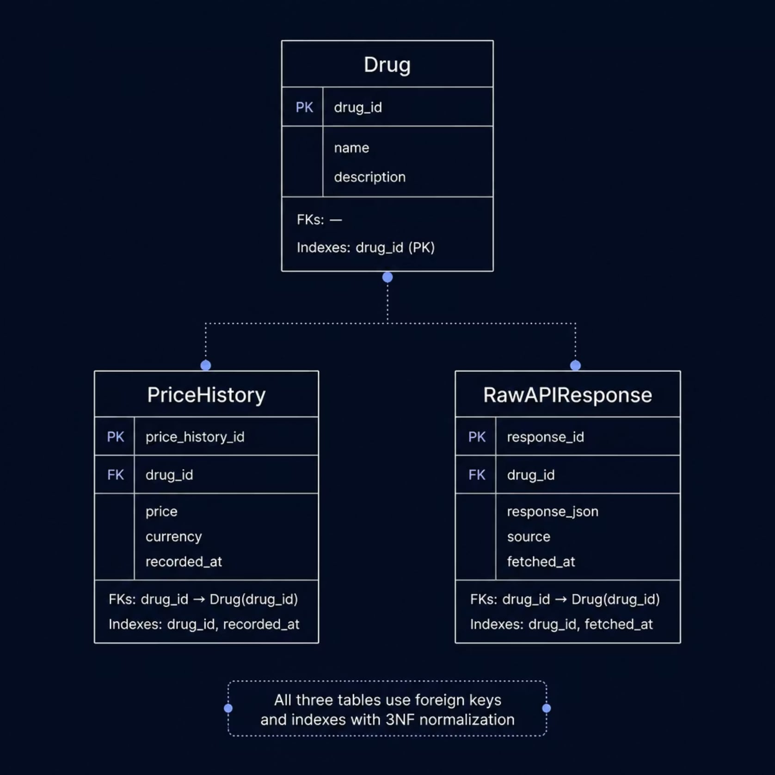
Database Design
The system uses SQLite with a normalized schema (3NF) ensuring data integrity through primary keys, foreign keys, and optimized indexes.
Drug
PriceHistory
RawAPIResponse
Master medicine records
Historical price data per drug
Stored external API responses

Slide 9








Machine Learning Pipeline
The pipeline uses Prophet for time-series forecasting, offering automatic seasonality detection, trend modeling, and confidence interval generation.
Raw Drug Data
Cleaning
Feature Engineering
Historical Price Series
Prophet Training
Forecast Generation
Confidence Interval
Prediction API

Slide 10
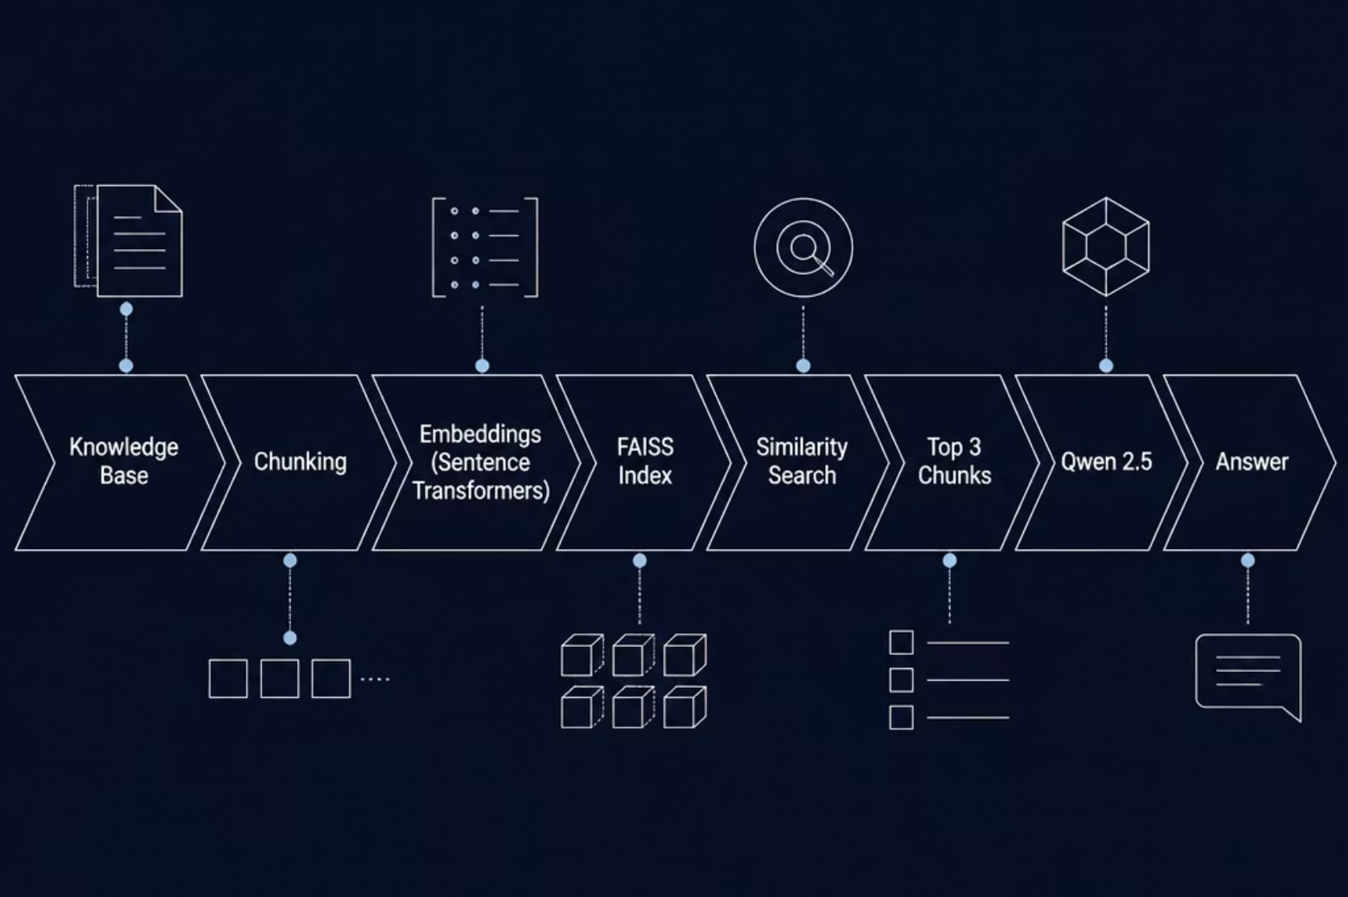

RAG Architecture
Retrieval-Augmented Generation powers the AI pharmacist using Sentence Transformers, FAISS vector search, and Qwen 2.5 via FastAPI.
Knowledge Base
Medical documents chunked and embedded
FAISS Index
Fast similarity search over vector embeddings
Qwen 2.5
Generates grounded, accurate answers

Slide 11






Backend Workflow
FastAPI architecture built on a clean layered pattern — from routing to data persistence and external APIs.
Router
Service
Repository
SQLite
External API
Supported by Caching, Validation, Error Handling, and Dependency Injection throughout the stack.

Slide 12
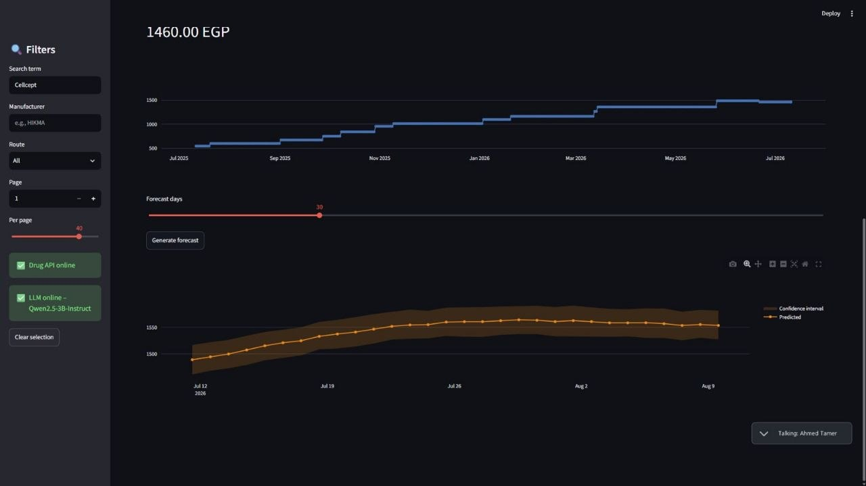
Streamlit Dashboard
🔍 Medicine Search
Search and filter medicines with responsive layout.
📊 Price Charts
Visualize price trends and forecasting graphs.
💊 Drug Details
Detailed medicine information with prediction graphs.
📱 Responsive Layout
Adaptive interface for all screen sizes.

Slide 13
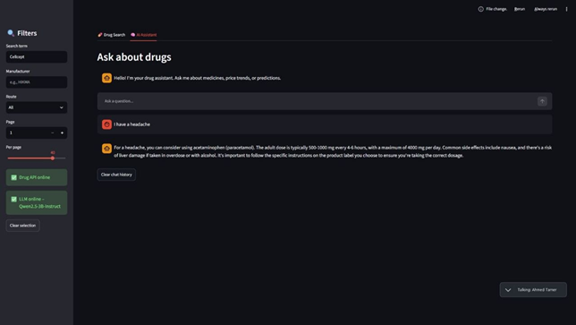

AI Assistant
POWERED BY QWEN 2.5 3B INSTRUCT
Capabilities
Medicine information queries
Symptom guidance
Knowledge-base grounded responses via RAG
Hallucination reduction
Out-of-domain detection
Example: "What are the side effects of paracetamol?" → Grounded, cited response from knowledge base.

Slide 14
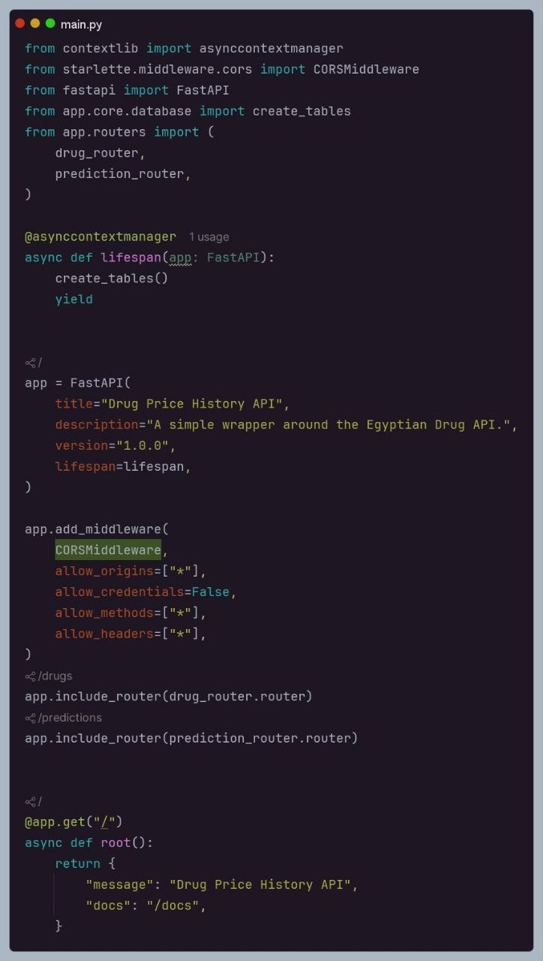

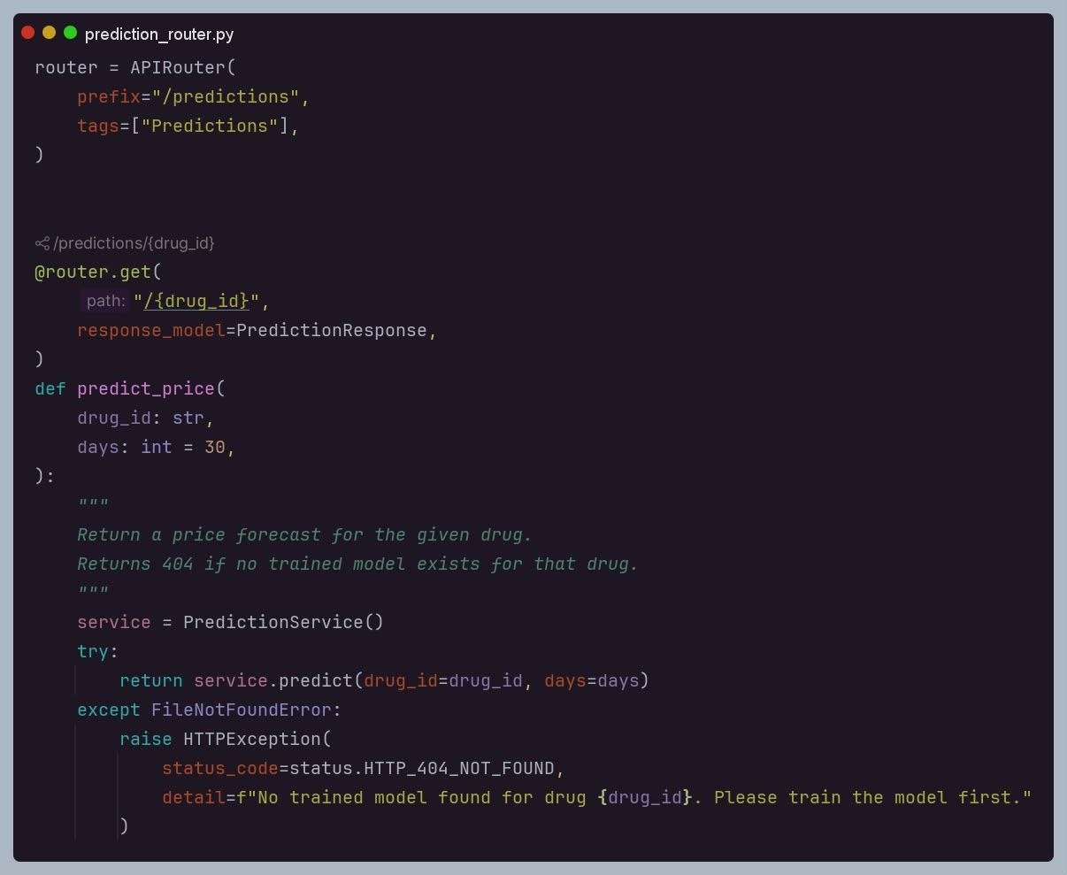
API Endpoints
The REST API exposes four endpoints returning structured JSON responses for drug data, predictions, and chat interactions.
GET /drugs
List all medicines
GET /drugs/{id}
Get drug by ID
GET /predictions/{id}
Fetch price predictions
POST /chat
Send message to AI assistant

Slide 15
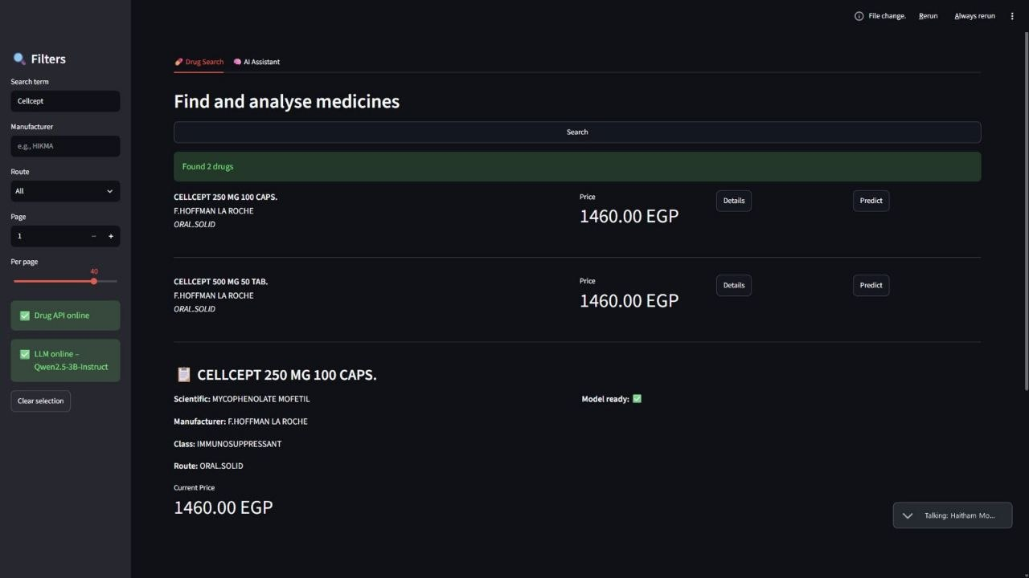

Results
⚡ Fast Response
📈 Accurate Forecasting
Low-latency drug search and API responses across all endpoints.
Machine learning models deliver reliable medicine price predictions.
🤖 Grounded AI
RAG-powered chatbot responses with hallucination reduction and out-of-domain detection.

Slide 16
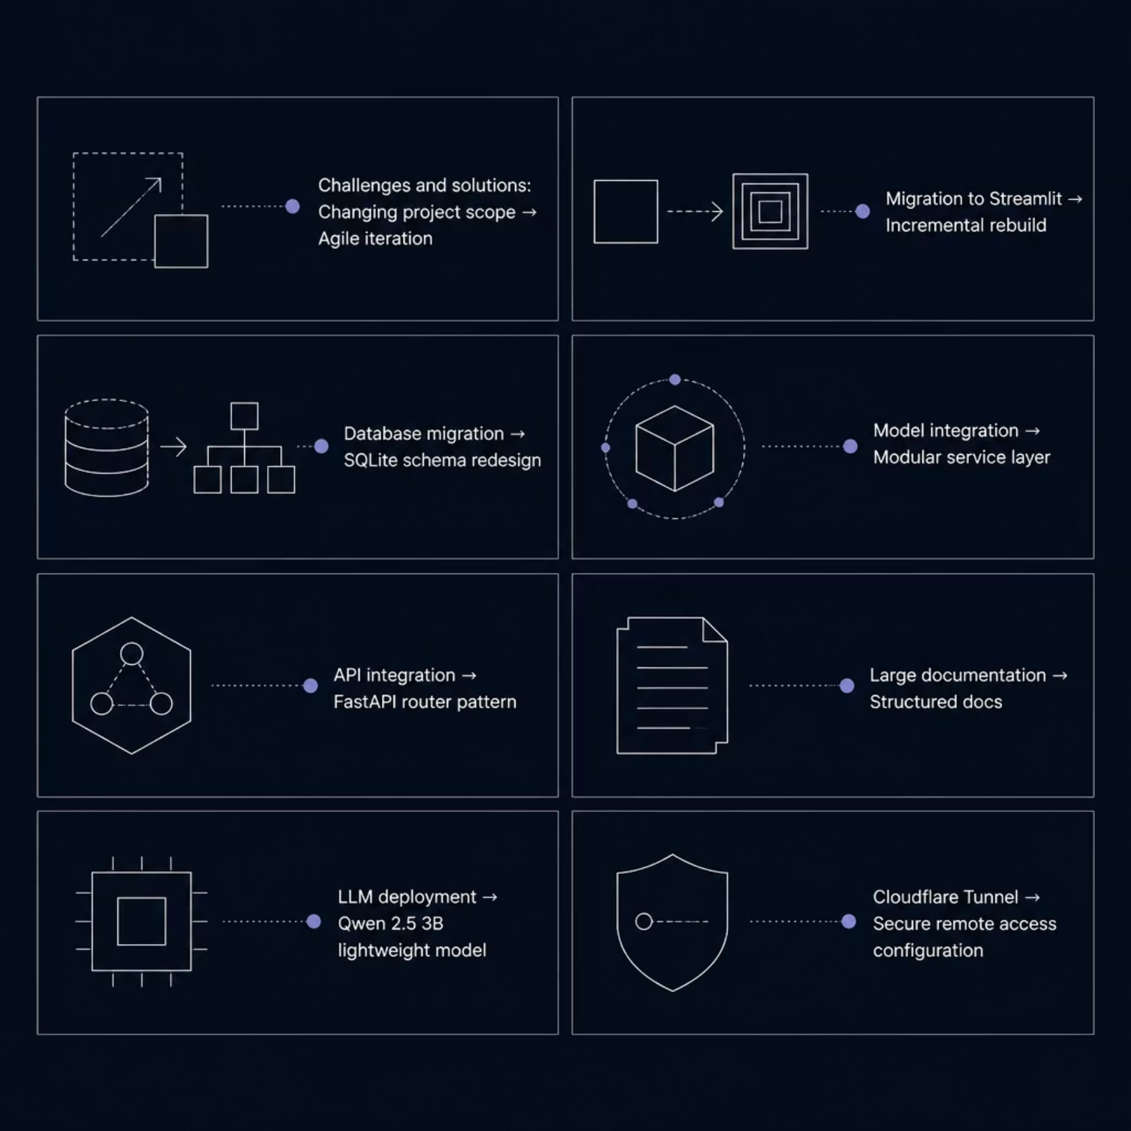
Challenges & Solutions
The project faced several technical hurdles
each addressed with targeted solutions.

Slide 17





Future Improvements
Live Pharmacy Integration
Auth & Notifications
Cloud & Docker
Real-time pricing from pharmacy APIs.
User accounts, authentication, and medicine alerts.
Containerized cloud deployment for scalability.
Mobile & Multilingual
Advanced Forecasting
Mobile app with multilingual chatbot support.
Next-generation ML models for improved price prediction.

Slide 18




Conclusion
This project successfully combines Machine Learning, Artificial Intelligence, FastAPI, Streamlit, and SQLite to build an intelligent medicine price prediction and pharmaceutical assistant platform.
Scalable
Modular
Easy to Extend
Healthcare Oriented

Slide 19
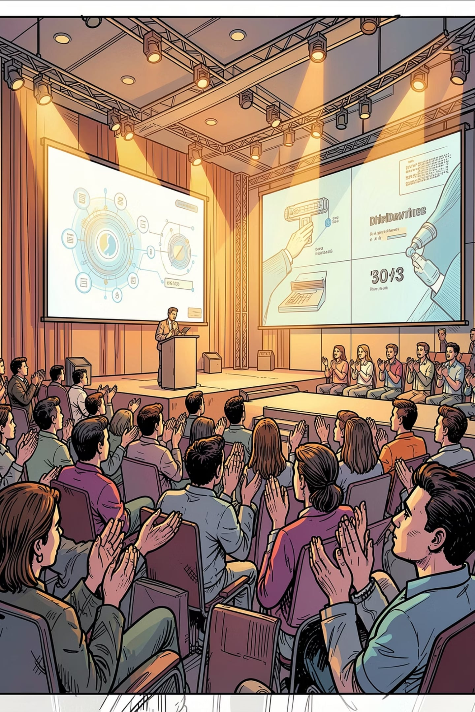
Thank You
Questions?
We appreciate your time and attention. We welcome any questions about the architecture, AI assistant, forecasting models, or future roadmap.

