Slide 1
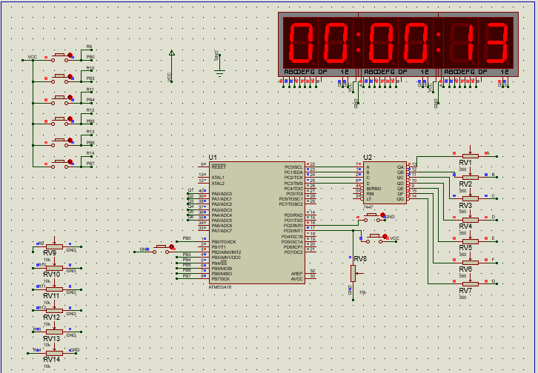
This is the layout of the final project which it’s function once the simulation starts is to be a digital watch that counts from 0 s to 99hr,59min,59s and return again to the 0s.

Slide 2
The other function of this digital watch is it can be a count down stop watch as the user may enter the seconds, minutes and hours and it begins to count down till it reaches the 0s and if this happens it will display zeros and stop the timer at the microcontroller till the user get out of this mode. and when the user breaks the mode it will count again from where it stopped.

Slide 3
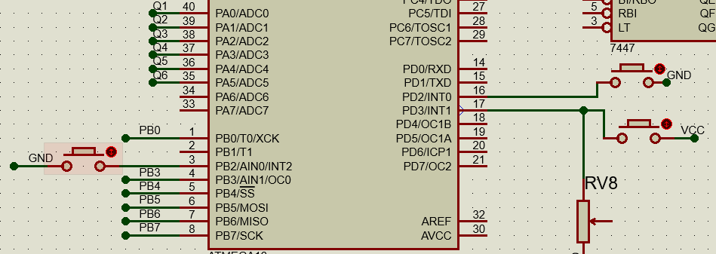
Now lets describe each button functions:
The button connected to PD2 resets the timer and begins to count from the beginning again from 0s.
The button connected to PD3 pauses the watch and stop the timer(the timer clock source will be zero) from counting.
The button connected to PB2 resumes the watch and makes the timer begins to count again from where it stops.

Slide 4
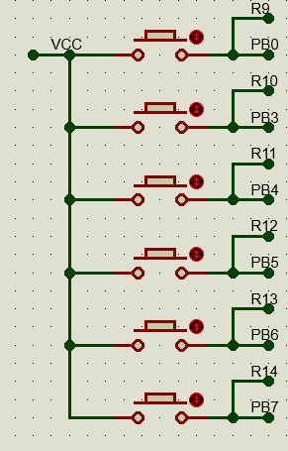
Stops the timer, makes the timer counter TCNT1=0 and swaps to the count down mode
Increment the seconds by 30s every press.
Increment the minutes by 5min every press.
Increment the hours by 1hr every press.
Initiate the count down mode (set the timer clock source) till the watch reaches the 0hr, 0min, 0s and waits the user to get out of the mode .
Break the user from the count down mode and makes the watch count again from where it stopped.

