Slide 1

Financial Times Summary
2025/09/01

Slide 2
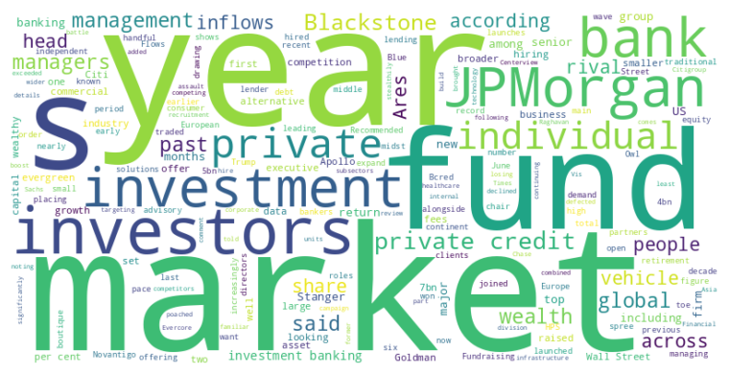
Financial Times Summary
2025/09/01
Headline : Financial giants JPMorgan Chase and private credit funds aggressively expand market reach.
Main Idea : JPMorgan Chase is strategically hiring top talent to dominate key investment banking sectors, while private credit funds are attracting significant investments from wealthy individuals, offsetting institutional slowdowns and marking a new growth frontier in the financial industry.
Subtopics :
- JPMorgan's aggressive hiring of senior bankers to boost market share.
- Surge in individual investments fueling the growth of private credit funds.
- Increased competition and potential impact on returns in the private lending market.
References :
- JPMorgan Chase poaches record number of ... : https://www.ft.com/content/3d613989-5662-461d-a987-49ee02ad6ca5
- Wealthy Americans pour record sums into ... : https://www.ft.com/content/0b3cd961-f748-4c0b-8298-e9329820e244

Slide 3

Financial Times Summary
2025/09/01
Headline : Geopolitical Tensions Rise as Iran, Venezuela, and Gaza Face Internal and External Pressures
Main Idea : Several regions are experiencing escalating tensions due to a combination of internal challenges and external pressures. Iran grapples with internal legitimacy issues and external military threats, Venezuela faces potential US intervention, and Gaza endures intensified Israeli bombardment, leading to dire humanitarian crises and displacement.
Subtopics :
- Iran's internal struggles and response to external threats.
- Venezuela's confrontation with the US and the potential for intervention.
- Escalating violence and humanitarian crisis in Gaza.
References :
- Iran’s new nationalism won’t give its le... : https://www.ft.com/content/e8e945b2-a473-4a0a-8723-37330eb21b9c
- Is Trump’s mission in Venezuela to fight... : https://www.ft.com/content/66251e3a-662e-4427-904d-2dc4304c36b5
- Palestinians flee Israeli bombardment of... : https://www.ft.com/content/75c1819a-9768-4914-be7f-705438c56b82

Slide 4
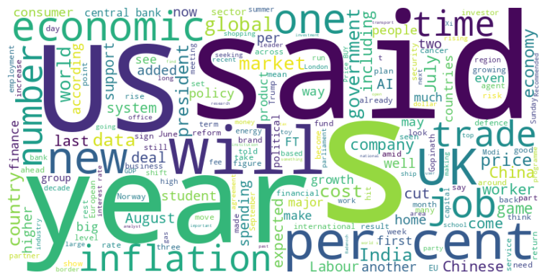
Financial Times Summary
2025/09/01
Headline : Global Economy Faces Headwinds from Trade Wars, Policy Shifts, and Technological Disruption
Main Idea : The global economy is navigating increasing challenges, including trade wars initiated by the Trump administration, shifts in immigration and economic policies affecting labor markets, and the disruptive potential of artificial intelligence. These forces are creating economic uncertainty and pressuring businesses across multiple sectors, from agriculture and manufacturing to shipping and finance.
Subtopics :
- Impact of immigration policy changes on labor markets
- Financial risks and regulation in the face of increasing global debt
- Economic implications of artificial intelligence and automation
References :
- Wisconsin meatpackers face labour shorta... : https://www.ft.com/content/f055fee3-87b0-4ca0-af5a-ea964a6c6d21
- Shipping companies seek non-Chinese fina... : https://www.ft.com/content/0464fa65-3e0e-4e08-9eb4-09c054bcf720
- Will the next US jobs report make a Fed ... : https://www.ft.com/content/62fc0f17-2ac5-4024-8a1d-f807a4d7b668

Slide 5
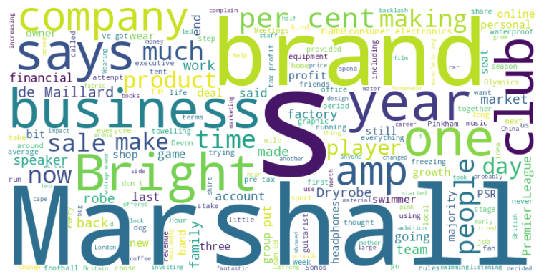
Financial Times Summary
2025/09/01
Headline : Entrepreneurs Find Success Innovating in Niche Markets and Balancing Heritage with Expansion
Main Idea : Innovative entrepreneurs are carving out successful businesses by identifying unmet needs and building strong brands. They face challenges like scaling production, managing growth, balancing tradition with expansion, and maintaining brand integrity in competitive markets.
Subtopics :
- Identifying and capitalizing on niche markets.
- Challenges of scaling production and brand management.
- Balancing heritage and tradition with expansion and innovation.
References :
- Dryrobe CEO Gideon Bright: ‘I wear it pr... : https://www.ft.com/content/cbdc16e0-b697-4ae9-b2c1-ff19da5995e0
- Marshall plan: rock n’ roll amp brand ai... : https://www.ft.com/content/108a309d-c281-4d5d-a762-739853196821
- How FT readers are faring in the Footbal... : https://www.ft.com/content/ee5b2444-9b20-4a38-81a8-6cbe3bf3df2a

Slide 6
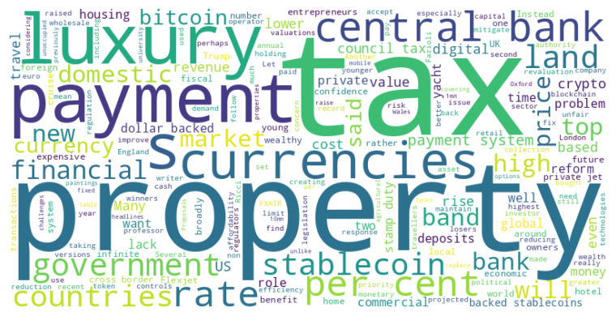
Financial Times Summary
2025/09/01
Headline : Governments and Industries React to Shifting Economic Landscapes: Tax Reforms, Digital Currencies, and Luxury Consumption
Main Idea : Governments globally are grappling with fiscal challenges and the implications of emerging financial technologies like stablecoins, while industries adapt to shifts in consumer behavior driven by the rise of digital assets and new wealth demographics. This includes considerations of tax reforms, responses to digital currency adoption, and the luxury travel sector catering to crypto-affluent clients.
Subtopics :
- Potential tax reforms to address fairness and revenue generation
- The impact of stablecoins on monetary policy and payment systems
- Luxury travel operators adopting cryptocurrency payments for wealthy clients
References :
- Britain needs a wealth tax on property... : https://www.ft.com/content/bb4e7566-4bc6-45c9-87e4-271cc40c66a5
- Stablecoins will force finance to modern... : https://www.ft.com/content/72aa6431-366b-4409-b3ce-9a99d661473d
- Bitcoin boom sees newly wealthy splurgin... : https://www.ft.com/content/da4e36d8-fb82-454f-8448-4db0752ffa68

