Slide 1

Financial Times Summary
2025/08/30

Slide 2
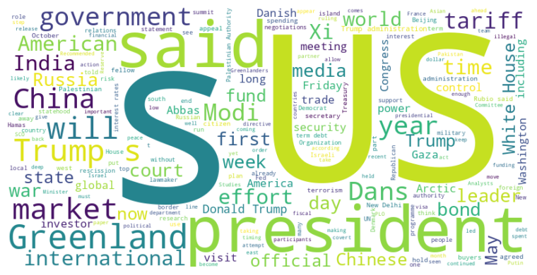
Financial Times Summary
2025/08/30
Headline : Trump Administration Actions Test Limits of Presidential Authority on Multiple Fronts
Main Idea : The Trump administration is aggressively pushing the boundaries of presidential power through various actions, including imposing tariffs, redirecting congressionally approved funds, influencing international relations, and potentially meddling with the Federal Reserve, raising concerns about executive overreach and the erosion of institutional norms.
Subtopics :
- Unlawful tariffs imposed and potential appeal to the Supreme Court.
- Attempting to unilaterally redirect foreign aid funds already approved by Congress.
- Accusations of covert US influence in Greenland and barring Palestinian leader from UNGA.
References :
- Trump’s tariffs ruled illegal by US appe... : https://www.ft.com/content/f3c7deb6-928c-426c-8dbc-574b21b02063
- Donald Trump moves to scrap $4.9bn in al... : https://www.ft.com/content/bb136ab7-c14a-4997-bbd7-88210dcc9e33
- US bars Palestinian leader Mahmoud Abbas... : https://www.ft.com/content/15fb8518-d55f-46cb-aa62-fd2aa2b10272

Slide 3

Financial Times Summary
2025/08/30
Headline : Integrated Summary of News Articles
Main Idea : This is an integrated summary of multiple news articles covering a range of topics, including pharmaceutical approvals, job market challenges for graduates, economic trends, neurological studies on music, financial market dynamics, and corporate strategies across various industries. These articles collectively reflect both advancements in healthcare and economic uncertainties impacting different sectors and demographics.
Subtopics :
- Regulatory approvals and market impact of Alzheimer's drugs
- Challenges faced by UK graduates in a competitive job market
- Strategies and financial performances of companies in diverse sectors
References :
- US regulator approves at-home version of... : https://www.ft.com/content/4147b61e-6cc9-40c2-adb0-18ff97d1c878
- It’s been a terrible year to graduate an... : https://www.ft.com/content/867fba45-3d8e-4d84-bedc-0dd9a4e53a11
- Why are UK borrowing costs so high?... : https://www.ft.com/content/372c13ed-c5ad-4dda-a98e-6474cb37c55f

Slide 4
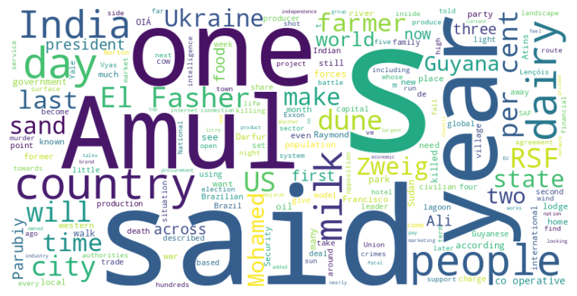
Financial Times Summary
2025/08/30
Headline : Amul's success, rooted in co-operative model and protectionism, faces challenges in balancing farmer welfare and global competition.
Main Idea : Amul, India's largest dairy farm collective, has achieved remarkable success through its co-operative model, which prioritizes farmer ownership and procurement, contributing significantly to India's position as the world's largest milk producer; however, this success is also bolstered by high levels of protection from foreign competition, creating tension in trade negotiations and raising concerns about long-term sustainability and generational engagement.
Subtopics :
- Amul's farmer-centric co-operative model and its historical roots.
- Trade protectionism and its impact on Amul's market dominance.
- Challenges of generational transition and global competition.
References :
- How an Indian farmers’ dairy co-op outpa... : https://www.ft.com/content/d697cd57-e091-4d16-8cc6-787b8bb2e221
- Hiking this national park feels like an ... : https://www.ft.com/content/c7081757-896f-4f0c-8ceb-b8911dd2cca1
- ‘We watch the graveyards from space’: sa... : https://www.ft.com/content/d3313835-71ef-47ab-8111-49fad465acca

