Slide 1

Financial Times Summary
2025/09/03

Slide 2
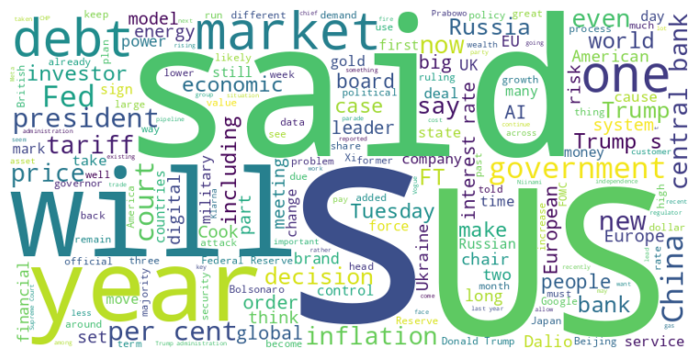
Financial Times Summary
2025/09/03
Headline : Global Economic and Political Tensions Fuel Market Volatility and Policy Shifts
Main Idea : A confluence of events, including US-China trade disputes, political pressure on central banks, and increasing global debt, are creating volatility across markets, prompting policy shifts, and raising concerns about the stability of the existing global economic order.
Subtopics :
- US Trade and Tech Restrictions Impacting Global Chip Manufacturing
- Political Interference and Central Bank Independence Under Threat
- Rising Debt Levels and Potential for Financial Instability
References :
- US curbs TSMC’s tool shipments to China... : https://www.ft.com/content/30f0041d-9095-45fc-84d4-e235f3f1ee43
- The Fed is getting slowly Cooked... : https://www.ft.com/content/883bbfc7-8b70-4ae3-9eea-cbabc038b1d5
- The Avignon Federal Reserve... : https://www.ft.com/content/a6b2dd2e-6bfb-4aea-9d7b-f04f068da704

Slide 3
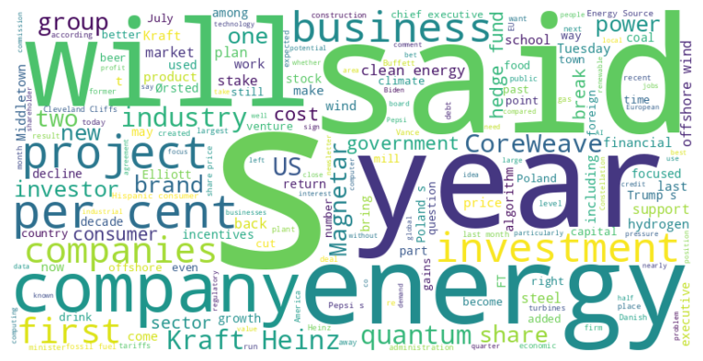
Financial Times Summary
2025/09/03
Headline : Economic Headwinds and Policy Shifts Impact Diverse Industries Globally
Main Idea : Various sectors are facing challenges due to a combination of factors including shifting consumer behavior, changing governmental policies, economic slowdown, and advancements in new technologies like AI and quantum computing, leading to strategic realignments and increased uncertainty.
Subtopics :
- Consumer Demand and Market Shifts
- Policy Changes and Governmental Influence
- Technological Advancements and Strategic Realignments
References :
- Modelo maker hit by lower beer sales to ... : https://www.ft.com/content/9ed54cbc-4a5d-4404-9467-2deb69e34b08
- How JD Vance’s hometown fell foul of Tru... : https://www.ft.com/content/d11fab1f-cd00-4e5f-9474-d5d6e9a7dc77
- Kraft Heinz announces break-up a decade ... : https://www.ft.com/content/326f5a89-c562-46ef-b6c5-1816d55cb39c

Slide 4
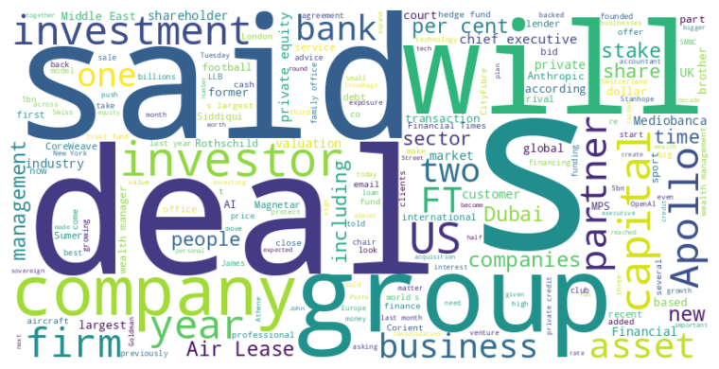
Financial Times Summary
2025/09/03
Headline : Global Finance Sees Wave of Consolidations, Strategic Shifts, and Investment Vehicles Amidst AI Boom and Economic Uncertainties
Main Idea : The financial world is experiencing a surge in consolidation across various sectors, including aircraft leasing, wealth management, and accounting, driven by factors like economies of scale, regulatory pressures, and investor demand. Simultaneously, new investment vehicles are emerging, particularly in sports and AI, while investors are strategically adjusting their portfolios due to geopolitical concerns and potential policy shifts, reflecting a dynamic and evolving global financial landscape.
Subtopics :
- Sector Consolidation: Mergers and acquisitions reshape wealth management, aircraft leasing, and accounting industries.
- Investment Strategy: New funds target sports and AI sectors, while geopolitical uncertainties drive portfolio diversification.
- Financial Maneuvering: Debt financing, asset sales, and internal transitions mark significant strategic shifts within companies.
References :
- Air Lease to be sold for $7.4bn to inves... : https://www.ft.com/content/ad5ac7c5-ddd0-48b3-9e21-cbe11aff5c7d
- US group’s acquisition of top UK wealth ... : https://www.ft.com/content/08101ac3-aaf5-4f54-9d0e-334e8427880b
- AI start-up Anthropic valued at $170bn i... : https://www.ft.com/content/c701ea30-0454-4c7d-a88d-1cf63eb9f008

Slide 5
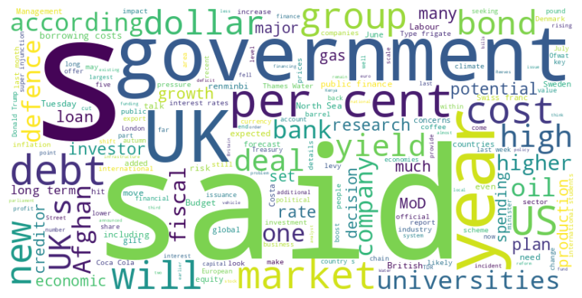
Financial Times Summary
2025/09/03
Headline : Global Economic Concerns Trigger Market Fluctuations and Strategic Shifts
Main Idea : A confluence of factors, including rising bond yields, geopolitical tensions, and fiscal uncertainties, are driving market volatility and prompting strategic shifts in investment and policy, as evidenced by concerns over UK public finances, developing countries seeking alternative currencies, and shifts in energy policy.
Subtopics :
- Concerns over UK fiscal stability and high borrowing costs
- Developing nations' move away from dollar-denominated debt
- Defense spending and international alliances
References :
- Asda owner TDR Capital among suitors cir... : https://www.ft.com/content/b1b660fd-7f6e-4604-8719-896c1922042a
- Jaguar Land Rover says production ‘sever... : https://www.ft.com/content/ba88baca-cd59-48d3-a982-e73c9401b85a
- US stocks fall as bond sell-off spills i... : https://www.ft.com/content/cf711815-09dc-4ef3-8bb7-de6b7cb1fb24

Slide 6
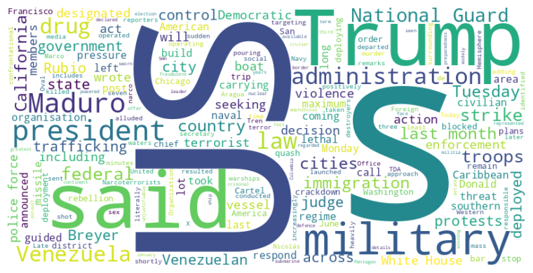
Financial Times Summary
2025/09/03
Headline : US Military Actions Spark Controversy Domestically and Internationally
Main Idea : The Trump administration's use of military force, both domestically and internationally, is generating significant controversy and legal challenges. A US strike against a vessel linked to Venezuelan drug-trafficking and a federal judge blocking the deployment of the National Guard in California highlight the administration's aggressive approach and the pushback it is facing.
Subtopics :
- US military strike against alleged drug vessel from Venezuela
- Federal judge blocks National Guard deployment in California
- Tensions between the US government and Democratic-led cities over military presence
References :
- US strikes ‘drug vessel’ in Caribbean as... : https://www.ft.com/content/fc46d955-a5e6-4b5b-bdde-ba328b8f69b1
- Judge blocks Donald Trump’s deployment o... : https://www.ft.com/content/05a6ea8b-3736-4c26-b982-8b34494bf8dc

