Slide 1

Financial Times Summary
2025/09/02

Slide 2
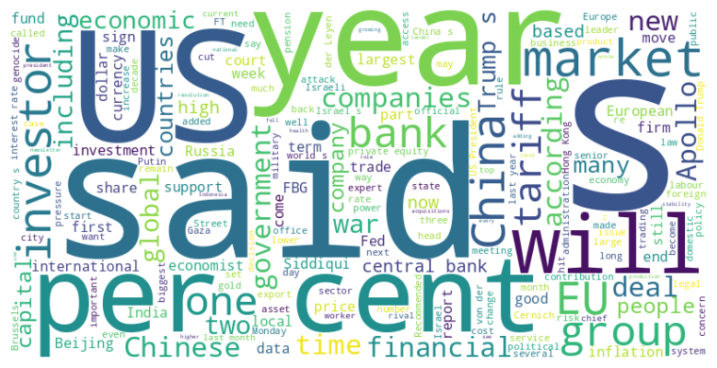
Financial Times Summary
2025/09/02
Headline : Apollo Faces Court Battle Over Alleged Industrial Espionage, Trump's Fed Attacks Threaten US Economy, and EU Trade Deals Hang in the Balance.
Main Idea : This summary covers diverse topics: a private equity firm's legal pursuit of former employees, economists' concerns about political interference with the Federal Reserve, and the EU's struggle to finalize trade agreements amid global tensions and internal disputes.
Subtopics :
- Apollo's lawsuit against former employees for alleged theft of confidential information to start a rival firm
- Economists' fears that Trump's interventions against the Federal Reserve will undermine its independence and destabilize the US economy
- EU's push for new trade deals amid US protectionism and internal opposition from member states
References :
- Apollo bust-up heads to New York trial... : https://www.ft.com/content/f4ba359d-8d56-44c2-aed5-730ff644e217
- Investors underestimate Donald Trump’s t... : https://www.ft.com/content/be7070f5-1db3-4831-974b-f6698ea91da1
- The real significance of the US court ru... : https://www.ft.com/content/81be473e-7270-4138-900c-52c240c80a38

Slide 3
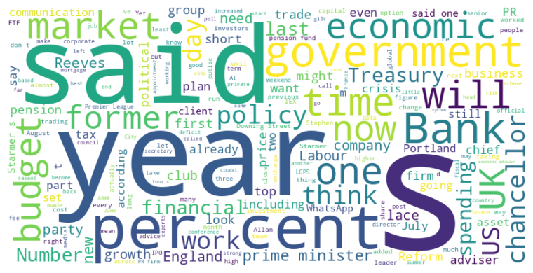
Financial Times Summary
2025/09/02
Headline : Economic shifts and political strategies dominate recent news cycles.
Main Idea : The news highlights significant economic shifts and political strategies across various sectors, from IEX's options market challenge to the resurgence of Royal Mail, the transformation of PR firms, Reform UK's pension proposals, Labour's economic team overhaul, France's political instability, Premier League's spending records and UK media's changing economic narrative.
Subtopics :
- Financial market disruptions and regulatory responses
- Political maneuvering and economic policy debates
- Industry adaptation to evolving market dynamics
References :
- Citadel’s options fight is a battle for ... : https://www.ft.com/content/26026345-4d11-4702-86f8-d6deaf322819
- Royal Mail returns to profit for first t... : https://www.ft.com/content/efcbdba8-bbd1-4651-811e-e55676cfd519
- London’s IPO drought: PRs swap ‘leaks ov... : https://www.ft.com/content/55c2f209-2ed5-41d9-8953-3e763faf92f4

Slide 4

Financial Times Summary
2025/09/02
Headline : Controversies and New Policies Emerge Across US Public Health, Politics, and Technology Sectors
Main Idea : Recent events in the US encompass controversies surrounding vaccine data and leadership within the CDC, new public health regulations in Texas focusing on food labeling and restrictions on SNAP benefits, alongside concerns over authoritarian tendencies within the Trump administration and advancements in AI-driven vaccine research.
Subtopics :
- Turmoil and policy disputes within US health agencies
- New health-focused regulations and potential impacts in Texas
- AI-driven advancements in vaccine research funded by technology leaders
References :
- Trump calls for more Covid vaccine data ... : https://www.ft.com/content/7fd181dc-3c03-41d2-84b8-fa01278af457
- Maha: Making America Held to internation... : https://www.ft.com/content/c9ffc5ce-b45a-4cec-a974-f0841189af91
- Trump’s fawning cabinet and the threat t... : https://www.ft.com/content/4052d80c-b09a-413d-bdc9-990b54293107

Slide 5

Financial Times Summary
2025/09/02
Headline : Revolut and McLaren Racing see significant valuation events with employee share sales and ownership restructuring.
Main Idea : Revolut is allowing employees to sell a portion of their shares at a $75 billion valuation, offering liquidity to staff, while McLaren Racing is undergoing an ownership restructuring valuing the Formula 1 team owner at over £3 billion, underscoring significant financial growth.
Subtopics :
- Revolut employee share sale for future investors.
- McLaren Racing buyout of minority shareholders by Middle Eastern backers.
- Increased valuation driven by performance and F1's broader growth.
References :
- Revolut to allow staff to sell shares at... : https://www.ft.com/content/e158a5fc-6500-48c2-9d98-722cf6812456
- McLaren F1 team owner valued at more tha... : https://www.ft.com/content/0c677a38-dfbc-468f-ad08-6dfee77648cd

