Slide 1

Financial Times Summary
2025/09/01

Slide 2
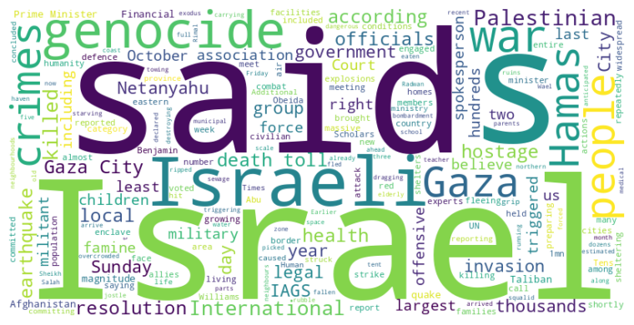
Financial Times Summary
2025/09/01
Headline : Escalating conflict in Gaza prompts mass displacement, genocide allegations, and urgent international scrutiny.
Main Idea : The ongoing conflict in Gaza has intensified with increased Israeli military actions causing mass displacement and a severe humanitarian crisis, while also facing growing allegations of genocide and prompting international organizations to investigate potential war crimes.
Subtopics :
- Intensified Israeli military operations and Palestinian displacement
- Allegations of genocide and war crimes by Israel
- Dire humanitarian conditions and famine in Gaza
References :
- Palestinians flee Israeli bombardment of... : https://www.ft.com/content/75c1819a-9768-4914-be7f-705438c56b82
- Israeli campaign in Gaza meets definitio... : https://www.ft.com/content/470b61ff-aa1c-487f-a9ae-477b5c142a53
- Powerful earthquake hits Afghanistan... : https://www.ft.com/content/eb4b7299-e5c2-44f6-92a4-8dd3229e5d17

Slide 3
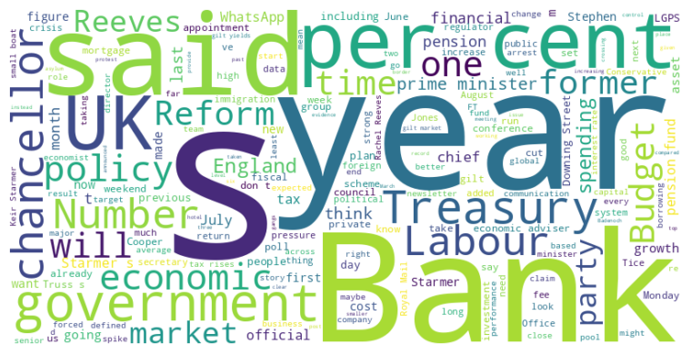
Financial Times Summary
2025/09/01
Headline : UK Politics Grapples with Immigration, Economic Strategies, and Party Reshuffles Amidst Shifting Polls
Main Idea : The UK political landscape is currently defined by pressures on immigration policy amidst rising anti-immigration sentiment and controversies, alongside debates around economic strategies involving fiscal rules, taxation, and central bank influence, while various parties undergo reshuffles and adjustments in leadership and policy stances in response to evolving public opinion and economic challenges.
Subtopics :
- Immigration policy and the challenges of managing small boat arrivals
- Economic policy debates surrounding fiscal rules, taxation, and growth
- Party reshuffles and adjustments in leadership and strategy
References :
- Crossings of small boats to UK in August... : https://www.ft.com/content/4a6d51d5-02c1-4ce6-8e18-fa4c40a8b938
- Royal Mail returns to profit for first t... : https://www.ft.com/content/efcbdba8-bbd1-4651-811e-e55676cfd519
- Reform UK calls for end to ‘egregious’ c... : https://www.ft.com/content/f325a41d-bd4d-45a4-9159-0ff76471c823

Slide 4
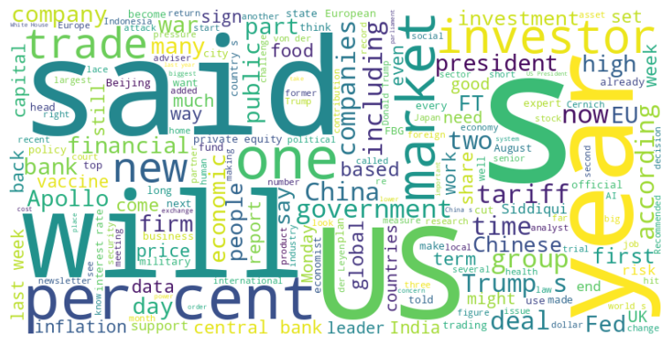
Financial Times Summary
2025/09/01
Headline : Global Events Trigger Political and Economic Instability Across Nations
Main Idea : A confluence of factors including controversial government policies, trade wars, and geopolitical tensions are sparking political unrest, economic uncertainty, and shifts in global power dynamics across various countries.
Subtopics :
- Political turmoil and protests against government policies in Indonesia and France
- Impact of Donald Trump's policies and trade wars on international relations and economic stability
- China's increasing global influence amid US policy shifts
References :
- FirstFT: Indonesian finance minister’s h... : https://www.ft.com/content/d09b4eb5-6e27-4ed7-b954-25950d6af40b
- Crunch time for US economic institutions... : https://www.ft.com/content/34f41017-ebe9-42fa-867f-dd38c2706b60
- Apollo bust-up heads to New York trial... : https://www.ft.com/content/f4ba359d-8d56-44c2-aed5-730ff644e217

