Slide 1

Financial Times Summary
2025/09/01

Slide 2
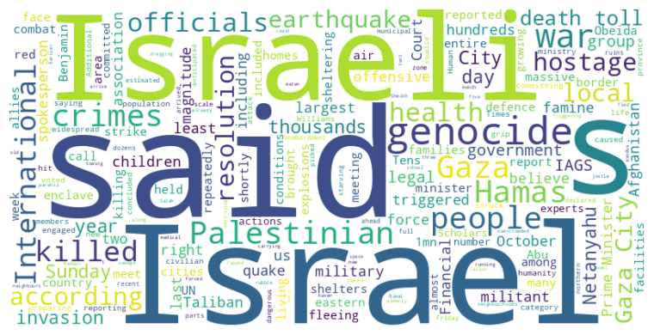
Financial Times Summary
2025/09/01
Headline : Escalating Conflict in Gaza Leads to Famine, Displacement, and Genocide Accusations Amidst New Israeli Offensive
Main Idea : The ongoing conflict in Gaza has intensified, leading to mass displacement, famine, and a mounting death toll as Israeli forces prepare for a new offensive on Gaza City. Accusations of genocide and war crimes have been levied against Israel by international organizations and rights groups, further escalating the crisis and drawing condemnation from around the globe. The situation is exacerbated by the dire humanitarian conditions and the continued holding of Israeli hostages by Hamas.
Subtopics :
- Worsening humanitarian crisis and mass displacement in Gaza
- International accusations of genocide and war crimes against Israel
- Military escalation and planned offensive on Gaza City
References :
- Palestinians flee Israeli bombardment of... : https://www.ft.com/content/75c1819a-9768-4914-be7f-705438c56b82
- Israeli campaign in Gaza meets definitio... : https://www.ft.com/content/470b61ff-aa1c-487f-a9ae-477b5c142a53
- Powerful earthquake hits Afghanistan... : https://www.ft.com/content/eb4b7299-e5c2-44f6-92a4-8dd3229e5d17

Slide 3
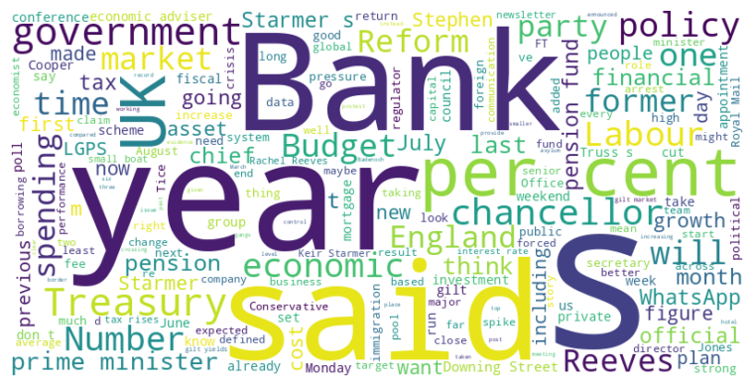
Financial Times Summary
2025/09/01
Headline : UK Politics Grapples with Immigration, Economic Policy, and Party Shifts
Main Idea : The UK political landscape is currently navigating complex issues including fluctuating immigration patterns, economic policy adjustments amid budgetary constraints, and the rise of populist movements influencing traditional party dynamics. The Labour government faces scrutiny over border control and economic strategies, while the Conservative party and Reform UK debate the country's future direction on issues ranging from human rights to pension fund management.
Subtopics :
- Immigration policy and border control controversies
- Economic policy and financial market communication
- Political party strategies and internal dynamics
References :
- Crossings of small boats to UK in August... : https://www.ft.com/content/4a6d51d5-02c1-4ce6-8e18-fa4c40a8b938
- Royal Mail returns to profit for first t... : https://www.ft.com/content/efcbdba8-bbd1-4651-811e-e55676cfd519
- Reform UK calls for end to ‘egregious’ c... : https://www.ft.com/content/f325a41d-bd4d-45a4-9159-0ff76471c823

Slide 4
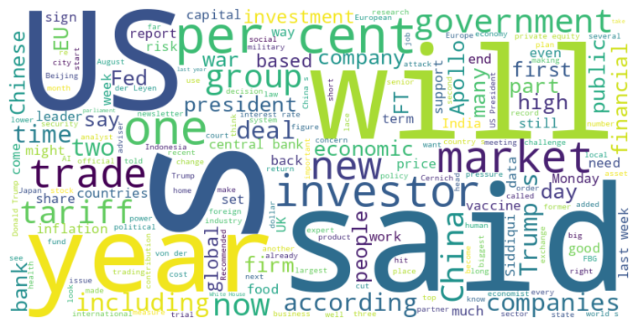
Financial Times Summary
2025/09/01
Headline : Global Unrest and Policy Shifts Drive Market Volatility and Economic Concerns
Main Idea : Several global events, including political instability in Indonesia and France, alongside changing trade policies and challenges to central bank independence, are creating uncertainty and impacting financial markets, economic growth, and investor sentiment.
Subtopics :
- Political Instability and Economic Impact: Protests in Indonesia and potential government collapse in France threaten economic growth and investor confidence.
- Trade Policy and Tariffs: US trade policy adjustments and retaliatory measures impacting various countries, highlighting global trade tensions.
- Central Bank Independence: Concerns grow over political interference with central banks, potentially leading to inflationary pressures and loss of confidence in sovereign debt.
References :
- FirstFT: Indonesian finance minister’s h... : https://www.ft.com/content/d09b4eb5-6e27-4ed7-b954-25950d6af40b
- Crunch time for US economic institutions... : https://www.ft.com/content/34f41017-ebe9-42fa-867f-dd38c2706b60
- Apollo bust-up heads to New York trial... : https://www.ft.com/content/f4ba359d-8d56-44c2-aed5-730ff644e217

