Slide 1
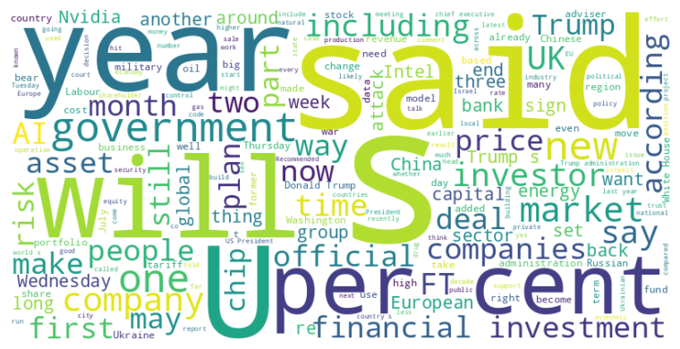
Headline: Integrated Summary of Diverse News Articles
Main Idea: This summary covers a range of pressing issues from political accusations and economic anxieties to social disruptions and geopolitical tensions, highlighting the complex and interconnected nature of current global events. The news includes Donald Trump's accusations against George Soros, market instability due to reinsurance and corporate actions, and global concerns ranging from the use of AI to the war in Ukraine.
Subtopics:
- Trump's legal threats and accusations against political opponents
- Market volatility due to new entrants in reinsurance and corporate controversies
- Social and economic impacts of AI and new tech
- Geopolitical tensions involving the US, Russia, China, and Iran
- Political and regulatory interference in corporate affairs
References:
- Donald Trump says George Soros should be charged with racketeering : https://www.ft.com/content/8a98f49e-1df5-4619-b2ee-9a0ed9538c68
- Hedge funds’ insurance binge threatens catastrophe cover, warns Munich Re : https://www.ft.com/content/573a537c-adf7-4373-a8cd-4ef60513eb23
- How US restaurant chain Cracker Barrel became a Maga lightning rod : https://www.ft.com/content/a1d338f1-30ba-4f1f-8092-12c046adf445

Slide 2
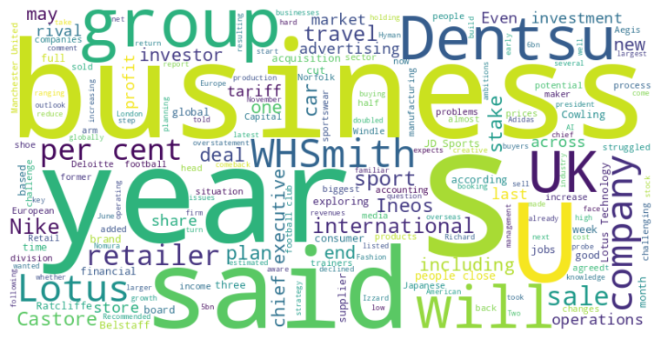
Headline: Various companies face restructuring, sales, and challenges amidst market shifts.
Main Idea: Several companies are undergoing significant changes, including potential sales of business units, restructuring efforts involving job cuts, and responses to accounting irregularities and shifting market dynamics, particularly influenced by economic conditions and emerging technologies.
Subtopics:
- Dentsu explores selling its international business due to poor performance and AI's impact.
- WHSmith faces a profit overstatement probe impacting its valuation and leadership.
- Nike and JD Sports face market realities despite stock rebounds, while Ineos sells Belstaff.
- Lotus plans job cuts in the UK amidst restructuring and global market changes.
References:
- Advertising group Dentsu explores sale of international business : https://www.ft.com/content/cc3dbb7b-183e-4577-8593-ea63cacd1bc6
- WHSmith backs CEO as it probes damaging accounting errors : https://www.ft.com/content/703cad52-8c94-44b0-8603-7e4cea9bd281
- Sports shoe sellers are heading for a stumble : https://www.ft.com/content/60a224f6-79f2-4b53-903b-770416092713

