Slide 1
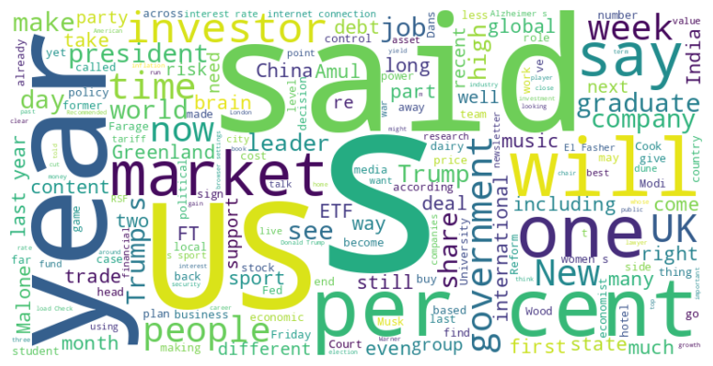
Headline: Financial Times Analyzes Trends in Investing, Healthcare, Politics, and More
Main Idea: This compilation of articles from the Financial Times explores diverse topics, from investment strategies in media and cryptocurrency to political developments, healthcare advancements, and societal trends, painting a picture of the current global landscape and potential future shifts.
Subtopics:
- Activist investing in media companies like The New York Times and the integration of AI in content creation
- Regulatory approval and market impact of Alzheimer's drug Leqembi, alongside advancements in early detection blood tests
- Political actions, including US visa denials to Palestinian leaders and the debate over governmental norms and the role of leadership
- Economic challenges faced by experts, the rise of populism, and its impact on various sectors.
- The shift to sustainability across business sectors.
References:
- New York Times activist could be good news for investors : https://www.ft.com/content/aded0d83-0a63-49bd-8670-63cc8e4d20be
- US regulator approves at-home version of Alzheimer’s drug Leqembi from Eisai and Biogen : https://www.ft.com/content/4147b61e-6cc9-40c2-adb0-18ff97d1c878
- US bars Palestinian leader Mahmoud Abbas from UN meeting to recognise state : https://www.ft.com/content/15fb8518-d55f-46cb-aa62-fd2aa2b10272

Slide 2
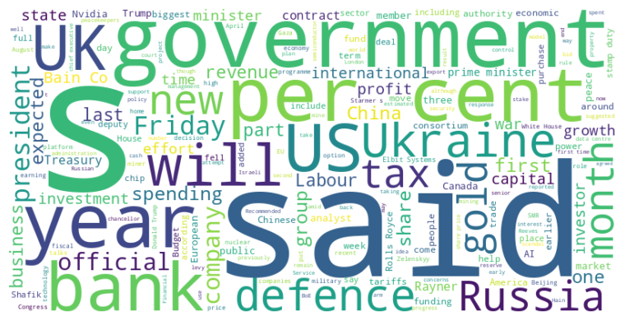
Headline: Government Policies and Economic Shifts Trigger Market Volatility and Debates
Main Idea: Recent government actions, including tariffs, spending cuts, and economic policy shifts, are creating market uncertainty and sparking debates over presidential authority, fiscal responsibility, and the direction of key sectors such as technology, defense, and finance, impacting both domestic and international economic landscapes.
Subtopics:
- Challenges to presidential authority through tariff disputes and spending rescissions.
- Impact of tariffs and economic policies on international trade and economic growth.
- Market reactions to sector-specific challenges in tech, finance, and defense industries.
References:
- Trump’s tariffs ruled illegal by US appeals court but stay in place : https://www.ft.com/content/f3c7deb6-928c-426c-8dbc-574b21b02063
- Donald Trump moves to scrap $4.9bn in already allocated US foreign aid : https://www.ft.com/content/bb136ab7-c14a-4997-bbd7-88210dcc9e33
- Donald Trump ‘proposed Chinese peacekeepers’ for Ukraine : https://www.ft.com/content/dc6488e9-b853-4abe-b257-71a2e8a5c35b

