Slide 1
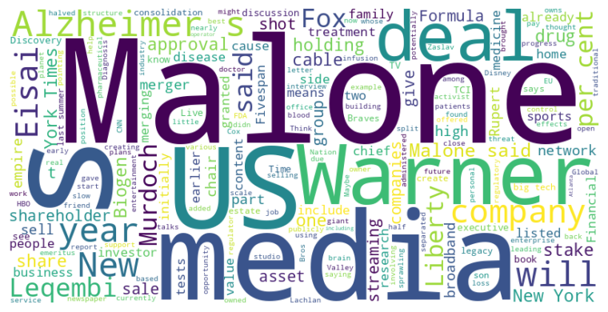
Headline: Media and Healthcare Sectors Face Activist Investors, Regulatory Changes, and Potential Mergers
Main Idea: Several sectors are undergoing significant shifts driven by activist investor pressure, regulatory approvals, and the possibility of large-scale mergers. These changes are impacting established business models and creating both opportunities and challenges for major players in the media, pharmaceutical, and telecommunications industries.
Subtopics:
- Activist investors seek to increase value in media companies through AI integration and optimized pricing strategies.
- Regulatory approval and at-home administration of Alzheimer's drug Leqembi impacts pharmaceutical companies' sales and market competition.
- Media landscape consolidation driven by streaming challenges, tech competition, and potential mergers of major players like Warner Bros. Discovery, Fox, Disney, and Paramount.
References:
- New York Times activist could be good news for investors : https://www.ft.com/content/aded0d83-0a63-49bd-8670-63cc8e4d20be
- US regulator approves at-home version of Alzheimer’s drug Leqembi from Eisai and Biogen : https://www.ft.com/content/4147b61e-6cc9-40c2-adb0-18ff97d1c878
- John Malone held talks with Rupert Murdoch over Warner Bros-Fox merger : https://www.ft.com/content/3a32fdcb-1248-4721-8269-2867dc5e4d78

Slide 2
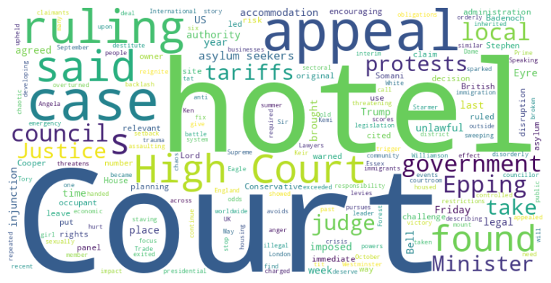
Headline: Appeals courts address legality of Trump-era tariffs and asylum seeker housing, leaving both in temporary limbo.
Main Idea: Appeals courts have recently delivered rulings on two politically charged issues: Trump-era tariffs and the housing of asylum seekers. While a court found many of the tariffs unlawful, it temporarily stayed the decision pending a potential Supreme Court appeal; similarly, a court overturned an injunction against housing asylum seekers in a specific hotel, though the underlying legal challenge persists.
Subtopics:
- Trump administration tariffs and presidential authority
- UK government's accommodation of asylum seekers and local council challenges
- Judicial reasoning regarding the impact of protests and practical challenges of relocation
References:
- Trump’s tariffs ruled illegal by US appeals court but stay in place : https://www.ft.com/content/f3c7deb6-928c-426c-8dbc-574b21b02063
- Court of Appeal overturns Essex hotel ban on asylum seekers : https://www.ft.com/content/f70c6bda-4abb-4e65-a8a1-a641bad97ac8

Slide 3
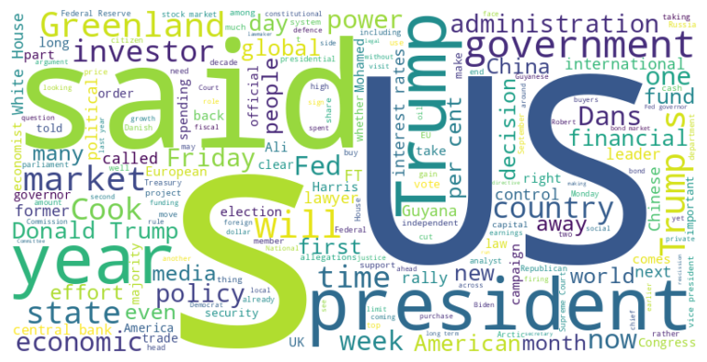
Headline: Trump's Actions Test Presidential Power Limits and Stir Global Economic Uncertainty
Main Idea: Donald Trump's recent actions, including rescinding approved foreign aid, challenging the Federal Reserve's independence, and influencing Greenland's affairs, demonstrate an aggressive assertion of presidential power, raising concerns about the erosion of institutional norms and potential global economic instability. These moves have sparked legal challenges, congressional opposition, and debates over the appropriate boundaries of executive authority, while also creating uncertainty in financial markets.
Subtopics:
- Rescission of approved foreign aid and congressional pushback
- Trump's interference with the Federal Reserve and market reactions
- Covert and overt US influence in Greenland and Danish relations
References:
- Donald Trump moves to scrap $4.9bn in already allocated US foreign aid : https://www.ft.com/content/bb136ab7-c14a-4997-bbd7-88210dcc9e33
- Donald Trump ends Secret Service protection for Kamala Harris : https://www.ft.com/content/95fef500-a952-4e99-89ed-ce2420358fe3
- Donald Trump urges judge to deny Lisa Cook’s appeal to remain at Fed : https://www.ft.com/content/499b9db0-6cdf-4a5f-8cd0-6a0839efa7ce

Slide 4
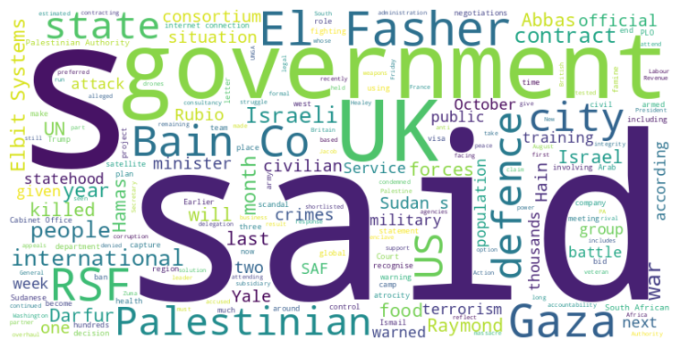
Headline: International Community Grapples with Complex Conflicts and Humanitarian Crises in Palestine, Sudan, and Beyond
Main Idea: Several geopolitical hotspots are experiencing escalating tensions and dire humanitarian situations, prompting international scrutiny and debate over appropriate responses, including visa restrictions, arms contracts, and humanitarian aid; these crises raise questions about international accountability, human rights, and the effectiveness of existing intervention strategies.
Subtopics:
- US barring Mahmoud Abbas from UNGA amidst Palestinian statehood recognition efforts
- Controversy over UK military contract with company linked to Israeli war in Gaza and consultant involved in South African corruption scandal
- Imminent catastrophe in Sudan's El Fasher due to RSF siege and potential for ethnic cleansing
References:
- US bars Palestinian leader Mahmoud Abbas from UN meeting to recognise state : https://www.ft.com/content/15fb8518-d55f-46cb-aa62-fd2aa2b10272
- UK under pressure over controversial bidders for MoD training contract : https://www.ft.com/content/b46d135b-8d83-4f69-b5ba-51ced7cb2edd
- ‘We watch the graveyards from space’: satellites track Sudanese city under siege : https://www.ft.com/content/d3313835-71ef-47ab-8111-49fad465acca

Slide 5
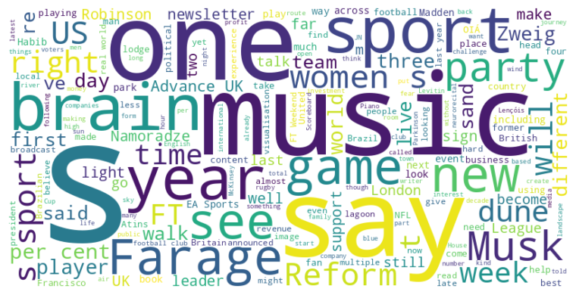
Headline: Synthesizing Words and Actions: A Critical Look at Politics, Business, and Sports
Main Idea: This collection of articles scrutinizes the pervasive gap between rhetoric and reality across various sectors, including politics, business, sports, and even the arts. It emphasizes the need for tangible action and meaningful impact, rather than mere promises and superficial gestures, to achieve real progress and maintain credibility.
Subtopics:
- The prevalence of empty promises and inaction in politics and business
- The importance of aligning words with concrete actions in sports and personal endeavors
- Exploring the convergence of gaming and live sports, and harnessing music's therapeutic power in healthcare
References:
- It’s time to shut up and get on with it : https://www.ft.com/content/3bddbe64-bbf0-4775-9071-f037583584dd
- Can a UK party backed by Elon Musk outflank Nigel Farage on the right? : https://www.ft.com/content/27c3321a-9b07-4e9f-a55e-07c7d3900908
- Hiking this national park feels like an escape to another universe : https://www.ft.com/content/c7081757-896f-4f0c-8ceb-b8911dd2cca1

Slide 6
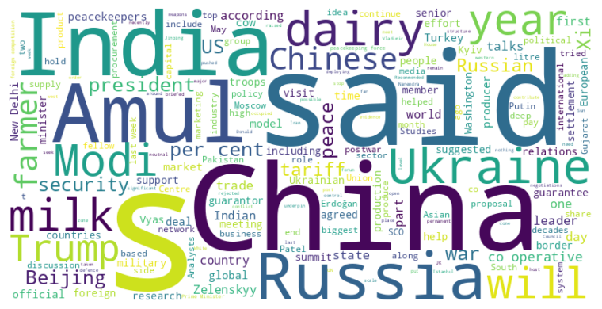
Headline: Diverse Visions for Global Order Emerge Amidst Geopolitical Tensions and Trade Disputes
Main Idea: Several global powers are pursuing alternative international orders, highlighted by discussions of Chinese peacekeeping in Ukraine and the strengthening of the Shanghai Cooperation Organization as a counterpoint to Western dominance, while trade disputes complicate relationships and countries seek to balance their strategic interests.
Subtopics:
- China's potential role in Ukraine peace talks and peacekeeping
- The Shanghai Cooperation Organization as an alternative global order
- India's balancing act between US trade tensions and engagement with China
References:
- Donald Trump ‘proposed Chinese peacekeepers’ for Ukraine : https://www.ft.com/content/dc6488e9-b853-4abe-b257-71a2e8a5c35b
- Xi Jinping to host Vladimir Putin and Narendra Modi as China presents rival front to US : https://www.ft.com/content/58bf303e-ff10-442b-a527-dc61ba6c7eca
- How an Indian farmers’ dairy co-op outpaced global giants : https://www.ft.com/content/d697cd57-e091-4d16-8cc6-787b8bb2e221

Slide 7
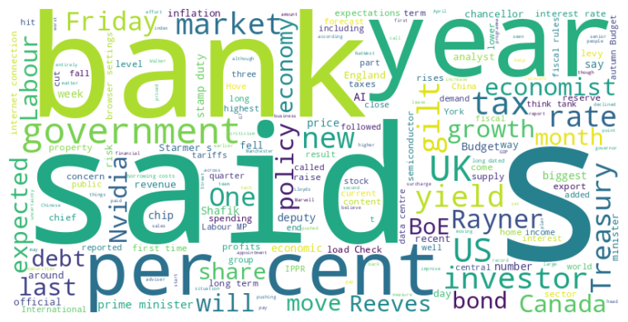
Headline: Global Economic Trends Show Weakness in Canada, Tech Sector Concerns in US, and Fiscal Challenges in the UK.
Main Idea: Recent economic news reveals challenges across multiple countries, including a contraction in Canada's economy due to trade tensions, anxieties surrounding the artificial intelligence sector's growth impacting US tech stocks, and mounting concerns in the UK regarding potential tax hikes and rising borrowing costs.
Subtopics:
- Canadian economic contraction due to US tariffs and export decline
- US tech sector downturn driven by AI spending concerns and export limitations
- UK fiscal challenges from potential tax hikes, high borrowing costs, and political pressures
References:
- Canada’s GDP shrinks more than expected as Donald Trump’s tariffs hit : https://www.ft.com/content/e089f4cb-ff20-4323-a43c-97551a3f98d7
- US tech stocks drop as AI uncertainty knocks chip groups : https://www.ft.com/content/2b3b51d1-b9e1-4b7c-a262-ae531f621fef
- UK banks suffer sell-off over fears of tax rises : https://www.ft.com/content/f49f8996-0b22-4d19-a0d1-33c22614c231

Slide 8
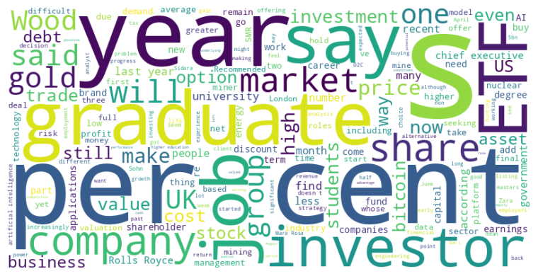
Headline: Diverse Market Trends Emerge as Companies Grapple with Debt, Competition, and Innovation
Main Idea: Several companies are facing unique challenges, from Wood Group's debt crisis leading to a discounted takeover and AJ Bell's market share growth to graduate job scarcity amidst technological advancements and corporate Bitcoin strategies, illustrating a dynamic and complex economic landscape.
Subtopics:
- Wood Group's debt-driven acquisition and regulatory scrutiny
- AJ Bell's competitive advantage and market share growth
- Graduate job market squeeze due to economic factors and AI influence
References:
- Wood Group recommends £216mn offer from Sidara : https://www.ft.com/content/b9b5f604-6de0-4cd5-9b9c-5ae4193cfd6a
- Directors’ Deals: AJ Bell chief executive takes advantage of share price rise : https://www.ft.com/content/f98cf469-6957-4a2d-b647-dbc2caff1c1a
- Stockpickers: Hochschild Mining, Boohoo, Bunzl : https://www.ft.com/content/3bea2968-20b7-4e3e-b047-a5cdba80ef55

