Slide 1
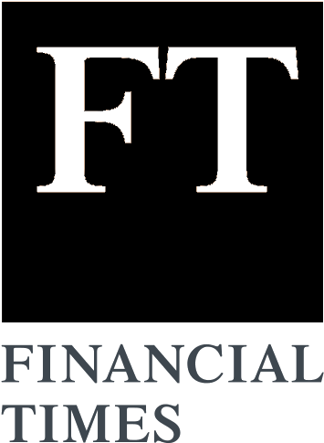
Financial Times Summary
2025/08/30

Slide 2
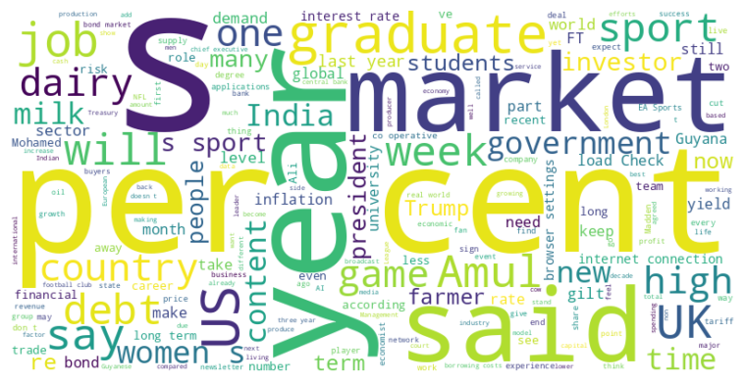
Financial Times Summary
2025/08/30
Headline : Global Economic and Industry Trends Face Political and Financial Pressures
Main Idea : Several global economic and industry trends are being shaped by political interventions, financial vulnerabilities, and competitive pressures. These factors include trade disputes, monetary policy interference, market instability, and the struggle of graduates to find employment.
Subtopics :
- Impact of political interference on monetary policy and market stability
- Challenges and opportunities in the Indian dairy industry amidst global trade tensions
- Difficulties faced by UK graduates entering a competitive job market
References :
- Trump’s tariffs ruled illegal by US appe... : https://www.ft.com/content/f3c7deb6-928c-426c-8dbc-574b21b02063
- Trump’s Fed meddling pushes investors cl... : https://www.ft.com/content/5e614112-e51a-414f-9030-9876235a1b28
- How an Indian farmers’ dairy co-op outpa... : https://www.ft.com/content/d697cd57-e091-4d16-8cc6-787b8bb2e221

Slide 3
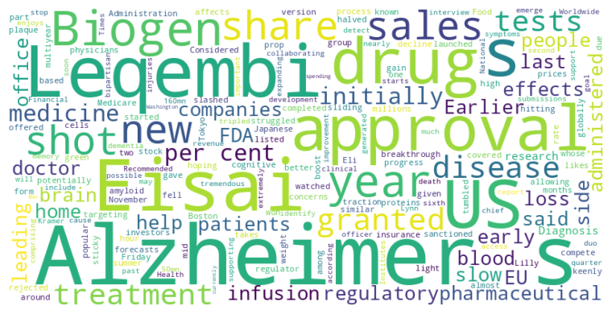
Financial Times Summary
2025/08/30
Headline : FDA approves at-home Leqembi shot for Alzheimer's, aiming to improve accessibility and sales.
Main Idea : The FDA has approved an at-home injectable version of Leqembi, an Alzheimer's drug developed by Eisai and Biogen, to improve accessibility and potentially boost sales after initial challenges with uptake. This approval is expected to provide a more convenient administration method for patients who have completed 18 months of infusions and increase competition with other Alzheimer's treatments.
Subtopics :
- Leqembi's shift from infusion to at-home injection
- Financial implications for Eisai and Biogen
- Impact of early Alzheimer's detection on treatment
References :
- US regulator approves at-home version of... : https://www.ft.com/content/4147b61e-6cc9-40c2-adb0-18ff97d1c878

Slide 4
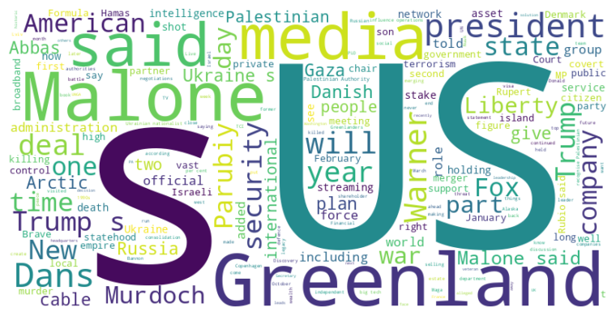
Financial Times Summary
2025/08/30
Headline : International tensions rise as US blocks Palestinian leader's visa, covert operations in Greenland are alleged, and Ukrainian politician assassinated.
Main Idea : Multiple international events, including the US barring Mahmoud Abbas from the UN General Assembly, allegations of US covert influence in Greenland, and the assassination of Andriy Parubiy in Ukraine, are contributing to increased global tensions and uncertainty.
Subtopics :
- US-Palestinian relations deteriorate amid statehood recognition efforts.
- Allegations of US influence operations in Greenland strain relations with Denmark.
- Political assassination in Ukraine highlights ongoing conflict and instability.
References :
- US bars Palestinian leader Mahmoud Abbas... : https://www.ft.com/content/15fb8518-d55f-46cb-aa62-fd2aa2b10272
- The pro-Trump influencer making waves in... : https://www.ft.com/content/b2aa1d3d-6dbc-44a0-aba4-83b43182ddce
- John Malone held talks with Rupert Murdo... : https://www.ft.com/content/3a32fdcb-1248-4721-8269-2867dc5e4d78

Slide 5
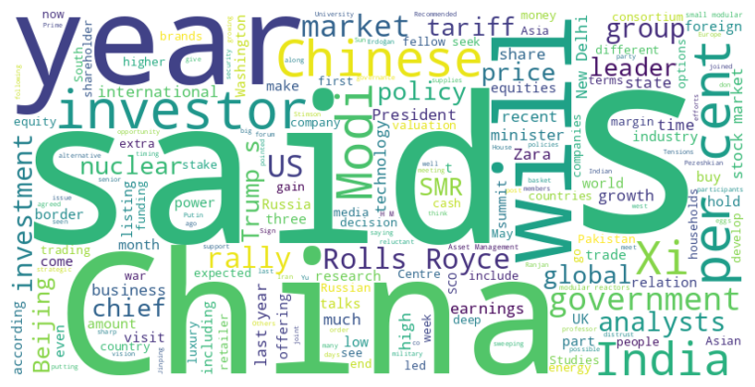
Financial Times Summary
2025/08/30
Headline : China, Rolls-Royce Nuclear, and Shifting Luxury Markets Highlight Global Economic Trends
Main Idea : Recent developments across various sectors, from China's geopolitical positioning and domestic stock market rally to Rolls-Royce's nuclear ambitions and shifts in the luxury goods market, showcase evolving global economic trends driven by political tensions, monetary policies, and changing consumer preferences.
Subtopics :
- China's pursuit of an alternative global order and domestic market surge.
- Rolls-Royce explores options for its small modular nuclear reactor business.
- Luxury market dynamics change as affordability impacts sales and mass-market brands step in.
References :
- Xi Jinping to host Vladimir Putin and Na... : https://www.ft.com/content/58bf303e-ff10-442b-a527-dc61ba6c7eca
- China’s stock market outpaces global pee... : https://www.ft.com/content/97578194-435b-420e-a410-8f0102700fba
- Rolls-Royce explores small nuclear react... : https://www.ft.com/content/234b4c2e-5e1a-46ba-82fd-472e271a289f

Slide 6
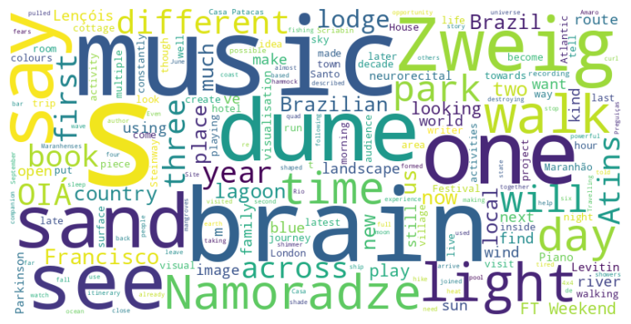
Financial Times Summary
2025/08/30
Headline : Exploration of Brazil's natural beauty and neuroscience reveals the power of immersive experiences.
Main Idea : The article explores the captivating landscape of Lençóis Maranhenses National Park in Brazil, reminiscent of Stefan Zweig's idealistic vision of the country, while also examining innovative approaches in neuroscience using music to visualize brain activity and address neurological conditions.
Subtopics :
- Travel through Brazil's Lençóis Maranhenses National Park
- The evolving intersection of neuroscience and music
- Therapeutic applications of music for neurological disorders
References :
- Hiking this national park feels like an ... : https://www.ft.com/content/c7081757-896f-4f0c-8ceb-b8911dd2cca1
- Why Beethoven is good for your brain... : https://www.ft.com/content/5618fe95-a048-464d-8ff9-8bab7e5eff09

Slide 7
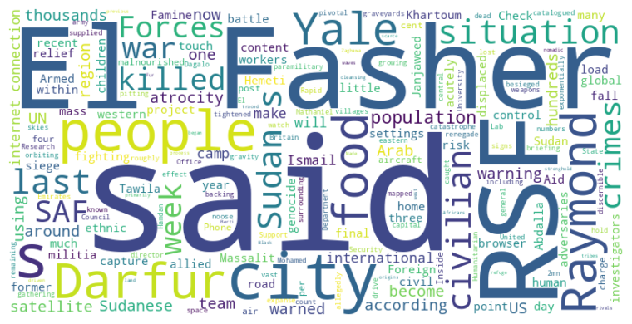
Financial Times Summary
2025/08/30
Headline : El Fasher faces imminent catastrophe as RSF siege intensifies, threatening mass atrocities and famine.
Main Idea : The Sudanese city of El Fasher is on the brink of collapse due to a relentless siege by the Rapid Support Forces (RSF), leading to widespread famine, potential war crimes, and ethnic cleansing, with warnings of mass atrocities echoing previous devastating events in Darfur, while the international community's response remains inadequate.
Subtopics :
- RSF siege and military advancements
- Humanitarian crisis and famine conditions
- International inaction and warnings of genocide
References :
- ‘We watch the graveyards from space’: sa... : https://www.ft.com/content/d3313835-71ef-47ab-8111-49fad465acca

Slide 8
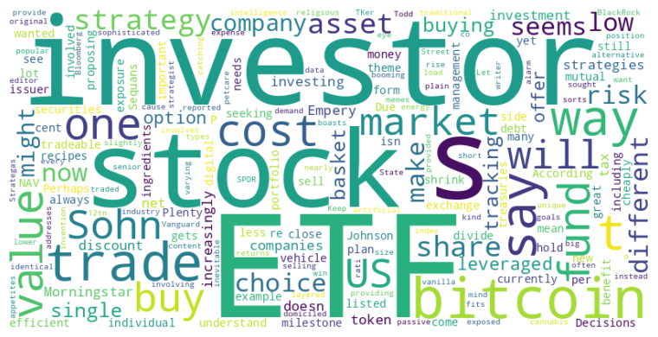
Financial Times Summary
2025/08/30
Headline : ETF market surpasses individual stocks, while companies explore Bitcoin treasuries with varying success.
Main Idea : The ETF market has expanded significantly, offering diverse investment options but also creating complexity and potential risks for investors; simultaneously, some companies are adopting Bitcoin treasury strategies, with varying outcomes based on market valuation and strategic decisions.
Subtopics :
- ETF market growth and investor choice overload
- Risks and considerations in ETF investing
- Bitcoin treasury strategies and company valuation
References :
- Of course, there are more ETFs than indi... : https://www.ft.com/content/0907462a-363b-46bf-94d9-59249f16106a
- Why bad bitcoin treasuries could make th... : https://www.ft.com/content/f448ba4f-3012-4acc-b331-0ebdc1b016ee

