Slide 1

Headline: Climate Alliances and Renewable Energy Investments Face Challenges Amid Political and Economic Shifts
Main Idea: The Net-Zero Banking Alliance is struggling with membership retention and internal divisions, while renewable energy investments, particularly in the US wind sector, are facing headwinds due to political opposition, rising costs, and policy uncertainties, potentially shifting investment towards Europe.
Subtopics:
- Decline of Net-Zero Banking Alliance
- Trump administration's impact on US renewable energy
- Shifting investment landscape favoring Europe
References:
- Climate banking group pauses activities amid rising political pressure : https://www.ft.com/content/5bba361e-aae4-4d1e-b077-eebb340ede81
- Surging US electricity prices put Trump pledge in jeopardy : https://www.ft.com/content/689243af-865f-4330-a9bb-ce7a9a114f40
- European green investment stands to gain at the US’s expense : https://www.ft.com/content/2e3ee55b-f956-415d-9ad0-89d85a6bb260

Slide 2

Headline: Trump's actions spark concerns over Federal Reserve independence and UK borrowing costs.
Main Idea: Former President Trump's attempts to exert influence over the Federal Reserve, coupled with his rhetoric against George Soros, raise alarms about the politicization of institutions and potential threats to economic stability. Simultaneously, rising UK borrowing costs, exacerbated by global bond yield increases and domestic economic concerns, create additional financial pressures.
Subtopics:
- Trump's efforts to influence the Federal Reserve and potential consequences
- Trump's attacks on George Soros and concerns about intimidation of political opponents
- Rising UK borrowing costs and pressure on the Autumn Budget
References:
- The next stage of the Fed takeover : https://www.ft.com/content/ca65e559-fe04-4ce5-96ad-383197e9d7bd
- Donald Trump says George Soros should be charged with racketeering : https://www.ft.com/content/8a98f49e-1df5-4619-b2ee-9a0ed9538c68
- Winning elections is the only curb against strongmen : https://www.ft.com/content/8ccb051e-6637-4bc3-991a-5c768df03dd5

Slide 3
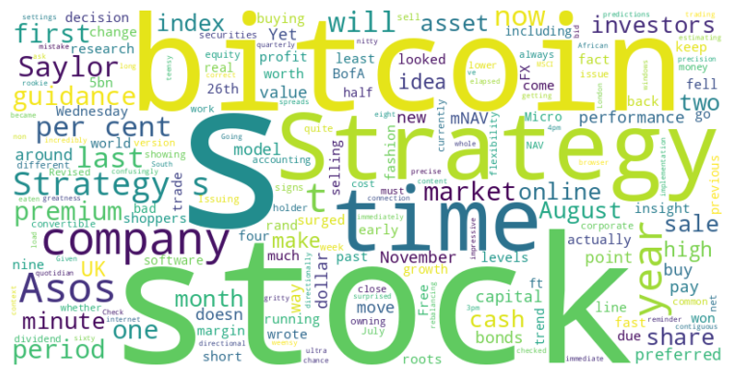
Headline: Financial News Roundup: BofA's FX Success, Asos' Index Exit, and MicroStrategy's Shifting Strategy
Main Idea: This collection of articles covers diverse financial topics, including Bank of America's successful FX trading strategy, Asos' removal from the FTSE 250 due to declining performance, and MicroStrategy's evolving bitcoin investment strategy and its impact on shareholders.
Subtopics:
- Bank of America's successful short-term FX trading predictions
- Asos' struggles with competition and changing consumer trends leading to its FTSE 250 removal
- MicroStrategy's bitcoin strategy and the potential dilution of shareholder value
References:
- How did those ultra-short-term FX calls pan out? : https://www.ft.com/content/dc6b9d5b-3c15-4a85-ac41-02a881f5778c
- FTSE 250 outcast Asos falls out of fashion in more ways than one : https://www.ft.com/content/79da4bef-6003-4f88-a72e-dc1265cf2358
- Strategy’s sagging bitcoin strategy : https://www.ft.com/content/c38c9045-0085-4cad-be3a-afc9dd8068fb

Slide 4
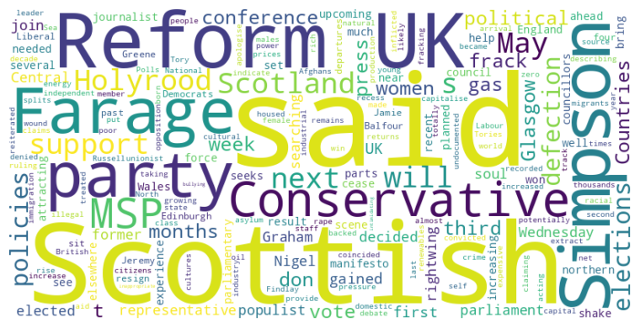
Headline: Reform UK Gains First Scottish Parliament Representative with Conservative MSP Defection
Main Idea: Conservative MSP Graham Simpson defected to Reform UK, marking the party's first representative in the Scottish Parliament; Nigel Farage aims to leverage this defection to increase Reform UK's influence by capitalizing on immigration concerns, advocating for increased North Sea oil and gas production, and opposing net-zero policies, further fragmenting the unionist vote.
Subtopics:
- Graham Simpson's defection and Reform UK's growing influence in Scotland
- Nigel Farage's stance on immigration and cultural issues in Scotland
- Reform UK's energy policy proposals and opposition to net-zero policies
References:
- Conservative MSP defects to Reform UK : https://www.ft.com/content/4b2c0481-d3ef-40a7-bbb7-347fadfe402e

Slide 5
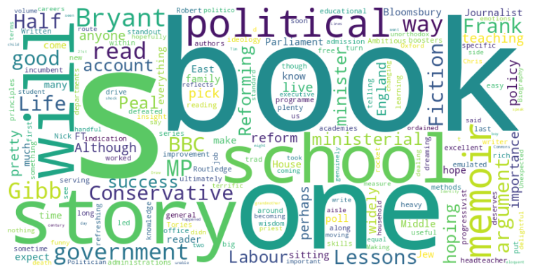
Headline: Recent book releases offer insights into political reform, personal journeys, and political trivia.
Main Idea: A collection of recently published books explores diverse aspects of the political landscape and personal experiences, ranging from analyzing successful government reforms in education to memoirs of politicians and journalists, and a lighthearted look at political trivia.
Subtopics:
- Analysis of Conservative education reforms in England
- Memoirs of political figures and their personal evolutions
- A collection of amusing political oddities and trivia
References:
- How to reform a school and other lessons for would-be ministers : https://www.ft.com/content/2c325a3f-a563-4f87-9928-091153f1f896

