Slide 1
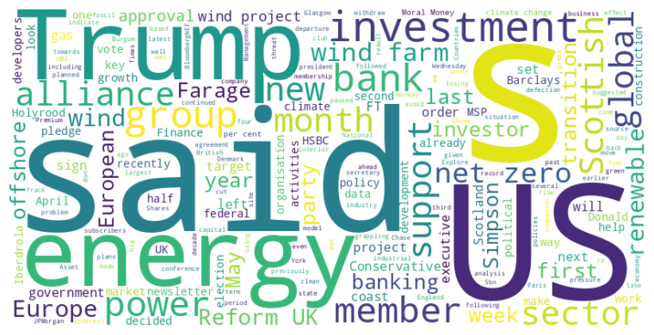
Headline: Climate Alliances and Renewable Energy Investments Face Setbacks Amid Political and Economic Shifts
Main Idea: Global climate alliances are facing internal strife and member departures, while renewable energy investments, particularly in the US wind sector, are experiencing a slowdown due to political opposition, policy changes, and economic factors, potentially leading to a reallocation of investments towards Europe.
Subtopics:
- The Net-Zero Banking Alliance's struggles and member departures due to conflicting pressures.
- Donald Trump's impact on US wind energy sector through policy changes and project obstruction.
- A shift in renewable energy investment from the US to Europe amid growing uncertainty.
References:
- Climate banking group pauses activities amid rising political pressure : https://www.ft.com/content/5bba361e-aae4-4d1e-b077-eebb340ede81
- Conservative MSP defects to Reform UK : https://www.ft.com/content/4b2c0481-d3ef-40a7-bbb7-347fadfe402e
- European green investment stands to gain at the US’s expense : https://www.ft.com/content/2e3ee55b-f956-415d-9ad0-89d85a6bb260

Slide 2
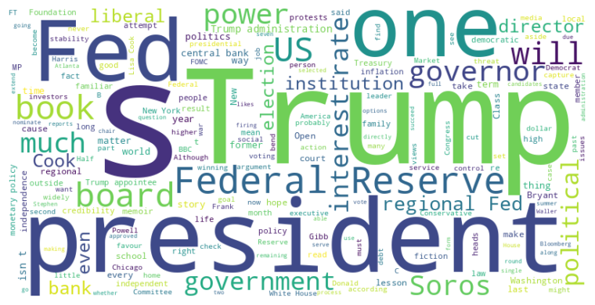
Headline: Trump Administration Explores Increased Influence Over Federal Reserve and Intensifies Attacks on Political Opponents.
Main Idea: The Trump administration is reportedly seeking greater control over the Federal Reserve's regional banks, raising concerns about the central bank's independence, while simultaneously escalating attacks against political adversaries like George Soros, signaling a willingness to challenge established norms and institutions.
Subtopics:
- Trump Administration's efforts to influence Federal Reserve policy
- Trump's threats and accusations against George Soros and other political opponents
- Liberal anxieties about the US constitution being too feeble to contain Trump.
References:
- The next stage of the Fed takeover : https://www.ft.com/content/ca65e559-fe04-4ce5-96ad-383197e9d7bd
- Donald Trump says George Soros should be charged with racketeering : https://www.ft.com/content/8a98f49e-1df5-4619-b2ee-9a0ed9538c68
- Winning elections is the only curb against strongmen : https://www.ft.com/content/8ccb051e-6637-4bc3-991a-5c768df03dd5

Slide 3
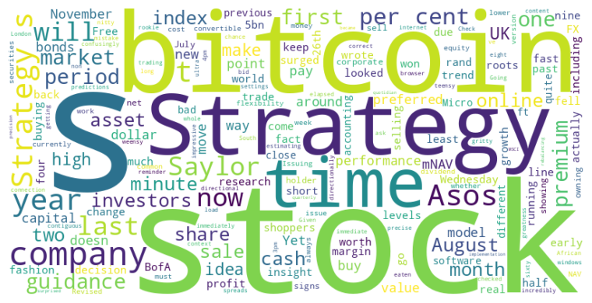
Headline: Financial Strategies Face Scrutiny as Market Dynamics Shift
Main Idea: Several companies are facing challenges in their financial strategies as market conditions evolve, leading to reassessments and adjustments. From BofA's FX trading to Asos' index removal and MicroStrategy's Bitcoin-linked stock performance, precision, adaptability, and investor confidence are proving crucial for sustained success.
Subtopics:
- BofA's precise FX trading strategy and its success rate
- Asos' struggle to maintain its position amid shifting consumer trends and competition
- MicroStrategy's Bitcoin-based strategy and concerns about stock dilution
References:
- How did those ultra-short-term FX calls pan out? : https://www.ft.com/content/dc6b9d5b-3c15-4a85-ac41-02a881f5778c
- FTSE 250 outcast Asos falls out of fashion in more ways than one : https://www.ft.com/content/79da4bef-6003-4f88-a72e-dc1265cf2358
- Strategy’s sagging bitcoin strategy : https://www.ft.com/content/c38c9045-0085-4cad-be3a-afc9dd8068fb

