Slide 1
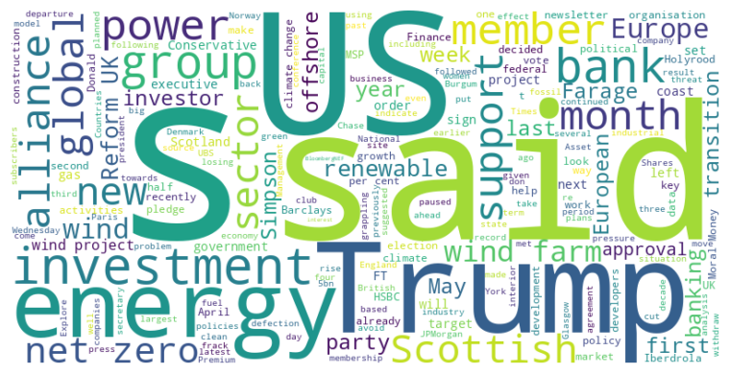
Headline: Climate Alliances and Renewable Investments Face Challenges Amid Political Shifts
Main Idea: Several climate-focused alliances are facing internal strife and member departures, while renewable energy investments, particularly in the US wind sector, are experiencing setbacks due to political pressures and policy changes, potentially shifting investments towards Europe.
Subtopics:
- Net-Zero Banking Alliance facing crisis due to member exits and internal divisions
- US wind energy sector investment decline due to political interference
- Rise of Reform UK party in Scotland and its impact on political landscape
References:
- Climate banking group pauses activities amid rising political pressure : https://www.ft.com/content/5bba361e-aae4-4d1e-b077-eebb340ede81
- Conservative MSP defects to Reform UK : https://www.ft.com/content/4b2c0481-d3ef-40a7-bbb7-347fadfe402e
- European green investment stands to gain at the US’s expense : https://www.ft.com/content/2e3ee55b-f956-415d-9ad0-89d85a6bb260

Slide 2
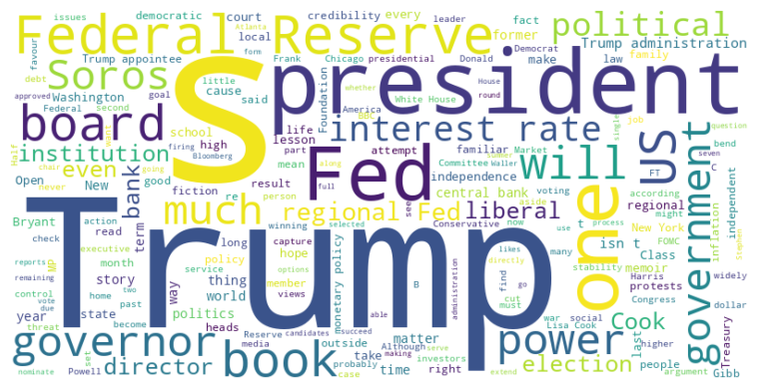
Headline: Trump's actions raise concerns about politicizing the Federal Reserve and other institutions, potentially undermining their independence.
Main Idea: Recent actions by Donald Trump, including attempts to influence the Federal Reserve and his rhetoric towards political opponents, are sparking concerns about the politicization of traditionally independent institutions and the erosion of constitutional checks and balances. Critics argue that these moves threaten the stability of the US economy and democratic norms, highlighting the importance of political engagement to safeguard against authoritarian tendencies.
Subtopics:
- Efforts to exert influence over the Federal Reserve's regional banks and monetary policy
- Threats and accusations against political adversaries, including George Soros
- The broader challenge of safeguarding institutional independence from political interference
References:
- The next stage of the Fed takeover : https://www.ft.com/content/ca65e559-fe04-4ce5-96ad-383197e9d7bd
- Donald Trump says George Soros should be charged with racketeering : https://www.ft.com/content/8a98f49e-1df5-4619-b2ee-9a0ed9538c68
- Winning elections is the only curb against strongmen : https://www.ft.com/content/8ccb051e-6637-4bc3-991a-5c768df03dd5

Slide 3
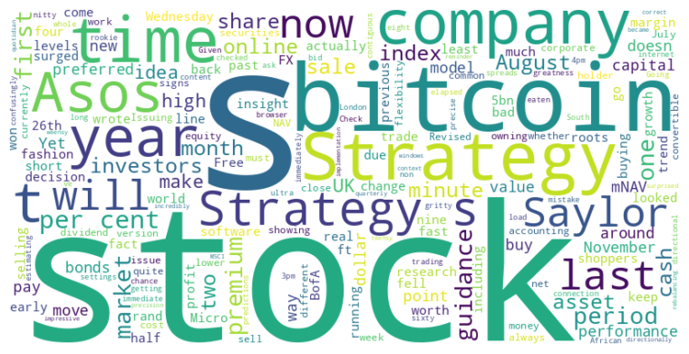
Headline: Financial Markets See Mixed Fortunes: BofA's FX Predictions, Asos's Index Exit, and MicroStrategy's Shifting Strategy
Main Idea: Recent financial news highlights the varying degrees of success and challenges faced by different entities: Bank of America's impressive FX trading predictions, Asos's struggle leading to its removal from the FTSE 250, and MicroStrategy's evolving Bitcoin strategy showing signs of strain as its stock underperforms despite Bitcoin's rally.
Subtopics:
- Bank of America's successful, precise FX trading predictions
- Asos's declining performance and removal from the FTSE 250 index
- MicroStrategy's changing Bitcoin strategy and the impact on its stock price
References:
- How did those ultra-short-term FX calls pan out? : https://www.ft.com/content/dc6b9d5b-3c15-4a85-ac41-02a881f5778c
- FTSE 250 outcast Asos falls out of fashion in more ways than one : https://www.ft.com/content/79da4bef-6003-4f88-a72e-dc1265cf2358
- Strategy’s sagging bitcoin strategy : https://www.ft.com/content/c38c9045-0085-4cad-be3a-afc9dd8068fb

