Slide 1
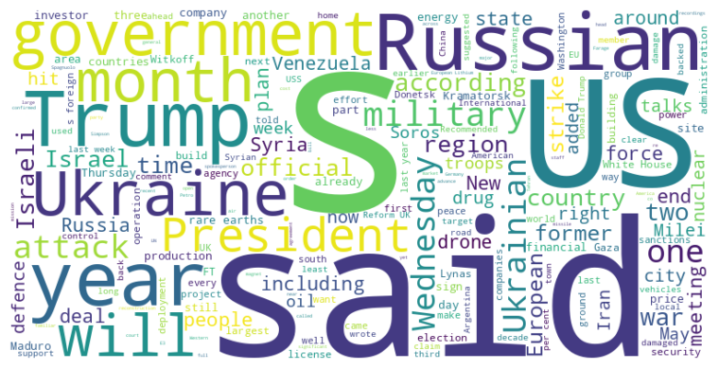
Headline: Global Political Landscape Marked by Controversies, Conflicts, and Economic Maneuvering
Main Idea: A complex web of interconnected events defines the current global political scene, ranging from domestic political disputes and international military deployments to economic strategies aimed at reshaping critical resource control and postwar recovery plans. These developments underscore ongoing tensions, power struggles, and the reshaping of international relations amid ongoing geopolitical shifts.
Subtopics:
- Right-wing populism and political attacks in the US and Scotland
- US military deployment and tensions in Latin America
- International negotiations concerning nuclear programs and war reconstruction
References:
- Donald Trump says George Soros should be charged with racketeering : https://www.ft.com/content/8a98f49e-1df5-4619-b2ee-9a0ed9538c68
- Conservative MSP defects to Reform UK : https://www.ft.com/content/4b2c0481-d3ef-40a7-bbb7-347fadfe402e
- US naval build-up near Venezuela stokes tensions in Latin America : https://www.ft.com/content/50db68c8-59d2-4a2a-b2c3-7c8c88237763

Slide 2
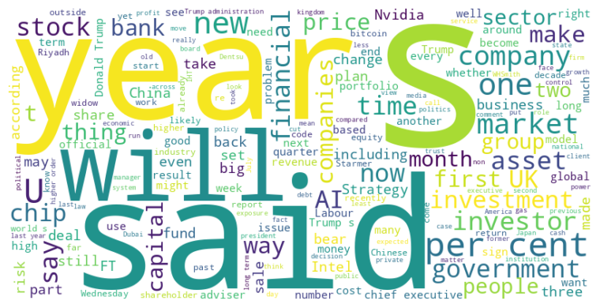
Headline: Political Instability and Economic Uncertainty Dominate Global Financial News
Main Idea: Recent news highlights a pervasive sense of instability across various sectors, including political interference in financial institutions, the fluctuating fortunes of tech companies, and the challenges faced by traditional businesses adapting to evolving consumer preferences and economic pressures, suggesting a climate of uncertainty and potential shifts in global power dynamics.
Subtopics:
- Political interference and institutional independence
- Challenges in tech and retail sectors
- Economic and social impact of government policies
References:
- Winning elections is the only curb against strongmen : https://www.ft.com/content/8ccb051e-6637-4bc3-991a-5c768df03dd5
- Trump’s attack on the Fed threatens US credibility : https://www.ft.com/content/d2eab80f-1314-41f1-8c1e-5fc3bbfb1e43
- FTSE 250 outcast Asos falls out of fashion in more ways than one : https://www.ft.com/content/79da4bef-6003-4f88-a72e-dc1265cf2358

