Slide 1

Financial Times Summary
2025/08/31

Slide 2
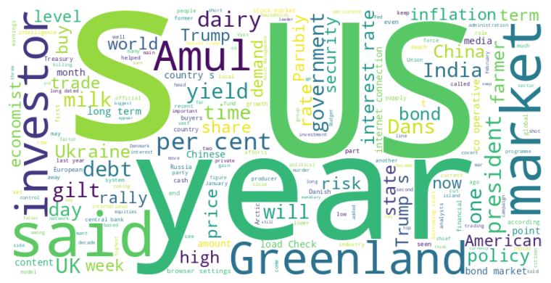
Financial Times Summary
2025/08/31
Headline : Global Markets Respond to US Political and Economic Factors Amidst Geopolitical Tensions
Main Idea : Global financial markets are being influenced by a complex interplay of factors, including US political interference with the Federal Reserve, protectionist trade policies in India, rising UK borrowing costs due to persistent inflation, and geopolitical tensions such as the assassination of a Ukrainian politician and covert US operations in Greenland. Investors are carefully watching these developments and adjusting their strategies in response to perceived risks and opportunities.
Subtopics :
- US political influence on the Federal Reserve and its potential impact on markets
- Impact of protectionist policies and geopolitical tensions on trade and foreign relations
- Rising borrowing costs in the UK and concerns about debt sustainability
References :
- Trump’s Fed meddling pushes investors cl... : https://www.ft.com/content/5e614112-e51a-414f-9030-9876235a1b28
- How an Indian farmers’ dairy co-op outpa... : https://www.ft.com/content/d697cd57-e091-4d16-8cc6-787b8bb2e221
- Why are UK borrowing costs so high?... : https://www.ft.com/content/372c13ed-c5ad-4dda-a98e-6474cb37c55f

Slide 3
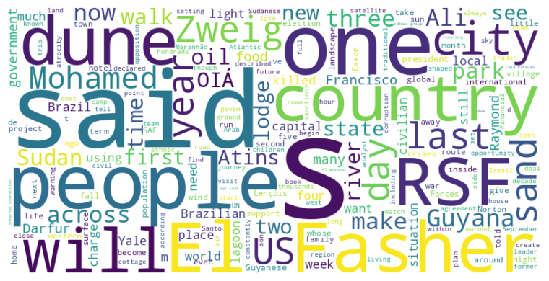
Financial Times Summary
2025/08/31
Headline : Global News Focuses on Brazil's Remote Landscapes and Sudan's Humanitarian Crisis Amidst Guyana's Oil Boom
Main Idea : Recent news highlights diverse global issues, from exploring Brazil's natural beauty and the historical context of Stefan Zweig's writings, to the dire humanitarian crisis unfolding in Sudan's besieged city of El Fasher, and the complex political landscape of Guyana navigating its newfound oil wealth.
Subtopics :
- Exploration of Brazil's Lençóis Maranhenses and Zweig's influence
- The unfolding humanitarian catastrophe in El Fasher, Sudan
- Guyana's political and economic challenges amidst an oil boom
References :
- Hiking this national park feels like an ... : https://www.ft.com/content/c7081757-896f-4f0c-8ceb-b8911dd2cca1
- ‘We watch the graveyards from space’: sa... : https://www.ft.com/content/d3313835-71ef-47ab-8111-49fad465acca
- World’s newest petrostate heads for ‘mot... : https://www.ft.com/content/3cc0e262-af5e-45da-9852-0450f8eb75cb

Slide 4

Financial Times Summary
2025/08/31
Headline : Varied challenges and opportunities emerge across graduate employment, music neuroscience, nuclear energy, media consolidation, and the business of sports.
Main Idea : This compilation of articles reveals a spectrum of developments across different sectors, from the struggles of graduates entering a competitive job market to advancements in understanding the brain's connection to music, the rise of small nuclear reactors, potential media mergers, and the growing but still nascent business of women's sports, showcasing both hurdles and potential.
Subtopics :
- Graduate job market difficulties and adaptations
- Advancements in music neuroscience and therapeutic applications
- The rise of small modular reactors and nuclear energy
References :
- It’s been a terrible year to graduate an... : https://www.ft.com/content/867fba45-3d8e-4d84-bedc-0dd9a4e53a11
- Why Beethoven is good for your brain... : https://www.ft.com/content/5618fe95-a048-464d-8ff9-8bab7e5eff09
- Rolls-Royce explores small nuclear react... : https://www.ft.com/content/234b4c2e-5e1a-46ba-82fd-472e271a289f

Slide 5
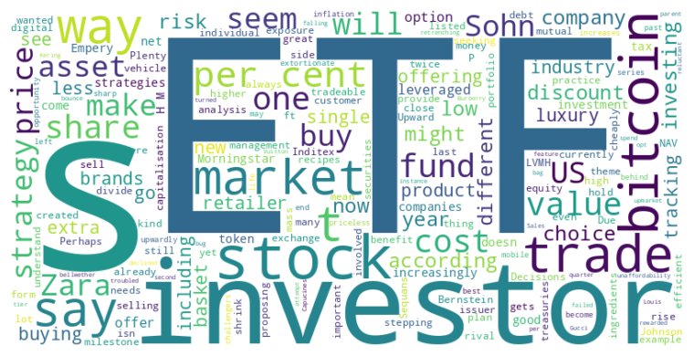
Financial Times Summary
2025/08/31
Headline : Market Trends Show Shifting Dynamics in Luxury Goods, Investment Vehicles, and Bitcoin Strategies
Main Idea : Consumer preferences are shifting in the luxury goods sector, with second-tier brands and retailers capitalizing on the unaffordability of top-tier luxury items; the ETF market is oversaturated, presenting both opportunities and risks for investors; and companies holding bitcoin face varying market valuations, leading to different strategies for creating shareholder value.
Subtopics :
- Luxury market segmentation and pricing strategies
- ETF proliferation and investor choice overload
- Corporate bitcoin treasuries and valuation disparities
References :
- Luxury blingflation creates opportunity ... : https://www.ft.com/content/aa5aae65-d2f4-454d-9210-f496418e7e5d
- Of course, there are more ETFs than indi... : https://www.ft.com/content/0907462a-363b-46bf-94d9-59249f16106a
- Why bad bitcoin treasuries could make th... : https://www.ft.com/content/f448ba4f-3012-4acc-b331-0ebdc1b016ee

