Slide 1
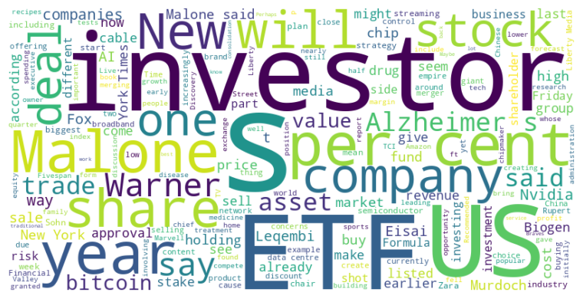
Headline: Diverse financial strategies emerge across industries, from media to tech and pharmaceuticals.
Main Idea: Several disparate sectors are undergoing strategic shifts driven by technological advancements, market pressures, and evolving consumer behavior, leading to varied financial outcomes and investment opportunities. Companies are exploring new revenue streams, operational efficiencies, and potential mergers to navigate these changes and enhance shareholder value, though with varying degrees of success.
Subtopics:
- Media companies exploring AI integration and potential mergers amid digital transformation
- Pharmaceutical companies navigating regulatory approvals and market adoption of new Alzheimer's treatments
- Tech companies facing slowing growth in AI sector and increased competition
References:
- New York Times activist could be good news for investors : https://www.ft.com/content/aded0d83-0a63-49bd-8670-63cc8e4d20be
- US regulator approves at-home version of Alzheimer’s drug Leqembi from Eisai and Biogen : https://www.ft.com/content/4147b61e-6cc9-40c2-adb0-18ff97d1c878
- US tech stocks drop as AI uncertainty knocks chip groups : https://www.ft.com/content/2b3b51d1-b9e1-4b7c-a262-ae531f621fef

Slide 2
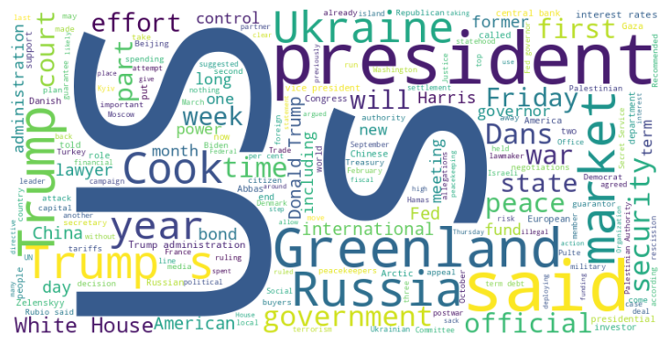
Headline: Trump Administration Tests Limits of Presidential Power Through Controversial Actions
Main Idea: The Trump administration is increasingly testing the boundaries of executive power through actions such as imposing tariffs, rescinding congressional appropriations, meddling with the Federal Reserve, influencing Greenland, and restricting visas, leading to legal challenges and political backlash.
Subtopics:
- Unlawful tariffs and legal challenges
- Attempted rescission of foreign aid
- Visa denial for Palestinian leader
References:
- Trump’s tariffs ruled illegal by US appeals court but stay in place : https://www.ft.com/content/f3c7deb6-928c-426c-8dbc-574b21b02063
- Donald Trump moves to scrap $4.9bn in already allocated US foreign aid : https://www.ft.com/content/bb136ab7-c14a-4997-bbd7-88210dcc9e33
- US bars Palestinian leader Mahmoud Abbas from UN meeting to recognise state : https://www.ft.com/content/15fb8518-d55f-46cb-aa62-fd2aa2b10272

Slide 3
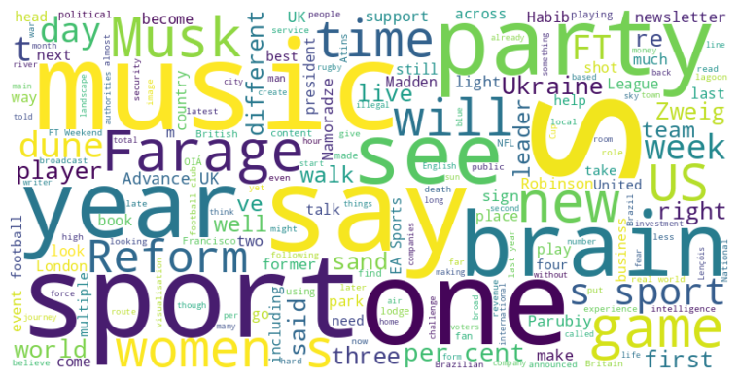
Headline: Words vs. Actions and Political Intrigue in Britain & Ukraine
Main Idea: This collection of articles highlights the disparity between talk and action in various sectors, from politics and business to sports and personal development, while also detailing political fractures in Britain and a prominent assassination in Ukraine, painting a picture of ineffectiveness and instability contrasted with tangible results.
Subtopics:
- The importance of action over empty rhetoric in achieving goals
- Political fragmentation and the rise of fringe parties in Britain
- Escalating violence and political assassinations in Ukraine
References:
- It’s time to shut up and get on with it : https://www.ft.com/content/3bddbe64-bbf0-4775-9071-f037583584dd
- Can a UK party backed by Elon Musk outflank Nigel Farage on the right? : https://www.ft.com/content/27c3321a-9b07-4e9f-a55e-07c7d3900908
- Hiking this national park feels like an escape to another universe : https://www.ft.com/content/c7081757-896f-4f0c-8ceb-b8911dd2cca1

Slide 4
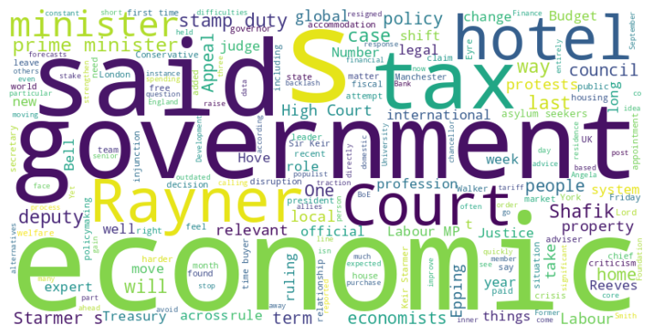
Headline: Economic Expertise Faces Challenges Amid Political Shifts and Policy Scrutiny.
Main Idea: Economists are struggling to maintain influence and relevance in a rapidly changing world marked by political instability, populism, and complex structural issues; the profession must adapt by embracing interdisciplinary approaches and improving forecasting models while political figures and institutions face scrutiny regarding policy decisions and transparency.
Subtopics:
- Decline in trust and influence of economic experts.
- Political figures face public and internal scrutiny over economic policy decisions.
- Legal and ethical considerations in political office, regarding taxation and asylum policies.
References:
- How economists lost traction : https://www.ft.com/content/6e7c6db8-c073-4bb6-9727-50a677dcbf56
- Keir Starmer names Minouche Shafik as top economic adviser : https://www.ft.com/content/7739bc75-b2dd-4109-bf07-2cba18c6eb04
- Stamp duty row: has Angela Rayner broken any rules? : https://www.ft.com/content/3480d460-1728-4842-a580-05eb622d7bde

Slide 5
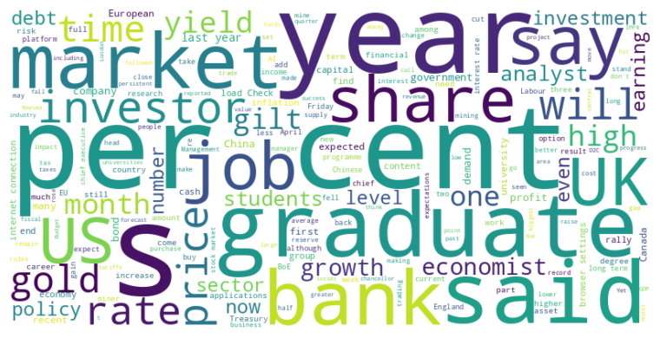
Headline: Global Economy Faces Diverse Challenges: From Canadian Trade to UK Borrowing Costs to Chinese Stock Rally
Main Idea: The global economy presents a mixed bag of challenges, ranging from trade pressures impacting Canada's GDP and potential bank tax hikes in the UK affecting stock prices to a domestic-investor-driven stock market rally in China and difficulties faced by UK graduates entering the job market, all amid discussions of long-term borrowing costs and shifting monetary policies.
Subtopics:
- Canada's economic contraction due to US tariffs and trade imbalances
- UK banking sector facing potential tax increases and rising borrowing costs
- Chinese stock market rally driven by domestic investors amidst deflationary pressures and policy shifts
- Difficulties for UK graduates entering a competitive job market
- EU loans-for-arms program to boost defence spending
- Investment platform performance and share price growth
- Gold as an investment asset and mining company challenges
References:
- Canada’s GDP shrinks more than expected as Donald Trump’s tariffs hit : https://www.ft.com/content/e089f4cb-ff20-4323-a43c-97551a3f98d7
- UK banks suffer sell-off over fears of tax rises : https://www.ft.com/content/f49f8996-0b22-4d19-a0d1-33c22614c231
- Directors’ Deals: AJ Bell chief executive takes advantage of share price rise : https://www.ft.com/content/f98cf469-6957-4a2d-b647-dbc2caff1c1a

Slide 6
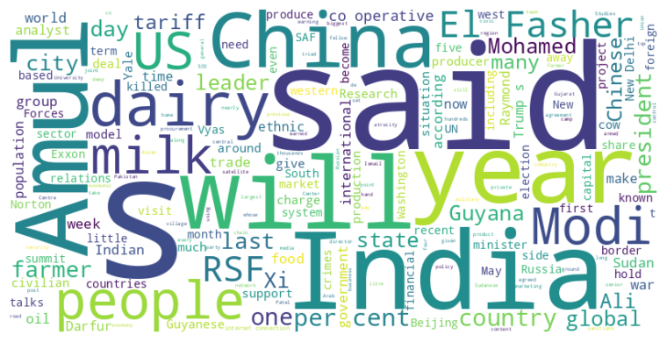
Headline: Global tensions and economic shifts highlight evolving international dynamics.
Main Idea: Several global events, including the Shanghai Cooperation Organization summit, India's economic balancing act, Sudan's humanitarian crisis, and Guyana's oil-driven economic boom, showcase shifting alliances, economic challenges, and humanitarian crises shaping international relations and domestic politics.
Subtopics:
- China's ambition for an alternative international order and strategic alliances
- India's navigation of US-China relations and economic policies
- Humanitarian catastrophe and geopolitical implications in Sudan
- Economic transformation and political challenges in Guyana due to oil revenue
References:
- Xi Jinping to host Vladimir Putin and Narendra Modi as China presents rival front to US : https://www.ft.com/content/58bf303e-ff10-442b-a527-dc61ba6c7eca
- How an Indian farmers’ dairy co-op outpaced global giants : https://www.ft.com/content/d697cd57-e091-4d16-8cc6-787b8bb2e221
- ‘We watch the graveyards from space’: satellites track Sudanese city under siege : https://www.ft.com/content/d3313835-71ef-47ab-8111-49fad465acca

Slide 7
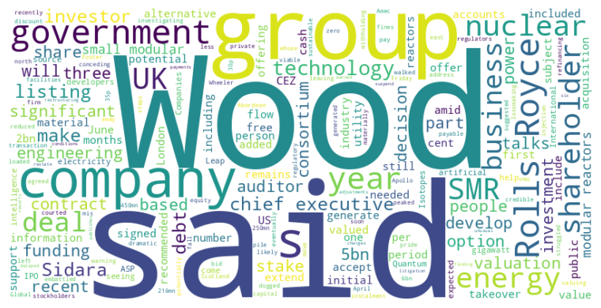
Headline: Wood Group accepts reduced Sidara takeover bid amid financial struggles, while Rolls-Royce explores IPO for its small nuclear business.
Main Idea: Wood Group, burdened by debt and regulatory issues, has agreed to a discounted takeover offer from Sidara as its best option, while Rolls-Royce is considering an IPO for its small modular reactor (SMR) business, capitalizing on growing investor interest in nuclear technology and government support for clean energy initiatives.
Subtopics:
- Wood Group's financial difficulties and the terms of Sidara's acquisition
- Rolls-Royce's potential IPO for its SMR business amid increasing interest in nuclear energy
- Government and investor support for SMRs and the intersection of nuclear technology with artificial intelligence
References:
- Wood Group recommends £216mn offer from Sidara : https://www.ft.com/content/b9b5f604-6de0-4cd5-9b9c-5ae4193cfd6a
- Rolls-Royce explores small nuclear reactor unit funding options including IPO : https://www.ft.com/content/234b4c2e-5e1a-46ba-82fd-472e271a289f

