Slide 1
Table of Contents
This slide deck consists of slides used in 3 lecture videos in Week 4. Below is a list of shortcut hyperlinks for you to jump into specific sections.
(page 2) Week 4: WA4E/CSS - Cascading Style Sheets (Part 1)
(page 13) Week 4: WA4E/CSS - Cascading Style Sheets (Part 2)
(page 24) Week 4: WA4E/CSS - Cascading Style Sheets (Part 3)
Notes:
Note from Chuck. If you are using these materials, you can remove my name and URL from this replace it with your own, but please retain the CC-BY logo on the first page as well as retain the entire last page when you remix and republish these slides.
TO Highlight – go to https://tohtml.com/html/ - paste and then do a "Paste RTF"

Slide 2

Cascading Style Sheets
Charles Severance
www.dj4e.com
https://www.dj4e.com/code/css.zip
Notes:
Note from Chuck. If you are using these materials, you can remove my name and URL from this replace it with your own, but please retain the CC-BY logo on the first page as well as retain the entire last page when you remix and republish these slides.

Slide 3


HTML
Time
Browser
Web Server
Database Server
DOM
Django
static
files
Sqlite or PostgreSQL
Parse
Request
Parse
Response
Views
django
code
JavaScript
RRC/HTTP
SQL

Slide 4
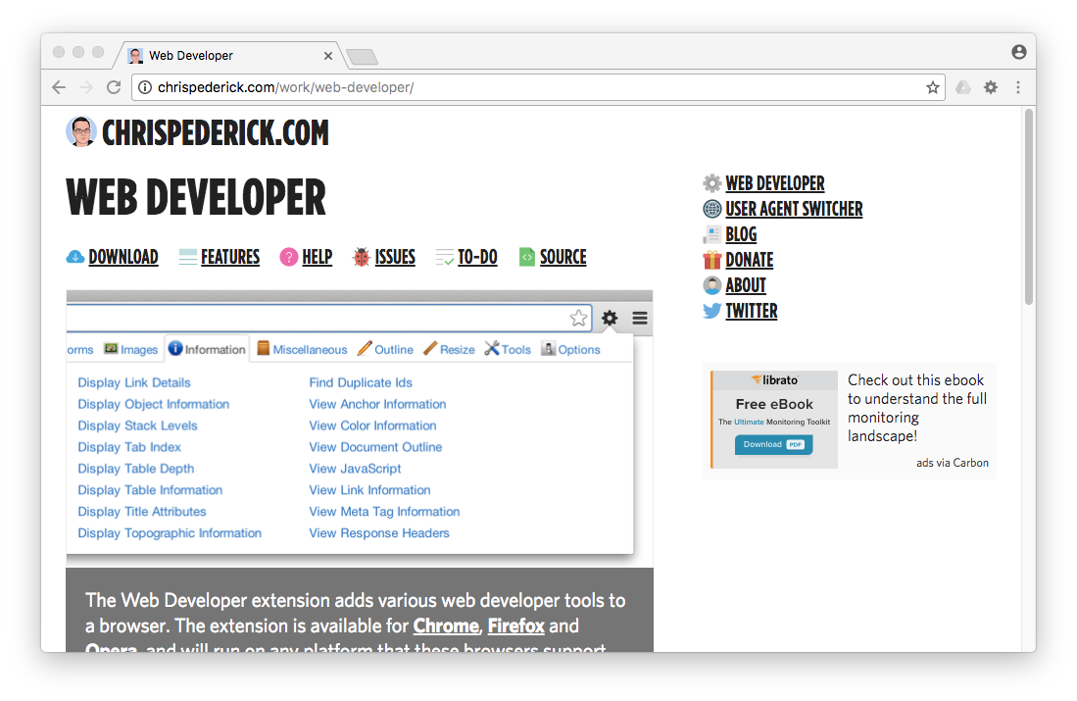
More than Developer Console
http://chrispederick.com/work/web-developer/

Slide 5

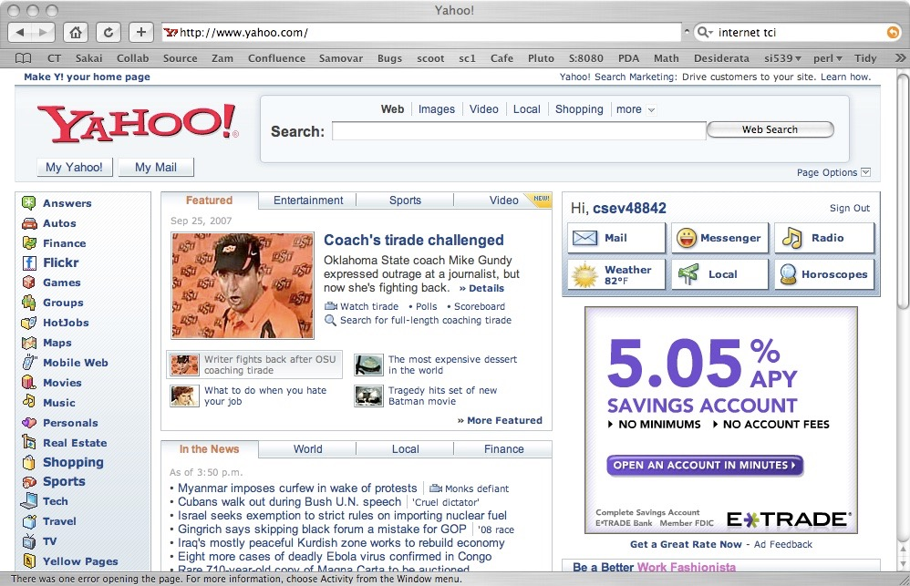
The Web is Still Evolving
HTML has evolved a *lot* over the years - as computers and networks have gotten faster
1996
2007

Slide 6
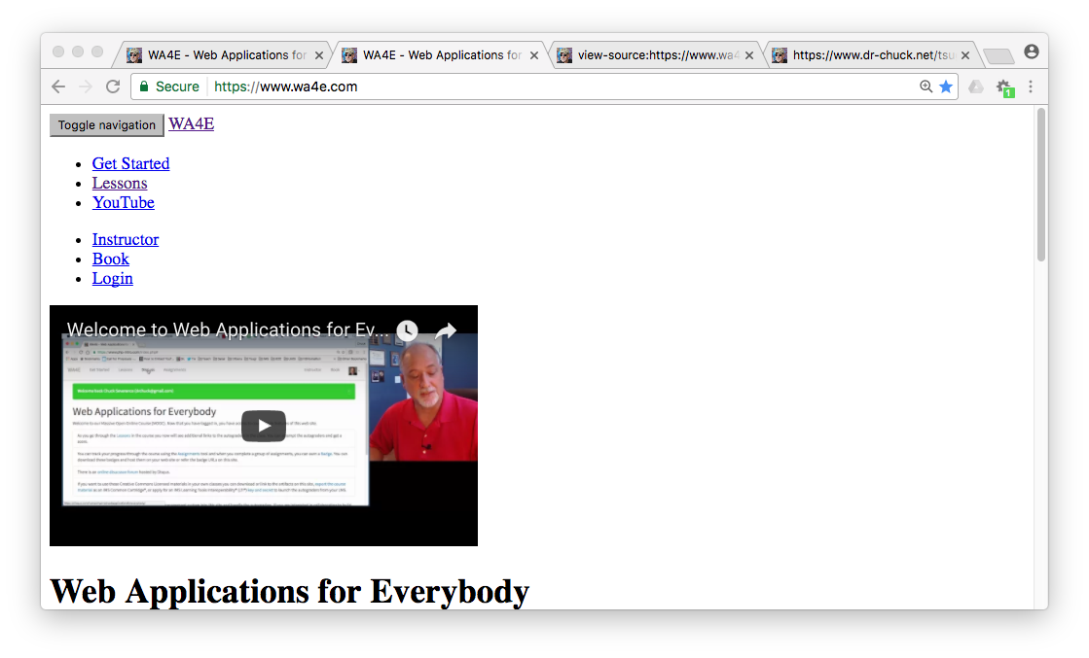
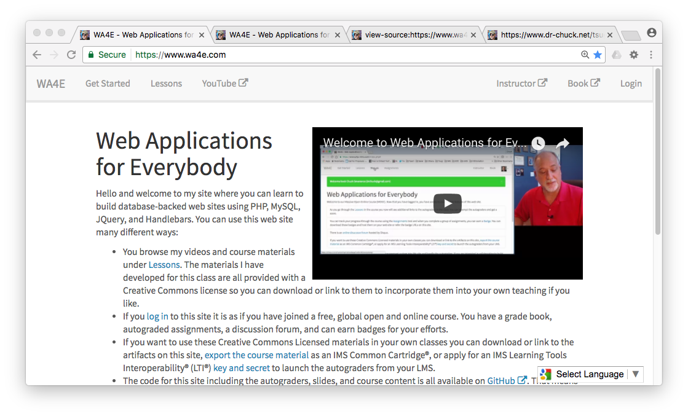
Screenshots
Without CSS
With CSS

Slide 7
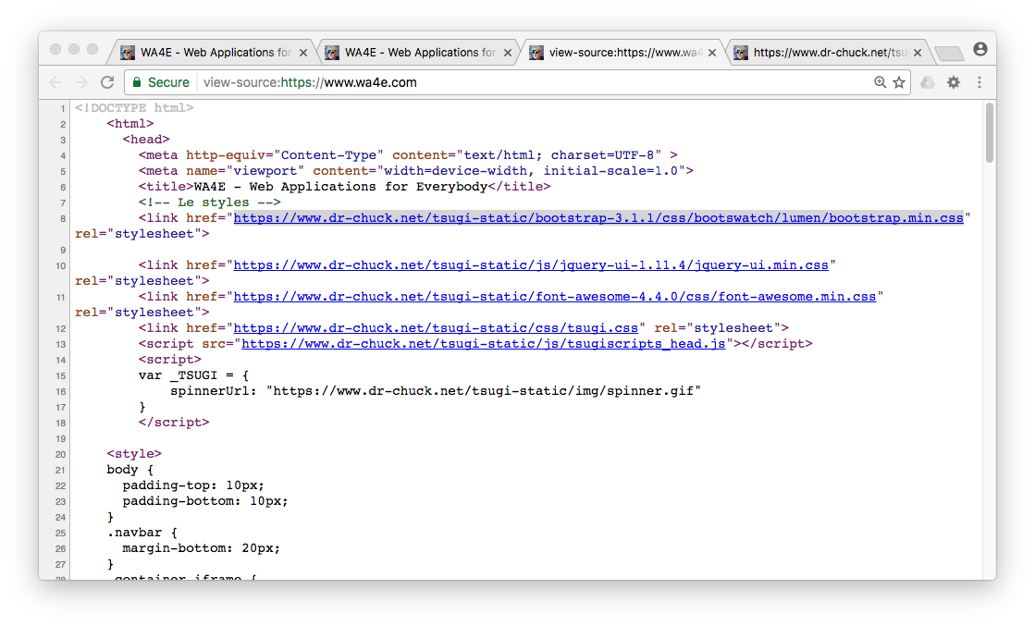
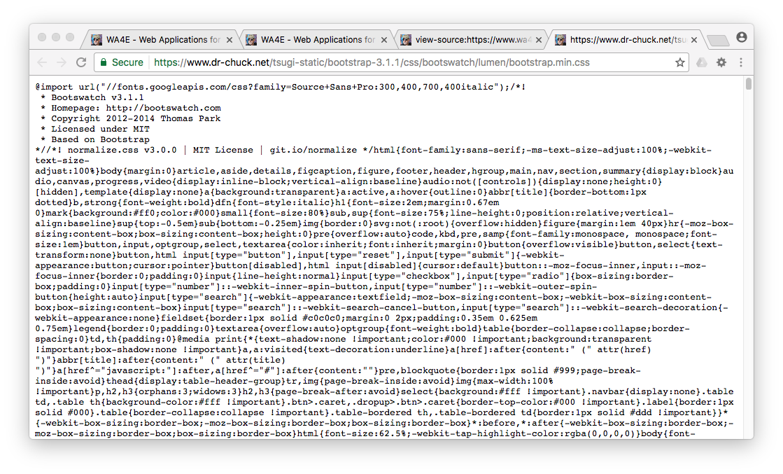
Screenshots
HTML
CSS

Slide 8
Separation of Concerns / Specialization
Developer
Designer
body {
font-family: arial, sans-serif;
}
h1 {
color: blue;
}
p {
border-style: solid;
border-color: red;
border-width: 5px;
}
a {
color: green;
background-color: lightgray;
text-decoration: none;
}
<html>
<head>
<title>Including CSS From a File</title>
<link type="text/css" rel="stylesheet" href="rules.css">
</head>
<body>
<h1>A Header</h1>
<p>
By putting the CSS rules into a separate file,
it can be included in many different web pages
with a single "link" tag, usually in the
"head" of the document.
</p>

Slide 9
CSS Syntax
CSS Syntax is very different than HTML.
CSS is a set of “rules” which in include a “selector” and one or more “properties” and “values” as well as some punctuation...
body {
font-family: arial, sans-serif;
}

Slide 10
Anatomy of a CSS Rule
selector - which part of the document this rule applies to
body {
font-family: arial, sans-serif;
font-size: 100%;
}
property - which aspect of CSS we are changing
value – what we are setting the property to

Slide 11
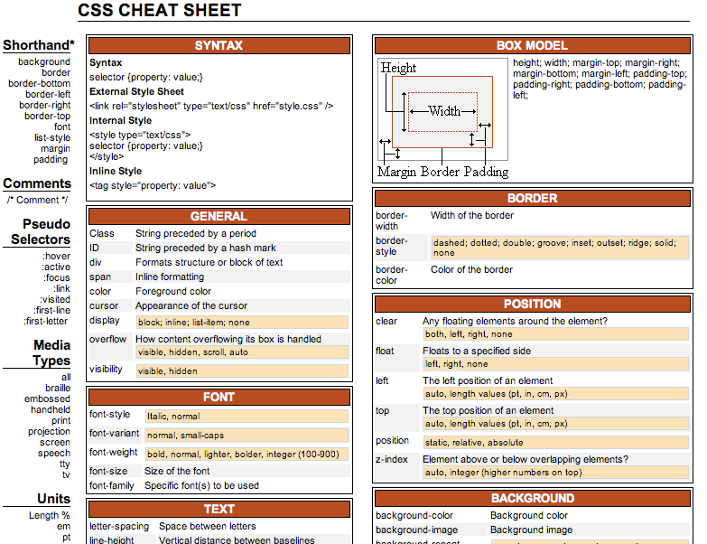
CSS cheat sheet
http://www.lesliefranke.com/files/reference/csscheatsheet.html

Slide 12
Partial List of CSS Properties
color
background-color
visibility (visible/hidden)
font-family (arial, sans-serif)
font-size
font-style (italic, normal)
font-weight (bold, normal)
text-align
vertical-align
text-transform (lowercase, etc)
text-decoration
border-width
border-style
border-color
margin
border
padding
float (left, right, none)
left / top
position (static, relative, absolute)
z-index
http://www.lesliefranke.com/files/reference/csscheatsheet.html

Slide 13
Using CSS in HTML

Slide 14
Applying CSS to our HTML
Inline - right on an HTML tag, using the style= attribute
An embedded style sheet in the <head> of the document
As an external style sheet in a separate file

Slide 15
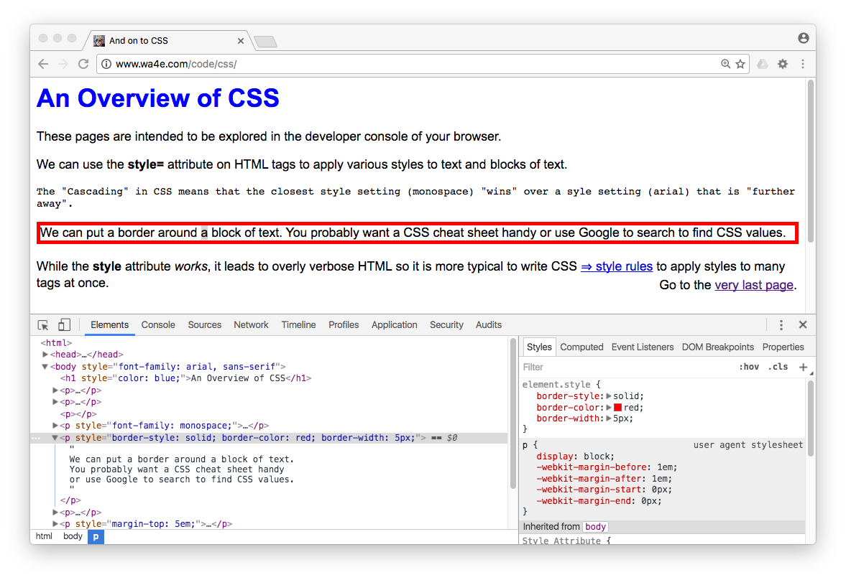
An Overview of CSS

Slide 16
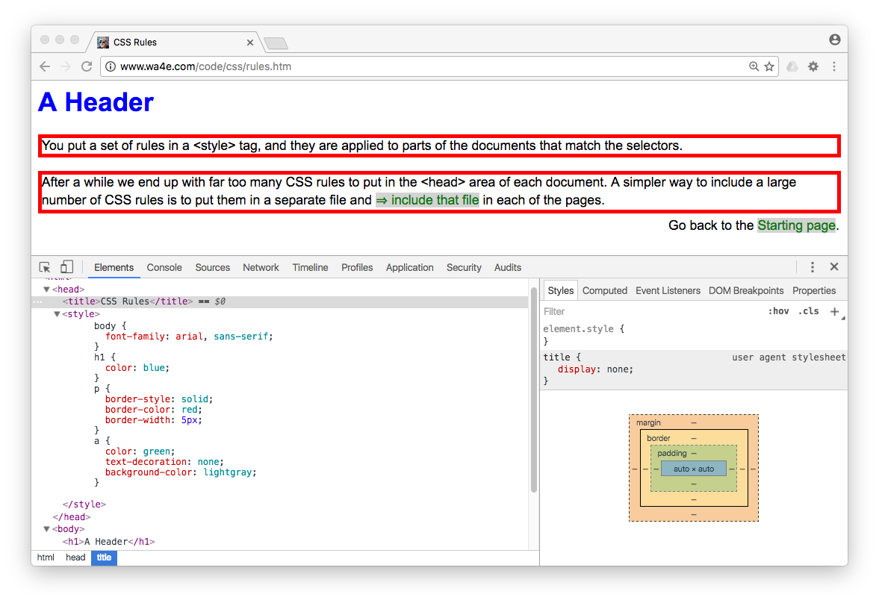
A Header

Slide 17
Code
<html>
<head>
<title>Including CSS From a File</title>
<link type="text/css" rel="stylesheet" href="rules.css">
</head>
<body>
<h1>A Header</h1>
csev $ ls -l
total 32
-rw-r--r-- 1 csev staff 44 Dec 19 06:06 rules.css
-rw-r--r-- 1 csev staff 679 Dec 19 06:07 index.htm
-rw-r--r-- 1 csev staff 883 Dec 19 05:59 include.htm
-rw-r--r-- 1 csev staff 679 Dec 19 05:59 colors.htm
csev $

Slide 18
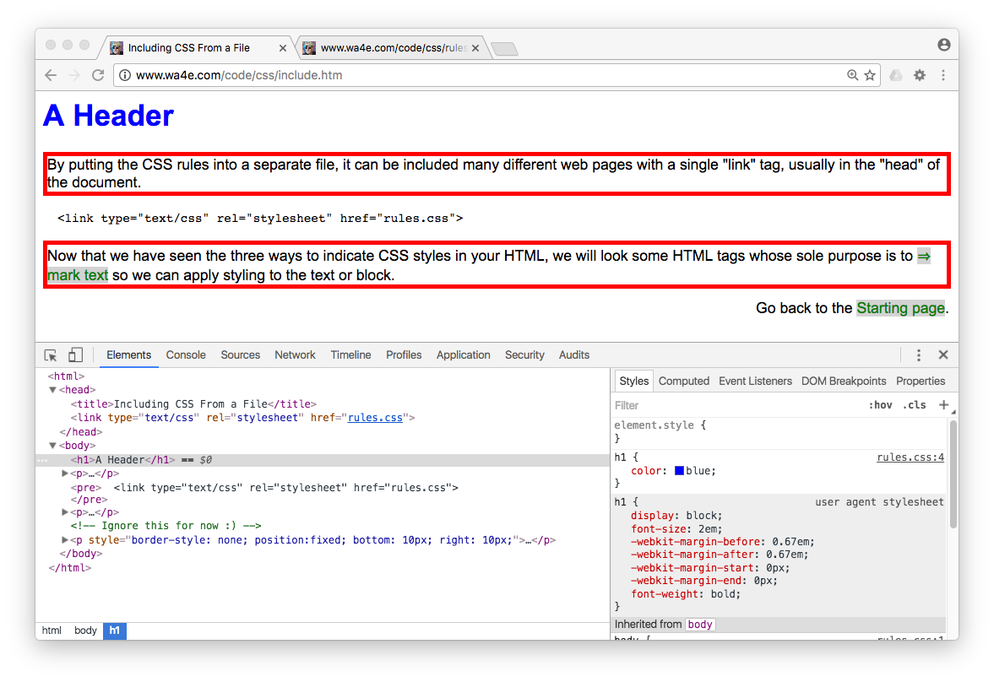
A Header

Slide 19
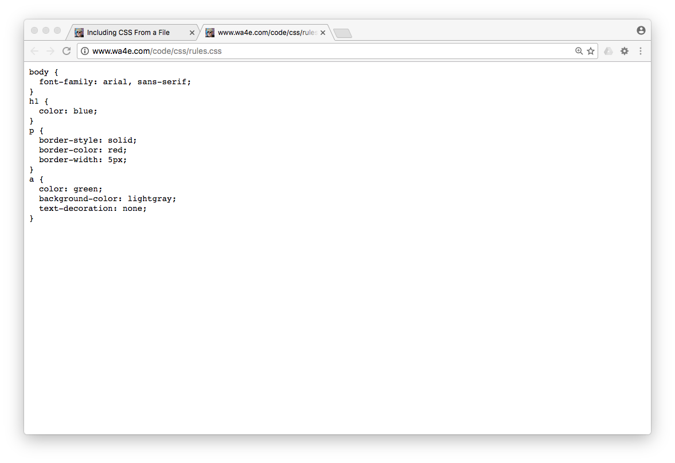
Screenshot

Slide 20
span and div Tags
<p style="border: 1px green solid;">
With CSS we wanted some tags that had no pre-existing style. So the <span style="color: green;">span</span> tag was invented as the new "inline" tag with no styling.
</p>
<div style="border: 1px blue solid;">
And the <strong>div</strong> tag is a new unstyled block tag with no padding, margin, background-color, or anything else. So you could mark blocks with the div tag and not inherit any default style.
<div style="border: 1px orange solid;">
And the <strong>div</strong> tags can be nested as well. Adding the 1-pixel borders does take up a pixel of space.
</div>
You can add some text in the outer div.
</div>

Slide 21
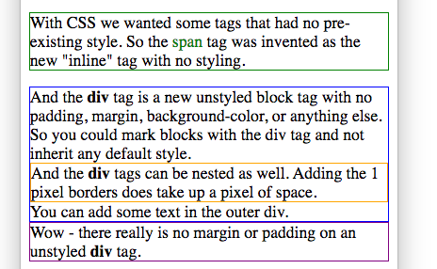
Code
<p style="border: 1px green solid;">
With CSS we wanted some tags that had no pre-existing
Style. So the <span style="color: green;">span</span>
tag was invented as the new "inline" tag with no styling.
</p>
<div style="border: 1px blue solid;">
And the <strong>div</strong> tag is a new unstyled
block tag with no padding, margin, background-color,
or anything else. So you could mark blocks with
the div tag and not inherit any default style.
<div style="border: 1px orange solid;">
And the <strong>div</strong> tags can be nested as well.
Adding the 1-pixel borders does take up a pixel of space.
</div>
You can add some text in the outer div.
</div>

Slide 22
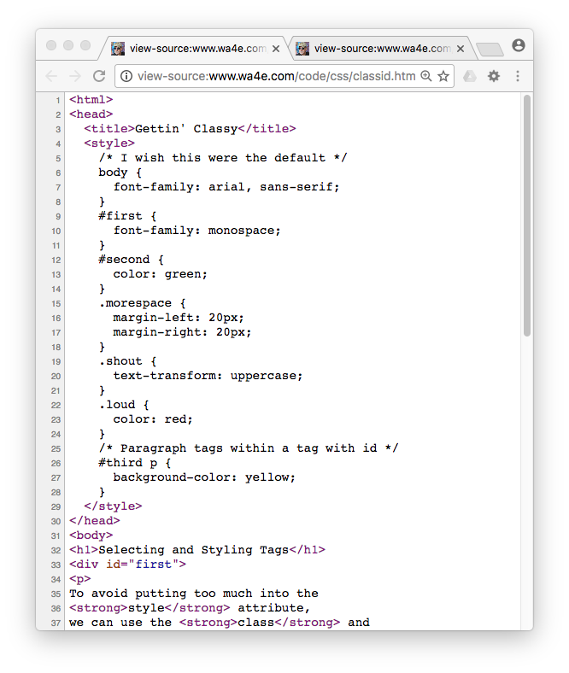
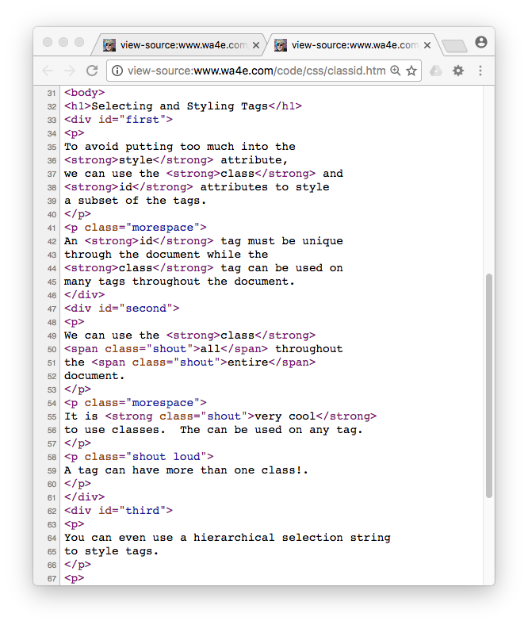
Screenshots

Slide 23
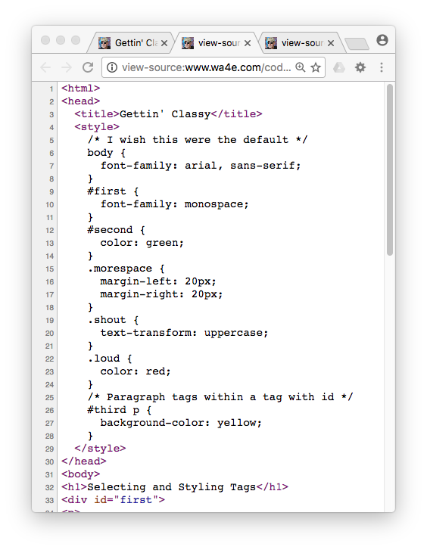
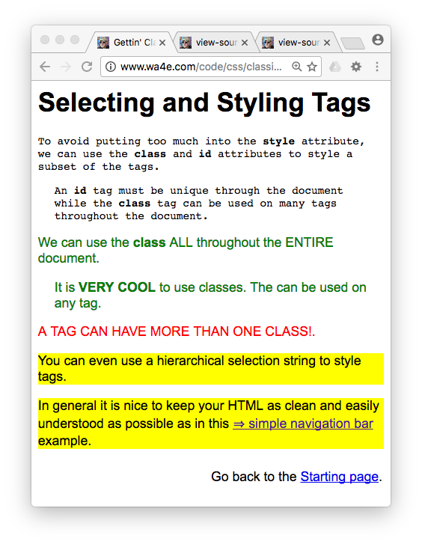
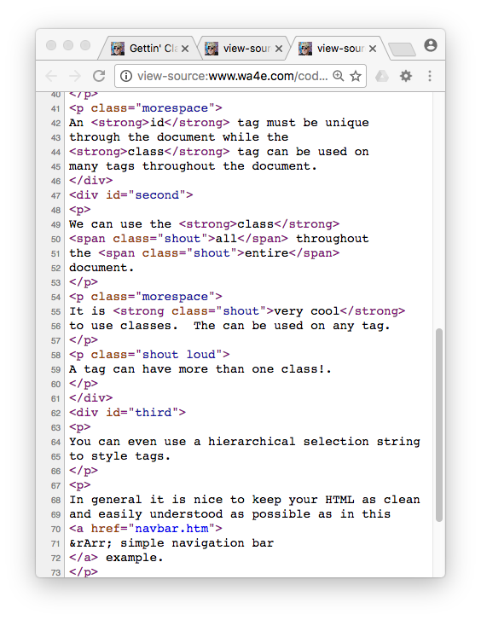
Screenshots

Slide 24
Images, Colors, and Fonts

Slide 25
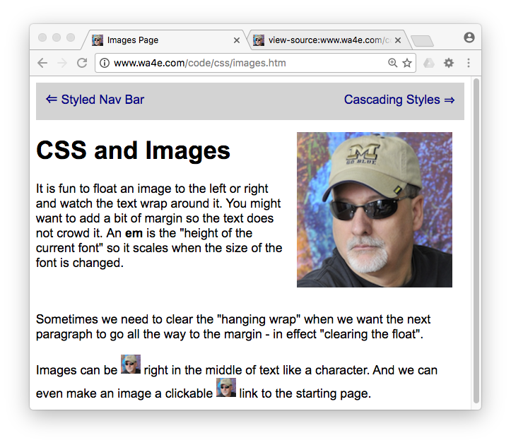
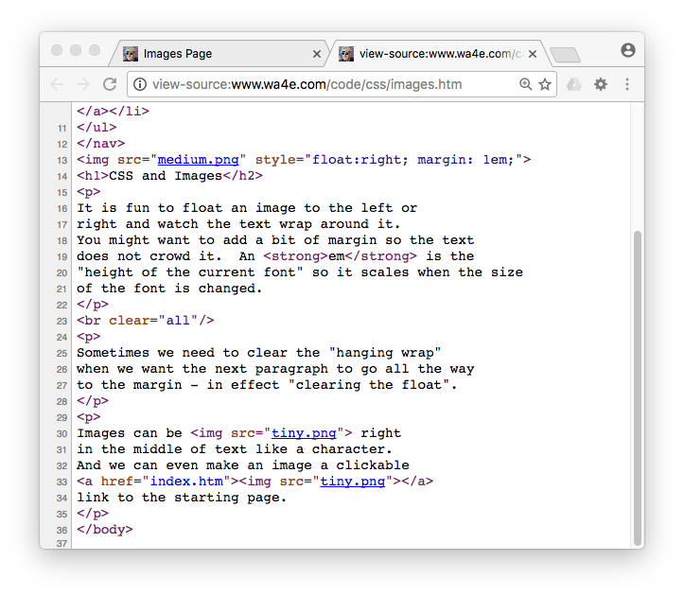
Screenshots

Slide 26
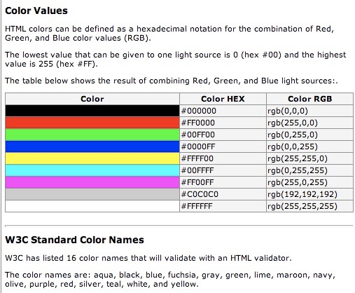
Color Names
W3C has listed 16 official color names that will validate with an HTML validator.
The color names are: aqua, black, blue, fuchsia, gray, green, lime, maroon, navy, olive, purple, red, silver, teal, white, and yellow.
http://www.w3schools.com/html/html_colors.asp

Slide 27
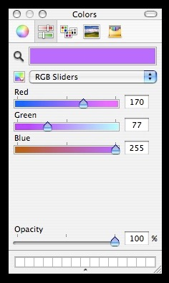
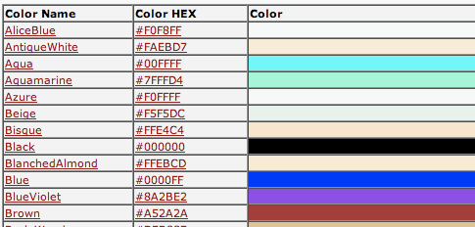
Advanced Colors...
Three numbers, Red, Green, and Blue - each from 00 - FF (Hexidecimal)
#e2edff
#ffffff = white
#000000 = black
#ff0000 = red
#00ff00 = green
#0000ff = blue
Web-safe
colors
http://www.w3schools.com/css/css_colornames.asp

Slide 28

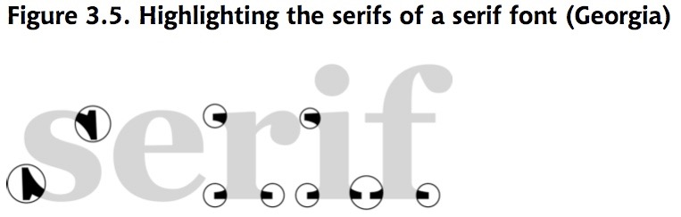
Fonts
Default fonts are ugly and they have serifs - which make them harder to read on a screen
So the first thing I usually want to do is override the fonts in my document
And I want to do this everywhere

Slide 29
Fonts
Most Favorite
Least Favorite
body {
font-family: "Trebuchet MS", Helvetica, Arial, sans-serif;
font-size: x-large;
}
Fallback fonts: serif, sans-serif, monospace, cursive, and fantasy

Slide 30
Font Factors
font-size:
xx-small
x-small
small
medium
large
x-large
xx-large
14px
font-weight: bold or normal
font-style: normal or italic
text-decoration: none, underline, overline, or line-through

Slide 31
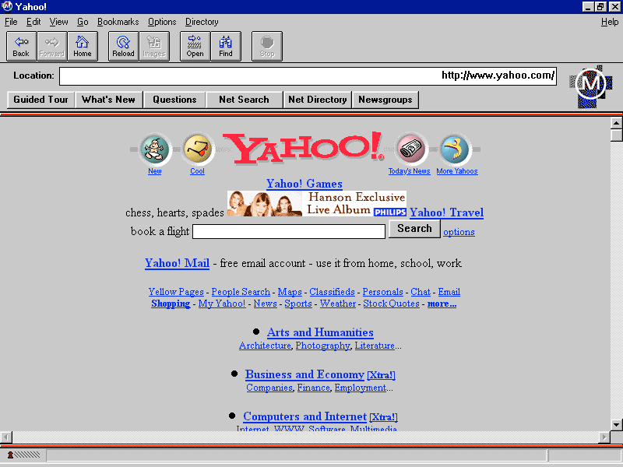

Styling for Links
Post-Click:
Browser default styling for links is downright ugly!

Slide 32
Styling Links
a {
font-weight: bold;
}
a:link {
color: black;
}
a:visited {
color: gray;
}
a:hover {
text-decoration: none;
color: white;
background-color: navy;
}
a:active {
color: aqua;
background-color: navy;
}
link - before a visit
visited - after it has been visited
hover - when your mouse is over it but you have not clicked
active - you have clicked it and you have not yet seen the new page

Slide 33
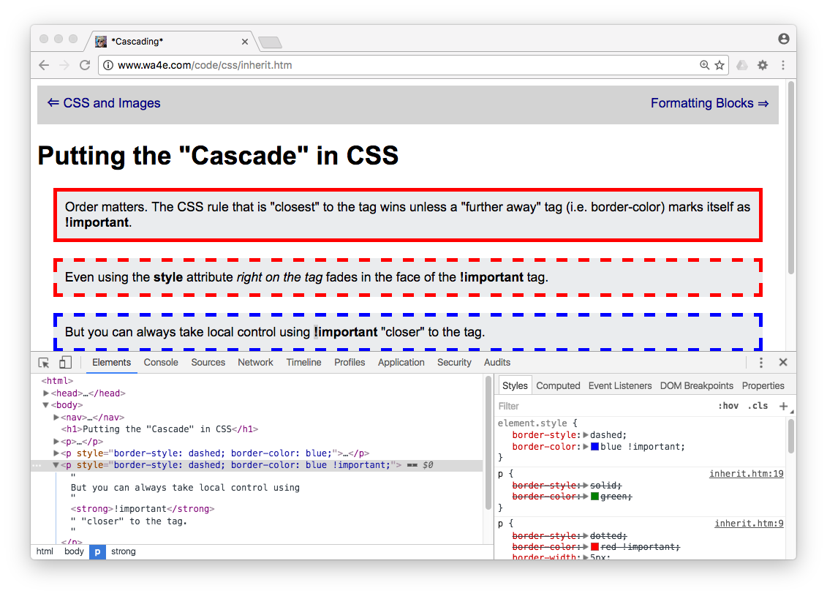
Many More Samples dj4e.com

Slide 34
CSS Summary
CSS layout is its own art and science.
CSS basics are well established and well supported in all modern browsers.
Site layout and markup is further evolving - mostly to make it increasingly possible to support desktop-like experiences on the web and mobile.
These innovations will naturally cause incompatibilities - which make things interesting and frustrating at times.

Slide 35
Acknowledgements / Contributions
These slides are Copyright 2010- Charles R. Severance (www.dr-chuck.com) as part of www.dj4e.com and made available under a Creative Commons Attribution 4.0 License. Please maintain this last slide in all copies of the document to comply with the attribution requirements of the license. If you make a change, feel free to add your name and organization to the list of contributors on this page as you republish the materials.
Initial Development: Charles Severance, University of Michigan School of Information
Insert new Contributors and Translators here including names and dates
Continue new Contributors and Translators here
Notes:
Note from Chuck. Please retain and maintain this page as you remix and republish these materials. Please add any of your own improvements or contributions.

