Slide 1

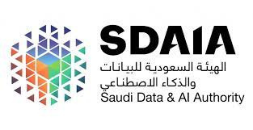

AI advertisement for Arabic dialects
Mohammed Aljuaid
Shayam Alsahli
Aydah Alenazi
Ahmed Alghamdi

Slide 2
Table Of Content
01
Abstract
02
Introduction
03
Business Background
04
Statistical study
05
Conclusion

Slide 3
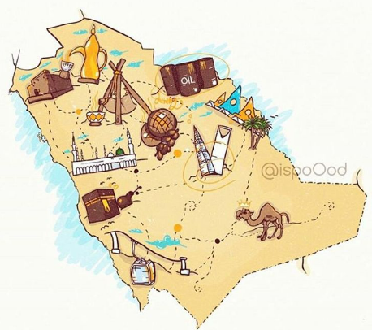
Abstract
The becoming age of vision 2030 and the aim of
increasing its population our aim with the help of AI to
broadcast ads campaigns for specific audience with their
reputation culture worldwide. For investments to come
and highly economic endeavors with marketing being
high in-demand

Slide 4

Introduction
IIn a world where communication knows no bounds, the need for seamless interaction across diverse Arabic dialects has never been more crucial. Meet our cutting-edge AI language solutions.

Slide 5
Business Background
people now sharing their lives through screens and the age of reaching to people has long gone instead we provide reaching out for people to target the audiunce in different regions
the relation between solution provided and the problem are one to many
Regional Targeting
personlized marketting
content localiztion

Slide 6
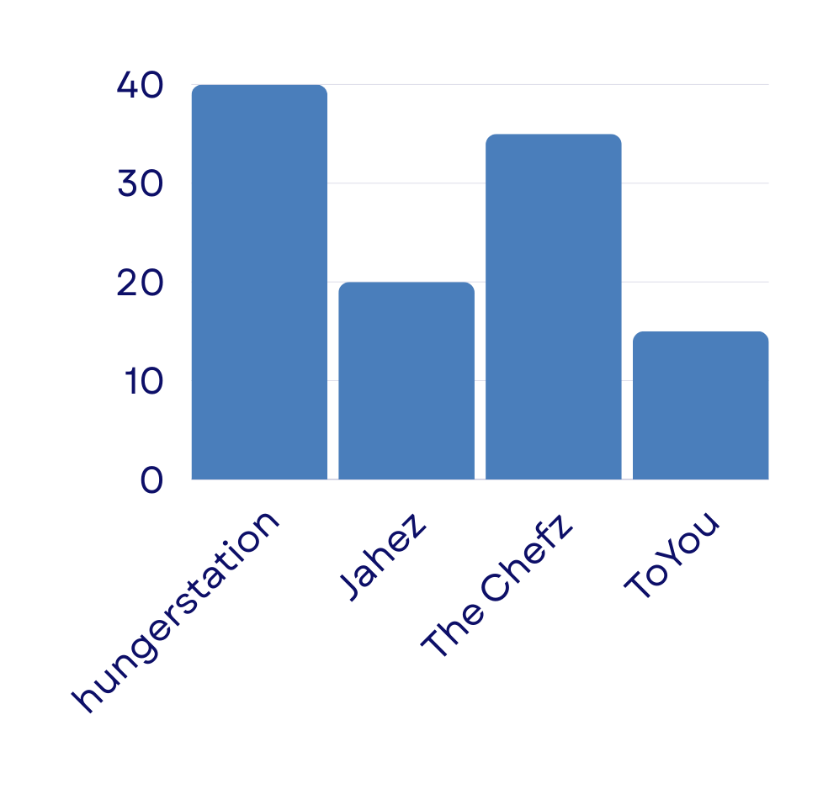




Statistical study

Slide 7
Conclusion
Conclusion
the capability of AI technologies Deep, Learning, to understand and cater to the diverse Arabic dialects. It should highlight the ability of these AI platforms to deliver optimized ad content, speech recognition, and natural language processing in various Arabic dialects, enabling businesses to effectively reach and engage with Arabic-speaking audiences. The conclusion should stress the potential for improved targeting, performance, and user experience through the use of AI in advertising for Arabic dialects..

Slide 8
Thank You

