Slide 1






CS316
Project
Analyzing Student Performance Factors

Slide 2


Abstract
Focused on analyzing student performance factors.
Dataset: 6,607 student records with 20 features (Kaggle).
Data features: Attendance, study hours, gender, school type, and more.
Aim: Identify key factors to support at-risk students and improve education.
Aligned with SDG 4 (Quality Education) for equitable learning opportunities.
Indirectly supports SDG 8 (Economic Growth) by fostering skilled students.

Slide 3





Research Questions
Factors
Correlations
Impact
What influences student academic performance the most?
Are personal and socioeconomic factors linked?
How can findings improve education and help at-risk students?

Slide 4






Methodology
Data cleaning and preparation
Visualization and Feature Analysis
Machine Learning Models
Findings and Interpretations

Slide 5
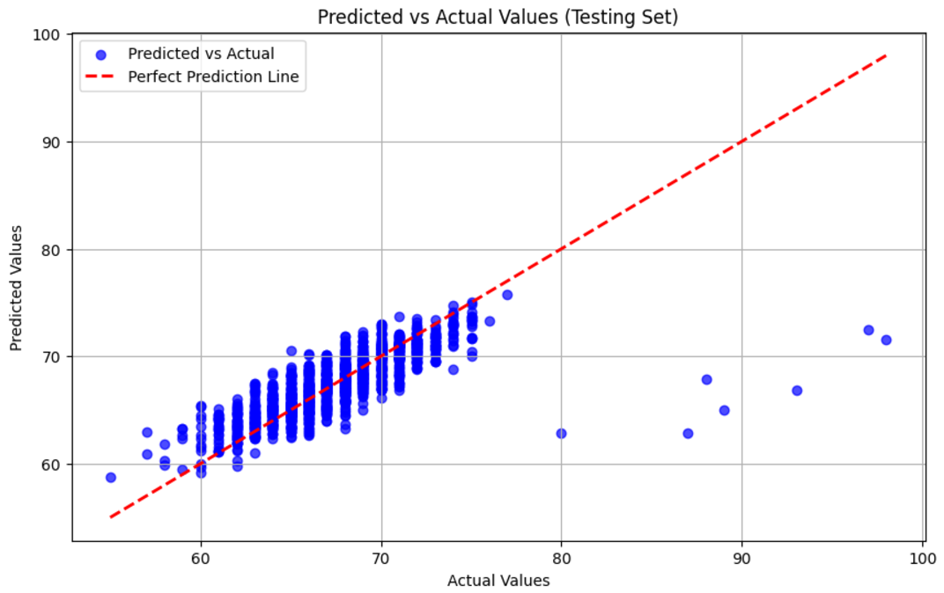
LINEAR REGRESSION FINDINGS (2 FEATURES)

Slide 6
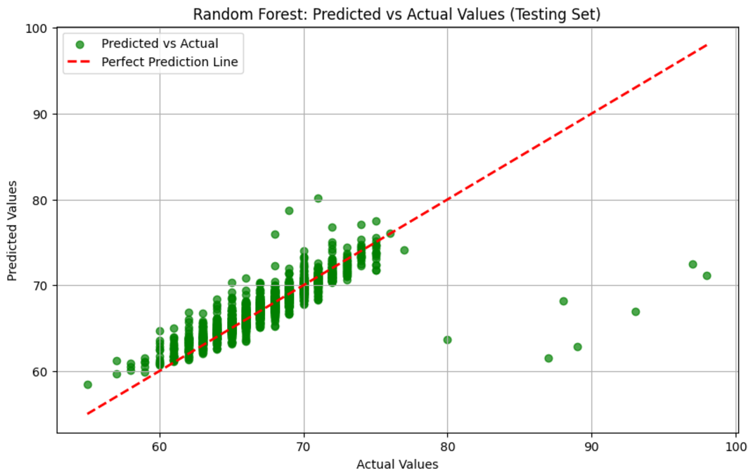
RANDOM FOREST FINDINGS

Slide 7
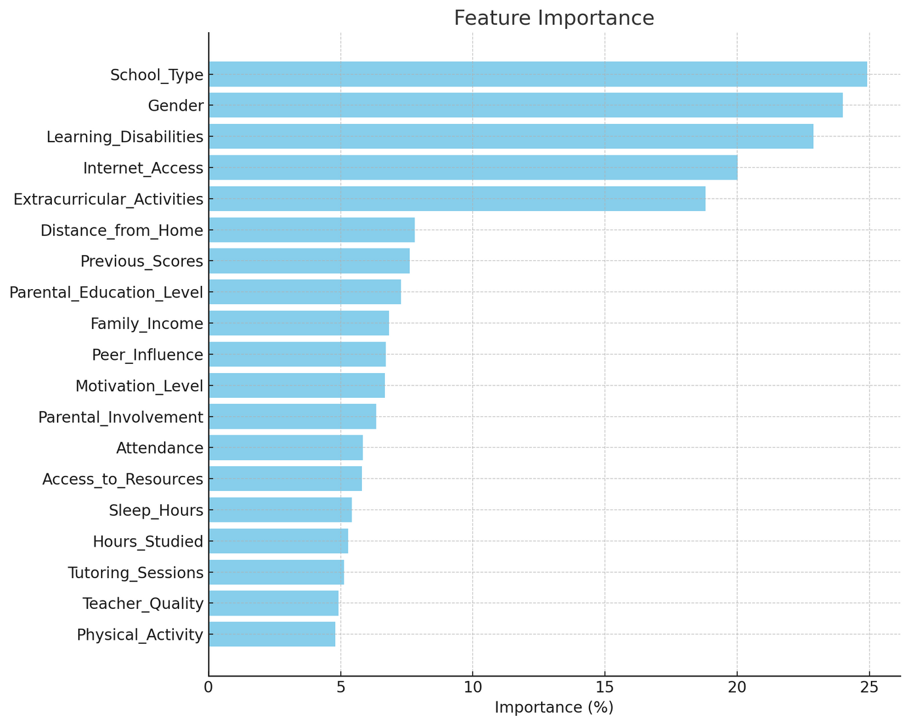
NEURAL NETWORK FINDINGS

Slide 8
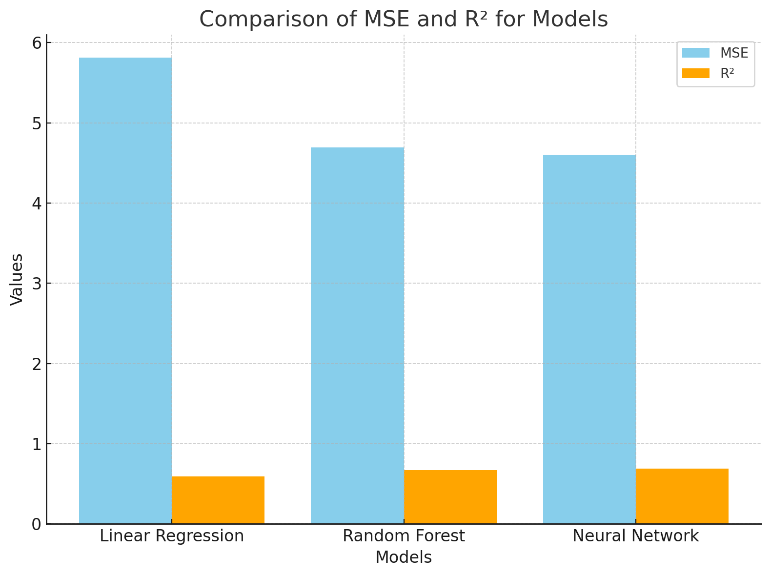

Slide 9





Conclusions
01
02
03
Recommendations include improving resource access, supporting students with learning disabilities, and fostering inclusive environments to address socio-cultural challenges.
Neural networks performed best by capturing complex relationships.
Attendance, hours studied, school type, gender, internet access, and learning disabilities significantly impact performance.

Slide 10
Thank's For Watching
Rami Gamal
Ahmed Yasser
Syed Fawaz
Mostafa Waheed

