Slide 1

Data analytics
Health Care project

Slide 2
Project Name: Health Care
TA: Yomna Ali
Date: 22/5/2023
Team Information
Name | ID | Section | Department
عبد الرحمن رضا عبد الفتاح | 20201700474 | 5 | IS
عبد الرحمن سعد رمضان محمد | 20201700475 | 5 | IS
احمد يسري عبد العظيم شحاته | 20201700098 | 1 | IS
احمد محمود بكر محمد | 20201701172 | 1 | IS
محمد فوزى حافظ سعودى | 20191700566 | 7 | IS

Slide 3
Health Care project
Data Description.
01
Data preprocessing.
02
Classification Models.
05
Data Exploration.
03
Data Visualization.
04

Slide 4
Description of data
The HealthCare-DataSet is a dataset that contains information about patients who have been diagnosed with stroke. The dataset contains 5110 row and 11 features, including age, gender, smoking status, blood pressure, cholesterol level, glucose level, heart rate, body mass index (BMI), and whether or not the patient has had a previous stroke.
The dataset also includes a target variable, which is whether or not the patient has had a stroke. The Health Care-DataSet can be used to train machine learning models to predict whether or not a patient is likely to have a stroke. The dataset can also be used to understand the factors that are associated with stroke risk.
The HealthCare-DataSet.csv is a valuable resource for researchers and healthcare professionals who are interested in understanding stroke risk and developing machine learning models to predict stroke.

Slide 5
Description of each column in the "HealthCare-DataSet.csv":
id: This column represents a unique identifier or ID for each record in the dataset. It is typically used to distinguish one entry from another.
gender: This column captures the gender or sex of the individual in the healthcare dataset. It could have values such as "Male," "Female,".
age: This column denotes the age of the individual. It represents the person's age in years, indicating their chronological age at the time of the data collection.
hypertension: This column indicates whether the individual has hypertension or high blood pressure. It is often represented as a binary value, with "1" indicating the presence of hypertension and "0" representing the absence., "1" typically represents the presence of a stroke, while "0" denotes no stroke.
heart_disease: This column represents whether the individual has a pre-existing heart disease. It is also a binary value, where "1" indicates the presence of a heart disease condition, and "0" denotes the absence.
ever_married: This column captures the marital status of the individual. It could have values like "Yes" or "No" to indicate whether the person has ever been married.

Slide 6
work_type: This column describes the type of work or occupation the individual is engaged in. It may include categories such as "Private," "Self-employed," "Government job," or other relevant work types.
Residence_type: This column indicates the type of residence or location where the individual lives. It may include values like "Urban" or "Rural" to differentiate between urban and rural areas.
avg_glucose_level: This column represents the average glucose level in the individual's blood. It is often measured in milligrams per deciliter (mg/dL) and provides information about the person's blood sugar level.
bmi: This column denotes the Body Mass Index (BMI) of the individual. BMI is a measure of body fat based on a person's height and weight. It provides insights into the individual's weight status.
smoking_status: This column captures the smoking status of the individual. It may include categories like "Smokes," "Formerly Smoked," "Never Smoked," or other relevant smoking status options.
stroke: This column indicates whether the individual has experienced a stroke. Similar to other binary columns

Slide 7
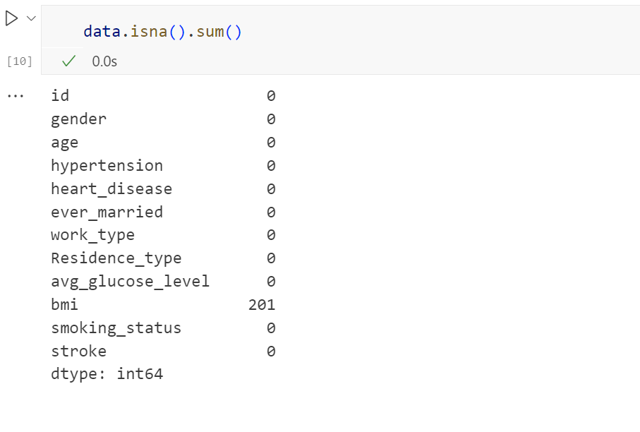
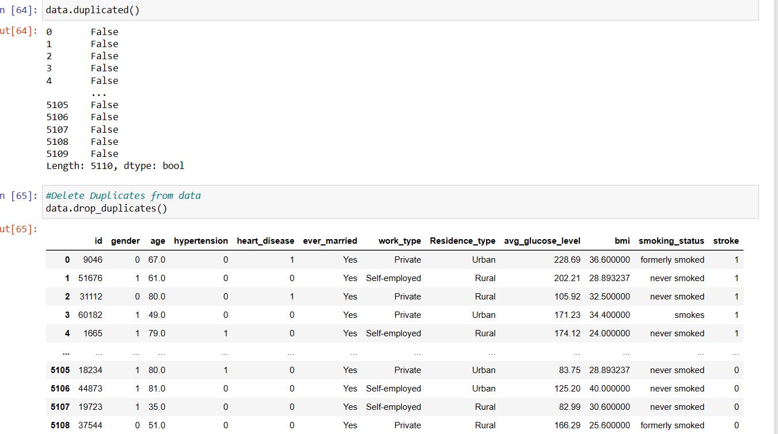
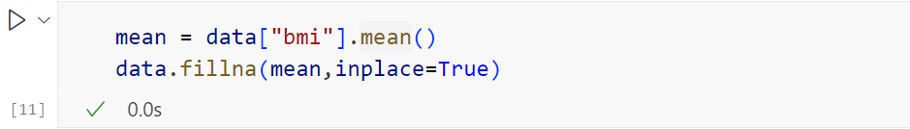
preprocessing
1. Check for missing values
2. Remove Duplicates from data
Handle Missing Data

Slide 8
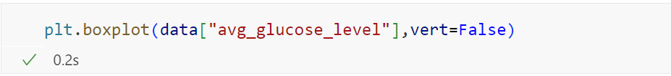
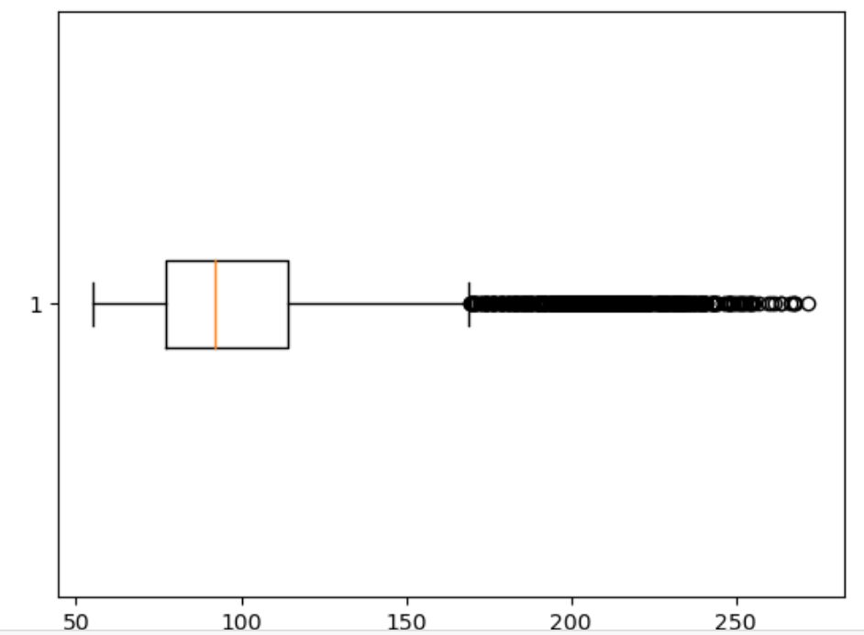
3. Anomaly Detection :
Check Outliers

Slide 9
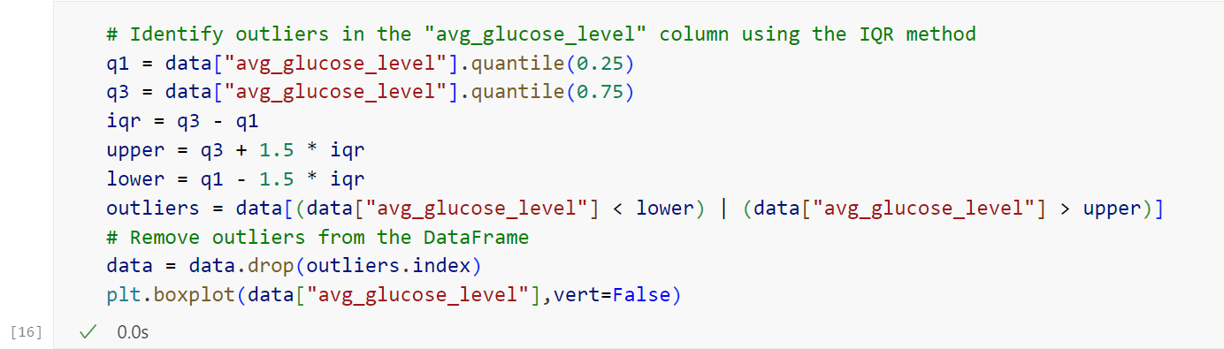
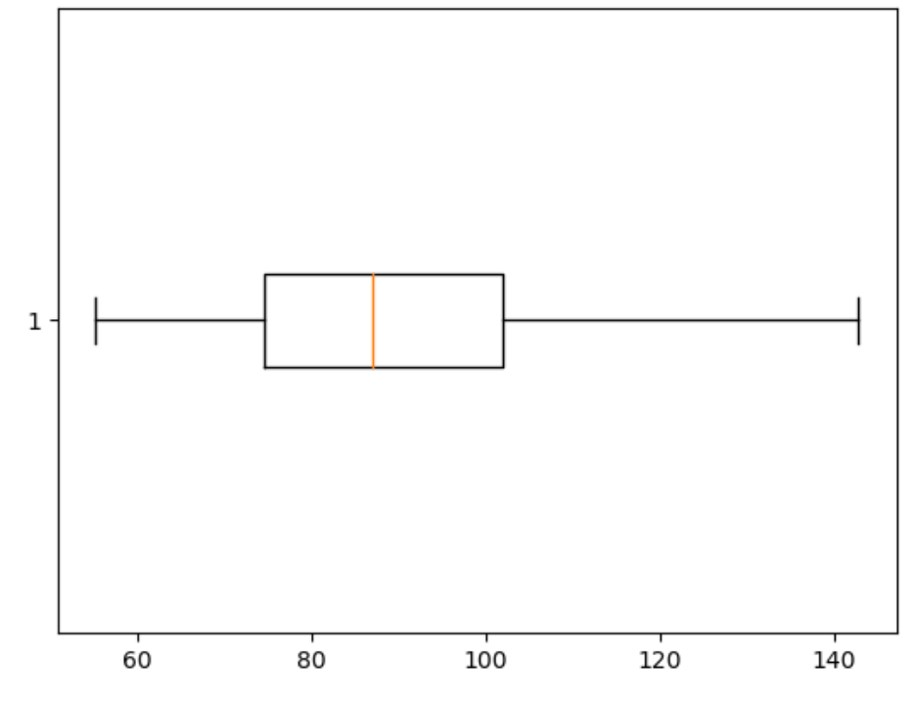
Remove Outliers

Slide 10
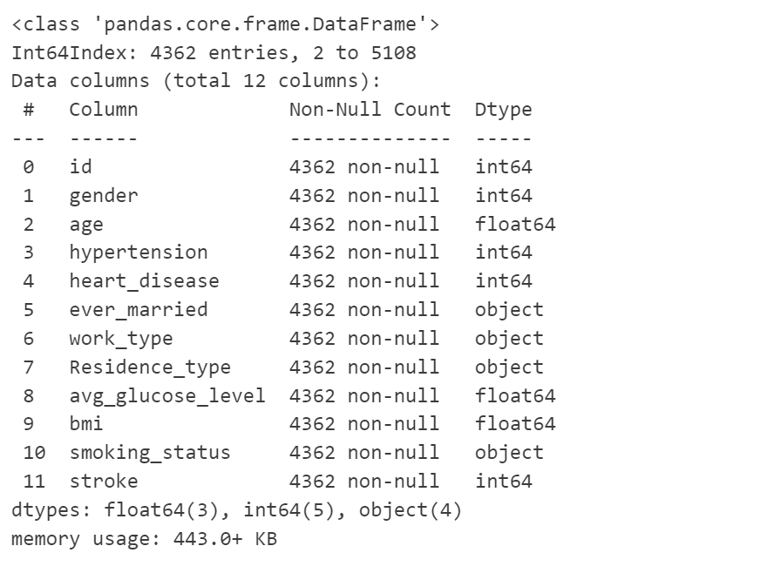
Data Exploration
1 .Summsry statistics :
df.info()

Slide 11
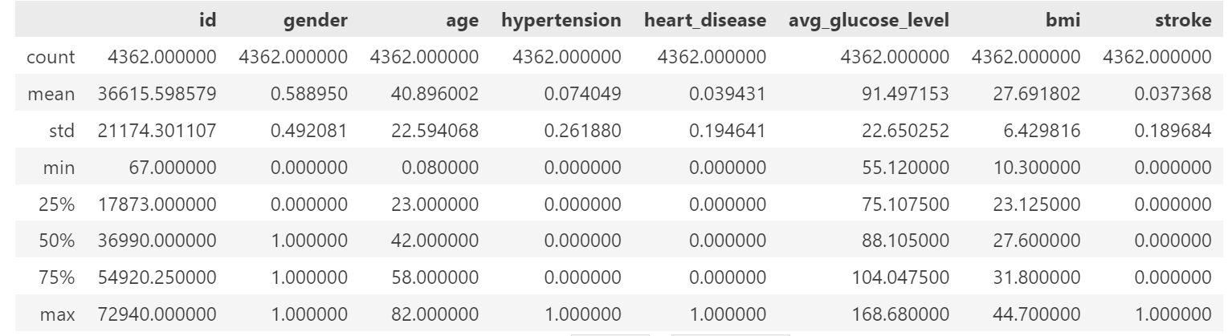
df.describe()

Slide 12
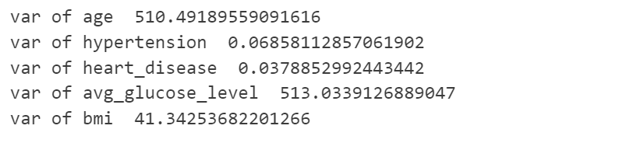
import statistics
va_age=statistics.variance(df['age'])
va_hypertension=statistics.variance(df['hypertension'])
va_heart_disease=statistics.variance(df['heart_disease'])
va_avg_glucose_level=statistics.variance(df['avg_glucose_level'])
va_bmi=statistics.variance(df['bmi'])
print("var of age " , va_age)
print("var of hypertension ",va_hypertension)
print("var of heart_disease ",va_heart_disease)
print("var of avg_glucose_level ",va_avg_glucose_level)
print("var of bmi ",va_bmi)

Slide 13
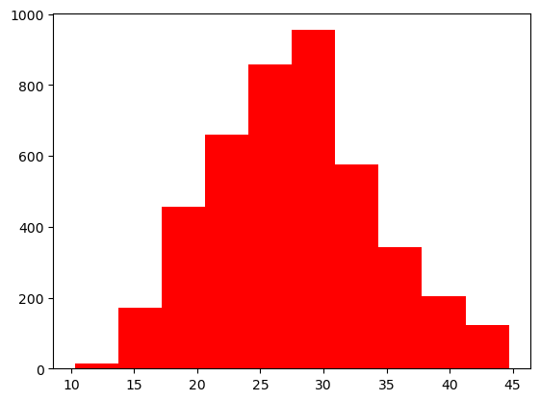
Visualization
Histogram
describe the bmi column as one numerical variable (continuous data) In a histogram, the type of data being measured is represented on the horizontal axis, and the vertical axis represents how many observations are in each bin.
import matplotlib.pyplot as plt
## Histogram
plt.hist(df['bmi'],color='red')

Slide 14
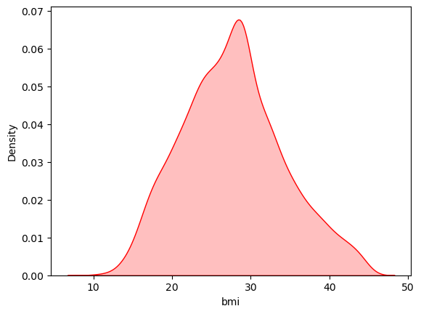
Density Plot
describe the bmi column as one numerical variable (continuous data) is a representation of the distribution of a numeric variable. It uses a kernel density estimate to show the probability density function of the variable. It is a smoothed version of the histogram and is used in the same concept. (help us to know if we will replace the missing value with mean or median )it shows us if the shape normal distribution or not
import seaborn as sns
sns.distplot(df['bmi'],
kde_kws = {'shade': True},
color='red',
hist=False)

Slide 15
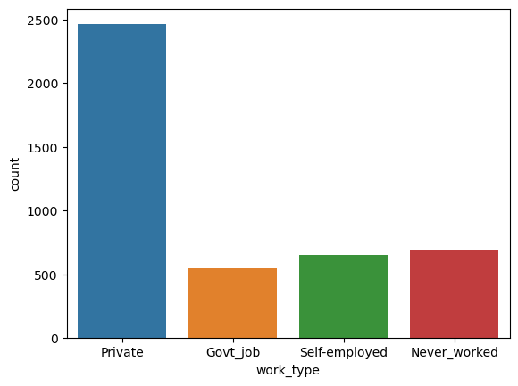
count plot
describe the work_type column as one categorical data it is used to represent the number of observations of a categorical variable for each group with bars and help us to know how many people work at each type(to know if the type of work affects people's health or not).
sns.countplot(x = 'work_type',data = df)

Slide 16
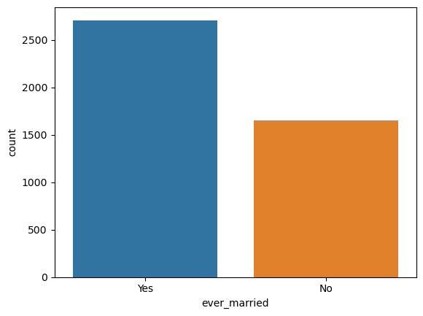
count plot
describe the ever_married column as one categorical data
it is used to represent the number of observations of a categorical variable for each group with bars and help us to know how many people work at each type(to know if the status affects people's health or not).
sns.countplot(x=df["ever_married"],data=df)

Slide 17
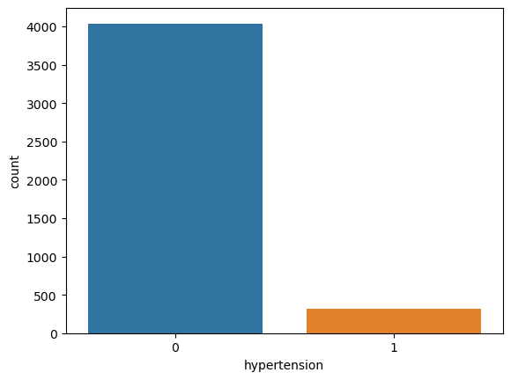
count plot
describe the hypertension column as one categorical data
it is used to represent the number of observations of a categorical variable for each group with bars and help us to know how many people work at each type(to know if the hypertension has a relation between that and stroke).
sns.countplot(x=df["hypertension"],data=df)

Slide 18
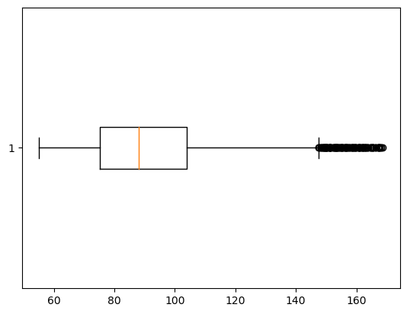
Boxplot
describe the avg_glucose_level column as one numerical variable (continuous data) A box plot indicates the position of the minimum, maximum and median values along with the position of the lower and upper quartiles. From this, the range, interquartile range, and skewness of the data can be observed and help us to know how many people have a problem in the avg_glucose_level on not
plt.boxplot(df['avg_glucose_level'],vert=False)

Slide 19
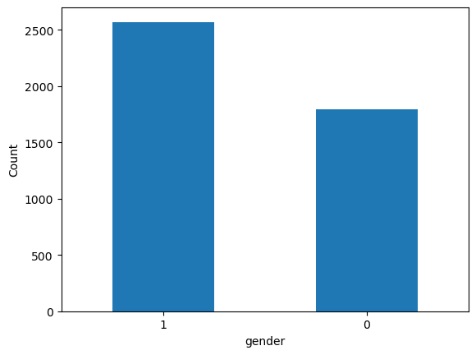
Bar chart
it describes the gender column as one categorical data it is used to represent differences between categories or other discrete data. Looking for differences between categories as a screening method for identifying possible relationships helps us to know how many men and women (to know if the disease affects men more or women ).
df['gender'].value_counts().plot(kind='bar', xlabel='gender', ylabel='Count', rot=0)

Slide 20
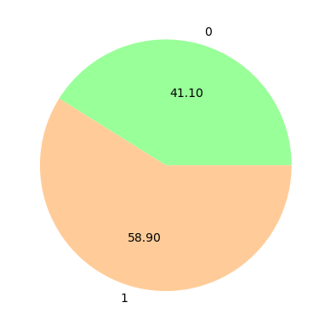
pie chart
it describes the gender column as one categorical data
A pie chart shows how a total amount is divided between levels of a categorical variable as a circle divided into radial slices. Each categorical value corresponds with a single slice of the circle, and the size of each slice (both in area and arc length) indicates what proportion of the whole each category level takes helps us to know how many men and women (to know if the disease affects men more or women).
colors = ['#99ff99','#ffcc99']
df.groupby('gender').size().plot(kind='pie', autopct='%.2f',colors=colors)

Slide 21
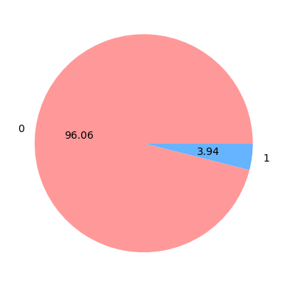
pie chart
it describes the heart_disease column as one categorical data
A pie chart shows how a total amount is divided between levels of a categorical variable as a circle divided into radial slices. Each categorical value corresponds with a single slice of the circle, and the size of each slice (both in area and arc length) indicates what proportion of the whole each category level takes help us to know how many people have heart disease.
colors = ['#ff9999','#66b3ff']
df.groupby('heart_disease').size().plot(kind='pie', autopct='%.2f',colors=colors)

Slide 22
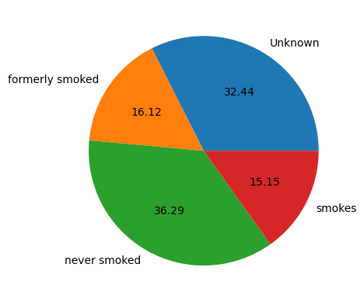
pie chart
it describes the smoking column as one categorical data
A pie chart shows how a total amount is divided between levels of a categorical variable as a circle divided into radial slices. Each categorical value corresponds with a single slice of the circle, and the size of each slice (both in area and arc length) indicates what proportion of the whole each category level takes helps us to know how many people smoking and the affect of smoking in health and if it make stroke or not).
df.groupby('smoking_status').size().plot(kind='pie', autopct='%.2f')

Slide 23
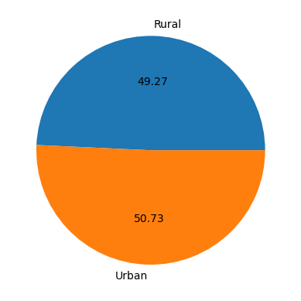
pie chart
it describes the Residence_type column as one categorical data
A pie chart shows how a total amount is divided between levels of a categorical variable as a circle divided into radial slices. Each categorical value corresponds with a single slice of the circle, and the size of each slice (both in area and arc length) indicates what proportion of the whole each category level takes helps us to know if residence_type has a relation between that and stroke).
import seaborn as sns
df.groupby('Residence_type').size().plot(kind='pie', autopct='%.2f')

Slide 24
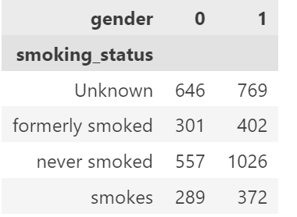
Stacked column chart
it describes the smoking column and gender column as two categorical data
The stacked bar chart (aka stacked bar graph) extends the standard bar chart from looking at numeric values across one categorical variable to two. Each bar in a standard bar chart is divided into a number of sub-bars stacked end to end, each one corresponding to a level of the second categorical variable (help us to know how many men and women smoke and the relation between that and stroke).
#grouped_df.head(5)
pivot_df.head(5)
grouped_df = df.groupby(['smoking_status', 'gender'])[['stroke']].count().reset_index()
pivot_df = grouped_df.pivot(index='smoking_status', columns='gender', values='stroke')

Slide 25
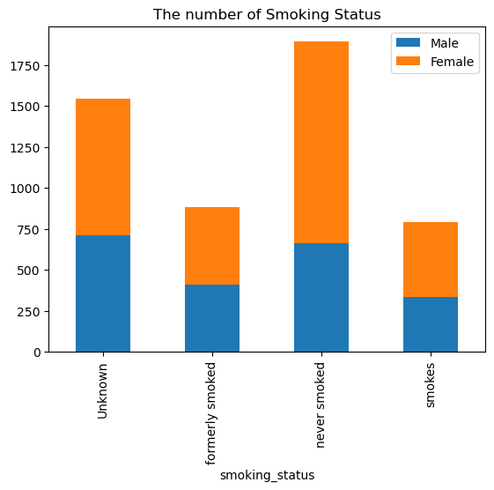
Dframe = pd.DataFrame({
'smoking_status': ['Unknown','formerly smoked','never smoked','smokes'],'Male':[708,407,663,337],'Female':[836,477,1229,452]
})
Dframe.plot.bar(x='smoking_status', stacked=True, title='The number of Smoking Status')

Slide 26
Apply Classification Models
Split the data into training and test sets
from sklearn.model_selection import train_test_split
y=df['stroke']
x=df.drop('stroke',axis=1)
X_train, X_test, y_train, y_test = train_test_split(x,y, test_size=0.2, random_state=42)
Gaussian Naive Bayes (GaussianNB).
from sklearn.naive_bayes import GaussianNB
from sklearn.metrics import accuracy_score
nb = GaussianNB()
nb.fit(X_train, y_train) y_pred = nb.predict(X_test) accuracy = accuracy_score(y_test, y_pred)
print("Accuracy:", accuracy)
Accuracy: 0.9576174112256587

Slide 27
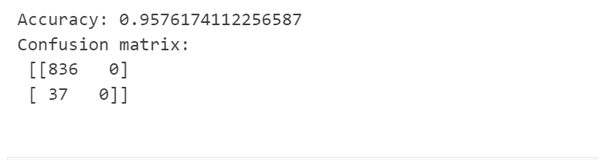
2. LogisticRegression
from sklearn.linear_model import LogisticRegression
from sklearn.metrics import accuracy_score, confusion_matrix
lr = LogisticRegression()
lr.fit(X_train, y_train)
y_pred = lr.predict(X_test)
accuracy = accuracy_score(y_test, y_pred)
confusion = confusion_matrix(y_test, y_pred)
print("Accuracy:", accuracy)
print("Confusion matrix:\n", confusion)

Slide 28
3. LinearRegression
from sklearn.linear_model import LinearRegression
from sklearn.metrics import mean_squared_error, r2_score
# Create an instance of the linear regression model
lr = LinearRegression()
# Fit the model to the training data
lr.fit(X_train, y_train)
# Make predictions on the test data
y_pred = lr.predict(X_test)
# Print the mean squared error and R-squared value of the model
mse = mean_squared_error(y_test, y_pred)
r2 = r2_score(y_test, y_pred)
print("Mean squared error:", mse)
print("R-squared:", r2)
Mean squared error: 0.03749613059993048
R-squared: 0.07613835128687352

Slide 29
4. KNeighborsClassifier
from sklearn.neighbors import KNeighborsClassifier
from sklearn.metrics import accuracy_score
# Create an instance of the k-NN classifier
k = 3 # choose the number of neighbors
knn = KNeighborsClassifier(n_neighbors=k) # Fit the classifier to the training data
knn.fit(X_train, y_train) # Make predictions on the test data
y_pred = knn.predict(X_test) # Print the accuracy score of the model
accuracy = accuracy_score(y_test, y_pred)
print("Accuracy:", accuracy)
Accuracy: 0.9541809851088202

Slide 30


