Slide 1

Adders Mania TEAM 1

Slide 2
Team Members
Name | Code | Sec | B.N
Ahmed Abdelatty | 9210097 | 1 | 10
Ahmed Zahran | 9210026 | 1 | 6
Mohamed Adel | 9211006 | 2 | 10
Kareem Alaa | 9210842 | 2 | 3

Slide 3
Team Members Roles
Member | Roles | Estimate Work Time
Ahmed Abdelatty | Carry bypass adder | 16 hours
Ahmed Zahran | Carry select adder | 30 hours
Mohamed Adel | Carry lookahead adder | 1524236 hours
Kareem Alaa | Ripple carry adder Floating point adder | نص ساعة وكباية شاي

Slide 4
Verilog (+)

Slide 5
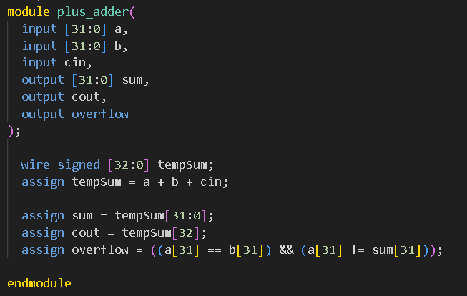
Code
The design is simple ‘+’ operator in Verilog.
Overflow bit to detect overflow according to sign of the inputs and sign of the output.

Slide 6
Metrics
The results of the report are as shown
Min Delay (without input delay) | 0.69
Max Delay (without input delay) | 11.63
Min Delay (with input delay) | 1.69
Max Delay (with input delay) | 12.63
Total Power | 403.8777 uW
Total cell area | 976.895985
Total area | 996.031251

Slide 7
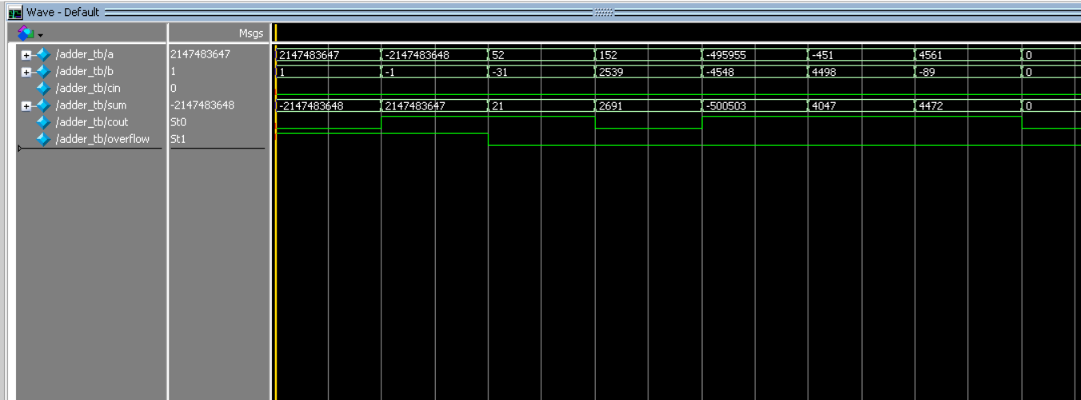
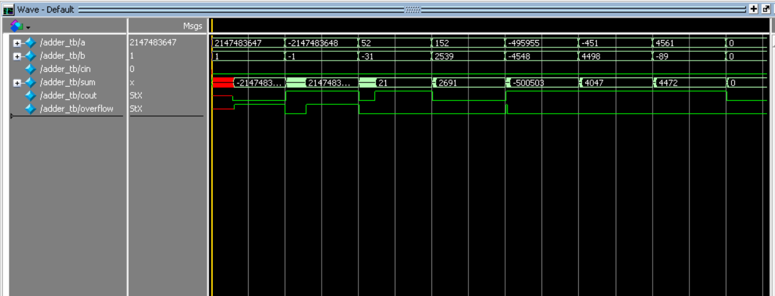
Before synthesis simulation
pass all 8 cases
After synthesis simulation
pass all 8 cases
We can see the delay in output due to synthesis

Slide 8
Ripple Carry Adder

Slide 9
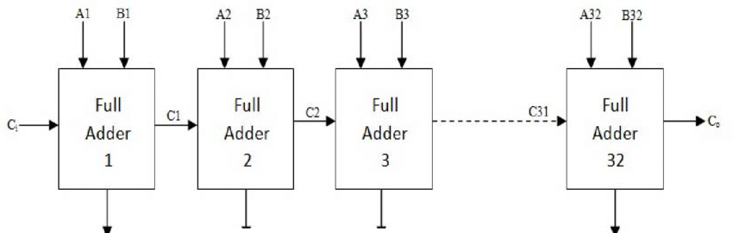
Design
32 full adder blocks

Slide 10
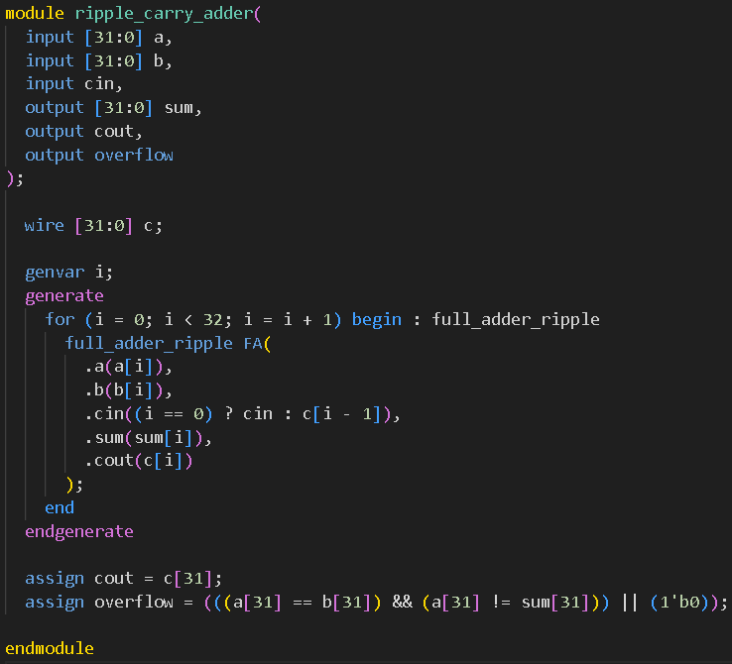
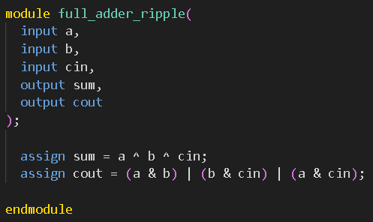
Code
For generic for 32 full adders
Overflow bit according to sign of inputs and output

Slide 11
Metrics
The results of the report are as shown
Min Delay (without input delay) | 0.67
Max Delay (without input delay) | 6.49
Min Delay (with input delay) | 1.67
Max Delay (with input delay) | 7.49
Total Power | 572.1782 uW
Total cell area | 1301.299213
Total area | 1343.561726

Slide 12
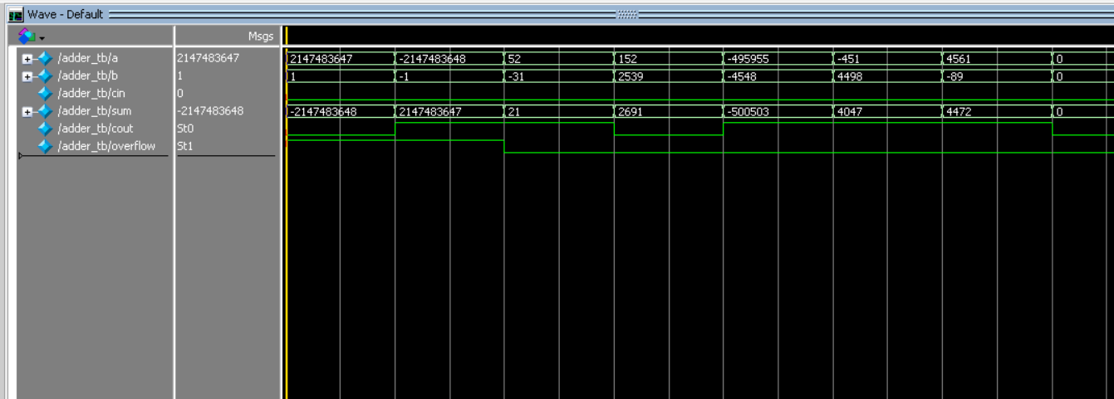
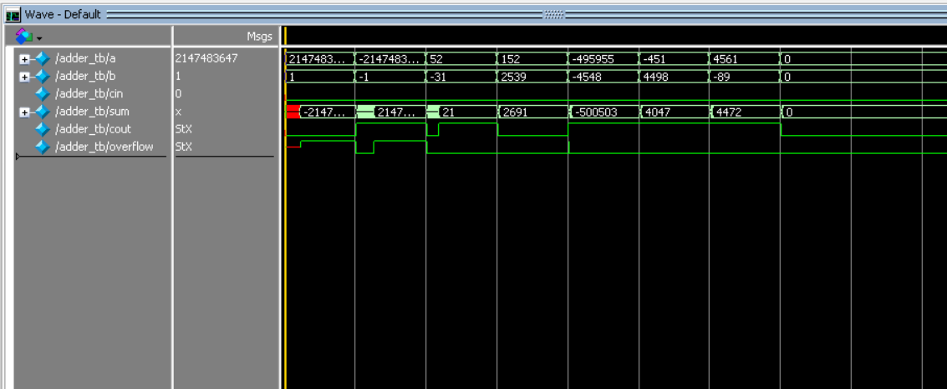
Before synthesis simulation
pass all 8 cases
After synthesis simulation
pass all 8 cases
We can see the delay in output due to synthesis

Slide 13
Floating Point Adder

Slide 14
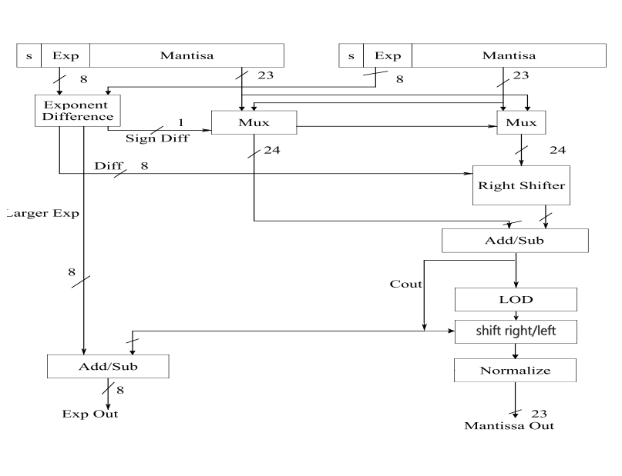
Design

Slide 15
Get the difference between exponent to choose which mantisa is going to be shifted and get larger exponent.
Shift mantisa b by value of exponent difference.
Add or subtract the two mantisa according to the signs .
Find the location of leading one in the result mantisa.
According to carry from the third operation we choose the shifted mantisa by the location of leading one value and exponent subtracted by this shift or we choose the shifted mantisa by 1 and the exponent is add by 1.
Determine the overflow according to larger exponent and carry from third operation.

Slide 16
According to the design I tried to make it faster but this lead to increase in the area.
So, I choose Verilog ‘+’ to make addition in the code to decrease the area a little.
I can choose carry lookahead or carry select adder to enhance the time, but this will lead to increase in area too and this will make a huge difference between area and time and doesn’t make sense.

Slide 17
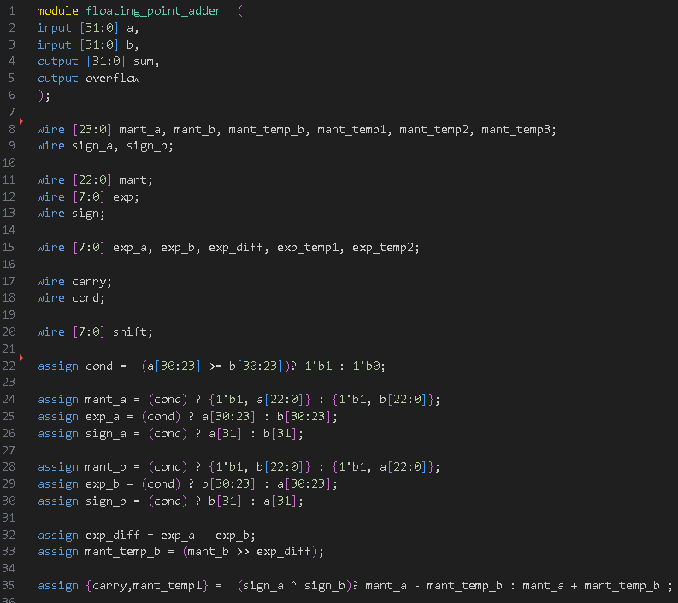
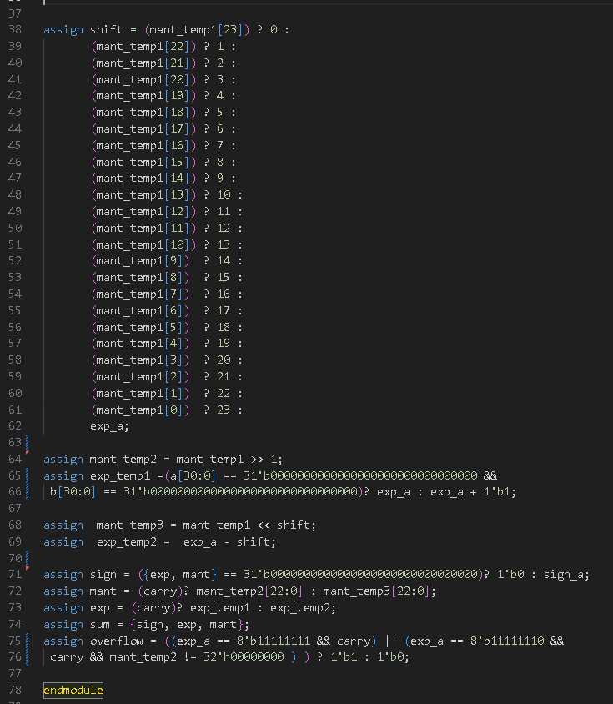
Code

Slide 18
Metrics
The results of the report are as shown
Min Delay (without input delay) | 16.49
Max Delay (without input delay) | 19.92
Min Delay (with input delay) | 17.42
Max Delay (with input delay) | 20.92
Total Power | 2.2831Ee+03 uW
Total cell area | 7288.934437
Total area | 7713.176478

Slide 19
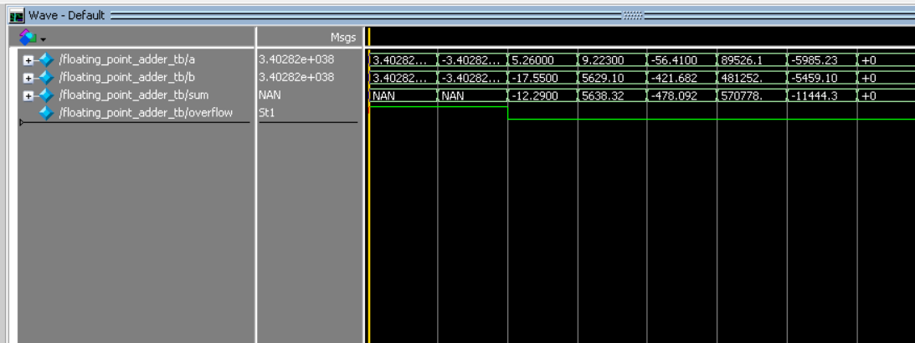
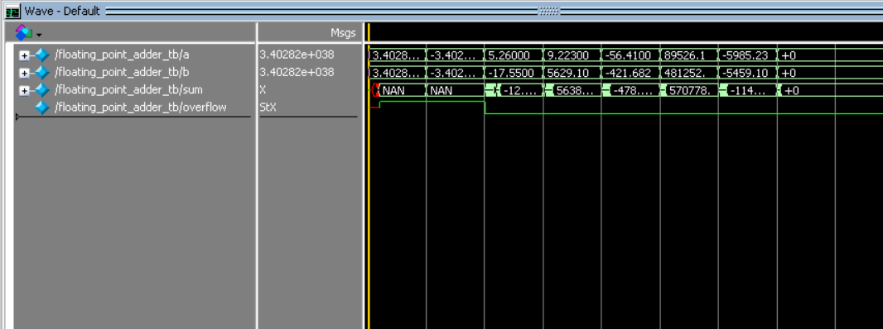
Before synthesis simulation
pass all 8 cases
After synthesis simulation
pass all 8 cases
We can see the delay in output due to synthesis

Slide 20
Carry-bypass Adder

Slide 21
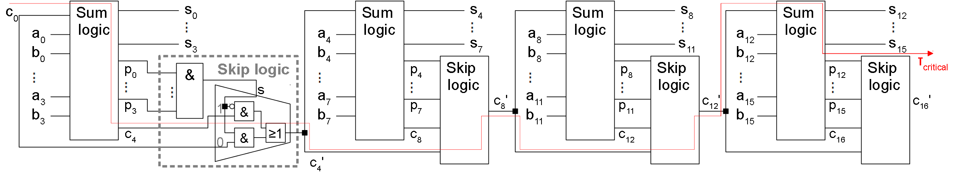
Design
A 16-bit carry-bypass adder with 4-bit ripple-carry adder blocks is shown

Slide 22
The carry-bypass adder consists of several blocks of ripple-carry adders followed by skip logic blocks.
It improves on the performance of the ripple-carry adder with little effort compared to other adders
Each block either propagates the previous carry or deletes it or generates it
If the block will propagate, the previous carry can bypass this block
The critical path goes through setup of the first block, then the carry bits, then it propagates through all middle blocks until it reaches the last sum bit in the last block

Slide 23
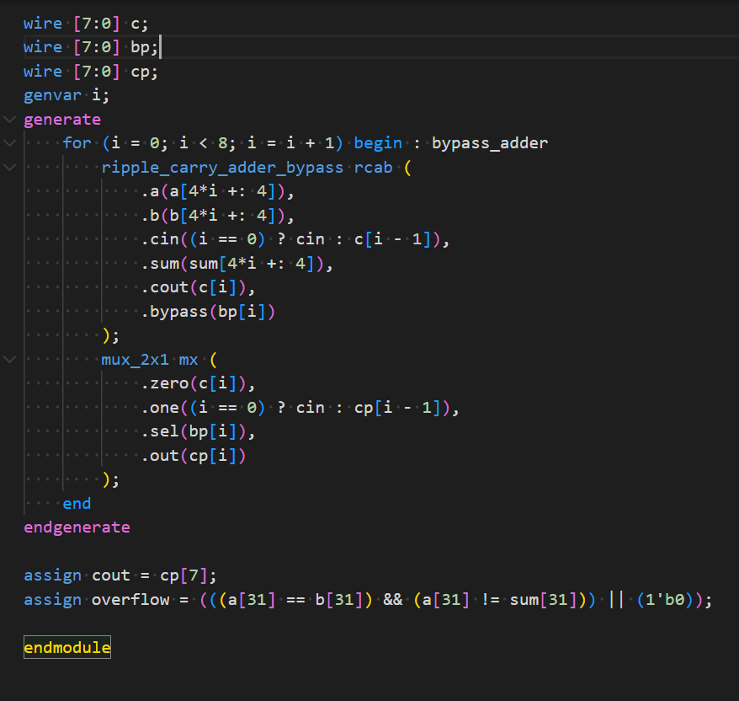
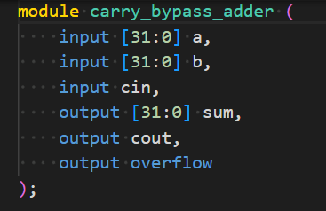
Code

Slide 24
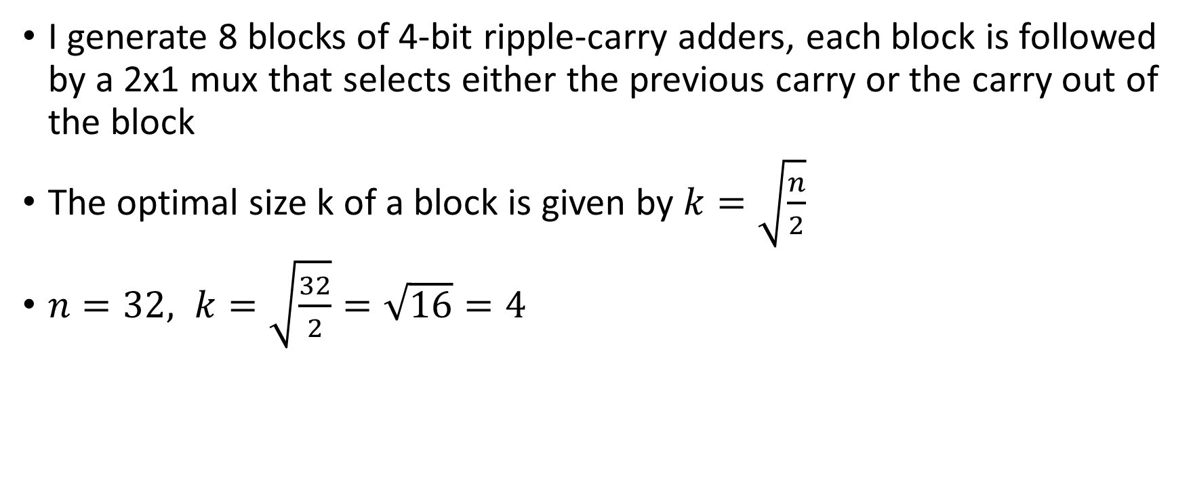
I generate 8 blocks of 4-bit ripple-carry adders, each block is followed by a 2x1 mux that selects either the previous carry or the carry out of the block
The optimal size k of a block is given by $k=\sqrt{\frac{n}{2}}$
$n=32, k=\sqrt{\frac{32}{2}}=\sqrt{16}=4$

Slide 25
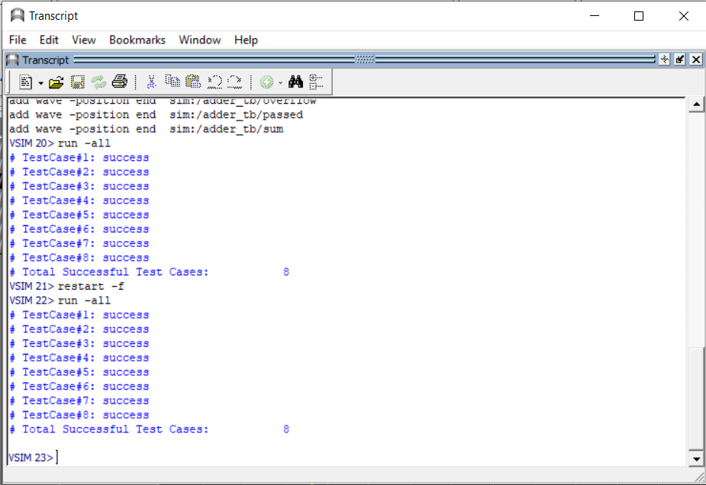
Testbench
The adder passes all 8 cases in the testbench

Slide 26
Metrics
The results of the report are as shown
Min Delay (without input delay) | 0.68
Max Delay (without input delay) | 6.5
Min Delay (with input delay) | 1.68
Max Delay (with input delay) | 7.5
Total Power | 615.4617 uW
Total cell area | 1470.873615
Total area | 1517.231929

Slide 27
The carry-bypass adder provides a balance of speed and area
It has a max delay of 7.5 which is faster than the plus adder (12.63) but slower than the carry-select adder (4.11)
While the plus adder has relatively small area (~996) and the carry-select adder is relatively larger (~2195), the carry-bypass adder sits somewhere in the middle (~1517)

Slide 28
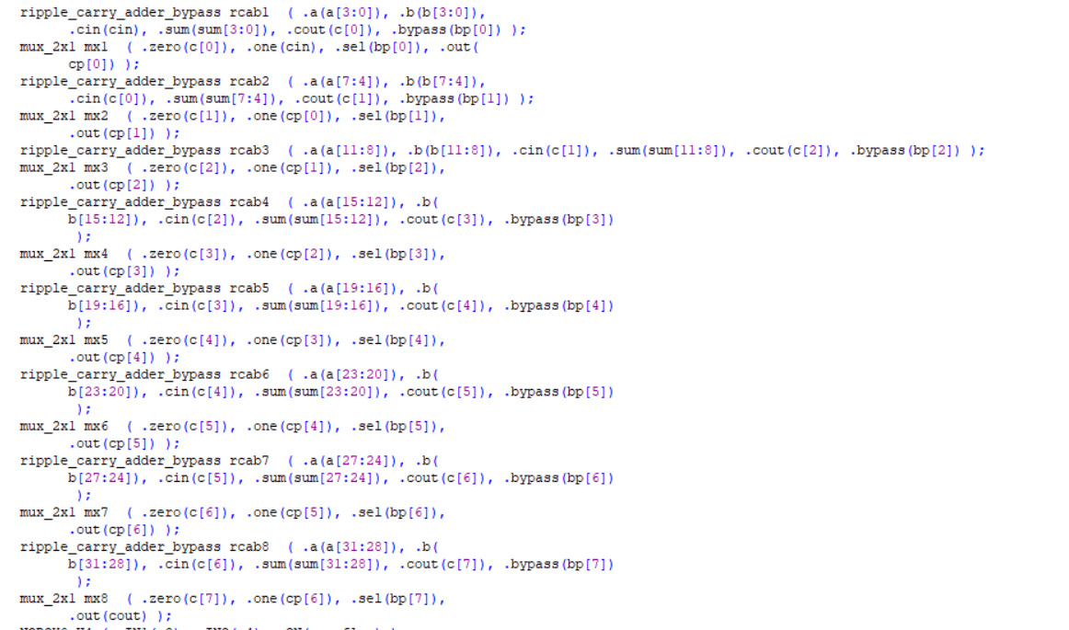
Synthesis Code
Output code from synthesis showing loop unrolling of the 8 blocks

Slide 29
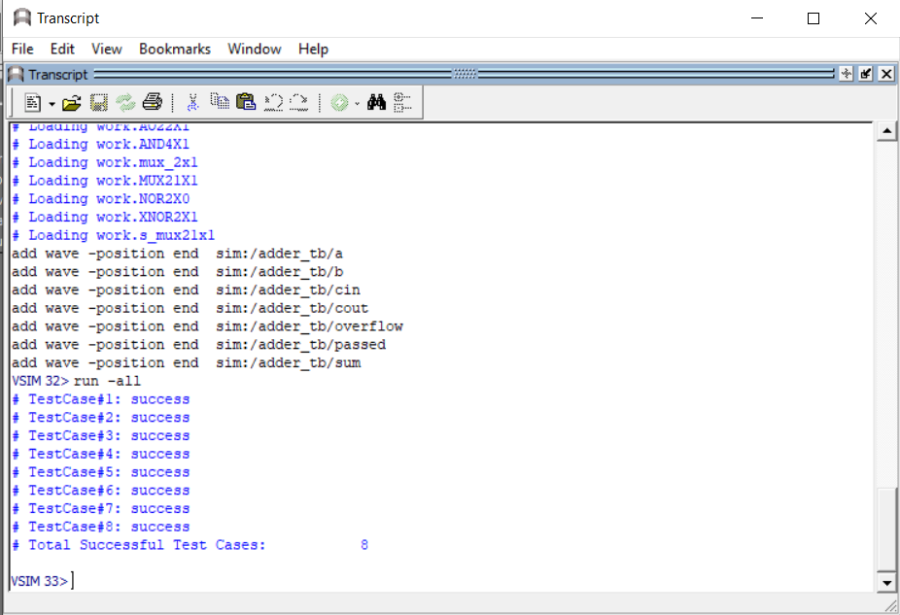
Testbench
Post-synthesis simulation of the adder passes all 8 cases in the testbench

Slide 30
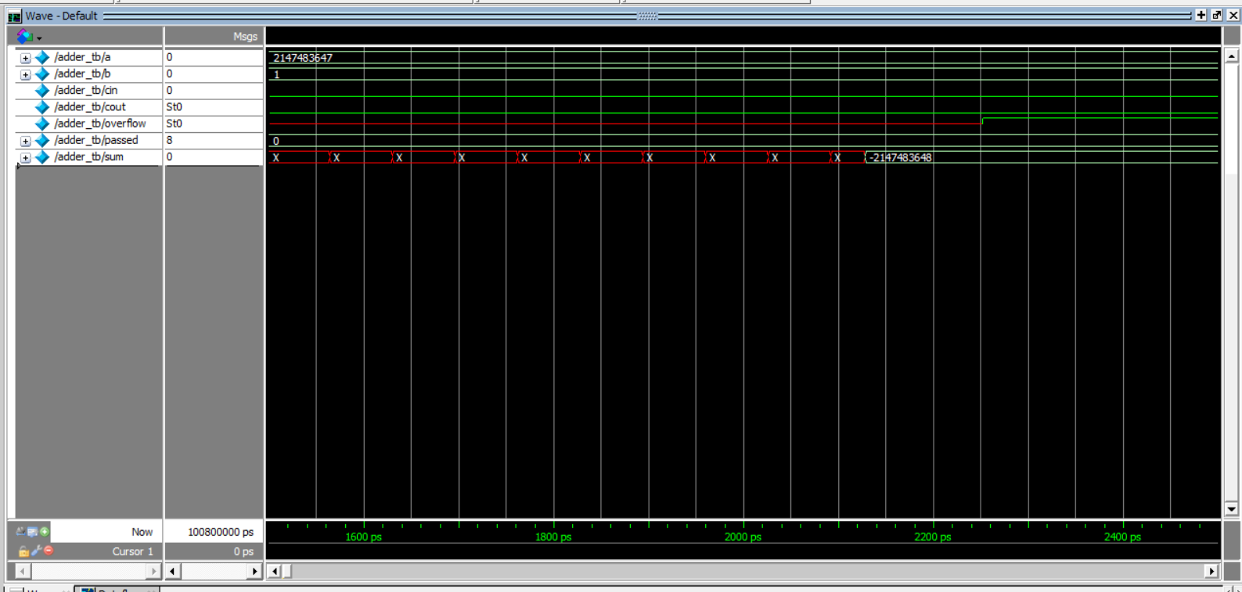
Waveform
The waveform of the post-synthesis simulation showing a delay

Slide 31
Carry Lookahead Adder

Slide 32
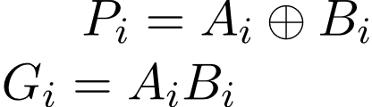
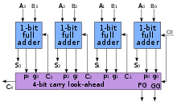
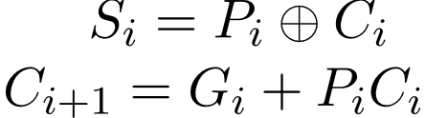
Design
A 4-bit carry lookahead adder circuit is like the following figure
https://www.geeksforgeeks.org/carry-look-ahead-adder/

Slide 33
The n-bits carry-lookahead adder consists of n full adders and some combinational circuit to determine the propagate and generate .
The idea is simple, instead of waiting for the previous carry to be calculated, why not just calculate it several times but at once which just means paralleling calculations
This adder is supposed to increase performance of adders but at the cost of the area
There is a way to keep the area low as much as possible but the delay will be long because we can’t achieve both metrics together

Slide 34
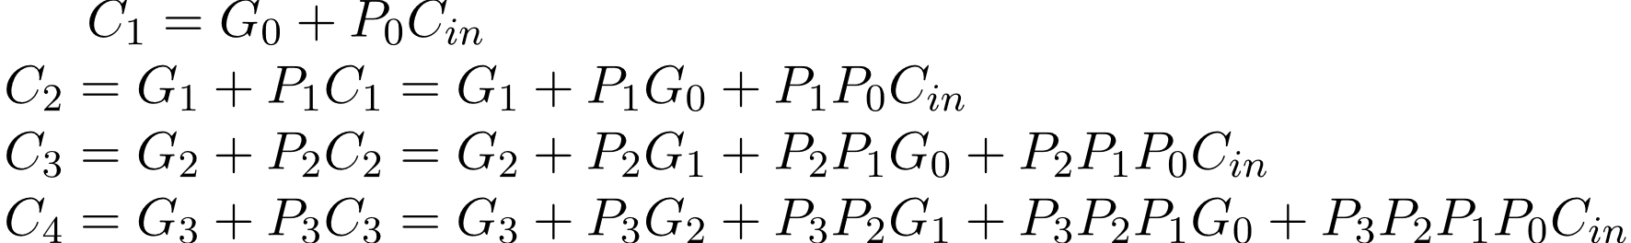
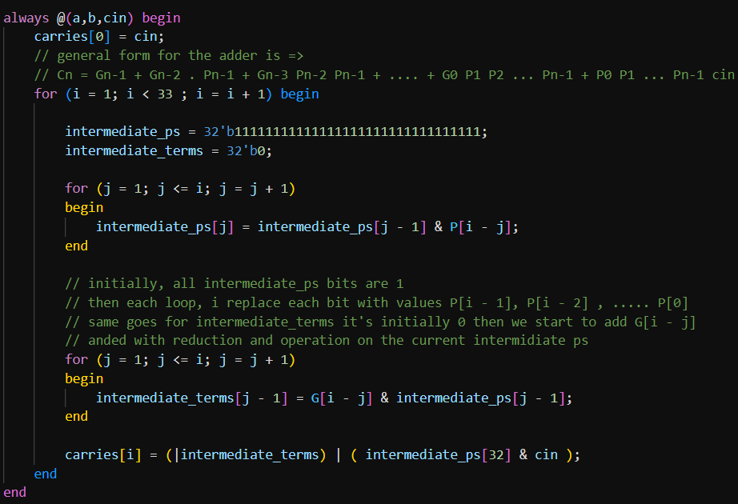
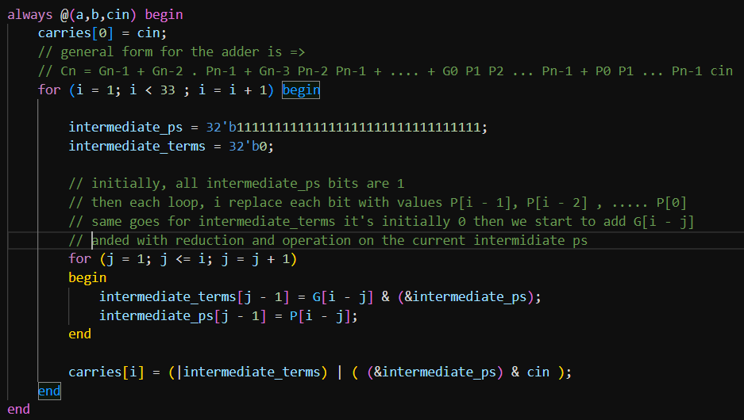
Code
High Performance
Low Area

Slide 35
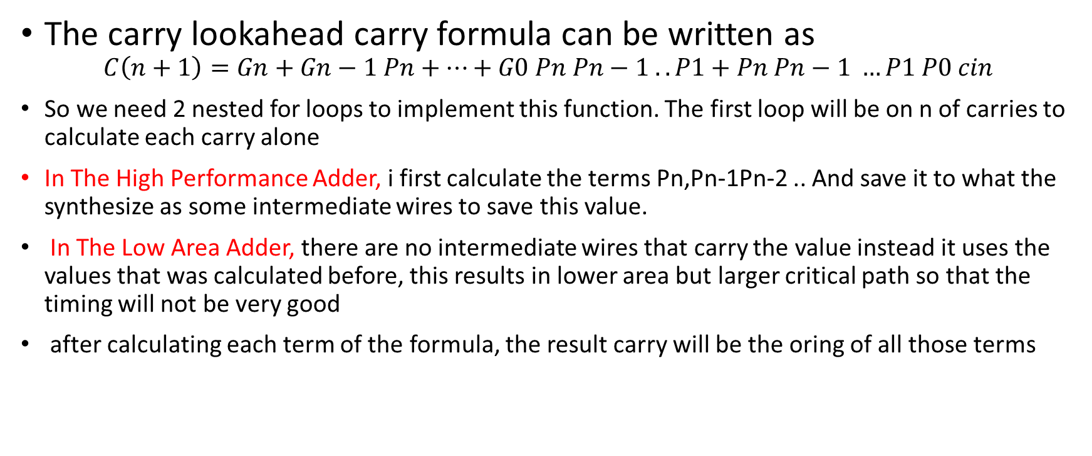
Code Description
The carry lookahead carry formula can be written as
$$C\left(n+1\right)=Gn+Gn−1 Pn+…+G0 Pn Pn−1 .. P1+Pn Pn−1 …P1 P0 cin$$
So we need 2 nested for loops to implement this function. The first loop will be on n of carries to calculate each carry alone
In The High Performance Adder, i first calculate the terms Pn,Pn-1Pn-2 .. And save it to what the synthesize as some intermediate wires to save this value.
In The Low Area Adder, there are no intermediate wires that carry the value instead it uses the values that was calculated before, this results in lower area but larger critical path so that the timing will not be very good
after calculating each term of the formula, the result carry will be the oring of all those terms

Slide 36
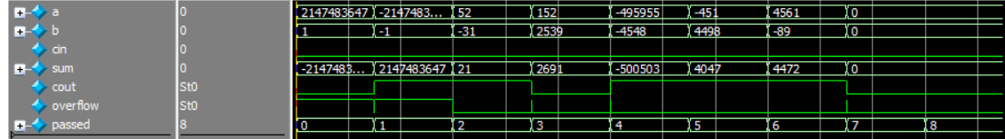
Testbench
Both adders pass all 8 cases in the testbench

Slide 37
Metrics
The results of the report are as shown
High Performance
Low Area
 | Carry Lookahead Adder
Min Delay | 4
Max Delay | 4.17
Total Power | 776.7851 uW
Total cell area | 2597.990415
Total area | 2716.986258
 | Carry Lookahead Adder
Min Delay | 7.44
Max Delay | 7.61
Total Power | 562.9705 uW
Total cell area | 1339.084813
Total area | 1387.654793

Slide 38
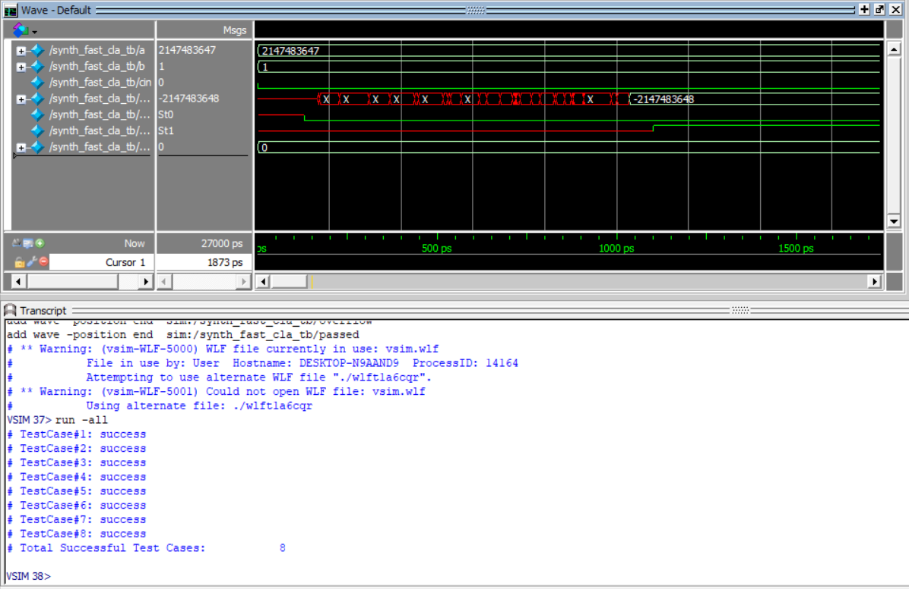
Post-synthesis simulation result
High Performance

Slide 39
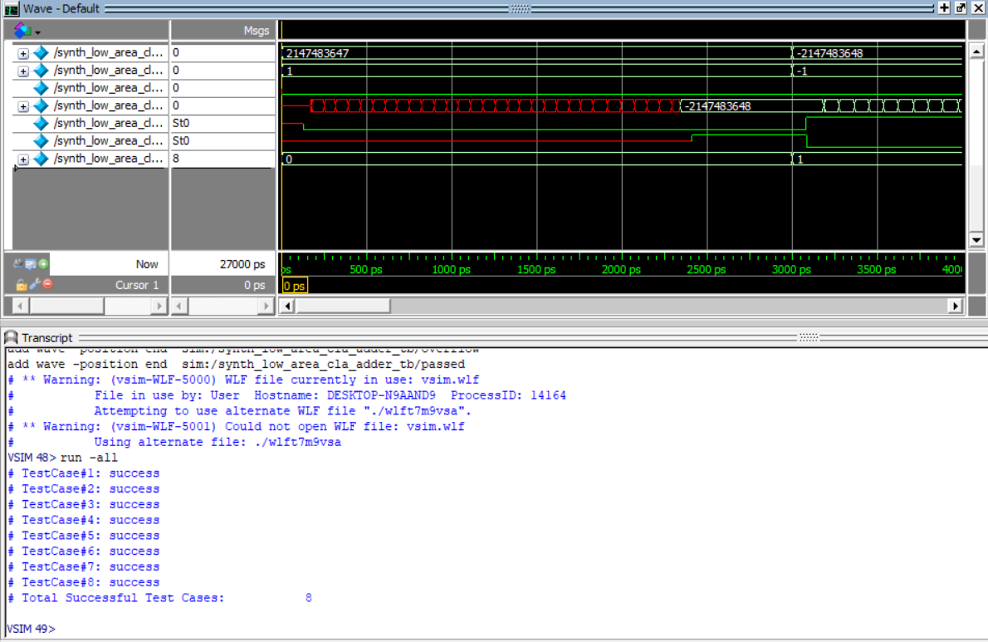
Post-synthesis simulation result
Low area

Slide 40
Carry Select Adder

Slide 41
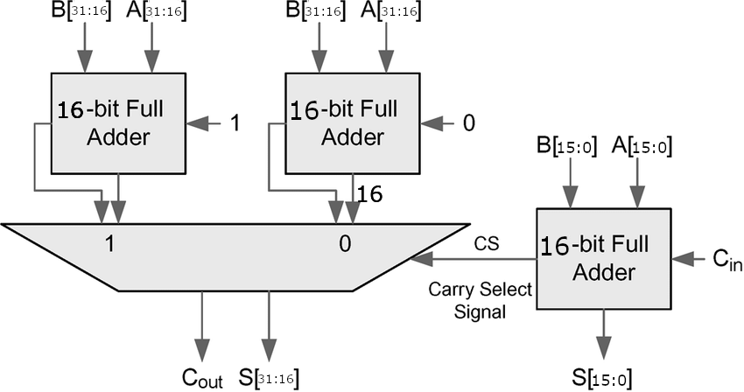
Design
A 3 16-bit full adders are used as shown below
The full adders can be any choice possible; we here chose to work on both plus adder and ripple adder

Slide 42
The carry select adder consists of 3 full adders that are divided so that parallelism is achieved.
Half the bits are calculated with the first full adder
The other half is calculated twice with carry 0 and carry 1
At last, the precalculated second part is chosen via the carry out of the first block
It improves on the performance of the selected adder nearly half the timing
The critical path goes only through half the way as the 2 parts we parallelly calculated

Slide 43
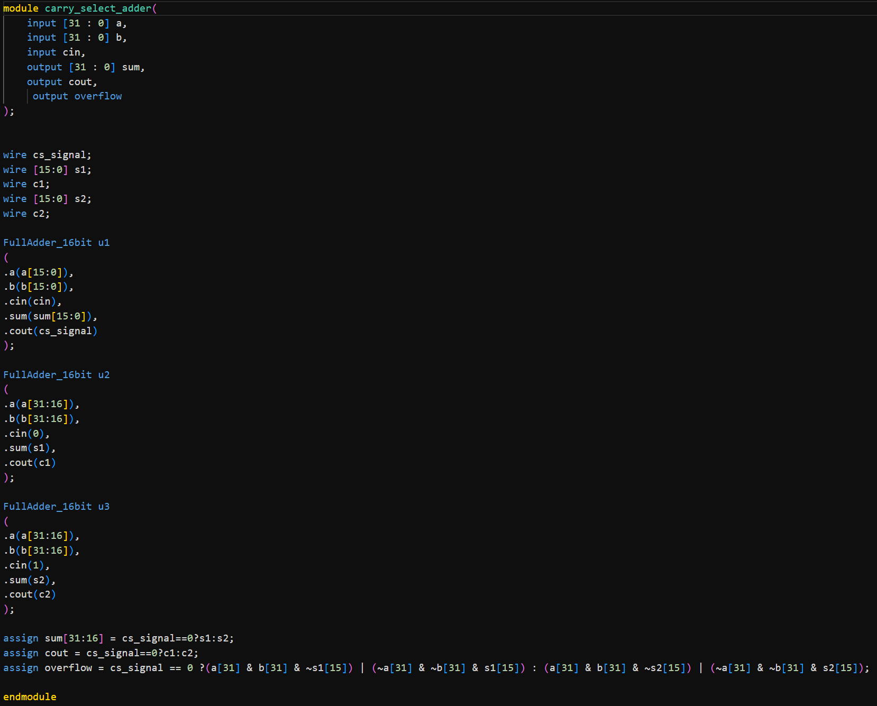
Carry Select Adder Code

Slide 44
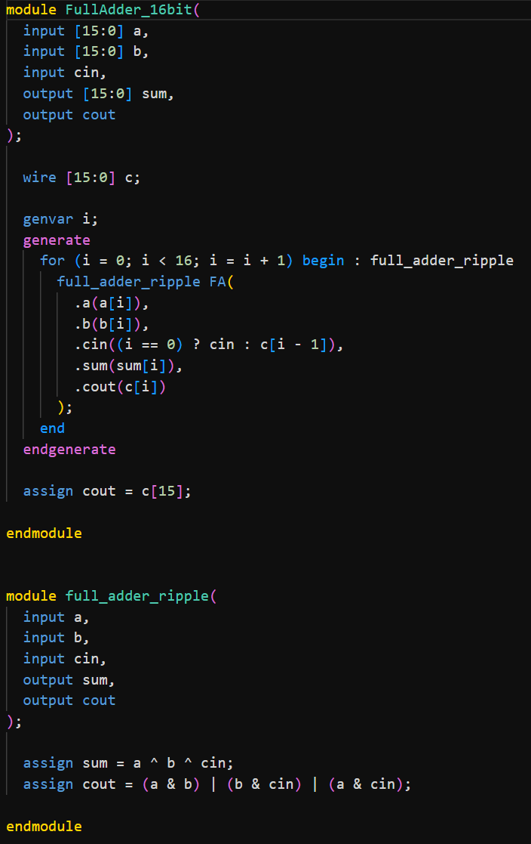
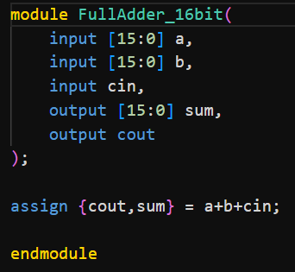
Full Adder Codes
Plus Adder
Ripple Adder

Slide 45
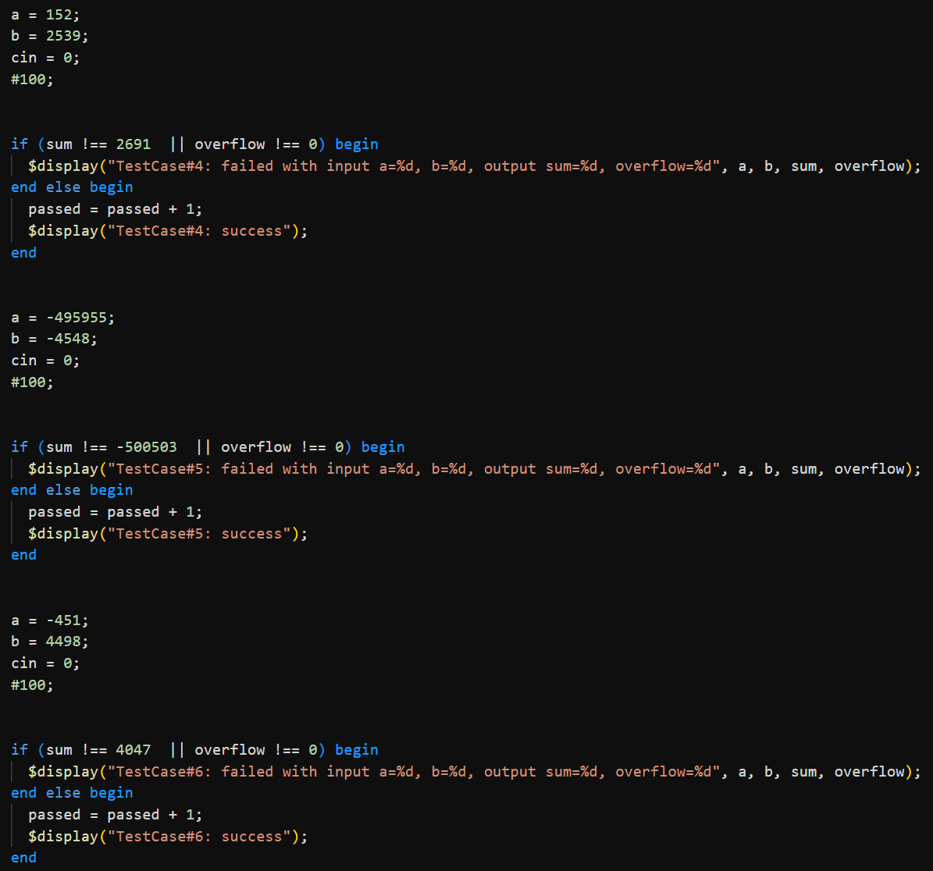
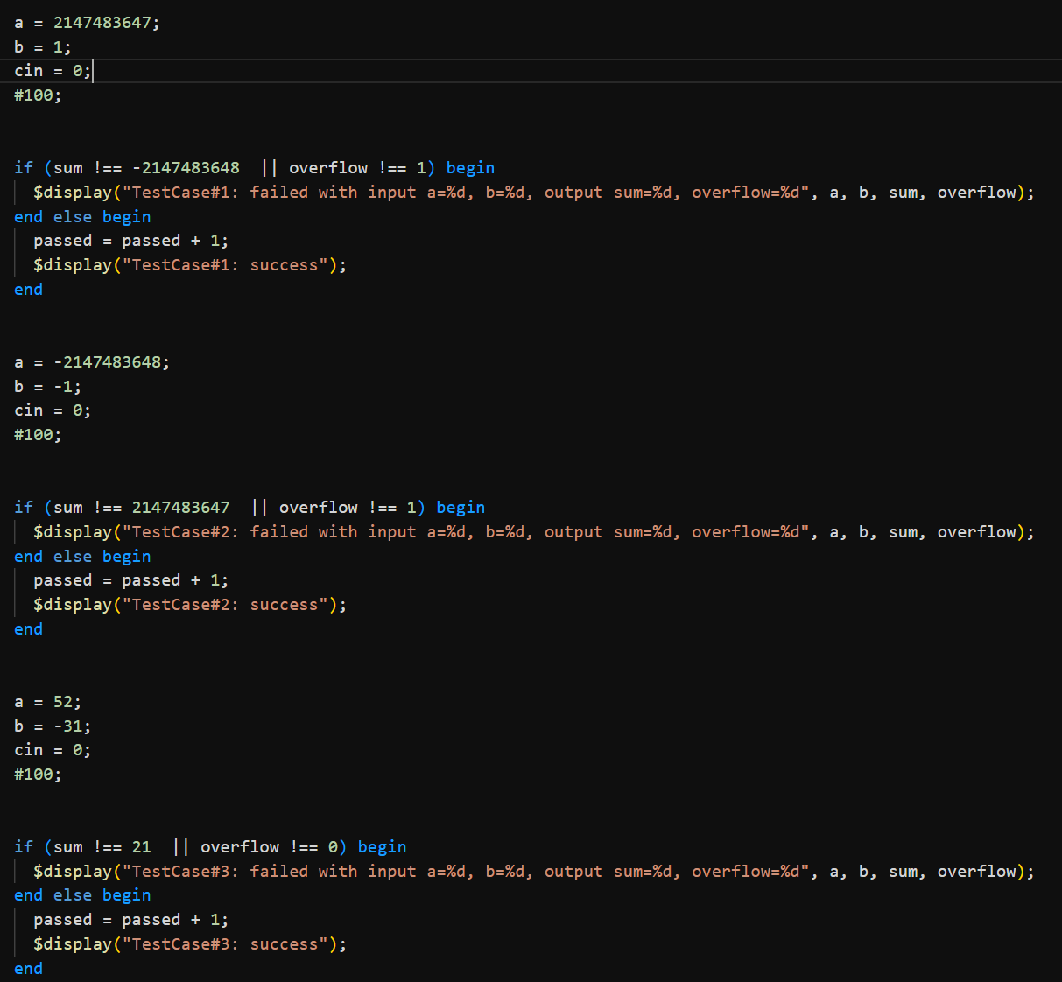
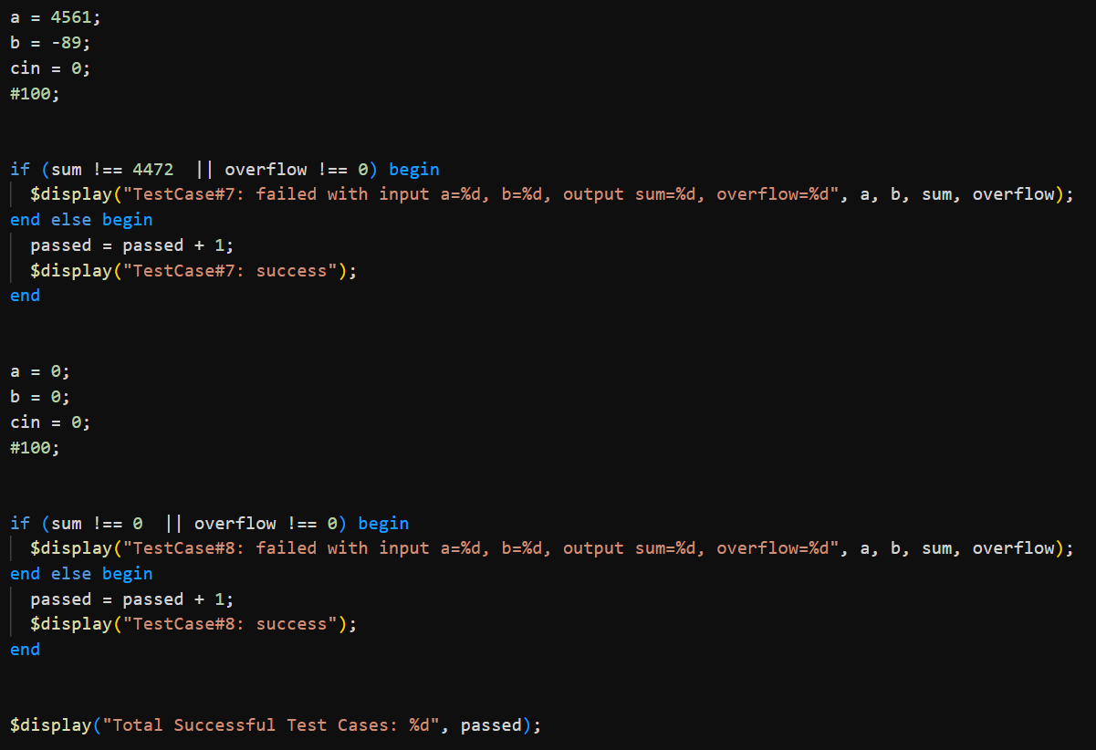
Testbench test cases

Slide 46
Testbench Results
The adder passes all 8 cases in the testbench

Slide 47
Metrics
The results of the report are as shown
 | Carry Select Adder (Ripple Adder) | Carry Select Adder (Plus Adder)
Min Delay(without input delay) | 0.67 | 1.48
Max Delay (without input delay) | 4.11 | 6.61
Min Delay (with input delay) | 1.67 | 2.48
Max Delay (with input delay) | 5.11 | 7.61
Total Power | 901.1790 uW | 653.2289 uW
Total cell area | 2119.680024 | 1633.075181
Total area | 2194.853107 | 1671.688896

Slide 48
The carry select adder provides both options of speed and area
It can reach a max delay of 5.11 only which is faster than most other adders
The selection of the full adder in the carry select adder depends on the design objectives, choosing better time over area or vice versa are considered a trade off that is acceptable

Slide 49
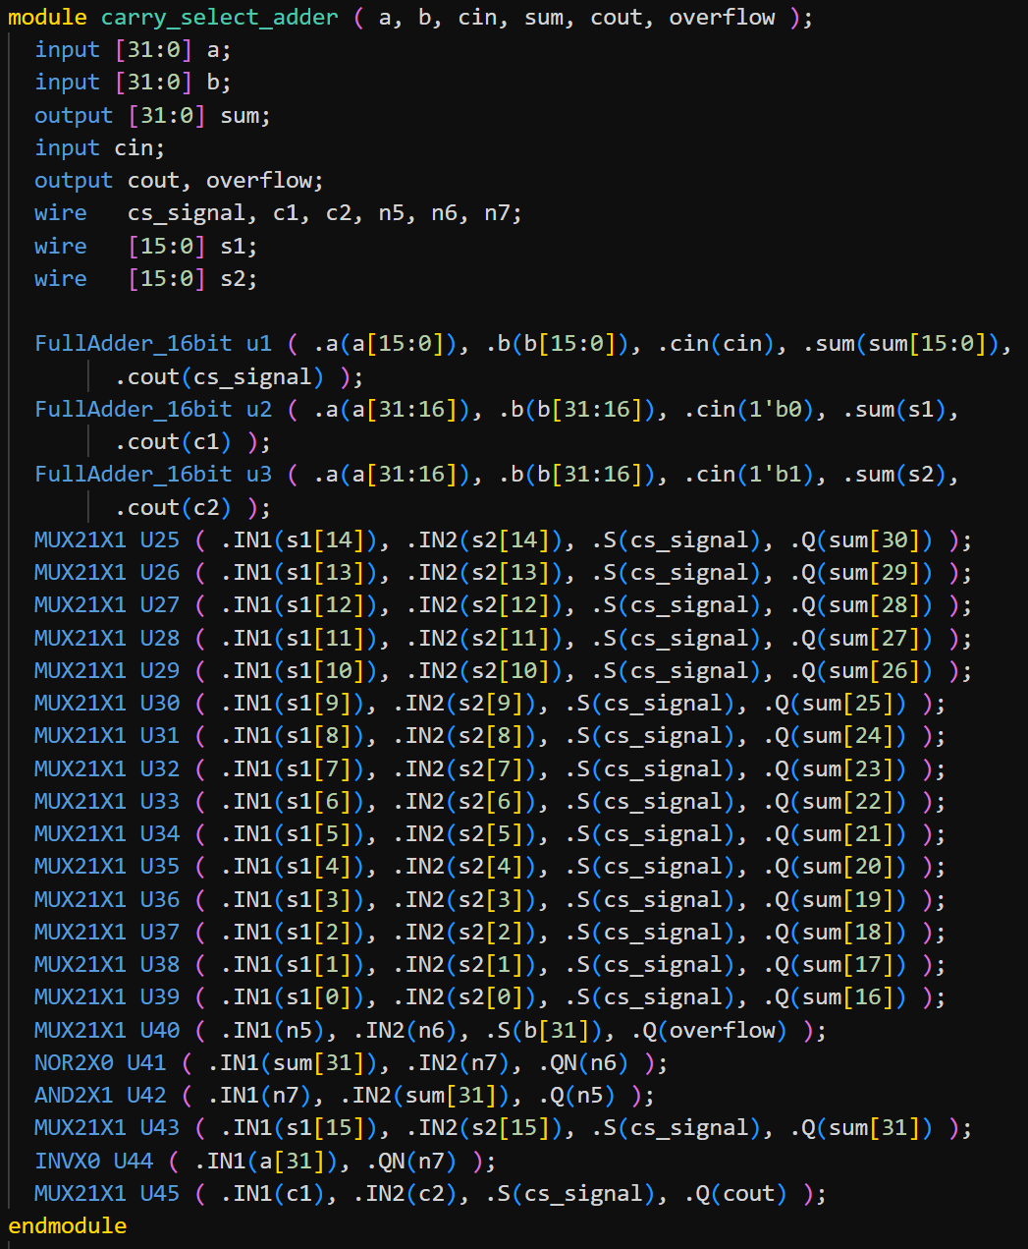
Carry select adder after synthesis

Slide 50
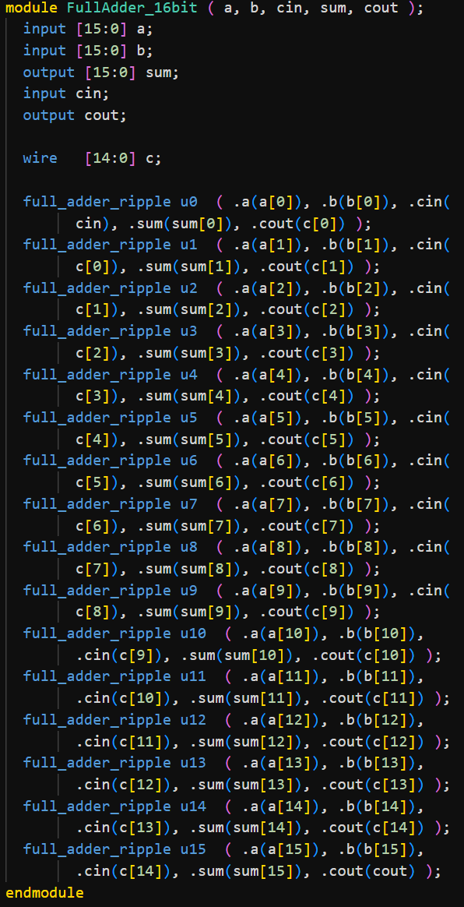
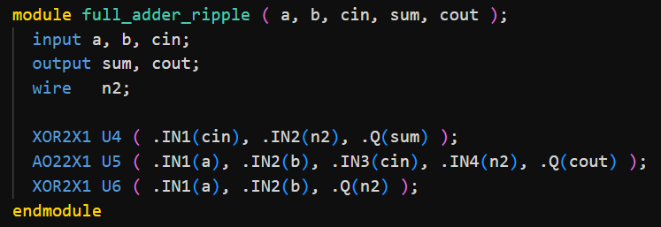
Ripple Adder Variant

Slide 51
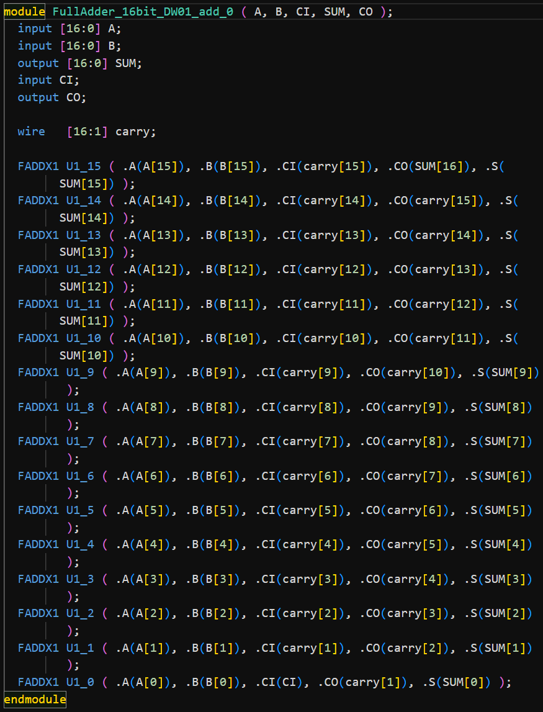
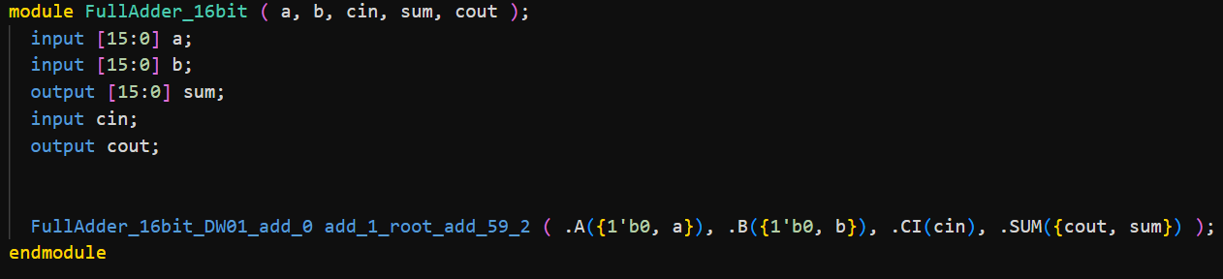
Plus Adder Variant

Slide 52
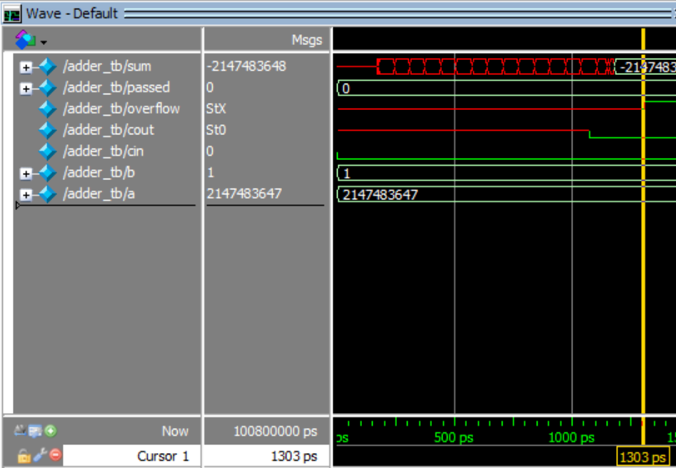
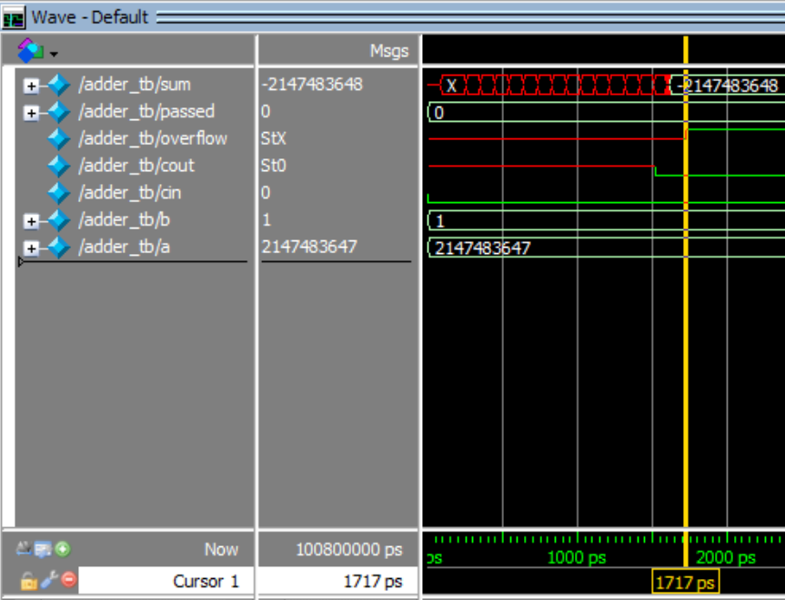
Carry Select Adder with Ripple Adder
Carry Select Adder with Plus Adder

Slide 53
Testbench
Post-synthesis simulation of the adder passes all 8 cases in the testbench

Slide 54
References
Carry-skip adder – Wikipedia
Carry-select adder – Wikipedia
Carry Look-Ahead Adder – GeeksforGeeks
Floating Point Tutorial | IEEE 754 Floating Point basics

