Slide 1

Isomorphic Graph
WELCOME to
Discrete Mathematics
Ziyad Ahmed Zarif (242-15-565)
Samiul Safi (242-15-574)
Syed Mueed Elahi (242-15-600)
MD Nabid Morshed (242-15-703)
Page 1 of 17

Slide 2

Agenda
1
Introduction
Fundamental concepts and terminology.
2
Finding out Isomorphic Graphs
Defining graph equivalence.
3
Adjacency Matrix Representation
Isomorphism through matrices.
4
Set Representation
Illustrating isomorphism with sets.
5
Adjacency List/Table Representation
Understanding tabular isomorphism.
6
Applications
Real life implementations of isomorphism.
Page 2 of 17

Slide 3
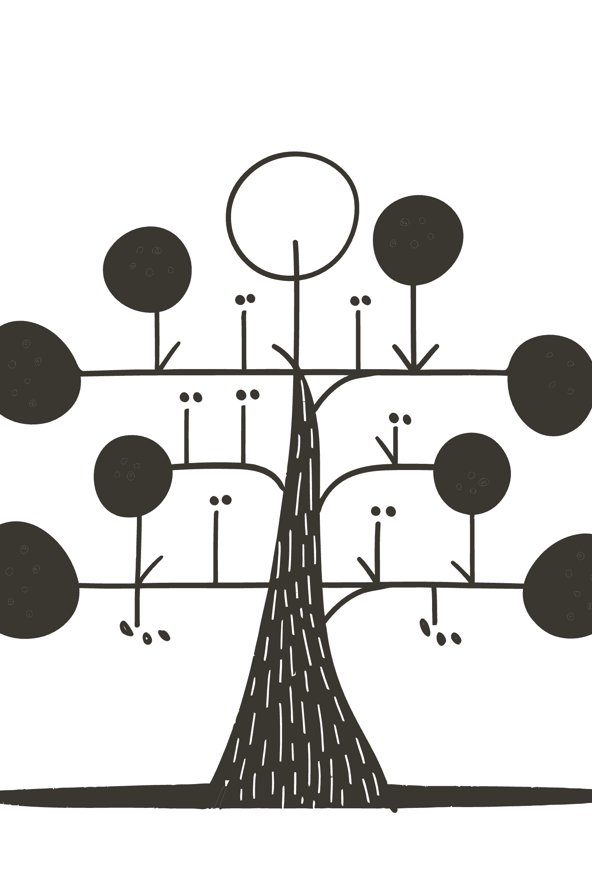
Isomorphic Graphs:
An Introduction
A journey into the fascinating world of discrete mathematics, focusing on the concept of isomorphism in graphs.
When two simple graphs are isomorphic, there is a bijection (one-to-one correspondence) between vertices of the two graphs that preserves the adjacency relationship. In other words, Two graphs are isomorphic if they are structurally identical, differing only in the labeling of their vertices.
Who Invented Isomorphic Graphs:
The concept of isomorphic graphs evolved over time as part of graph theory.
Leonhard Euler founded graph theory in 1736, but did not define isomorphism.
The term ”Isomorphism" comes from Algebra, meaning same structure.
It was formalized in the early 20th century, especially by mathematicians like Dénes Kőnig.
Page 3 of 17

Slide 4
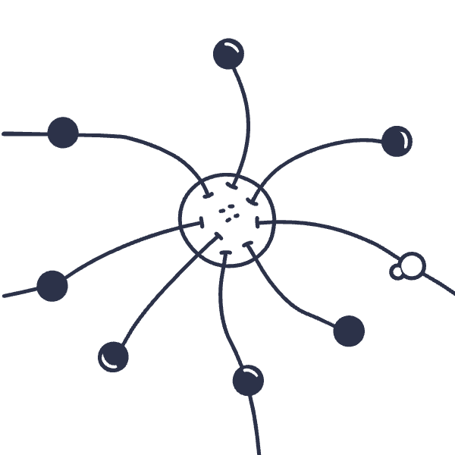
Graphs: The Basics
A graph G = (V, E) consists of:
Vertices (V): A finite set of nodes.
Edges (E): Connections between pairs of vertices.
Graphs model relationships and networks.
Formal Definition:
Let G1 = (V1, E1), G2 = (V2, E2)
Isomorphic ⇔ ∃ bijection f: V1 → V2 such that:
(a, b) ∈ E1 ⇔ (f(a), f(b)) ∈ E2
Such f is called an isomorphism
Page 4 of 17

Slide 5

What is Graph Isomorphism?
Two graphs, G1 and G2, are isomorphic if they are structurally identical.
Same number of vertices and edges.
Same connectivity pattern.
Think of it as a "relabeling" of vertices.
Page 5 of 17

Slide 6
Key Properties
1
2
Same Number of Vertices
Same Number of Edges
A fundamental prerequisite for isomorphism.
Connectivity must be preserved.
3
4
Degree Sequence
Mapping(Bijection)
The list of vertex degrees must be identical.
Morphism between two structures must be the same type
Page 6 of 17

Slide 7
_{u2}
_{v1}
_{u1}
_{u3}
_{v5}
_{v2}
_{u5}
_{u4}
_{v4}
_{v3}
G
H
Page 7 of 17

Slide 8

Graph Invariants
Necessary conditions for isomorphic graphs:
Same number of vertices
Same number of edges
Same degrees of vertices
These conditions are necessary but not sufficient. Breaking one condition proves non-isomorphism.
Page 8 of 17

Slide 9
2
2
_{u2}
_{v1}
2
2
2
_{u1}
_{u3}
2
_{v5}
_{v2}
_{u5}
_{u4}
_{v4}
_{v3}
2
2
2
2
G
H
Page 9 of 17

Slide 10



Key Takeaways
Structural Equivalence
Multiple Representations
Not Just Vertex Count
Isomorphism means identical graph structure, regardless of labeling.
Sets, matrices, and lists can all reveal isomorphism when appropriately compared.
Same number of vertices and edges is necessary, but not sufficient.
Page 10 of 17

Slide 11
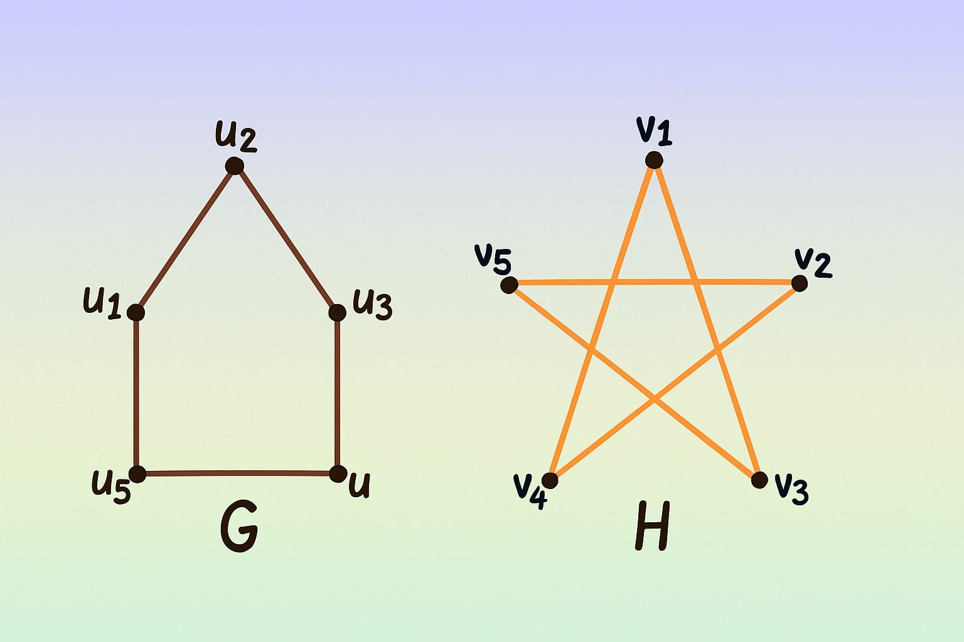
Vertex:
G=u1+u2+u3+u4+u5 = 5
H=v1+v2+v3+v4+v5 = 5
Edge:
G = 5 Edges
H = 5 Edges
Degree:
G = u1=2, u2=2, u3=2, u4=2, u5=2
H = v1=2, v2=2, v3=2, v4=2, v5=2
Mapping:
f(u1)= v1, f(u2)= v3, f(u3)= v5, f(u4)= v2, f(u5)= v4.
4
Page 11 of 17

Slide 12
Adjacency Matrix Comparison
Graph G
Graph H (reordered)
u1
u2
u3
u4
u5
v1
v3
v5
v2
v4
u1
0
1
0
0
1
v1
0
1
0
0
1
u2
1
0
1
0
0
v3
1
0
1
0
0
u3
0
1
0
1
0
v5
0
1
0
1
0
u4
0
0
1
0
1
v2
0
0
1
0
1
u5
1
0
0
1
0
v4
1
0
0
1
0
Adjacency matrices are identical when vertices are mapped.
Page 12 of 17

Slide 13
Isomorphism via Set Representation
Graph G1
Graph G2
Vertices: {1, 2, 3, 4}
Vertices: {a, b, c, d}
Edges: {(1,2), (2,3), (3,4), (4,1)}
Edges: {(a,b), (b,c), (c,d), (d,a)}
₁
>
₂
>
_{a}
_{b}
>
>
>
>
>
₃
>
_{c}
₄
_{d}
G1
G2
Mapping: 1->a, 2->b, 3->c, 4->d. Both form a cycle of 4 vertices.
Page 13 of 17

Slide 14
Adjacency List/Table Representation
Each vertex has a list of its neighbors. Isomorphic graphs have permuted lists.
Graph G1 List
Graph G2 List
Vertex
Neighbors
Vertex
Neighbors
1
{2, 4}
a
{b, d}
2
{1, 3}
b
{a, c}
3
{2, 4}
c
{b, d}
4
{1, 3}
d
{a, c}
A direct visual comparison can often reveal isomorphism when using this representation.
Page 14 of 17

Slide 15
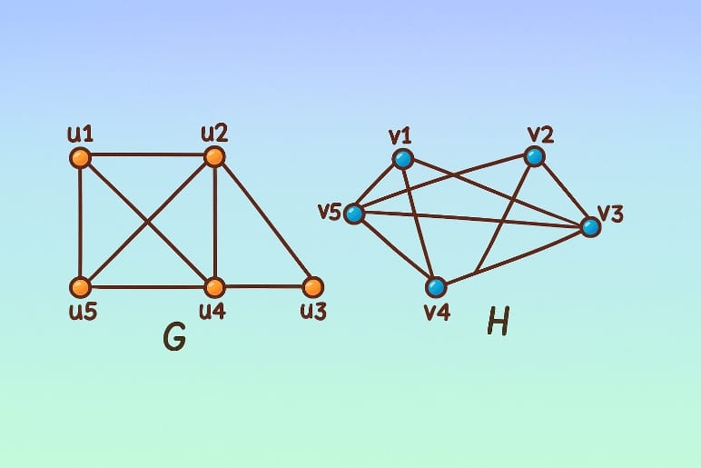
Are These Graphs
Isomorphic?
Vertex: G=u1+u2+u3+u4+u5=5
H=v1+v2+v3+v4+v5=5
Edge: G=8 Edges
H=8 Edges
Degree: G= u1=3,u2=3,u3=2,u4=4,u5=3
H=v1=3,v2=3,v3=4,v4=4,v5=4
Mapping: f(u1)=v1, f(u2)=v2,
f(u3)!=v5, f(u4)!=v2, f(u5)!=v4
✕
✕
Page 15 of 17

Slide 16




Practical Applications of Isomorphism
Chemical Isomers
Network Topology
Identifying molecules with the same structure but different arrangements.
Comparing the structure of different communication networks.
Circuit Design
Algorithm Optimization
Verifying equivalence of electronic circuits.
Finding efficient ways to represent and process graph data.
Page 16 of 17

Slide 17
Questions?
Thanks
Page 17 of 17

