Slide 1

Ohio

Slide 2
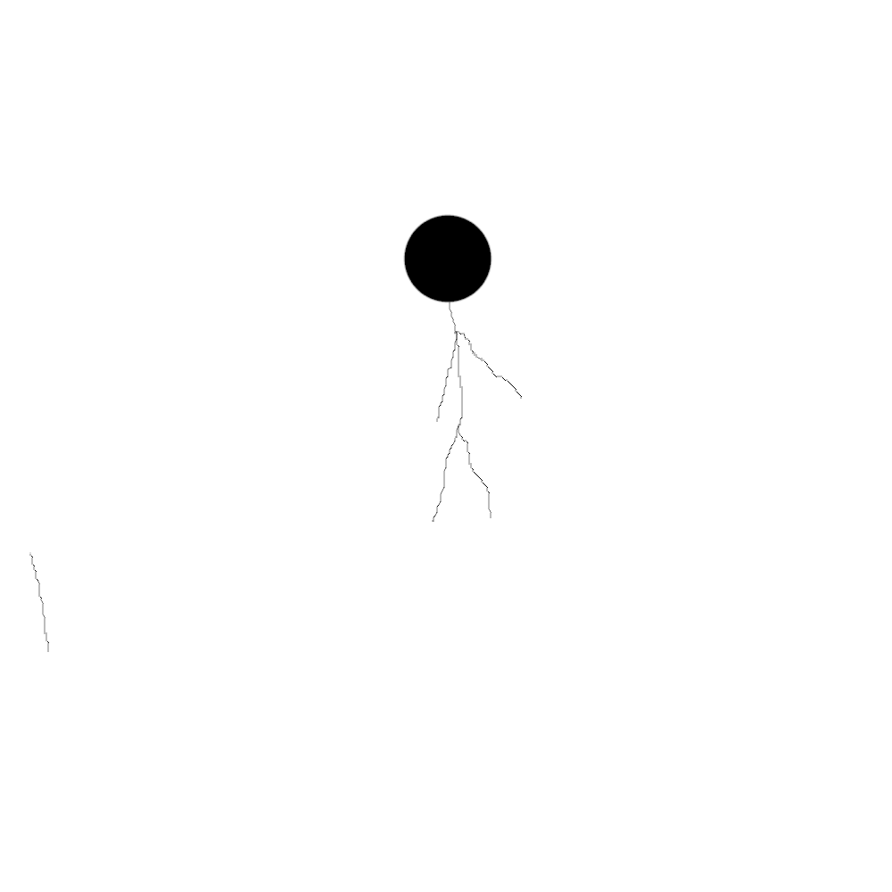
Its a Wonderful day and you want go to Ohio
Book A Flight

Slide 3
Now Book A Flight Ticket To Ohio
Book A Flight

Slide 6
TO BE CONTUNIUED

