Slide 1

Bootcamp: UBHM-VIRT-DATA-PT-10-2022-U-LOLC-MTTH
Project 1 – Team 6
Data Investigation into the Effect of Weather on Flight Disruption at UK Airports

Slide 2
Bootcamp: UBHM-VIRT-DATA-PT-10-2022-U-LOLC-MTTH
Presentation Content :
Hypotheses (questions to be answered)
Data Processing Methodology
Analysis Process & Results
Conclusions
Discussion and Further Areas for Investigation

Slide 3
Bootcamp: UBHM-VIRT-DATA-PT-10-2022-U-LOLC-MTTH
Hypotheses
Weather Conditions have an effect on Flight Cancellations Across UK Airports
Weather Conditions have an effect on Flight Delays Across UK Airports
Season Extremes have an effect on Flight Cancellations at Selected UK Airports
Season Extremes have an effect on Flight Delays at Selected UK Airports

Slide 4
Three Data Sources - Years 2018 and 2019
Airport Punctuality Data (24 .csv files) from caa.co.uk (Civil Aviation Authority)
Punctuality statistics 2018 (January to December).
Punctuality statistics 2019 (January to December).
2. Weather 1 Data (4 .txt links) from www.metoffice.gov.uk
https://www.metoffice.gov.uk/pub/data/weather/uk/climate/stationdata/armaghdata.txt
https://www.metoffice.gov.uk/pub/data/weather/uk/climate/stationdata/cardiffdata.txt
https://www.metoffice.gov.uk/pub/data/weather/uk/climate/stationdata/paisleydata.txt
https://www.metoffice.gov.uk/pub/data/weather/uk/climate/stationdata/heathrowdata.txt
3. Weather 2 Data (Python library and API) from dev.meteostat.net

Slide 5
Data cleaning
Merging Airport Punctuality Data:
A dataframe was deduced exported to .csv file to be used for analysis
Merging Weather 1 Data:
Text files were converted into dataframes and exported to .csv files for use later.
Merging Weather 2 Data:
Geoapify and Meteostat APIs were used to get weather dataframes for all 4 airports and subsequently exported to .csv for use later
Merging all 3 dataframes:
All 3 dataframes were merged into a dataframe "final_data" and exported as a .csv file for analysis

Slide 6
Bootcamp: UBHM-VIRT-DATA-PT-10-2022-U-LOLC-MTTH
3 Streams of Data Analysis
All Available Data - Scatter Plots for UK Airports
Analysis of 4 UK Airports across season extremes (Winter and Summer)
Map plots of UK Airports sized according to cancellation and delays
Hypothesis 1 and 2
Hypothesis 3 and 4
Supporting information

Slide 7
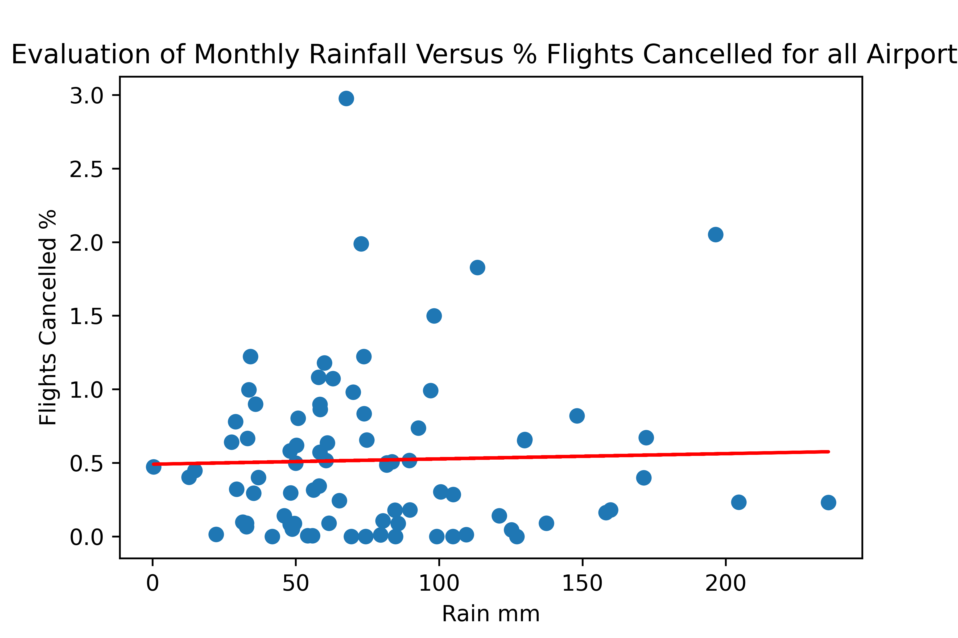
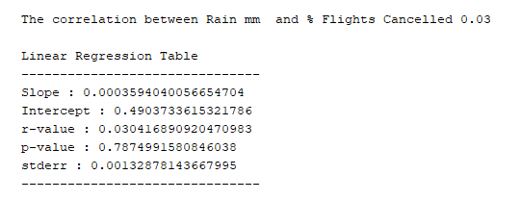
Bootcamp: UBHM-VIRT-DATA-PT-10-2022-U-LOLC-MTTH
Methodology : Investigate 4 weather variables (Monthly Rainfall / Av Wind Speed / Air Frost Days / Temperature) against 2 Flight Departure Conditions (Cancelled /Average Mins Late)
Example :

Slide 8
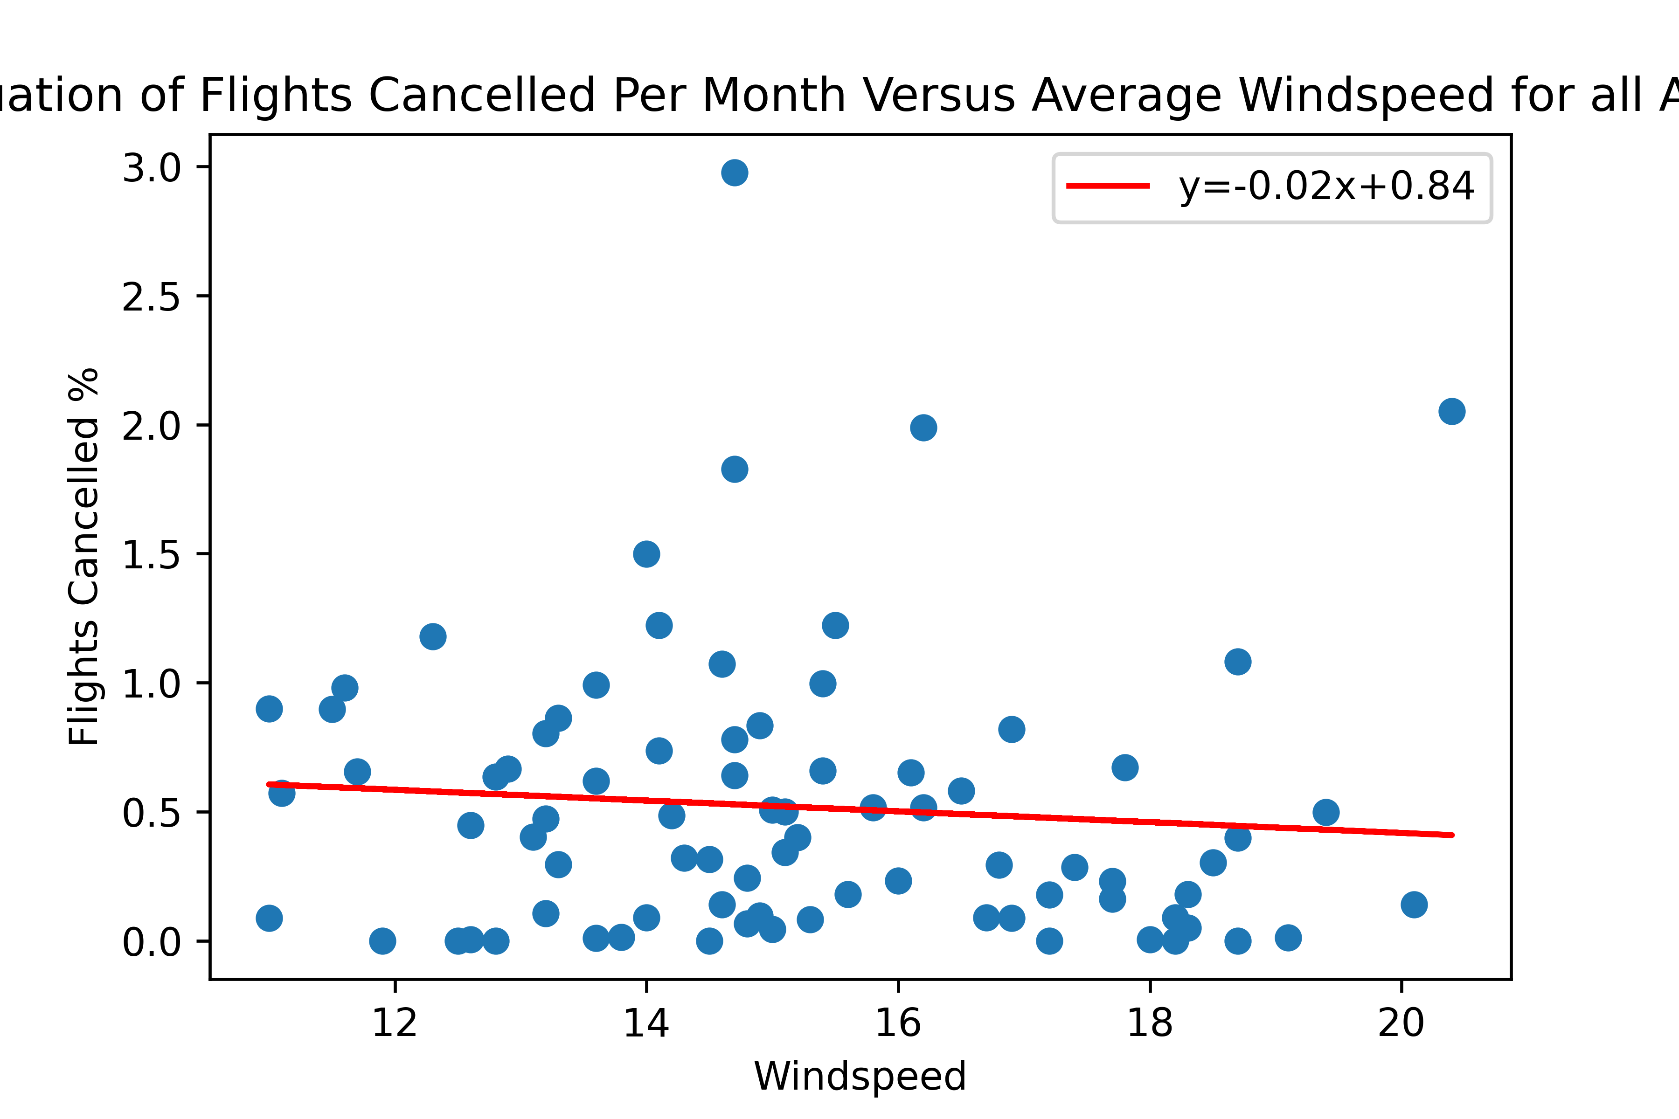
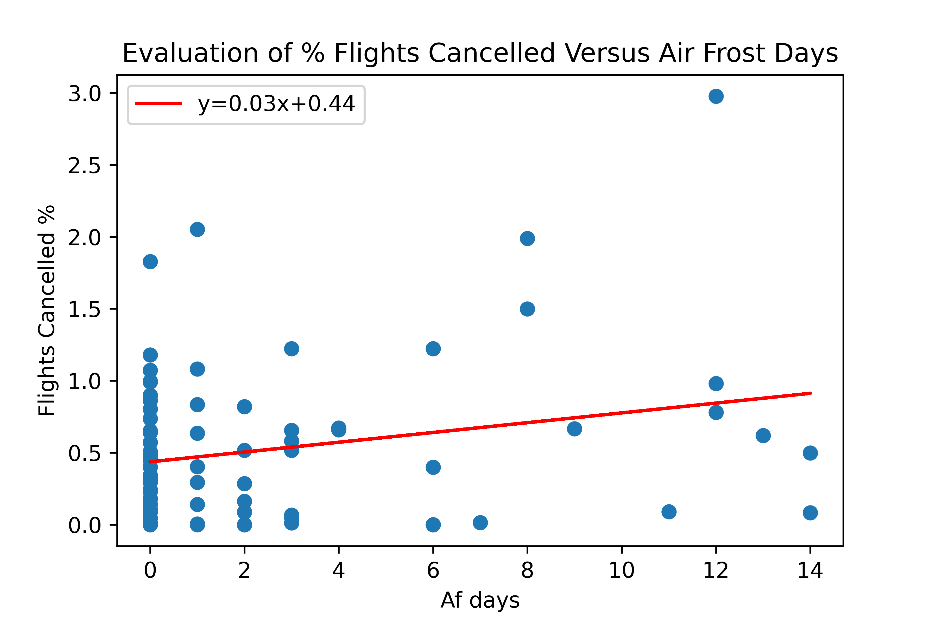
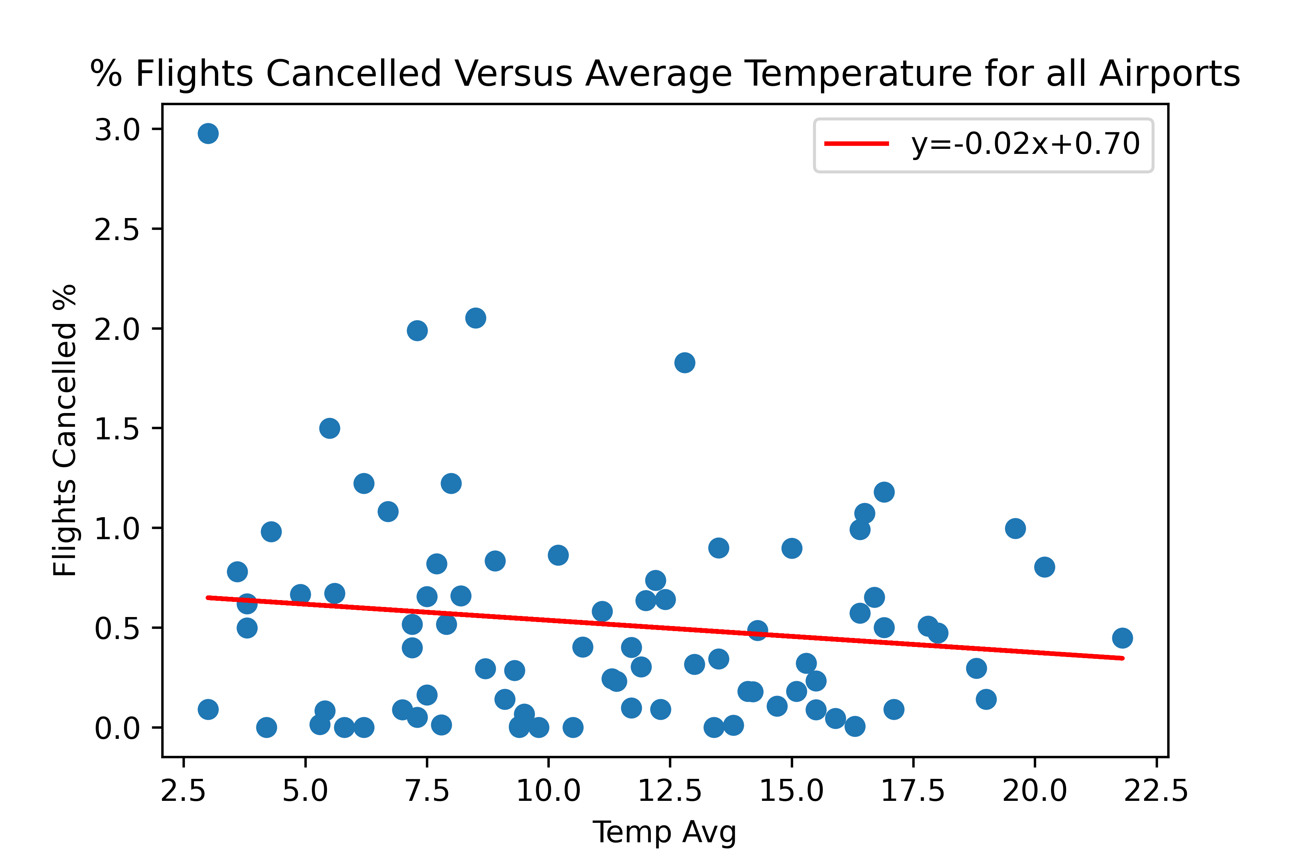
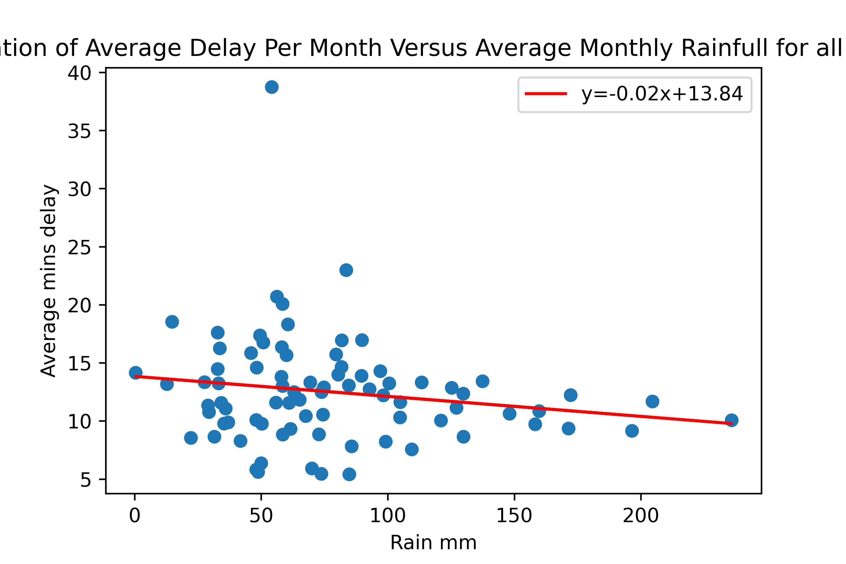
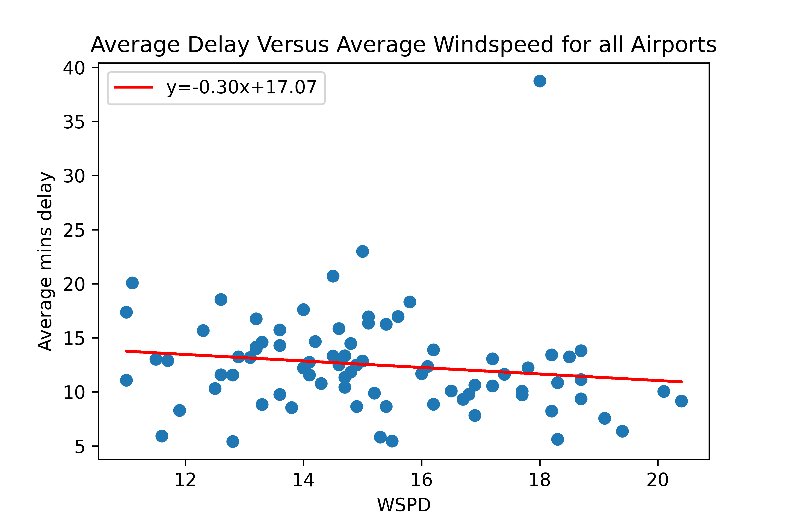
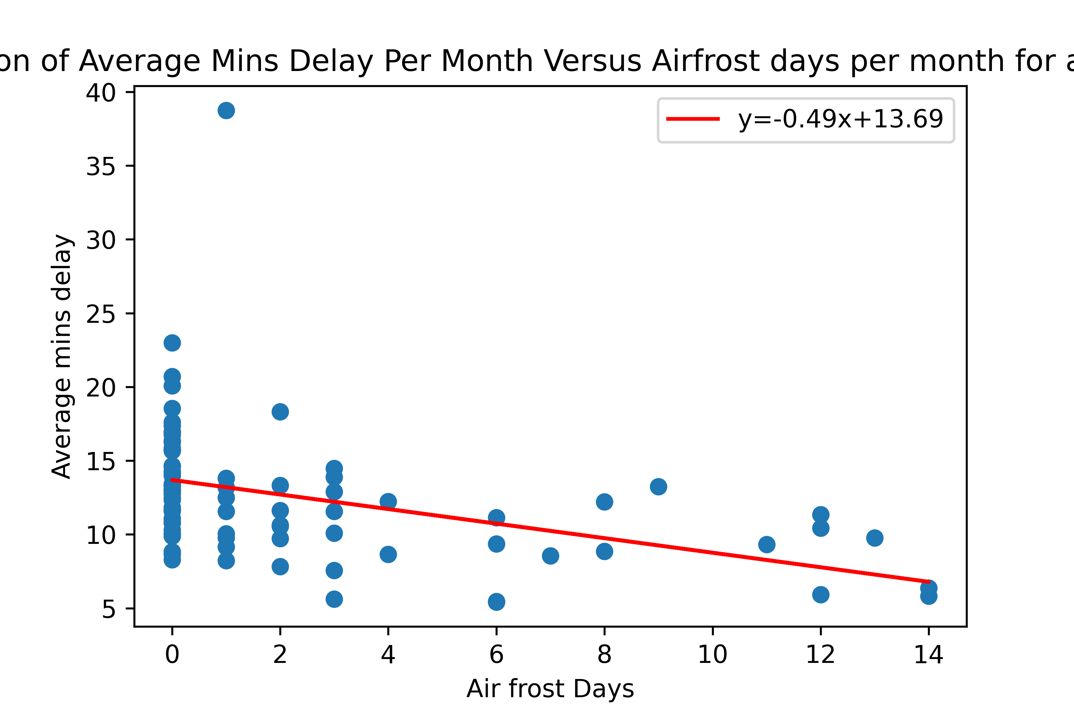
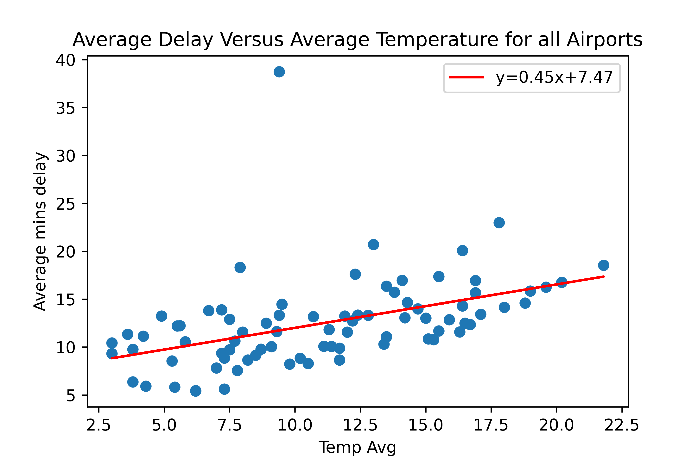
Bootcamp: UBHM-VIRT-DATA-PT-10-2022-U-LOLC-MTTH
Rainfall
Windspeed
Air Frost
Temperature
Cancelled
Delayed

Slide 9
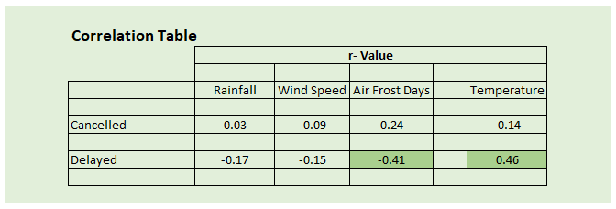
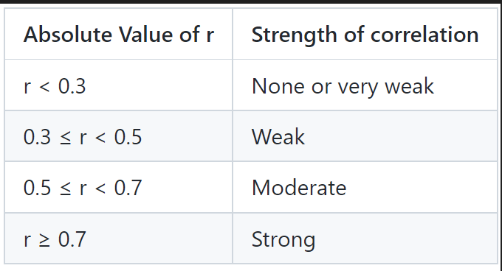
Bootcamp: UBHM-VIRT-DATA-PT-10-2022-U-LOLC-MTTH

Slide 10
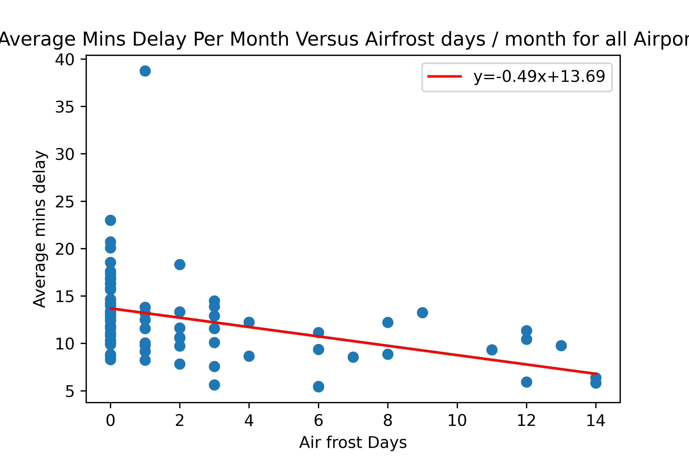
Bootcamp: UBHM-VIRT-DATA-PT-10-2022-U-LOLC-MTTH

Slide 11
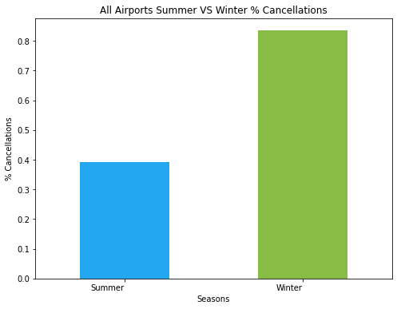
Bootcamp: UBHM-VIRT-DATA-PT-10-2022-U-LOLC-MTTH

Slide 12
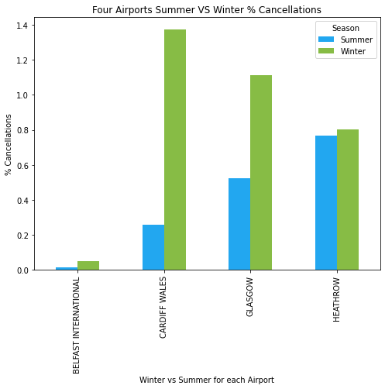
Bootcamp: UBHM-VIRT-DATA-PT-10-2022-U-LOLC-MTTH
HEATHROW
Highest cancellation during the summer.
Minimal seasonal deviation.
CARDIFF WALES
Highest cancellation during the winter.
BELFAST INTERNATIONAL
Lowest summer and winter cancellation.

Slide 13
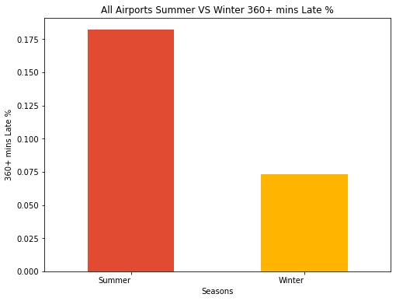
All Airport delays

Slide 14
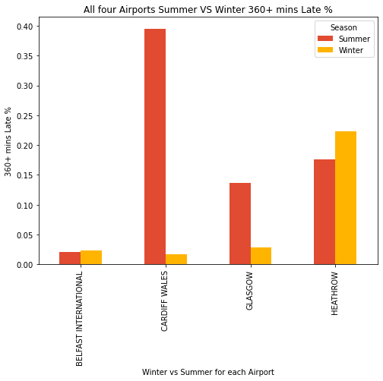
All 4 Airports Delays
According to the graphs on the right,
Notice Belfast International Airport and Heathrow Airport have more delays in Winter compared to the airports in Cardiff and Glasgow.
This implies delays to flights in all airports may be unrelated to weather and could be a result of other factors.

Slide 15
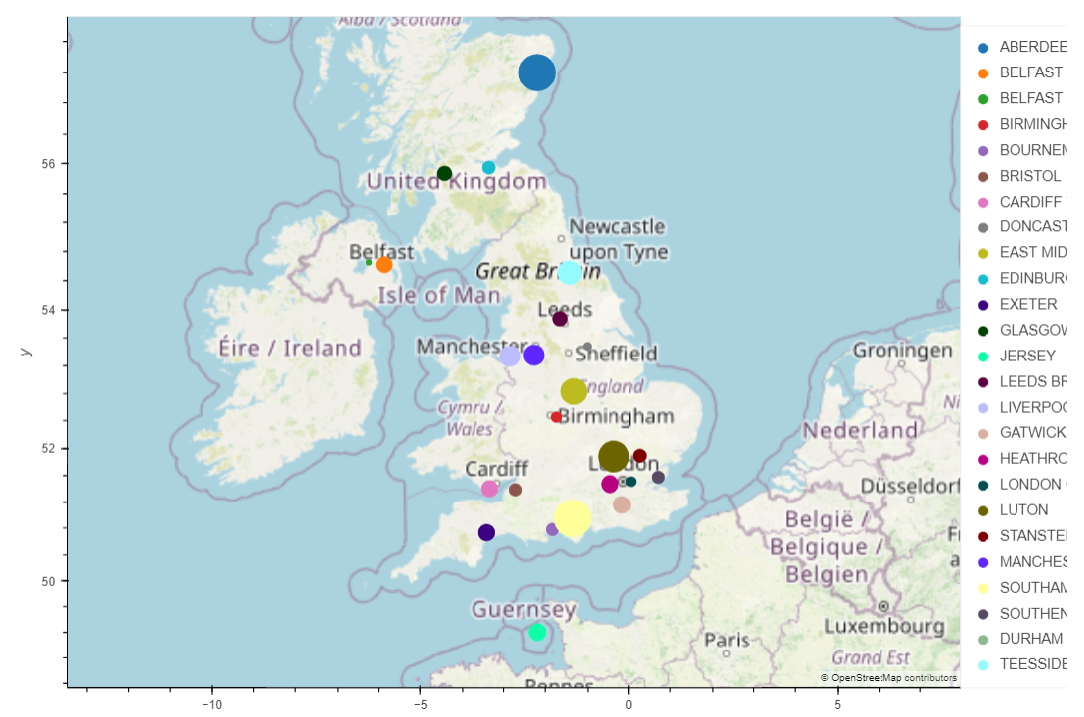
FLIGHT CANCELLATIONS
Bootcamp: UBHM-VIRT-DATA-PT-10-2022-U-LOLC-MTTH

Slide 16
Bootcamp: UBHM-VIRT-DATA-PT-10-2022-U-LOLC-MTTH
FLIGHT CANCELLATIONS
Southampton Airport and Aberdeen Airport both show the highest cancellation rates closely followed by Luton Airport.
Bournemouth compared with Southampton on the other hand shows a relatively good punctuality rate despite proximity (Similar Weather Conditions).
Heathrow fairs better than the aforementioned airports.
Belfast international has the least cancellation rate year-round.

Slide 17
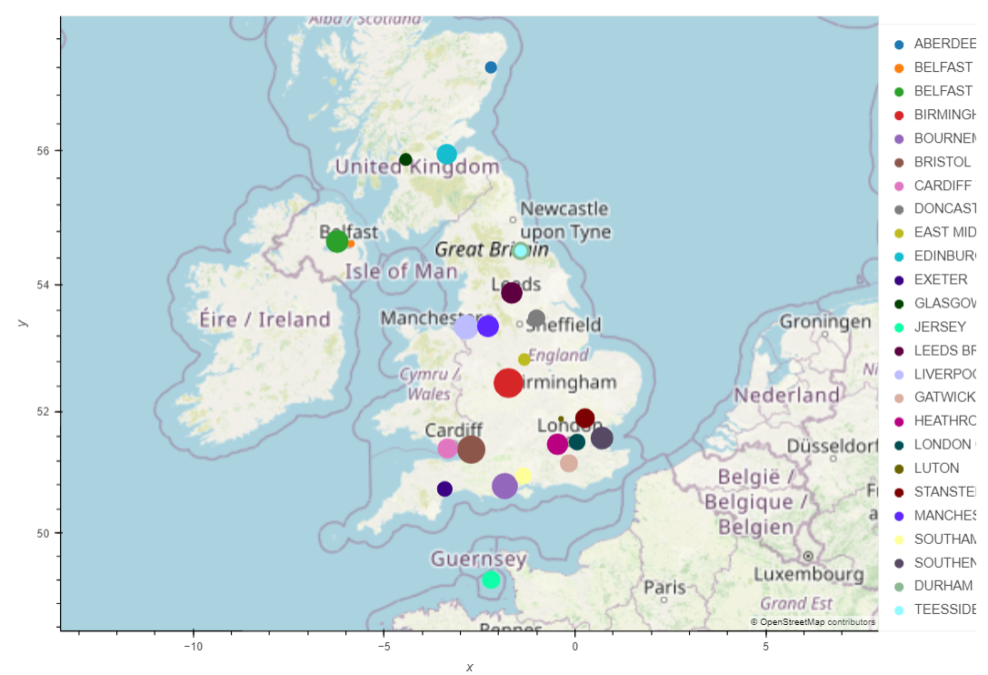
Bootcamp: UBHM-VIRT-DATA-PT-10-2022-U-LOLC-MTTH
FLIGHT DELAYS
Stanleys Spotty Graph 1 – Late Departures

Slide 18
Bootcamp: UBHM-VIRT-DATA-PT-10-2022-U-LOLC-MTTH
FLIGHT DELAYS
Birmingham International is the worst when it comes to Delays of 6 hours or more Followed closely by Bristol Airport
Bournemouth does worse than Southampton in this case even though they should be affected by relatively the same type of weather conditions.
Heathrow still performs better than most other airports
Belfast’s George Best and Luton are the best performers

Slide 19
Bootcamp: UBHM-VIRT-DATA-PT-10-2022-U-LOLC-MTTH
Conclusions

Slide 20
Bootcamp: UBHM-VIRT-DATA-PT-10-2022-U-LOLC-MTTH
From the analysis carried out the alternative hypothesis cannot be proved i.e the null hypothesis cannot be disproved.
The data indicates that there are likely more critical factors that may effect either flight cancellations or delays such as:
airport operations
capacity
usage across seasonal variations

Slide 21
Bootcamp: UBHM-VIRT-DATA-PT-10-2022-U-LOLC-MTTH
Scope for future work
Carry out more in-depth analysis of variation on specific airports, especially relating to detailed reasons for cancellations or delay.
When more accurate and detailed data is available used advanced techniques such as ANOVA, t-tests etc to confirm other hypotheses.

