Slide 1

BLE Digital Transmitter
Sponsored by
Mentors
Supervisors
Eng. Ahmed Hany
Prof. Hani Fikry Ragaai
Eng. Moaz Khaled
Eng. Abdelrahman

Slide 2
Presented by
Ahmed Alaa Mohamed Elsodany | 2101434
Sarah Hamed Mahmoud Al Sayed | 2101518
Habiba Essam Eldin Abdelhamid Foad | 2100321
Hanin Ahmed Abdelfattah Ahmed | 2100661
Mina Ayad Younan Bebawi | 2100546

Slide 3

Introduction
Bluetooth Low Energy (BLE) is a wireless standard created to complement Classic Bluetooth, but with a different priority: ultra-low power and low cost rather than high data rate. It’s widely used for short-range connections in IoT and battery-powered devices (wearables, sensors, beacons, smart home), where devices may need to run for months or years on small batteries.
BLE is low-cost since it has:
License-free spectrum: BLE operates in the global 2.4 GHz ISM band, so there are no paid spectrum licenses.

Slide 4
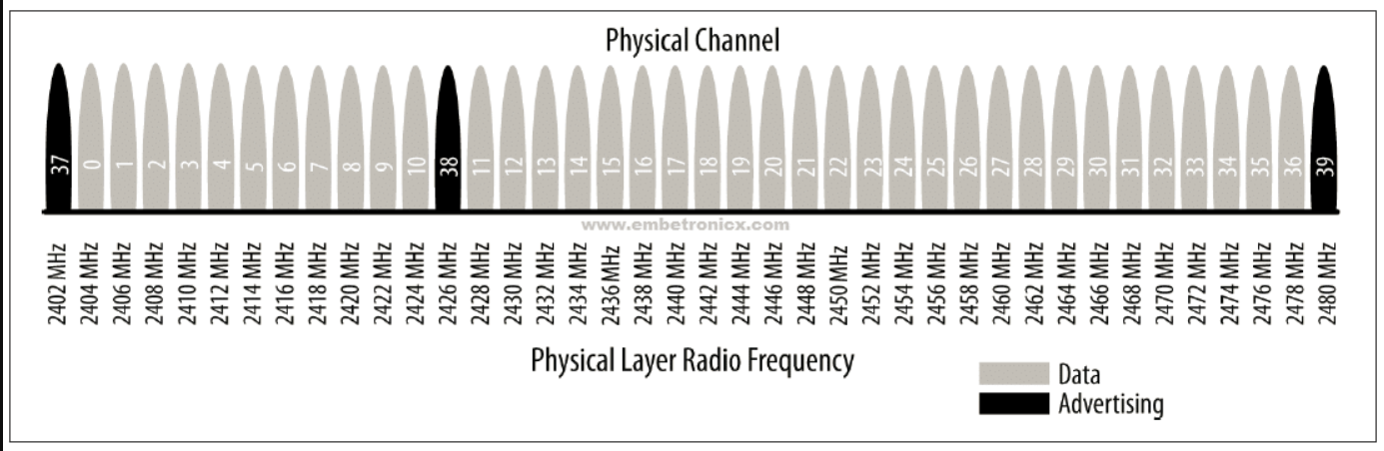
BLE 5.4 Specification and Modulation
z
Modulation — GMSK
  Gaussian Frequency Shift Keying with BT = 0.5
  Constant envelope → allows efficient non-linear PA
Frequency Deviation
  Nominal ±250 kHz for '1' and '0' symbols
  Minimum ±185 kHz at receiver for reliable demodulation
Data Rate
  LE 1M: 1 Mb/s at 1 Msym/s — mandatory
Eye Diagram
  Zero crossing shall be less than ±1/8 of a symbol period (±0.125 µs)

Slide 5
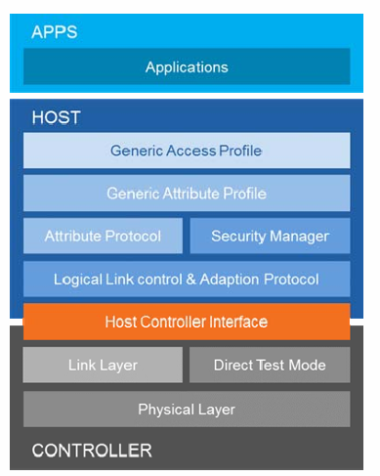
BLE core system architecture

Slide 6
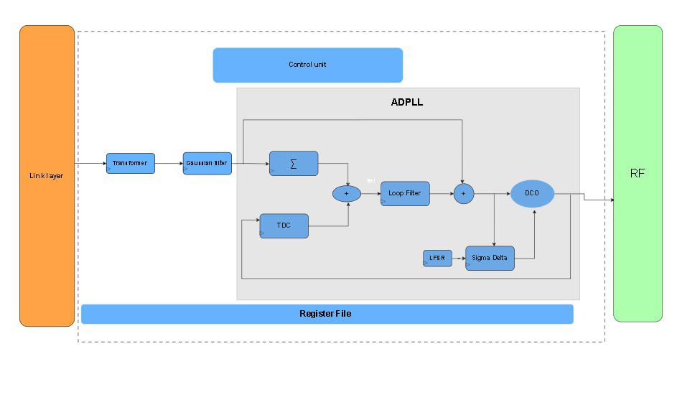
System Overview

Slide 7
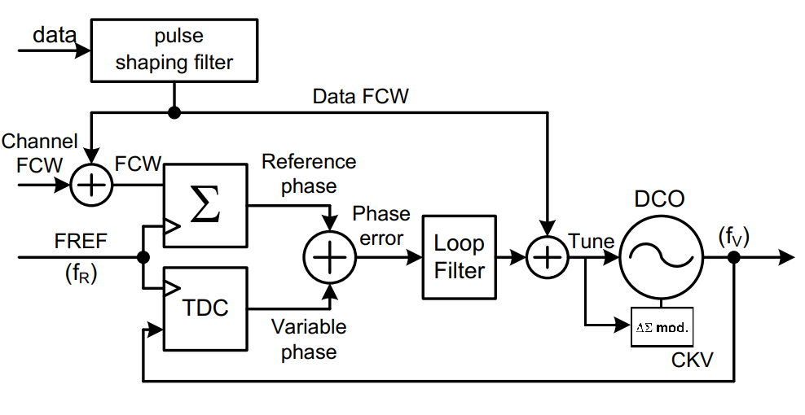
ADPLL Architecture

Slide 8
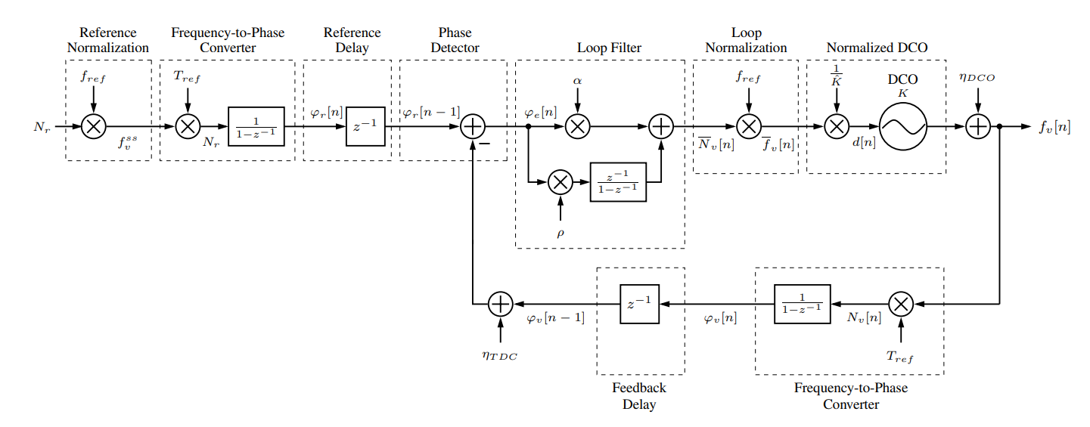
ADPLL Linear Model

Slide 9
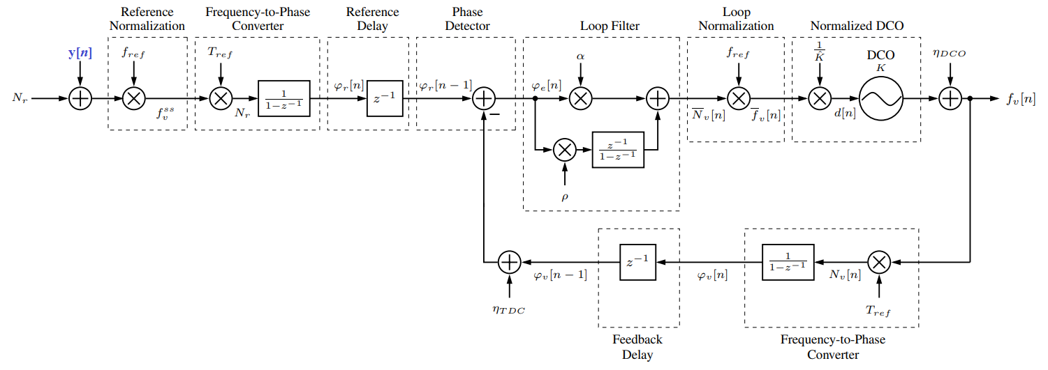


One Point Modulation at Reference Accumulator
Modulation Transfer function: where

Slide 10
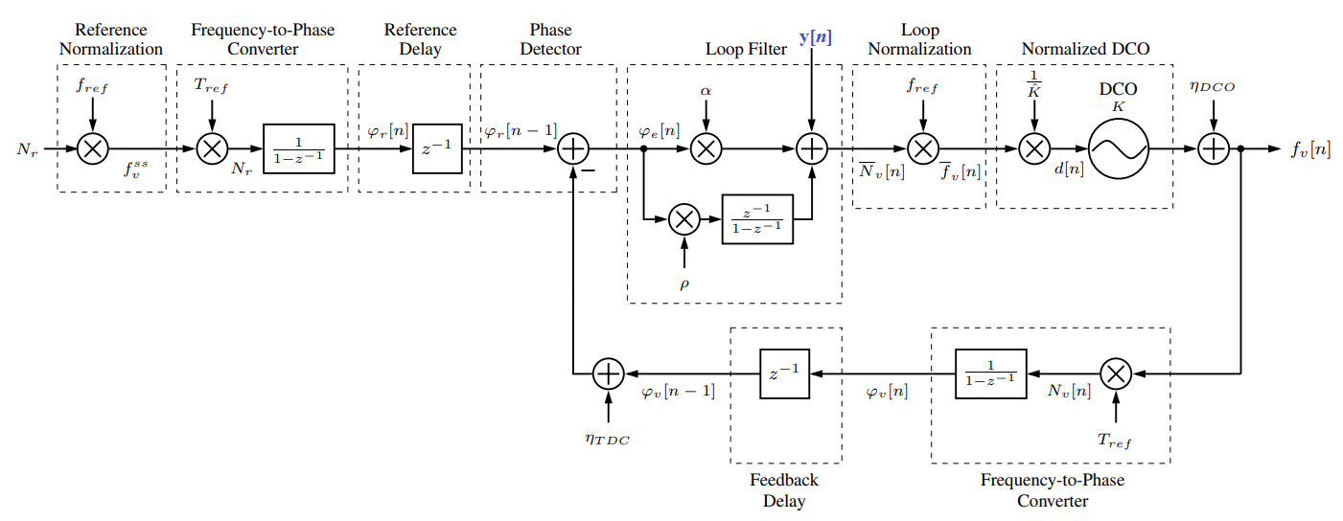

One Point Modulation at DCO Input
Modulation Transfer function: where

Slide 11
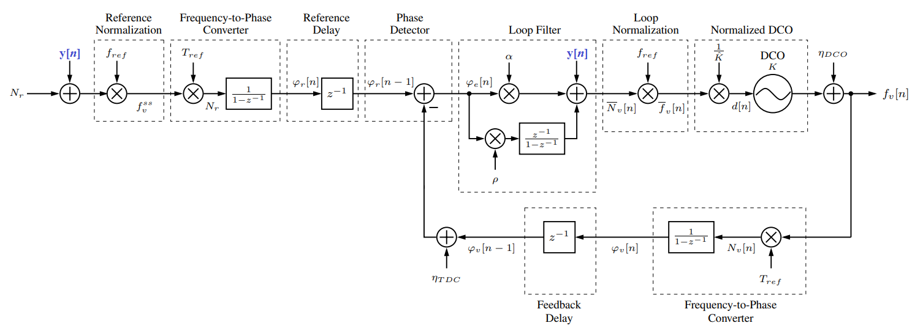



Two Point Modulation
Modulation Transfer function:
For the case of perfect gain estimation:
r = 1 thus the modulation transfer function is:

Slide 12
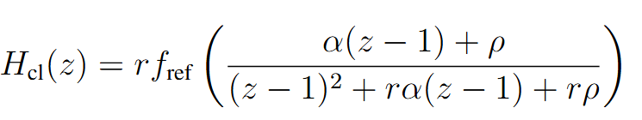
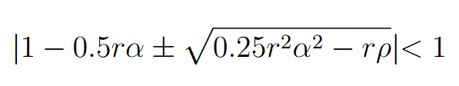
ADPLL Stability Criteria
Channel Control Word Closed Loop Transfer function:
Where:
Stability Criteria:

Slide 13
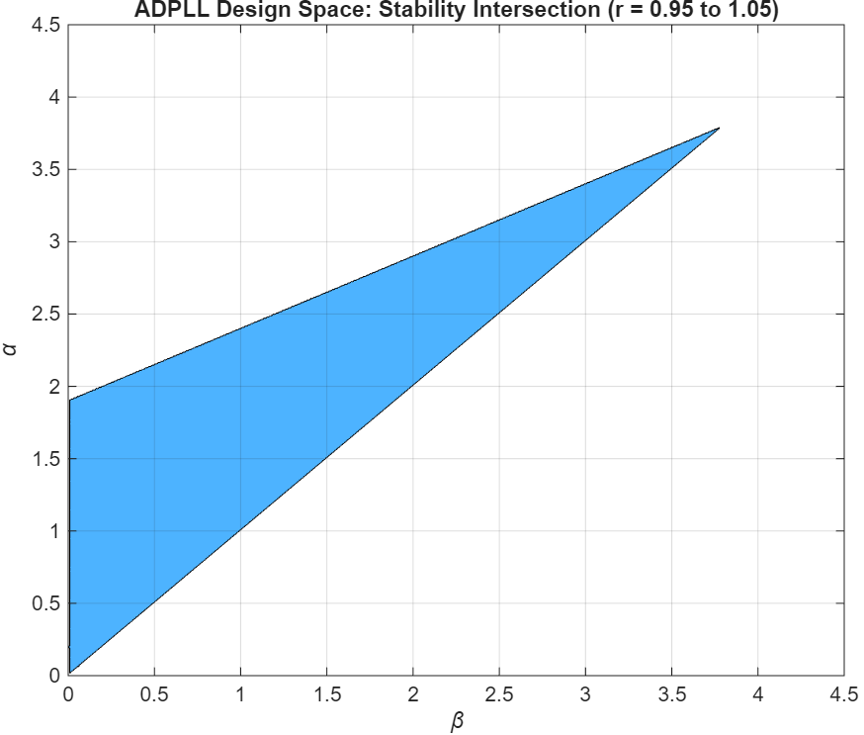
ADPLL Stability Region
For r = 0.95 - 1.05 :

Slide 14
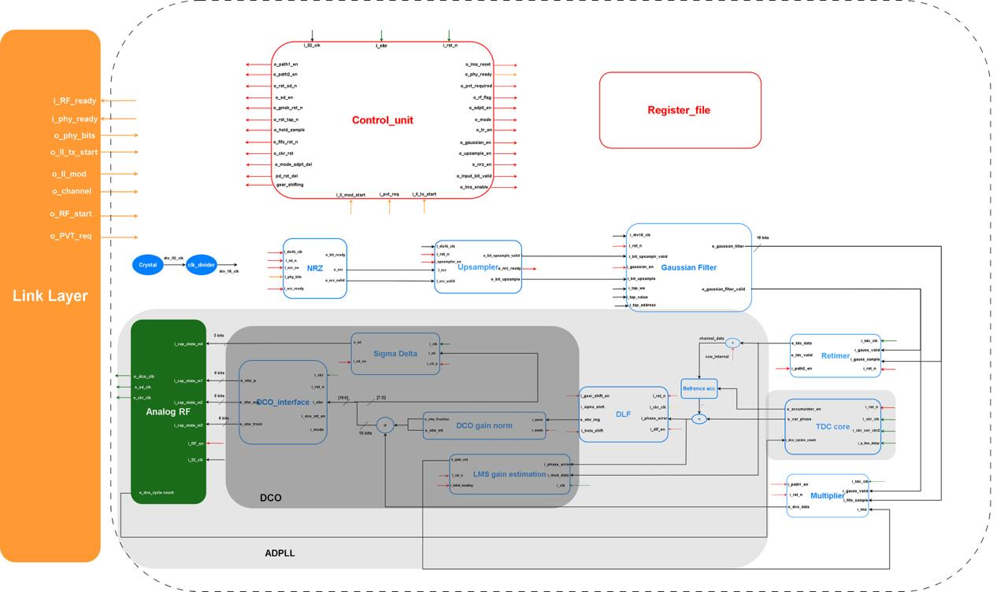
System Block Diagram

Slide 15
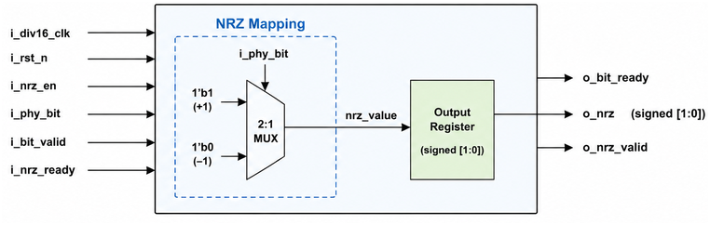
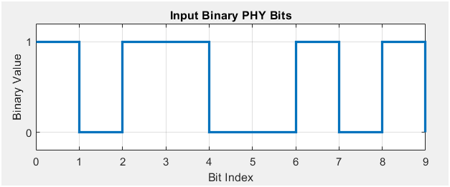
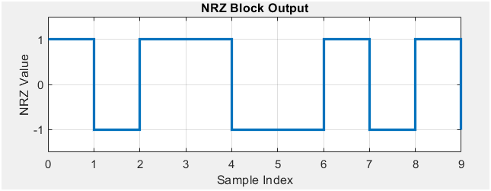
NRZ Block
• Converts binary PHY bits into signed bipolar NRZ samples.
• Creates a zero-centered signal required for GFSK modulation.
• RTL mapping:
1 → +1
0 → -1
• Output is signed 2-bit [1:0], enough to represent +1 and -1.
• Uses ready/valid handshaking to control data transfer between blocks.
• Operates on the 16 MHz data-path clock:
1 MSym/s × 16 samples/symbol = 16 MHz
• Hardware view: mapping logic acts as a 2:1 MUX selecting +1 or -1.

Slide 16
System Block Diagram

Slide 17
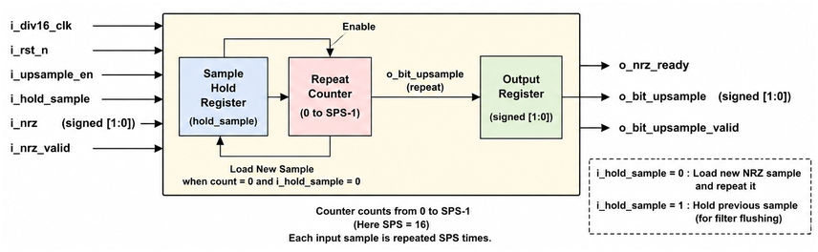
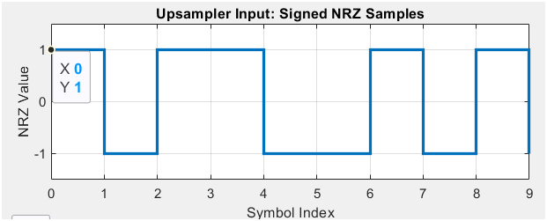
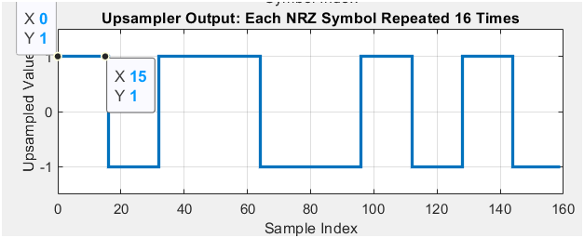
Upsampling Block
• Receives signed NRZ samples from the NRZ block.
• Repeats each NRZ sample for SPS = 16 clock cycles.
• Converts the data stream from:
1 MSym/s symbol rate → 16 MS/s sample rate
• Provides enough sample resolution for the Gaussian FIR filter.
• The upsampler does not smooth the signal; it only repeats the samples.
• Hardware view: sample-hold register + repeat counter.

Slide 18
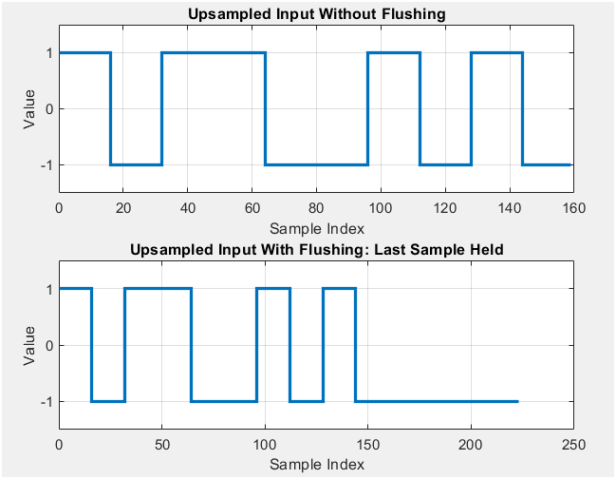
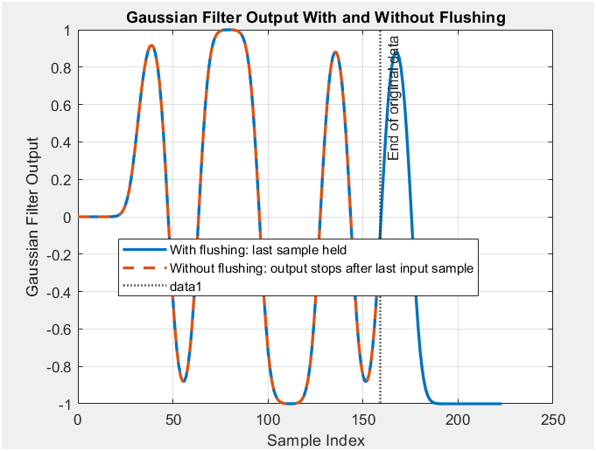
Upsampling Block
• i_hold_sample keeps the previous sample during Gaussian filter flushing.
The Gaussian FIR filter has memory because it uses a 64-sample delay line.
• Filter length: L = SPAN × SPS = 4 × 16 = 64 samples
• Linear-phase FIR group delay: Group delay = (L - 1) / 2 = 31.5 samples
• In symbols: 31.5 / 16 = 1.97 symbols ≈ 2 symbols
• This means about 2 symbols of the filtered response are delayed inside the Gaussian filter.
• To flush the full 4-symbol filter span: 4 symbols × 1 µs/symbol = 4 µs

Slide 19
System Block Diagram

Slide 20
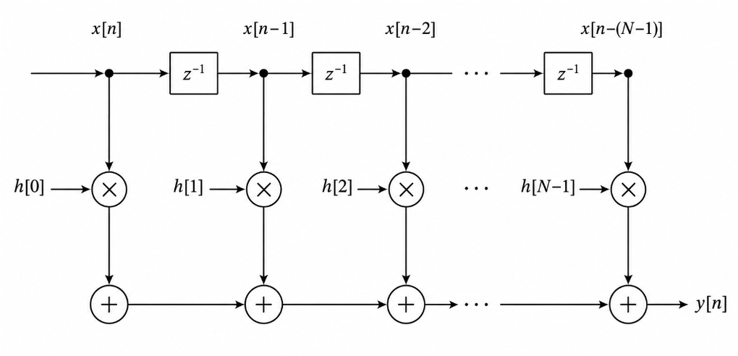
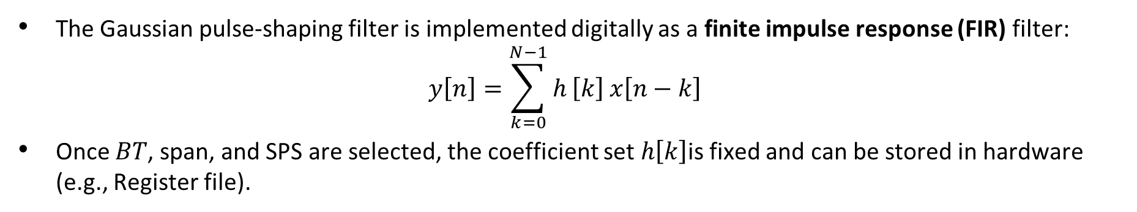
Gaussian Filter as FIR Filter
The Gaussian pulse-shaping filter is implemented digitally as a finite impulse response (FIR) filter:
$$y\left[n\right]=\sum_{k=0}^{N−1}{h}\left[k\right] x\left[n−k\right]$$
Once $BT$, span, and SPS are selected, the coefficient set $h\left[k\right]$is fixed and can be stored in hardware (e.g., Register file).

Slide 21
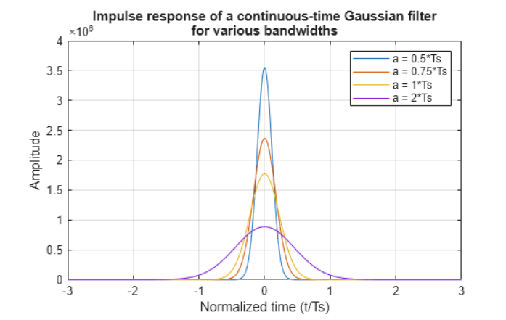
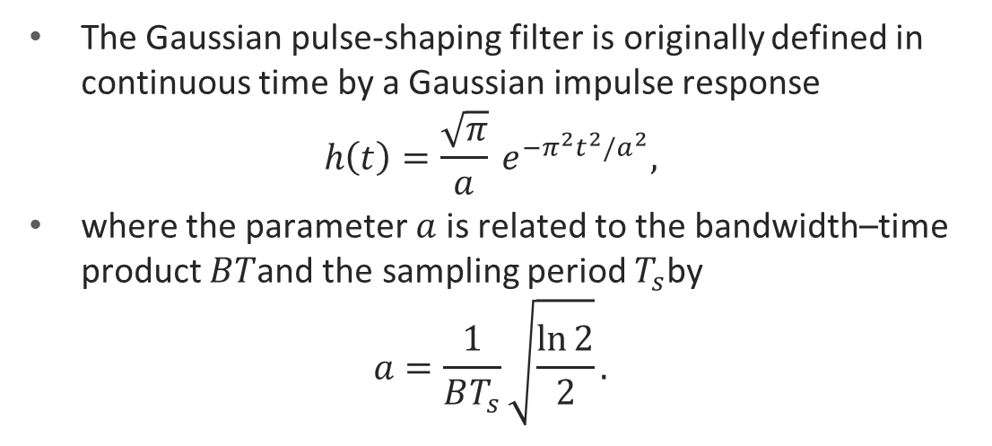
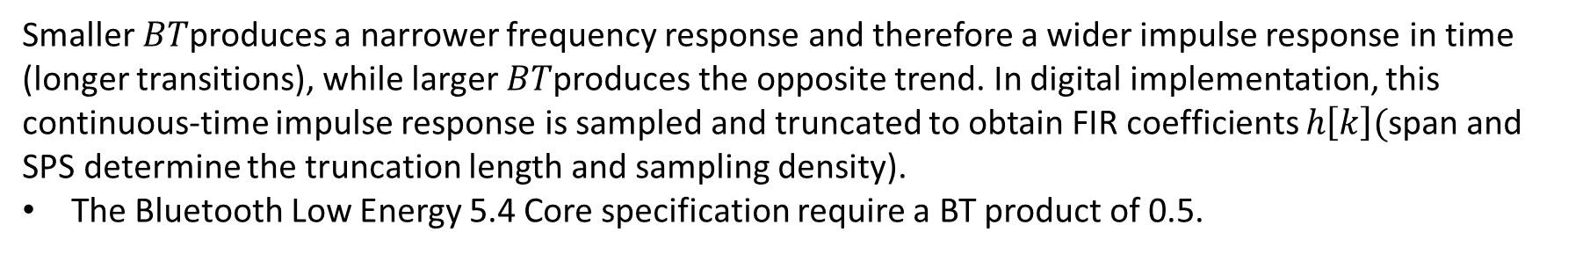
Gaussian Filter as FIR Filter
The Gaussian pulse-shaping filter is originally defined in continuous time by a Gaussian impulse response
$$h\left(t\right)=\frac{\sqrt{π}}{a} e^{−π^{2}t^{2}/a^{2}},$$
where the parameter $a$ is related to the bandwidth–time product $BT$and the sampling period $T_{s}$by
$$a=\frac{1}{BT_{s}}\sqrt{\frac{\ln{2}}{2}}.$$
Smaller $BT$produces a narrower frequency response and therefore a wider impulse response in time (longer transitions), while larger $BT$produces the opposite trend. In digital implementation, this continuous-time impulse response is sampled and truncated to obtain FIR coefficients $h\left[k\right]($span and SPS determine the truncation length and sampling density).
The Bluetooth Low Energy 5.4 Core specification require a BT product of 0.5.

Slide 22
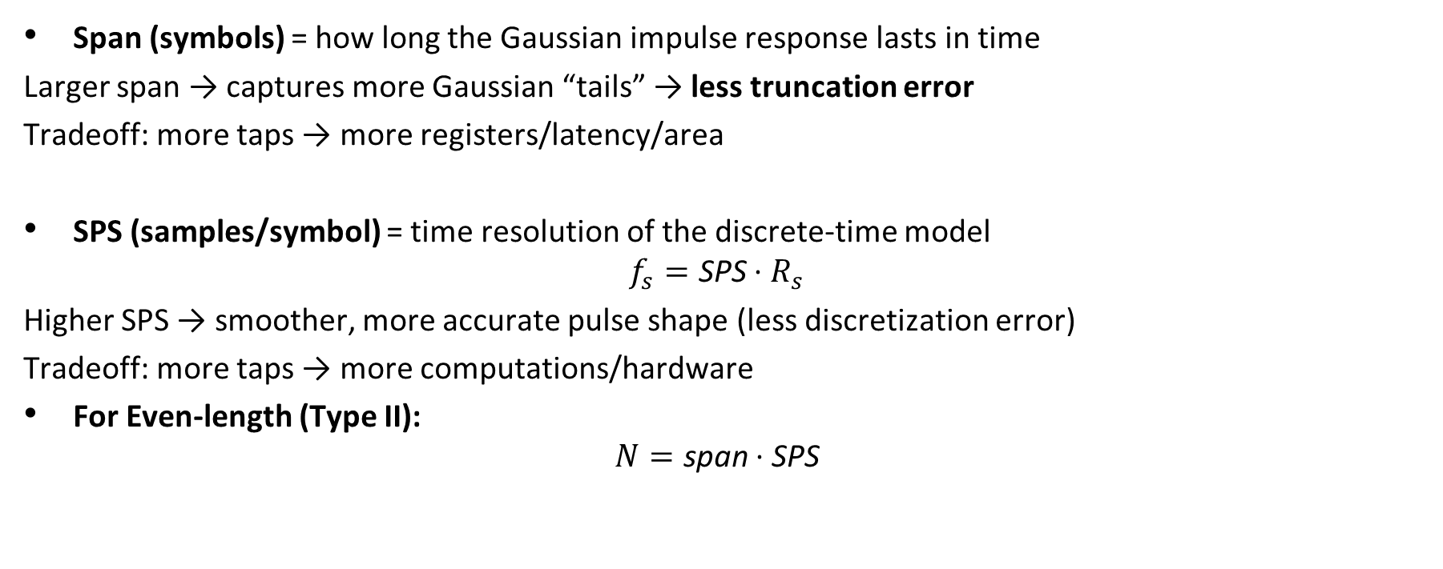
Parameters (span/sps)
Span (symbols) = how long the Gaussian impulse response lasts in time
Larger span → captures more Gaussian “tails” → less truncation error
Tradeoff: more taps → more registers/latency/area
SPS (samples/symbol) = time resolution of the discrete-time model
$$f_{s}=\text{SPS}⋅R_{s}$$
Higher SPS → smoother, more accurate pulse shape (less discretization error)
Tradeoff: more taps → more computations/hardware
For Even-length (Type II):
$$N=\text{span}⋅\text{SPS}$$

Slide 23
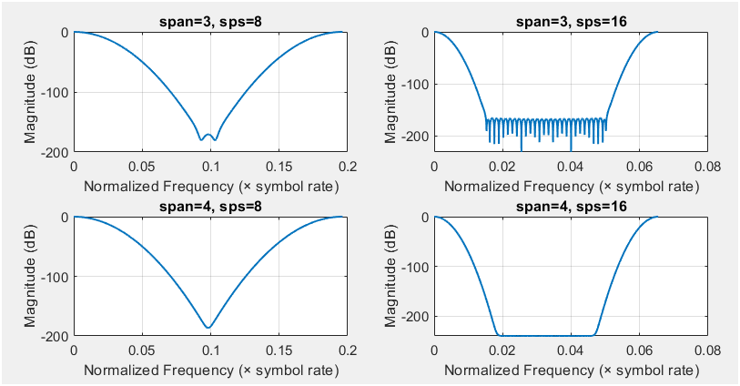
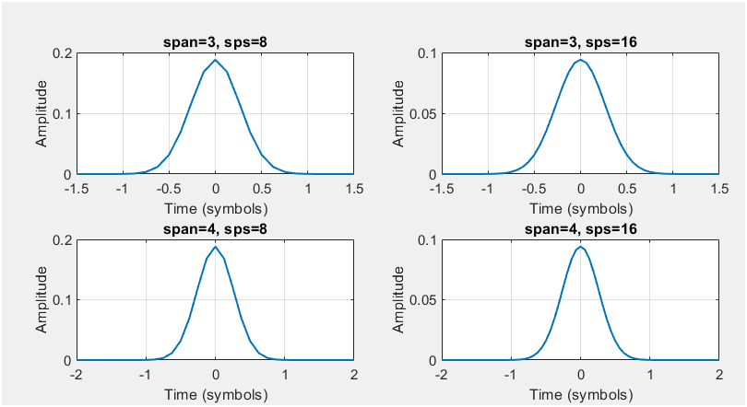

Simulation Results
Span 4 > Span 3: better tail capture in time; cleaner/less truncated shaping
SPS 16 > SPS 8: finer sampling → smoother impulse response and more faithful discrete-time shaping
Selected for primary model: span = 4, SPS = 16 , $N=\text{span}⋅\text{SPS}$ = 64 taps

Slide 24
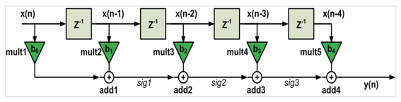
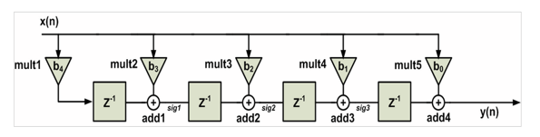
Direct VS Transposed Form
Goal in BLE TX: minimize power (not maximum throughput)
Direct Form
Local dataflow (delay line → MAC) → less switching / simpler routing
No input broadcast → lower fanout
We implement symmetric direct form (folding) to cut hardware
Transposed Form
High throughput (“self-pipelined”)
But input is broadcast to all multipliers → high fanout + more switching → higher power risk
Symmetric Direct-Form FIR used in our implementation (enables multiplier reduction + our multiplier-free logic).

Slide 25
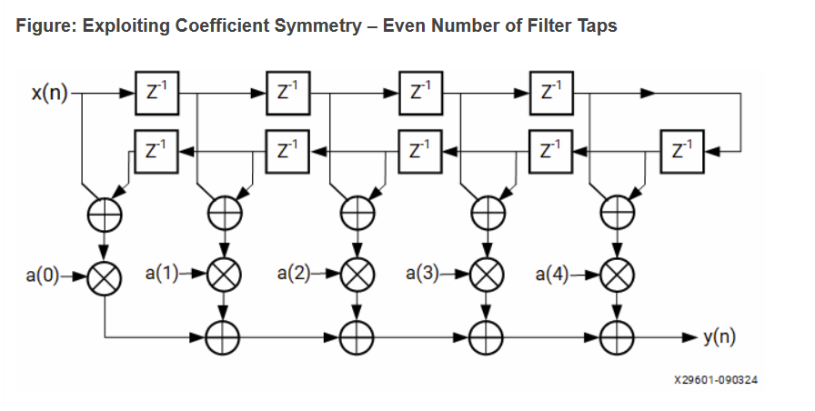
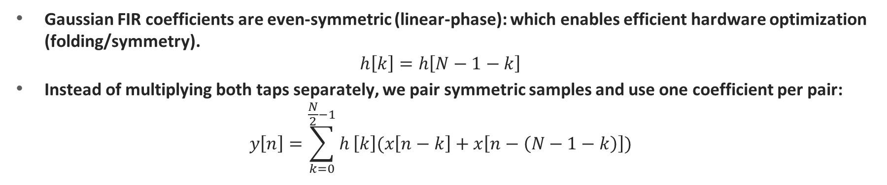
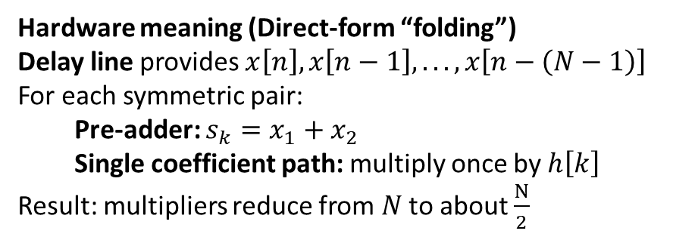
MATLAB: Symmetry Realization for Direct Form
Gaussian FIR coefficients are even-symmetric (linear-phase): which enables efficient hardware optimization (folding/symmetry).
$$h\left[k\right]=h\left[N−1−k\right]$$
Instead of multiplying both taps separately, we pair symmetric samples and use one coefficient per pair:
$$y\left[n\right]=\sum_{k=0}^{\frac{N}{2}−1}{h}\left[k\right](x\left[n−k\right]+x\left[n−\left(N−1−k\right)\right])$$
Hardware meaning (Direct-form “folding”)
Delay line provides $x\left[n\right],x\left[n−1\right],...,x\left[n−\left(N−1\right)\right]$
For each symmetric pair:
  Pre-adder: $s_{k}=x_{1}+x_{2}$
  Single coefficient path: multiply once by $h\left[k\right]$
Result: multipliers reduce from $N$ to about $\frac{N}{2}$

Slide 26
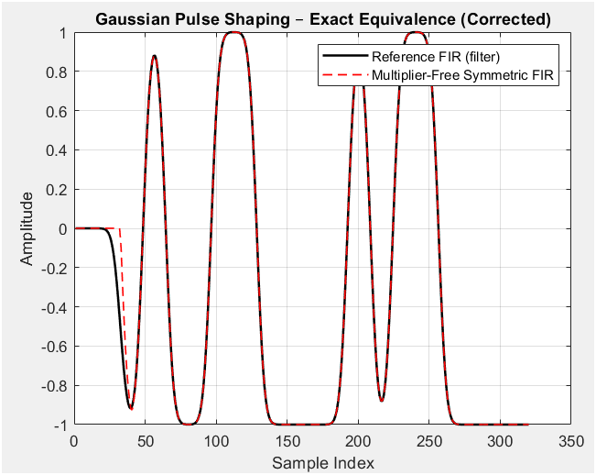
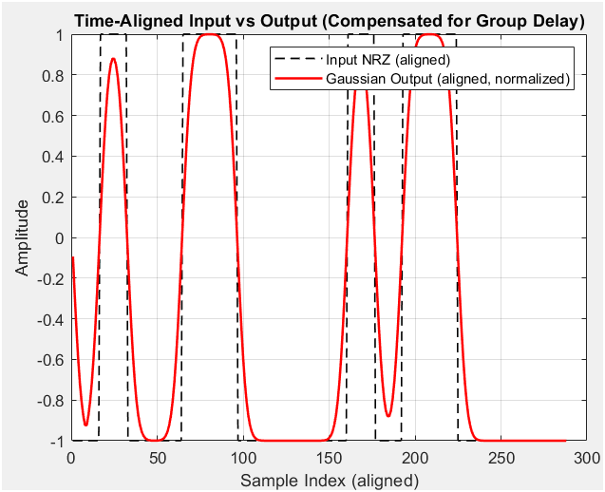
MATLAB Simulation Results

Slide 27
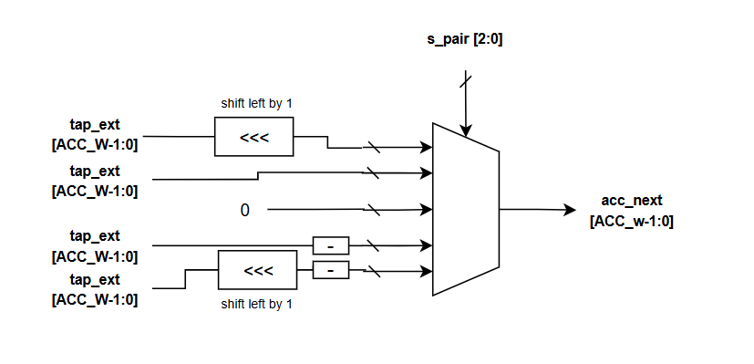
RTL Implementation/Optimization
Symmetric sample pair | s_pair | MUX selected output
+1 + +1 | +2 | +2h[k]
+1 + −1 | 0 | 0
−1 + +1 | 0 | 0
−1 + −1 | −2 | −2h[k]
+1 + 0 | +1 | +h[k]
−1 + 0 | −1 | −h[k]
• Multiplier-free optimization: Since s_pair ∈ {−2, −1, 0, +1, +2}, each tap contribution is selected using a small decoder and MUX instead of a full multiplier.
• The MUX selects: +2h[k], +h[k], 0, −h[k], or −2h[k].
• ±2h[k] is generated by a left shift by 1, and negative terms are generated using two’s-complement sign inversion.

Slide 28
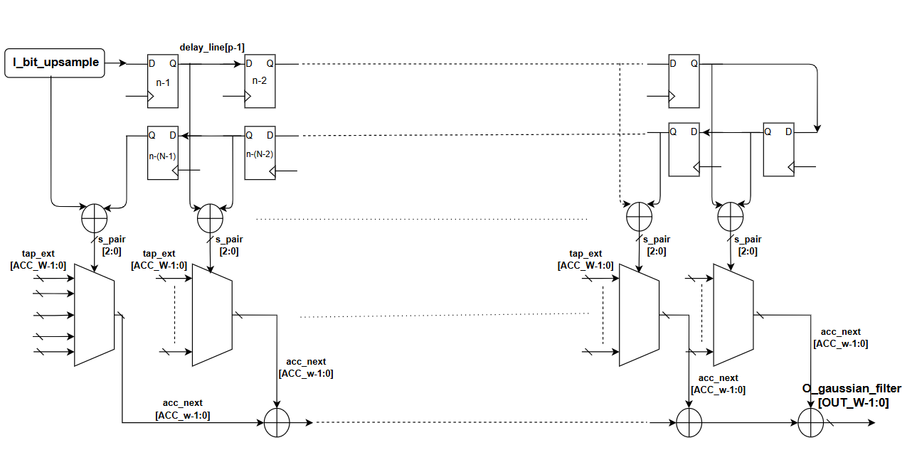
RTL Implementation
• MATLAB model: y[n] = Σ h[k] × x[n-k]
• RTL maps:
h[k] → tap_mem[k]
x[n-k] → delay_line registers

Slide 29
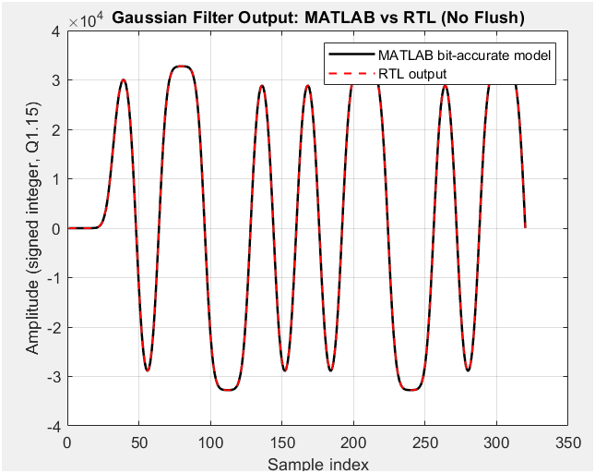
RTL/MATLAB Simulation Result

Slide 30
System Block Diagram

Slide 31
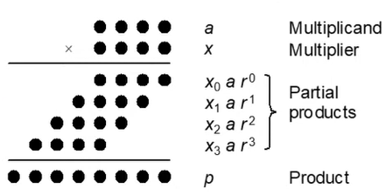
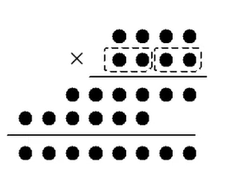
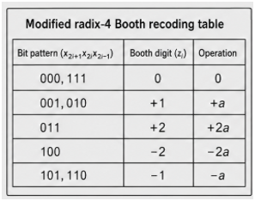
Comparison between Multipliers
• Ordinary binary multiplication generates about one partial product per multiplier bit.
• Radix-4 Booth recoding processes 2 multiplier bits per group.
• Partial products reduce from about B_W to about B_W / 2.
• For B_W = 12:
Number of Booth groups = (B_W + 1) / 2 = 6
• Radix-4 Booth recoding equation:
z_i = -2x_{2i+1} + x_{2i} + x_{2i-1}
• Final product:
Product = Σ (z_i × A × 2^{2i})

Slide 32
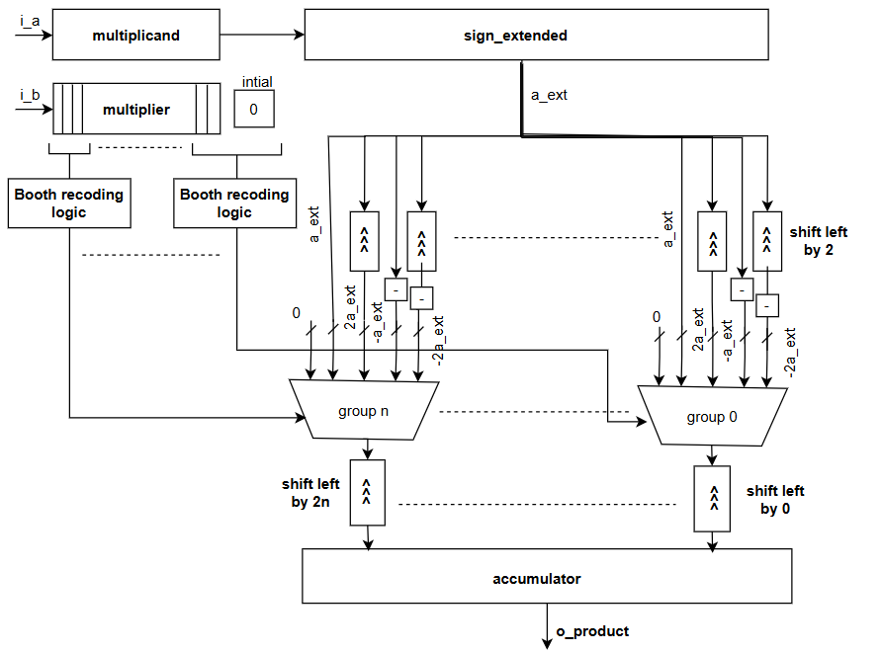
RTL:Radix 4 Booth Recoding Multiplier
• i_a is sign-extended to the accumulator width.
• A zero is appended to i_b:
b_ext = {i_b, 1'b0}
• The multiplier is divided into overlapping 3-bit Booth groups:
{x₂ᵢ₊₁, x₂ᵢ, x₂ᵢ₋₁}
• Each group is recoded to select one partial product:
0, +A, -A, +2A, or -2A
• Each partial product is shifted left by 2i.
• All shifted partial products are accumulated combinationally.
• The final product is registered at the output.

Slide 33
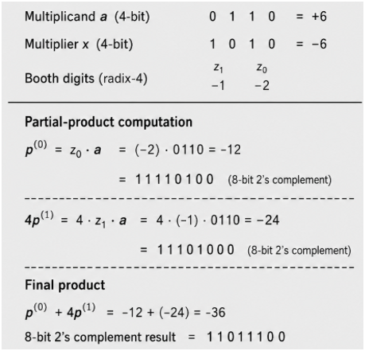
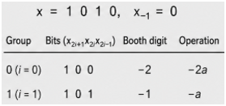
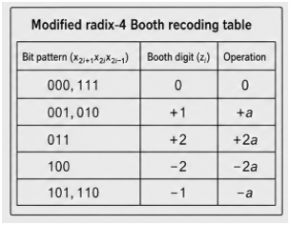
Radix 4 Booth Recoding Multiplier Example

Slide 35
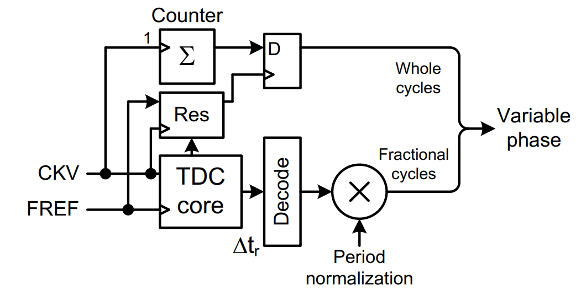
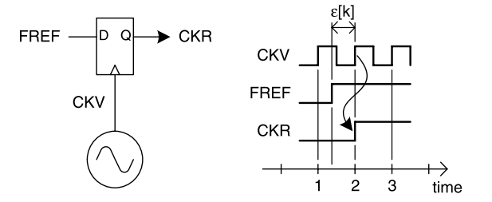
TDC Block Diagram & Operation
The block diagram of the TDC is shown below:

Slide 36
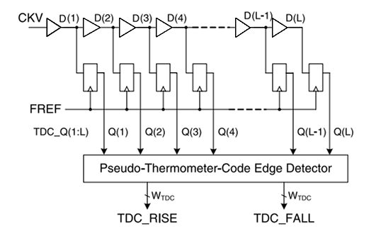
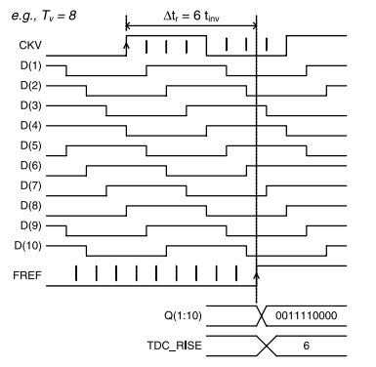
TDC Core

Slide 37

Pseudo-Thermometer-Code Edge Detector Implementation
Masks indicating the rising and falling edges in the pseudo-thermometer code are produced
These masks are input to priority encoder to find the first rising and falling edges.
Priority encoder implemented with a tree structure

Slide 38

TDC Core

Slide 39


Accounting for Random Phase Start
Initial phase relation between DCO and reference is unknown

Slide 40
MATLAB Simulation Setup
A sample-based fixed point MATLAB model of the TDC was developed to verify correct functionality and to quantify the measurement error introduced by the TDC
The nominal buffer (tap) delay used in the model is 10ps
The TDC was tested across a sweep of DCO clock period range 348ps – 520ps (1.92GHz - 2.87GHz) with step size of 2ps.
The fractional part of the TDC output was represented with 16 bits
For each selected DCO frequency the model computed the digital phase for 250 consecutive reference cycles

Slide 41

MATLAB Simulation Results
From simulation the maximum error of the TDC is found to be 0.048
Main source of error: quantization in tapped delay line with worst case quantization step: 1/30 = 0.033

Slide 42

RTL Verification & Coverage
Testbench set up as one in MATLAB. Stimulus provided by MATLAB
Reset assertion and de-assertion applied between each DCO frequency value to ensure TDC correctly accounts for random phase start.
Outputs are compared to ideal MATLAB TDC model
Maximum Error obtained: 0.046
Code Coverage summary:

Slide 43

Digital loop filter

Slide 44


Digital loop filter
Introduction
DLF processes the phase error signal from TDC and generate a stable control word for the DCO.
The DLF acts like a stabilizer. It smooths out the sharp, noisy, quantized output from TDC.
It converts phase error to frequency control.
Loop filter transfer function: (PI realization)
Ther filter will be composed of Proportional and Integral paths.
Phase Error
LOOP
FILTER
OTW

Slide 45

Digital loop filter
PI controller
Proportional path:
Controls loop bandwidth.
Responsible for fast response.
OTW is directly proportional to phase error.
Integral path:
Accumulates past phase errors
Eliminates steady-state phase error.
Responsible for fine and accurate tuning.
Improved noise suppression (introduce extra pole).
ρ
ρ

Slide 46

Digital loop filter
ADPLL operating modes
Fast tracking:
Operates as Type-I loop (only proportional path 𝛼 active)
Goal: Fast transient response, wide bandwidth to minimize lock/settling time.
Used in PVT calibration and Acquisition modes.
Normal Tracking:
Operates as Type-II loop. (integrator turned ON with gain ρ).
Goal: Narrower bandwidth to minimize phase noise, eliminate steady-state phase error.
Used in Modulation or Tracking mode.

Slide 47
Digital loop filter
Modes transition
Gear shifting:
Switching filter coefficients dynamically causes transient instability and frequency overshoot.
The goal is to keep the Normalized Tuning Word (NTW) constat at switching instant.
Proposed Hitless Transition technique:
Freeze mode is introduced by the control unit where:
freezes the DCO control word for one cycle.
resets phase error.
Change the proportional gain.

Slide 48



Digital loop filter
      Type II ADPLL Magnitude response:
From the stability analysis we can see that $ζ$ and $ωn$control the system dynamics.
The figure shows The effect of damping coefficient $ζ$ on the loop.
For critically damped system $ζ=\frac{1}{\sqrt{2}}$
$\text{α} \text{= }2^{−6}$ ${\text{ρ} \text{= }2}^{−13}$
$$ζ = \frac{α fr}{2ωn }= \frac{1}{2}(\frac{α}{\sqrt{\text{ρ} }})$$

Slide 49

Digital loop filter
Simulation results:
To verify the loop filter functionality and the effect on changing coefficients on the closed loop system, an ideal sample based ADPLL model assuming DCO central frequency = 2.432GHz ,

Slide 50


Digital loop filter
      Type I ADPLL Magnitude response:
DCO output frequency
Type I magnitude response

Slide 51

Digital loop filter
RTL Implementation of PI loop filter:
Configurable gain coefficients α and ρ are implemented as arithmetic variable shifters.
Integrator as hardware is accumulator.
Detection for gear_shift_en pulse to switch modes.

Slide 52

Digital loop filter
RTL verification Vs MATLAB Model
The testbench imports stimulus vectors generated from the MATLAB system model.
Quantized RTL output tracking words (OTW) are plotted against MATLAB results to verify design correctness.
Fixed-point optimization guarantees that hardware truncation matches the behavioral model with negligible error..

Slide 53
Gain Estimation

Slide 54
Gain Estimation
Introduction
Two-point modulation requires an all-pass transfer function.
From linear model analysis this requires gain correction coefficient (r=1).
Since KDCO​ varies with PVT, Accurate gain estimation is required.
Adaptive LMS algorithm is used in DCO gain estimation.

Slide 55



LMS
Sign-Sign LMS Algorithm
LMS algorithm was chosen for gain estimation because of its simplified hardware and Low power optimization.
An even more simplified algorithm was used with variable step size:
  Sign-Sign LMS (SS-LMS)
  $$G\left(n+1\right)=G\left(n\right)+μsign\left(m[n]\right)sign\left(φe​[n]\right)$$
The algorithm minimizes the correlation between modulation data and residual phase error.
Convergence occurs when the residual phase error is minimized, achieving an accurate KDCO estimation.
M[n]
$$G\left(n+1\right)$$
SS-LMS
$φe​$[n]

Slide 56

LMS
RTL Implementation

Slide 57

LMS
MATLAB Simulation Results
Relative Estimated Gain Error during training sequence:

Slide 58

LMS
RTL Verification Vs MATLAB
MATLAB reference sample-based model used for golden comparison.
Identical training sequence applied to MATLAB and RTL.
Estimated DCO gain convergence compared throughout training.

Slide 59

LMS Before optimization
LMS takes around 80 symbol to converge with rapid oscillation during transition time

Slide 60

LMS optimization
Adding two filters to reduce noise of phase error but that will cause delay mismatch between modulated signal and phase error signal
So we have to add same filters with same response to match delay between modulated data and phase error

Slide 61

IIR implementation
y[n] = (1 −α)y[n−1]+αx[n]

Slide 62

LMS optimized response
Oscillation reduced significantly
Response more faster it takes less than 10 symbol compared to 80 symbol before optimization

Slide 63

DCO operation
DCO has mainly has four modes :
  PVT Calibration: Compensates for PVT variations to align the baseline frequency with the BLE range.
  ACQ mode : Locks onto the specific communication channel selected by the link layer.
  Tracking mode : Utilizes fine-resolution tuning to actively reduce frequency offset from channel.
  SD operation : Reduces DCO quantization noise to improve signal

Slide 64

DCO on high level
The Digital Loop Filter (DLF) output is normalized to the reference frequency and operates independently of the DCO gain. It passes through a gain normalizer to generate the oscillator tuning word. This tuning word is added to the direct modulation path. The signal is then split: the integer portion connects to the DCO interface, while the fractional portion feeds the Sigma-Delta (SD) modulator for fine frequency control.

Slide 65

Gain normalizer
A 2-bit mode signal determines the required multiplication factor based on the current operating
PVT Mode: Multiplies the signal by 16 (32 MHz / 2 MHz), implemented directly as a 4-bit left shift.
Acquisition Mode: Multiplies by 64 (32 MHz / 0.5 MHz), implemented as a 6-bit left shift.
Tracking Mode: Multiplies by 1280 (32 MHz / 25 kHz), implemented by adding an 8-bit left shift to a 10-bit left shift.
Replacing a complex digital multiplier with basic shift registers and adders to save power and area

Slide 66

DCO interface implementation

Slide 67

Behavioral model of DCO
The DCO is modeled using three independent capacitor banks corresponding to the primary tuning modes: PVT, Acquisition (ACQ), and Tracking.
Behavioral Model: Based on standard LC tank equations:
$f_{o}+∆f=\frac{1}{2π\sqrt{LC_{0}(1+ΔC/C_{0})}}=f_{0}\left(1−\frac{ΔC}{2C_{0}}\right)→\frac{∆f}{f_{o}}= −\frac{ΔC}{2C_{0}}$
$∆C is increment capcitor selected by digital word to control dco frequncy$
Frequency step :
    At PVT = 2MHz
    At ACQ = 0.5MHz
    At Track = 25KHz

Slide 68

Sigma Delta

Slide 69

Why Sigma Delta
  The DCO’s varactor array has coarse frequency steps (LSBs) on the order of tens of kHz, far too large for the sub-Hz or sub-kHz resolution required by the ADPLL.
  A digital sigma–delta (ΣΔ) modulator converts a low-rate fractional tuning word into a high-rate integer sequence whose time-average equals the desired fractional value.
  23 kHz hardware resolution becomes 718 Hz effective frequency resolution improvement could be range of 32
  Sigma delta have 2 main function which are
    Noise shaping
    Averaging
  MASH architecture selected — literature
  consensus points to MASH as the optimal topology,
  offering the best trade-off between stability,
  hardware complexity, and noise shaping quality

Slide 70



First order MASH Sigma Delta Analysis
First order MASH accumulator
First order MASH model
First order MASH Z domain model
Quantization error is given by the fractional part of the accumulated input: eₙ = ⟨u₀ + Σxₖ⟩, which for a constant input simplifies to eₙ = ⟨U₀ + n(n+1)⟩ = ⟨U₀ + nX + X⟩
Periodic error (idle tones): if NX is an integer, the error sequence becomes periodic, producing idle tones in the frequency domain that corrupt the DCO output spectrum
Non-periodic error: if NX is irrational (non-integer), the accumulator never repeats, the error is pseudo-random, and idle tones are avoided — this is the desirable operating condition

Slide 71




3rd order MASH Implementation
$$STF(z) = (\frac{1}{M}) Z^{−2}$$
$$NTF(z) = {(1−Z^{−1})}^{3}$$

Slide 72

Sigma delta and DCO interface
rst_n – Active-low reset sourced from the control unit, ensuring synchronous initialization
sd_en – Driven by the control unit; sigma delta is only activated in specific operating modes (e.g., transmission), keeping it powered down otherwise
sd_in (10-bit) – From the gain normalizer block, which shifts the frequency word to compensate for the 1/M factor from the linear PLL model
sd_clk – Derived from DCO clock ÷ 8 via an analog clock divider, ranging from: 2402 / 8 ≈ 300 MHz to 2480 / 6 ≈ 310 MHz
o_sd – Signed 3-bit output; a constant 4 is added to convert it to an unsigned 3-bit code (0–7), as it drives the unary-weighted tracking capacitor bank of the DCO

Slide 73



Simulation Results
Extended output spectrum of the MASH 1-1-1 modulator for a rational input value (0.25). Strong periodic tonal components are clearly visible, resulting from the repetitive nature of the rational input sequence. The application of dithering significantly reduces these tones by breaking the periodicity.
Power spectral density (PSD) of the MASH 1-1-1 output for an irrational input value $\frac{\sqrt{2}}{10}$. The spectrum shows no periodic tonal components, as the irrational input prevents repetitive patterns in the quantization process.

Slide 74

Sigma delta Simulation results
Loop filter output ranges from 10⁻² to 10⁻³, which is then multiplied by the gain normalizer (×1280, the tracking mode gain), and only the fractional part of the result is fed into the sigma-delta — giving an input range on the order of 10⁻¹ as seen in the table
SD output averaging is performed over 12 cycles, corresponding to the ratio between the sigma-delta clock (sd_clk ≈ 400–413 MHz) and the reference clock — the Avg_SD_Output column reflects this time-averaged value
Quantization error (shown in the Error column) remains small and bounded, and is considered acceptable since the ADPLL loop filter will suppress and compensate these residual errors over time

Slide 75


RTL vs MATLAB Verification

Slide 76

Control Unit

Slide 77

Control unit Architecture
Main FSM
  Controls overall operation sequence of the BLE transmitter and d
  Coordinates transitions between different operating modes
ADPLL FSM
  Controls ADPLL phases: PVT calibration, acquisition, tracking & modulation
  Provides status information to the Main FSM
TMU (Time Management Unit)
  Determines the duration of each operating mode
  Generates timing control signals used for state transitions
Register File Interface
  TMU reads programmable timing parameters from the Register File
  Timing parameters can be modified without changing the hardware
Configurable Timing Registers
  PVT_CYCLES → cycles allocated for PVT calibration
  ACQUISITION_CYCLES → duration of acquisition mode
  TRACK_CYCLES → duration of tracking mode
Link Layer
  triggers transmission via i_ll_tx_start and
  i_ll_mod_start, and receives o_phy_ready from the Control Unit

Slide 78

Main Control Unit FSM

Slide 79



Slide 80


Modulation RTL Vs MATLAB
We pass the specification of BLE 1111 or 0000 should be between $±$225 & 275
And for 10101010 should be 80% of maximum frequency around 204KHz in our case

Slide 81

Multi packet modulation

Slide 82

Eye diagram - RTL
Eye diagram minimum frequency are 206 and max around 256KHz
From BLE specification maximum should be between 225 to 275 and minimum > 185 KHz

Slide 83

CDC Report :
CDC summary :
Register file configured before operation start so it’s signals are static signals
The relation between SD clock and retimed cock has no constant phase relation synchronizer is needed because the frequency ratio between them 9.375 to 9.6875
Solve all RDC between reference domain and SD domain

Slide 84

Data Qualifier Synchronizer
Data Qualifier Synchronizer solve CDC between SD clock and retimed clock
CDC structural check was performed on the synthesized netlist.
Fatal Errors: 0
CDC Violations: 0
Status: Clean. The design handles asynchronous crossings safely with no structural CDC violations detected

Slide 85
Synthesis summary
Synthesis summary:
Synthesis timing was validated at worst-case PVT corners: SS (125°C, 0.95V) for setup and FF (40°C, 1.16V) for hold."
Total area : 18.3K NAND gates on 32nm process .
Zero Setup violation
Hold violation on retimed clock domain can solved easily by insert buffer but usually ignored in Synthesis and solve after placement and routing

Slide 86
Thanks

