Slide 1

Advancements in Modern Healthcare
A Medical University Project — Exploring the frontiers of precision medicine, telehealth, and artificial intelligence in contemporary clinical practice.

Slide 2

Project Overview: Transforming Patient Care
This project examines the most significant technological and clinical innovations reshaping healthcare delivery. From genomic medicine to AI-assisted diagnostics, we explore how these advances are elevating standards of care, improving patient outcomes, and redefining the roles of medical and nursing professionals in the 21st century.

Slide 3

Key Areas of Innovation
Precision Medicine
Telehealth Expansion
AI in Diagnostics
Tailoring treatments to individual genetic profiles for maximum therapeutic efficacy and minimal side effects.
Enhancing remote patient monitoring and consultation to bridge geographical and systemic barriers to care.
Improving the accuracy and speed of disease detection through advanced machine learning algorithms.

Slide 4
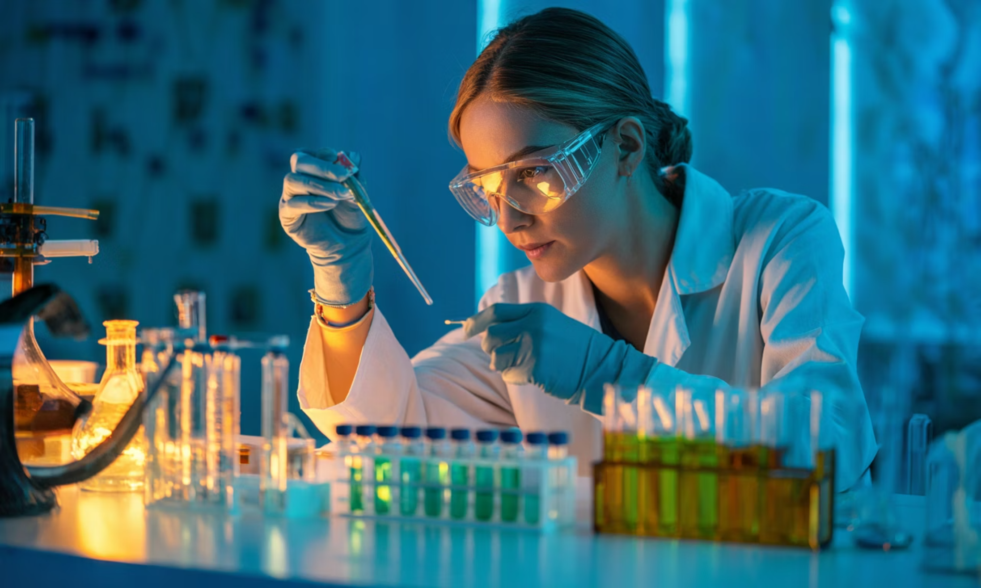
The Impact of Precision Medicine
Why It Matters
Precision medicine moves beyond the one-size-fits-all model, matching therapies to a patient's unique biological makeup.
Personalized treatment plans lead to significantly higher clinical efficacy across chronic and acute conditions.
Genetic screening reduces adverse drug reactions before they occur, enhancing patient safety.
Oncology breakthrough: Targeted therapies have increased cancer treatment success rates by 15% in documented case studies.

Slide 5
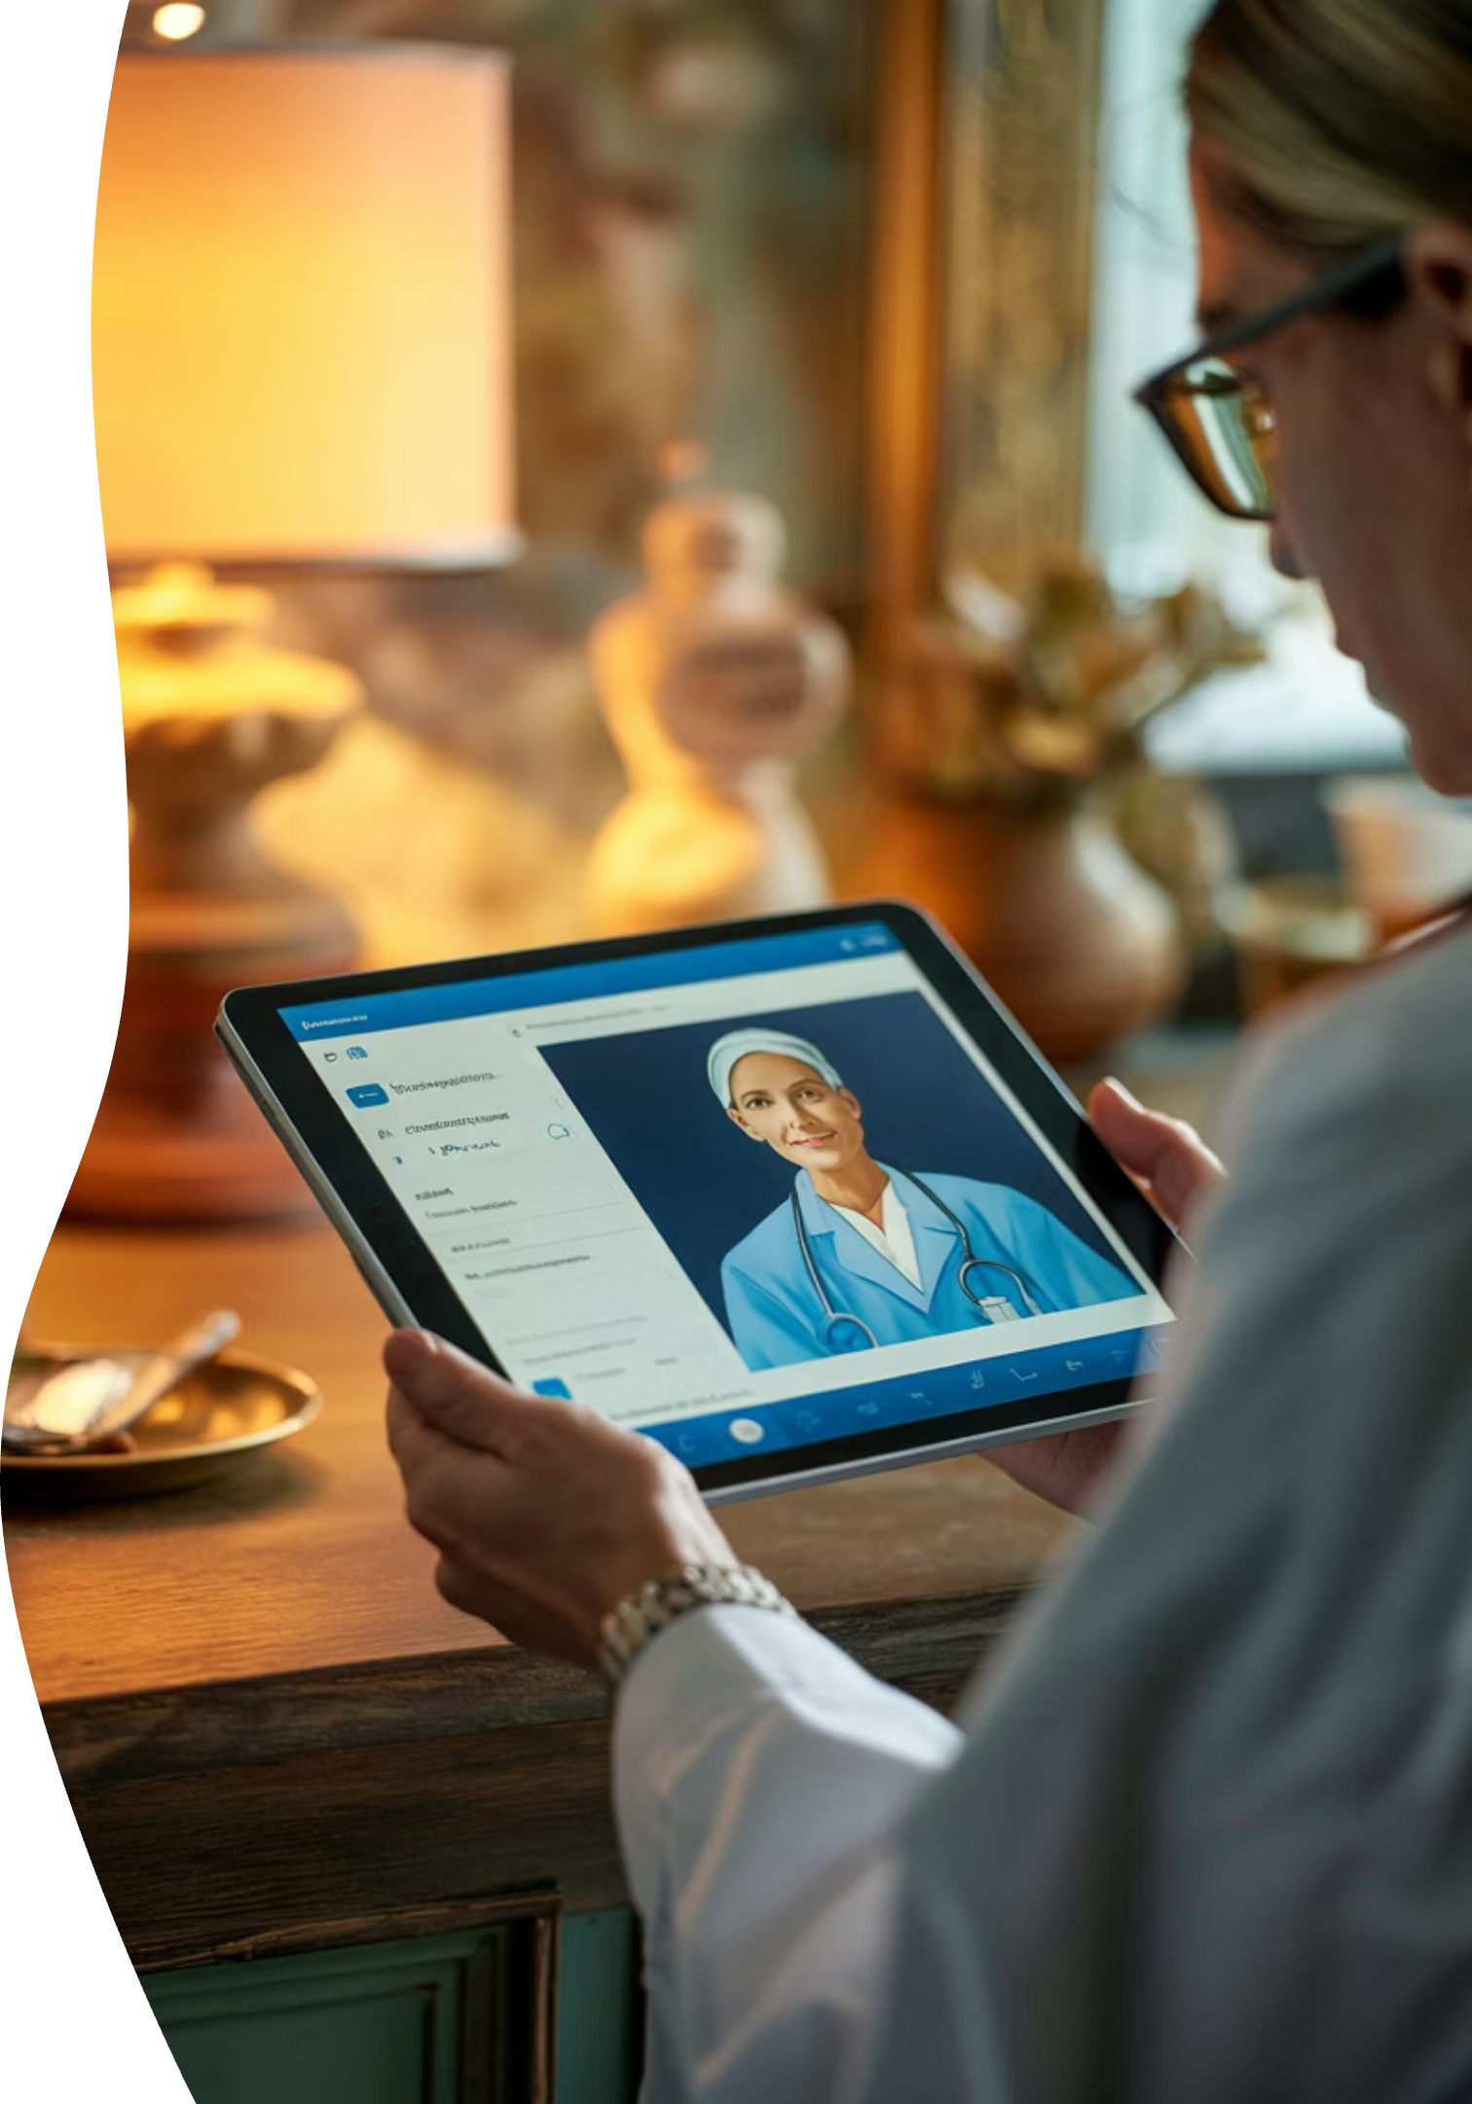
Bridging Distances: The Rise of Telehealth
Telehealth is revolutionizing the patient-provider relationship — delivering quality care beyond the walls of the clinic and into the homes of patients who need it most.
Remote Monitoring
Virtual Consultations
Improved Access
Real-time vitals tracking from home devices
Reaching underserved and rural populations
Reducing unnecessary in-person visits

Slide 6
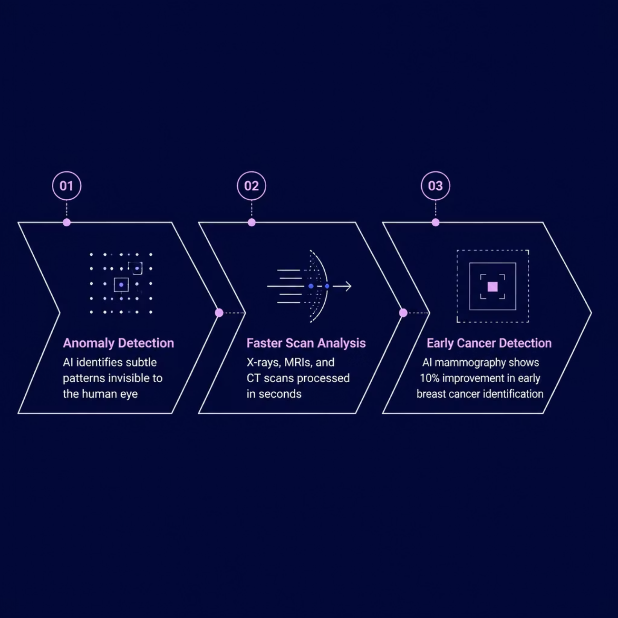


Artificial Intelligence in Medical Imaging
Redefining Diagnostic Precision
Artificial intelligence is fundamentally changing how radiologists and clinicians interpret imaging data. By processing thousands of reference scans, AI models detect anomalies with a consistency that complements — and often enhances — human expertise.
AI-powered mammography screening demonstrates a 10% improvement in early breast cancer detection, translating directly into lives saved.

Slide 7
The Future of Nursing: Enhanced Roles
1
2
3
Technology Integration
Patient Education & Holistic Care
Specialized Nursing Roles
Nurses at the forefront of implementing electronic health records, remote monitoring tools, and AI-assisted care protocols in clinical settings.
Emerging specializations in genomics nursing, digital health coordination, and telehealth facilitation are expanding the scope of nursing practice.
Empowering patients through education, advocating for whole-person wellbeing beyond the immediate diagnosis or treatment episode.

Slide 8

Decoding Health: The Power of Genomics
Genomic medicine unlocks the biological blueprint within each patient — enabling clinicians to predict risk, personalize therapy, and pioneer treatments once considered impossible. The convergence of genomics and digital health data is the defining medical frontier of our generation.

Slide 9

Challenges & Ethical Considerations
Navigating Complexity
Data Privacy & Security
Innovation in healthcare does not come without responsibility. As technology advances, the medical community must proactively address critical ethical and systemic concerns.
Protecting sensitive patient health information in an increasingly connected digital ecosystem.
Equitable Access
Ethical oversight must keep pace with technological capability — patient trust depends on it.
Ensuring advanced medical technologies reach all populations, not just the privileged few.
Evolving Professional Roles
Redefining the human role of clinicians and nurses in an AI-assisted care landscape.

Slide 10

Conclusion: A Healthier Tomorrow, Today
The convergence of precision medicine, telehealth, and AI is not a distant promise — it is an unfolding reality. By embracing innovation responsibly and collaboratively, the healthcare community stands poised to deliver better outcomes for every patient, everywhere.
🔬 Innovate
🤝 Collaborate
Embrace emerging technologies with scientific rigor
Unite clinicians, researchers, and technologists
💙 Care
Always center the patient in every decision
Thank you for your attention — Questions welcome.

