Slide 1
Autonomous-Car

Slide 2
Hardware

Slide 3
Components
Atmega32
Servo Motor
Ultrasonic Sensor
4 DC Motors
LCD 16x2
L293D Motor Driver
Ultrasonic Holder
RC Kit
Battery Holder
12V Battery package

Slide 4
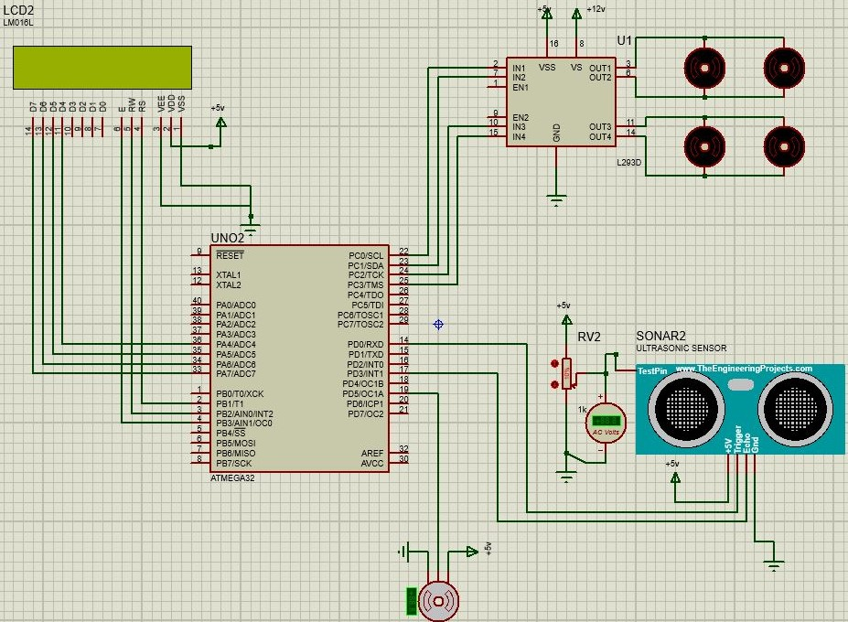
Wiring Diagram

Slide 5
Software

Slide 6
Peripherals
GPIO
2)External Interrupt
Timer Interrupt
Fast PWM

Slide 7
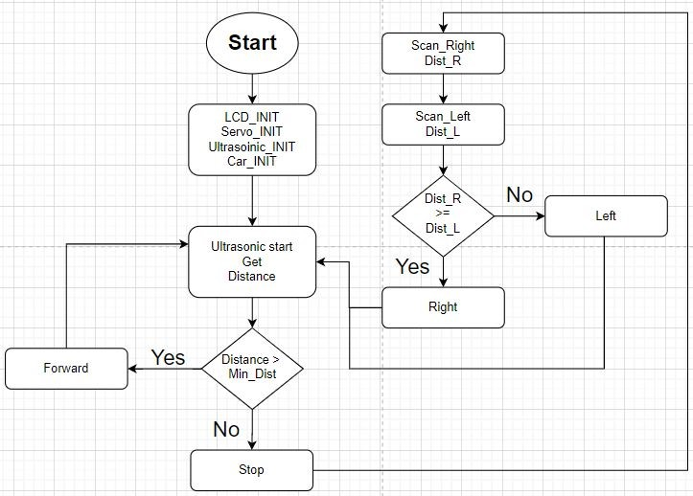
Flowchart

Slide 8
END

