Slide 1
FALL 2026 · MAIN SESSION
Planora
The student schedule planner for CSAI.
Choose sections, spot clashes, compare options and share your timetable before registration.
Directed by Ahmed Amir & Youssef Taha (الريبات المشطشطين)
PLANORA / INDEPENDENT STUDENT PROJECT
01
Notes:
Sources: Planora repository README.md and live site https://zc-planora.vercel.app/. This is an independent student project, not a university service.

Slide 2
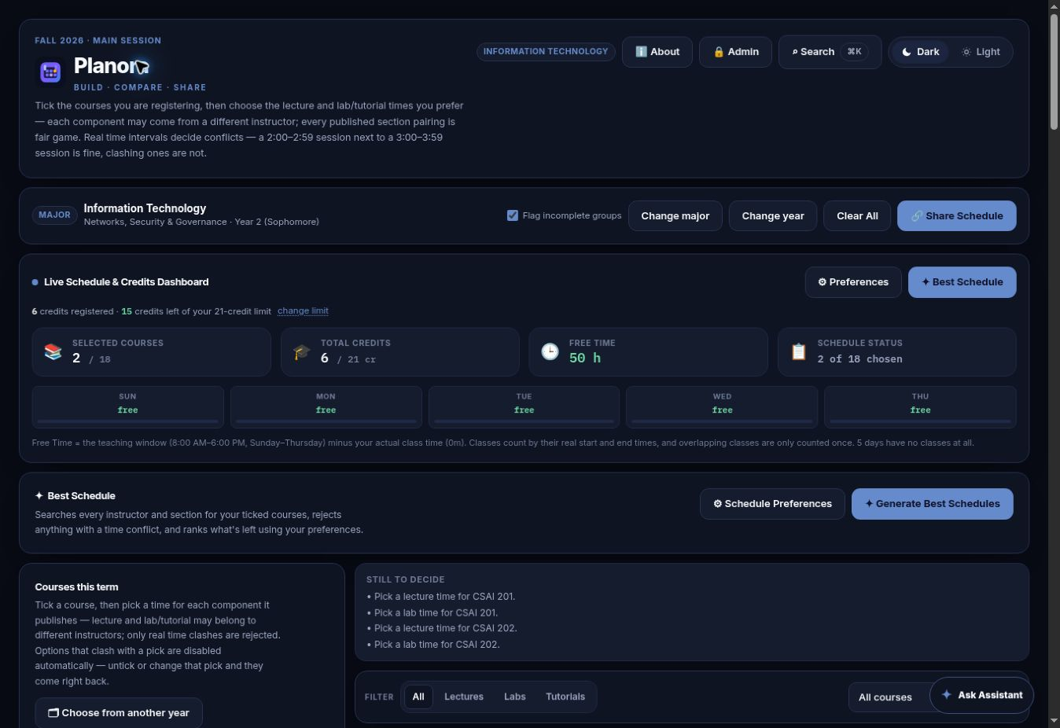
THE LIVE EXPERIENCE
A planner you can actually use
Years 1–4 · IT (Years 2–4), Data Science & AI, Software · Cyber Security (courses pending)
PLANORA / INDEPENDENT STUDENT PROJECT
02
Notes:
Source: screenshot of live site on 25 Sep 2026, https://zc-planora.vercel.app/. Cyber Security has no published courses in this dataset; IT starts at Year 2.

Slide 3
PLANORA FEATURES
Schedule decisions with guardrails
01 Pick lecture, lab and tutorial sections
02 See overlapping sessions and credit limits
03 Generate and compare best schedules
AI can suggest changes, but the planner checks the final schedule against meetings and locks before showing a proposal.
PLANORA / INDEPENDENT STUDENT PROJECT
03
Notes:
Source: src/App.tsx evaluateAssistantProposal; src/components/ScheduleAssistant.tsx; README.md. Check final registration facts in Self-Service.

Slide 4
NEXT TERM WORKFLOW
Keep the engine. Update the semester.
semester.json Term, dates and verification
courses.json Courses, instructors and meetings
majors.json Major and year mapping
sch.json SCH electives
Validator → TypeScript → Build → Platform, data, AI, admin, UI and scheduler tests
PLANORA / INDEPENDENT STUDENT PROJECT
04
Notes:
Source: src/semester/*.json, docs/SEMESTER_ROLLOVER.md, package.json. Only add published or creator-supplied academic facts.

Slide 5
ACCESS AND STATUS
Shared with students. Controlled by creators.
Share link · Image · Print / PDF · Calendar (.ics)
Installable PWA with refresh prompt and offline status
Course details on click; student reports in the private admin inbox
Private admin workspace: two accounts, saved drafts and feedback with optional names, ratings and comments. Course data changes require a separate release.
zc-planora.vercel.app
PLANORA / INDEPENDENT STUDENT PROJECT
05
Notes:
Sources: README.md; docs/ADMIN_PANEL.md; src/components/AppStatus.tsx; src/components/ReportIssueDialog.tsx. These inbox and import changes are on the project branch; verify before claiming they are live. Credentials intentionally excluded.

Slide 6
ADMIN WORKFLOW
Review the next semester before release
Edit one verified course, paste Self-Service results or upload CSV.
Compare section changes and inspect validation errors.
Save with a source note; undo the last saved draft if needed.
Admins review student reports and 1–10 feedback. Nothing publishes until the verified dataset passes CI and is deployed.
PLANORA / INDEPENDENT STUDENT PROJECT
06
Notes:
Sources: docs/ADMIN_PANEL.md, docs/SEMESTER_ROLLOVER.md, app/api/admin.ts and app/api/feedback.ts. Imports create drafts, not published course data.

