Slide 1

FROTH STABILITY
Realized by : Naji Oussama
Supervised by
Mr. El Hassan Abdelwahed
Mr. Ahmed BENDAOUIA

Slide 2
FROTH STABILITY
Definition:
Flotation froth stability refers to the ability of a froth layer to remain stable and not collapse during the flotation process. A stable froth layer is important for the effective separation of minerals in the flotation process.
The stability of the froth layer is determined by a number of factors, Collapse rate, for example.

Slide 3
FROTH STABILITY
Stable vs Unstable froth:
A stable froth layer will remain in place for an extended period of time, allowing for the effective separation of the ore particles. An unstable froth layer, on the other hand, will collapse quickly, resulting in reduced efficiency and lower recovery rates.

Slide 4
AVERAGE INTENSITY METHOD
Average Intensity:
The average intensity of an image refers to the overall brightness or darkness of the image. It is calculated by summing the intensity values of all the pixels in the image and dividing them by the total number of pixels. The intensity value of a pixel is a measure of the brightness or darkness of that pixel, with higher values corresponding to brighter pixels and lower values corresponding to darker pixels.

Slide 5
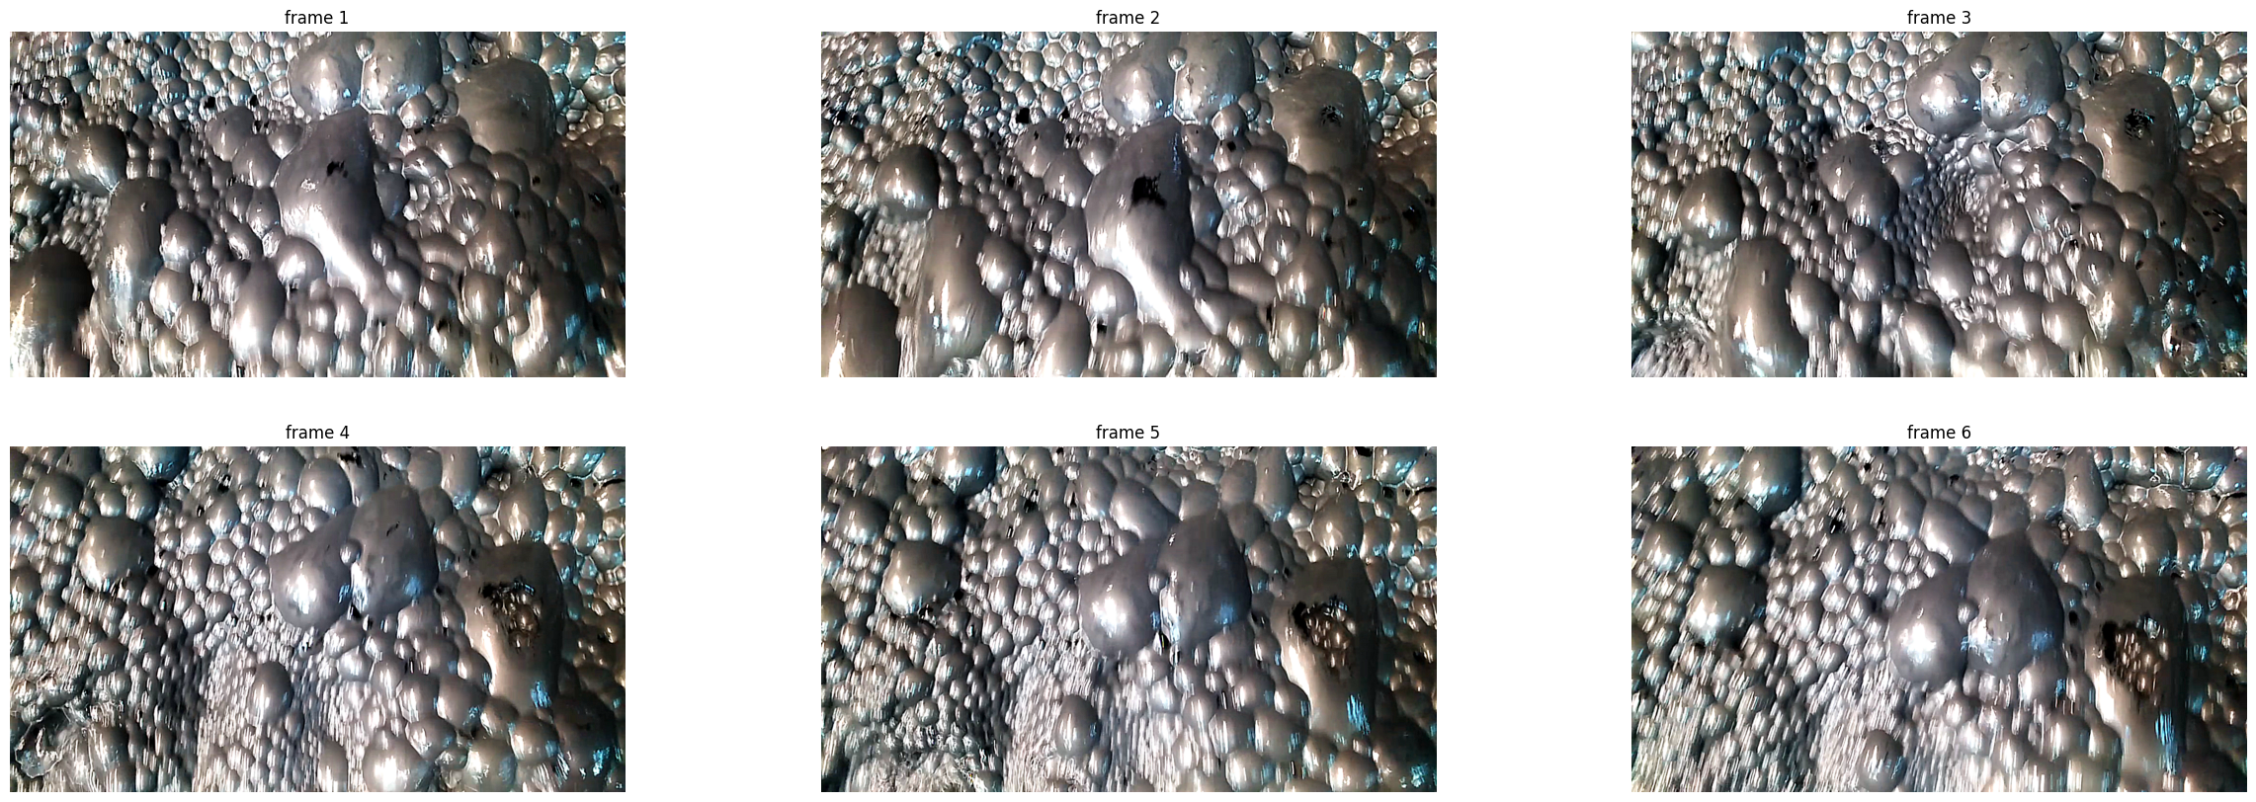
AVERAGE INTENSITY METHOD

Slide 6
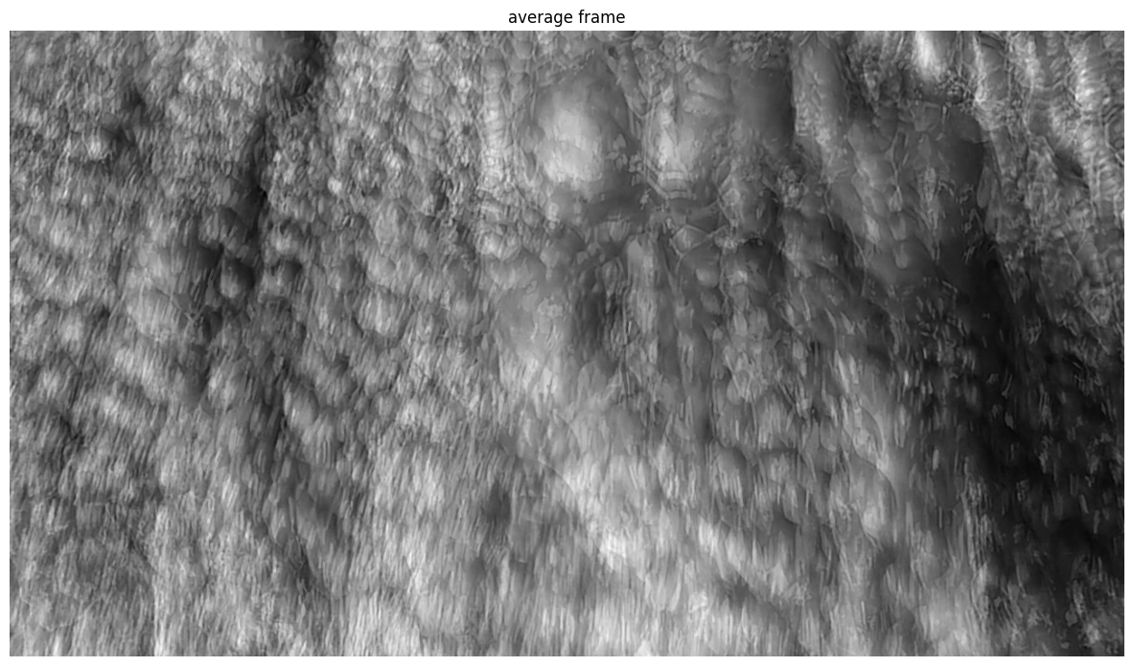
AVERAGE INTENSITY METHOD

Slide 7
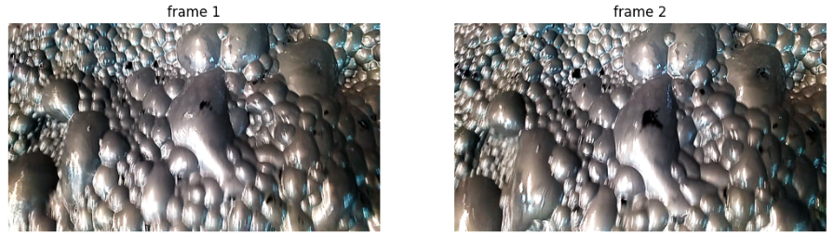
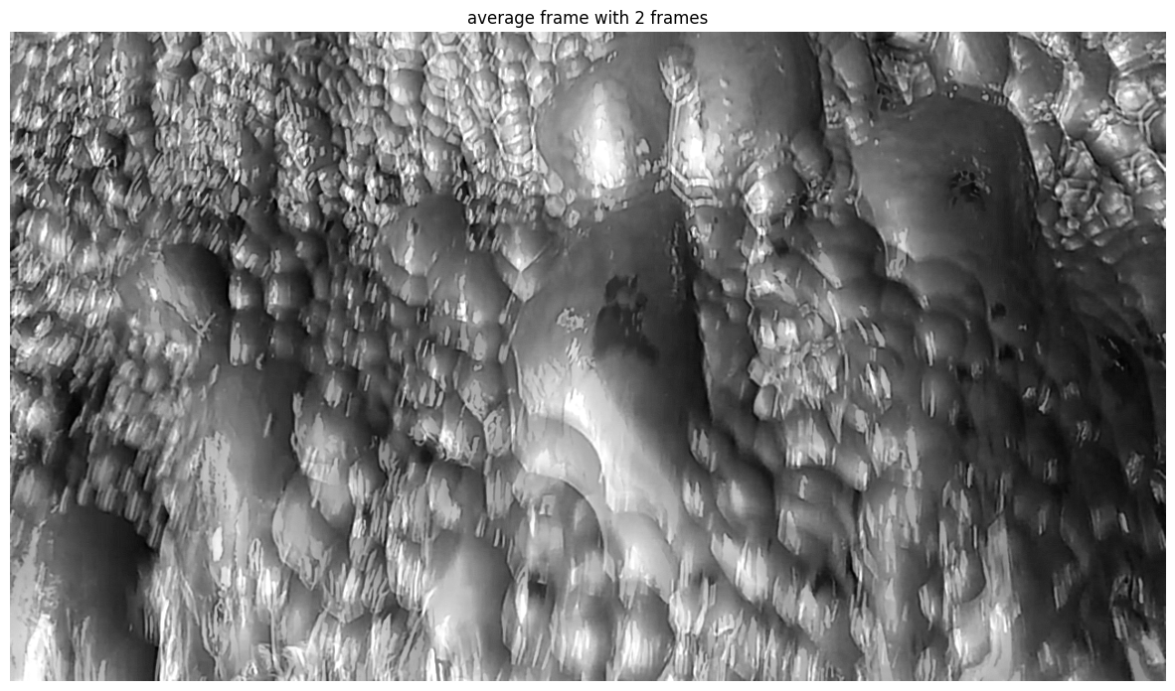
AVERAGE INTENSITY METHOD
If we average these two consecutive frames, we will get this image.
Average intensity value: 111.32 because there is no significant difference between the frames

Slide 8
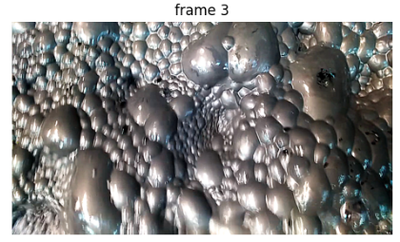
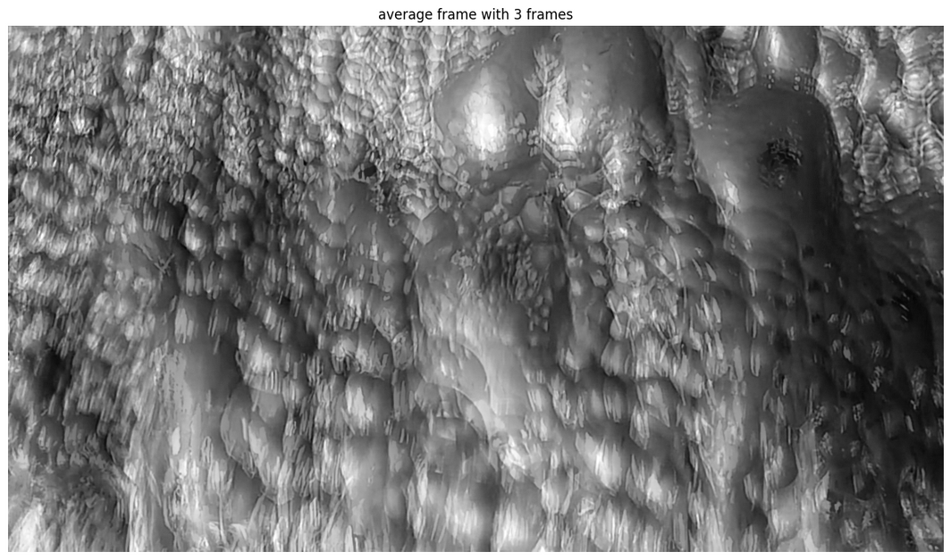
AVERAGE INTENSITY METHOD
If we add this third frame, we will get this image.
Average intensity value: 111.45 because the collapse event is not yet very clear in the average image (we can still see the shadows of the big collapsed bubble) that's why the value did not increase significantly

Slide 9
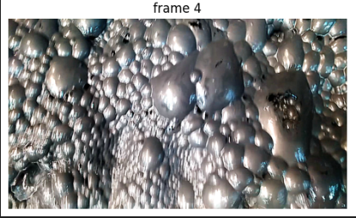
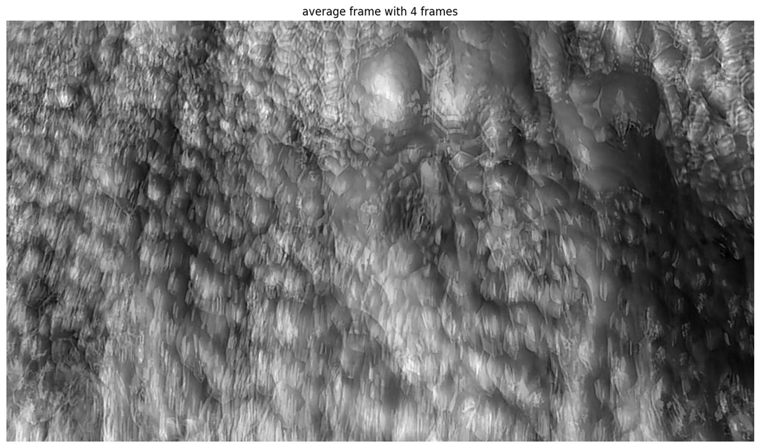
AVERAGE INTENSITY METHOD
By adding a fourth frame, we will get this result.
The average intensity value bumped up to: 112.61 because the collapse event is completed in the average image, that's why the value did increase.

Slide 10
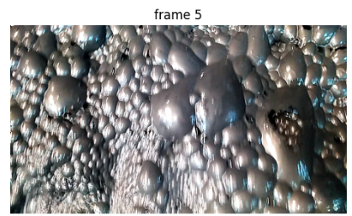
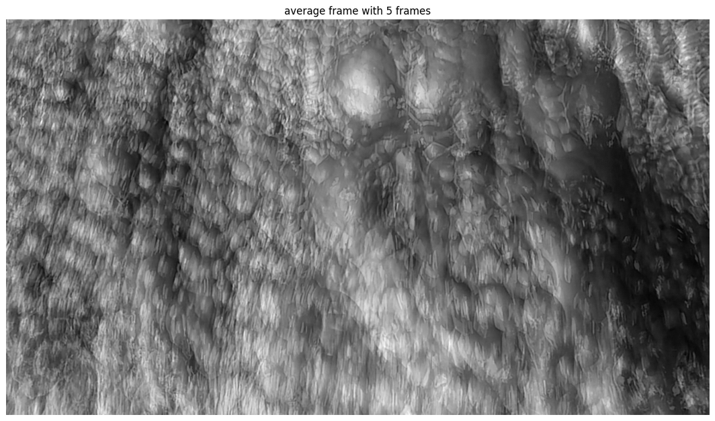
AVERAGE INTENSITY METHOD
The same thing when adding the fifth frame, the value increased to 113.36 because the average image became blurry.

Slide 11
APPLYING THE METHOD TO THE FIRST VIDEO
Video Information:
Fps: 30
Length: 31 seconds
Frames in total: 938
We average 5 frames, and we take the average intensity. As a result, we have 187 values

Slide 12
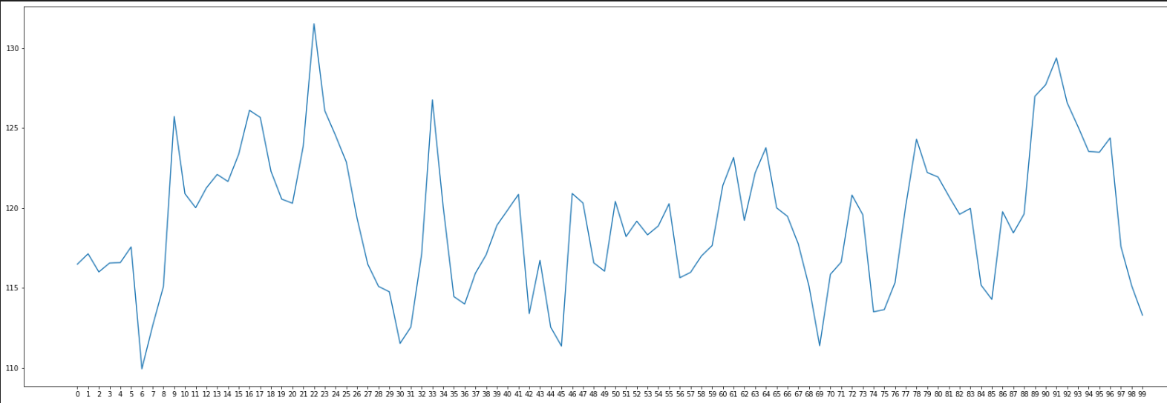
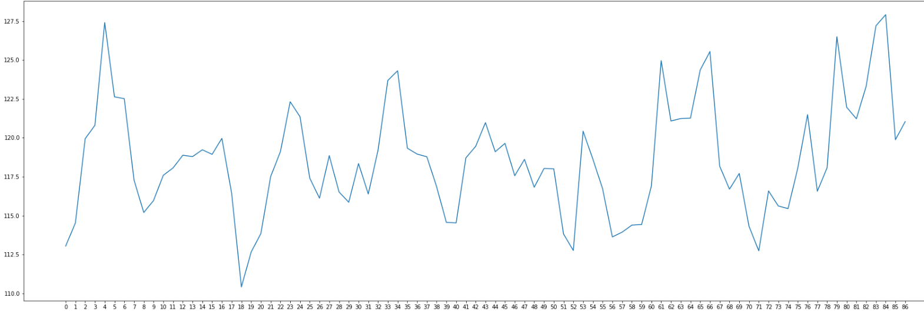
APPLYING THE METHOD TO THE FIRST VIDEO

Slide 13
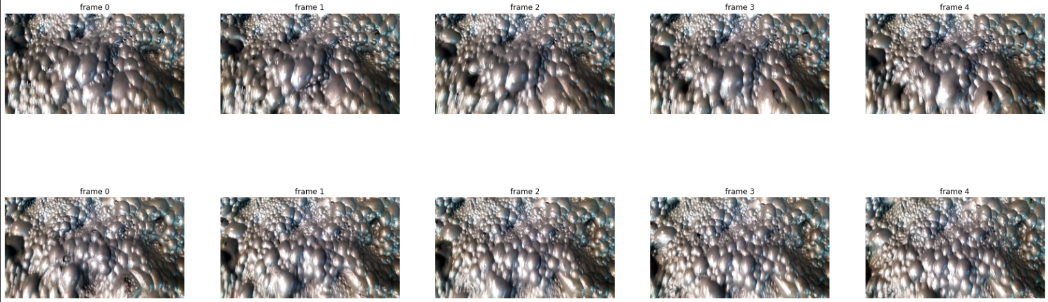
APPLYING THE METHOD TO THE FIRST VIDEO
For indexes 8 and 9

Slide 14
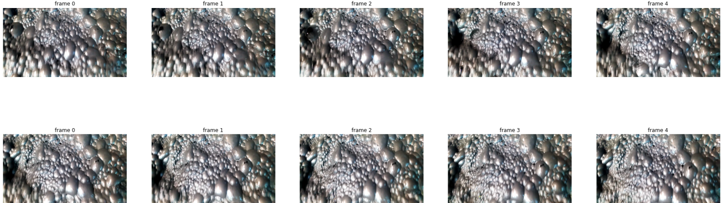
APPLYING THE METHOD TO THE FIRST VIDEO
For indexes 160 and 161

Slide 15
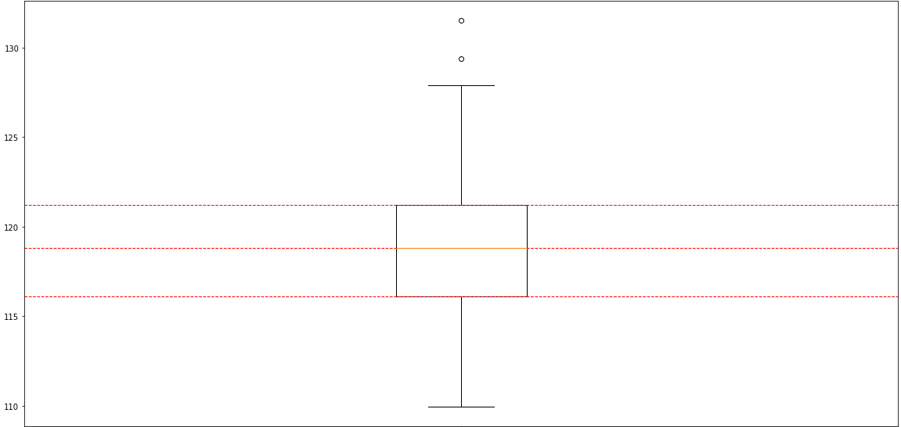
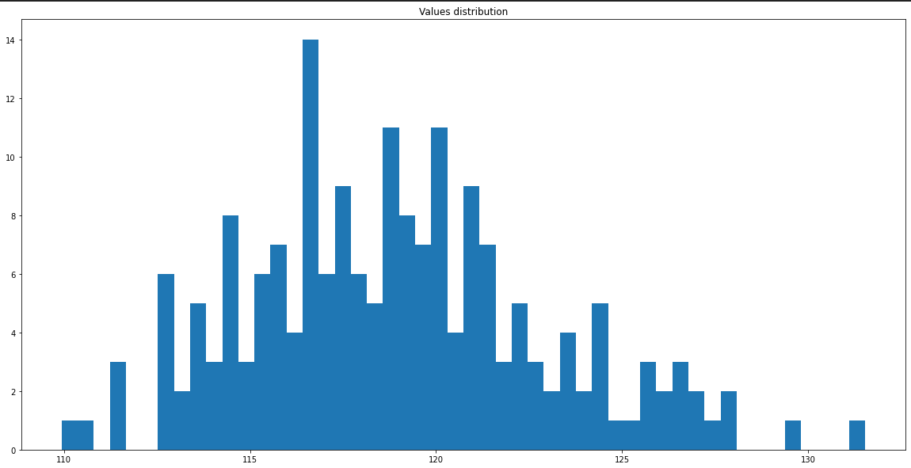
APPLYING THE METHOD TO THE FIRST VIDEO
The majority of values are between 115 and 120, For this video we can see that variance is high wish gives us an idea how the froth is behaving (High velocity or instability)

Slide 16
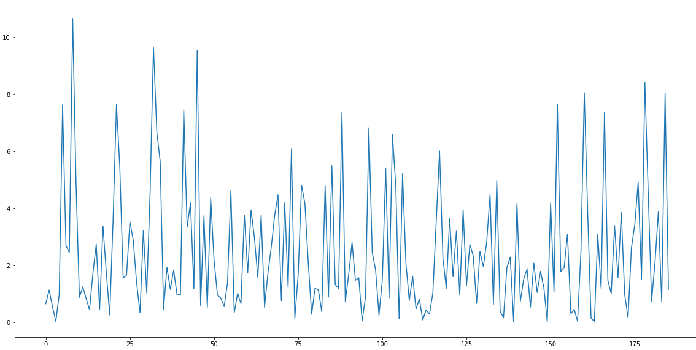
APPLYING THE METHOD TO THE FIRST VIDEO
Another representation of our data, is to calculate differences between a value and the next one, the values with a big difference means that the froth isn't stable.

Slide 17
APPLYING THE METHOD TO THE SECOND VIDEO
Video Information:
Fps: 30
Length: 29 seconds
Frames in total: 898
We average 5 frames, and we take the average intensity. As a result, we have 179 values

Slide 18
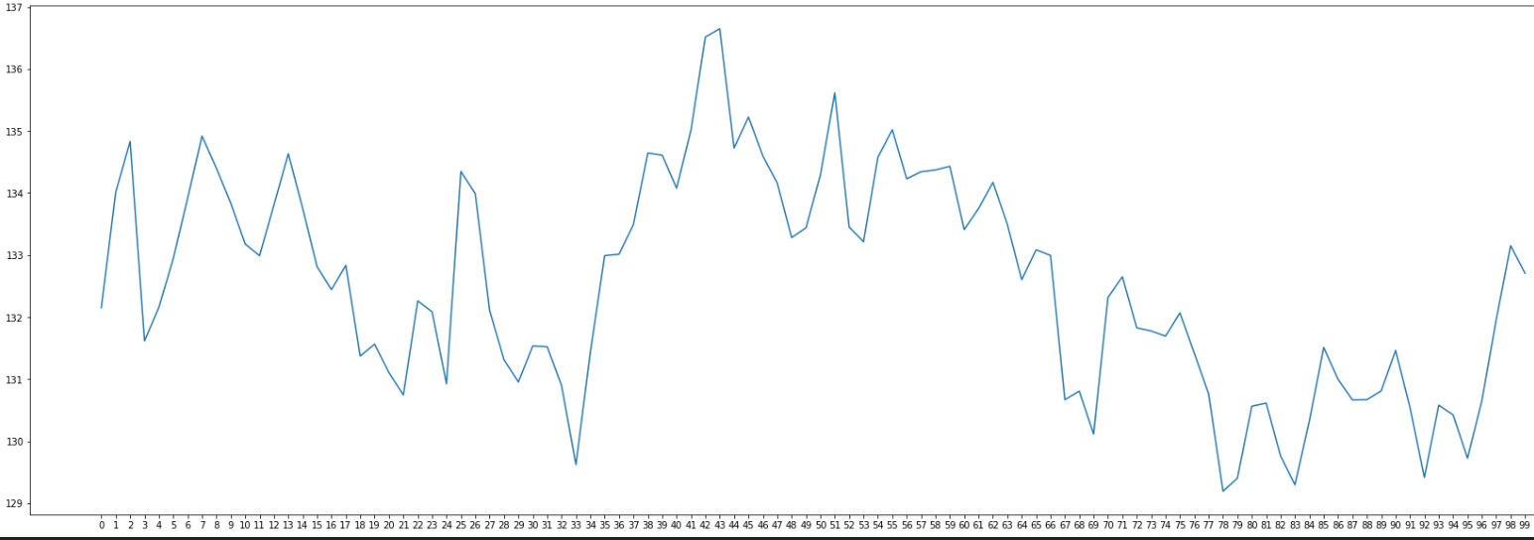
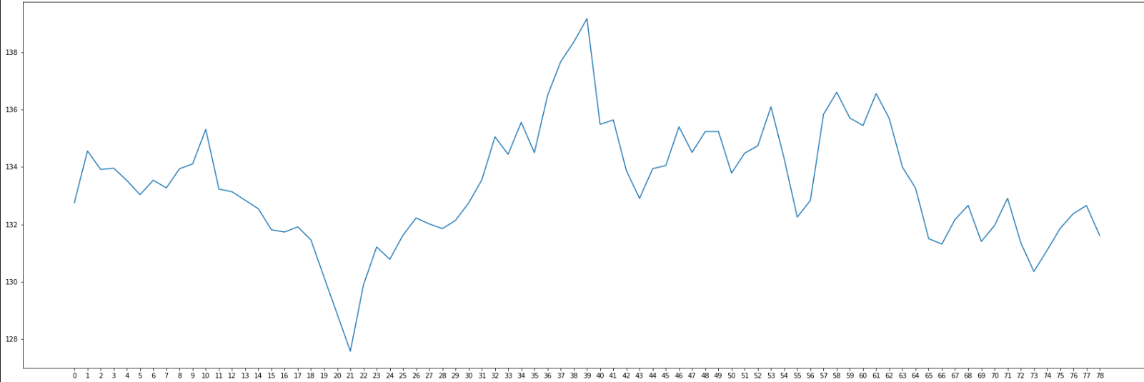
APPLYING THE METHOD TO THE SECOND VIDEO

Slide 19
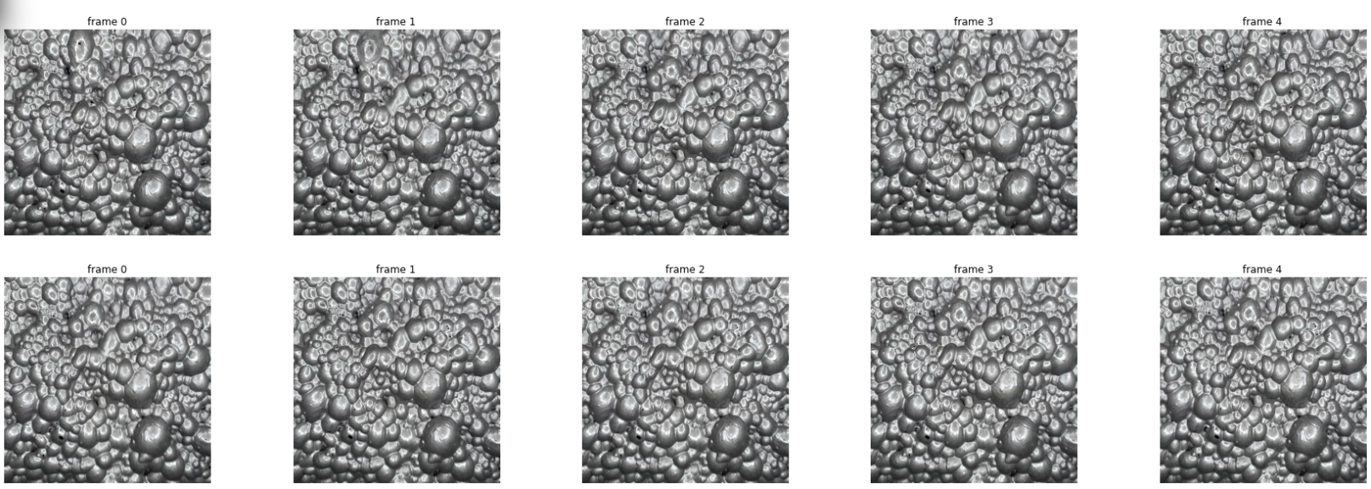
APPLYING THE METHOD TO THE SECOND VIDEO
For indexes 24 and 25

Slide 20
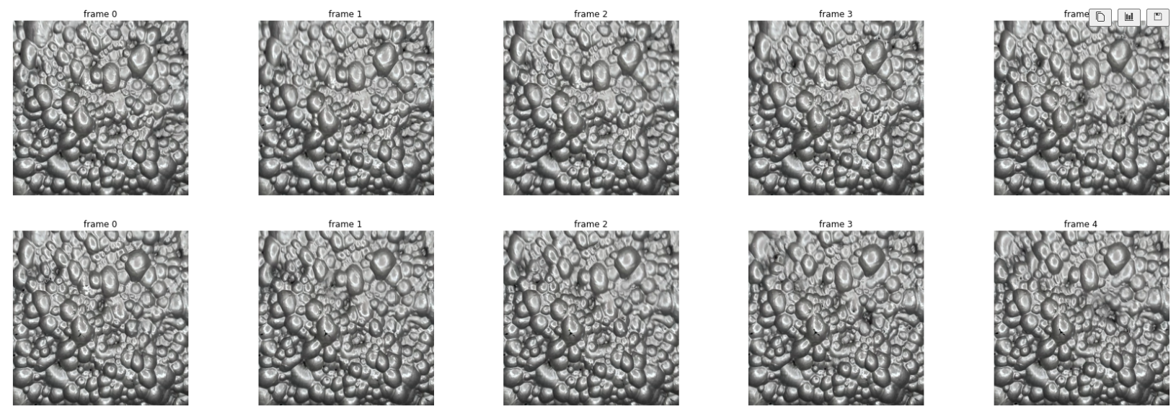
APPLYING THE METHOD TO THE SECOND VIDEO
For indexes 139 and 140

Slide 21
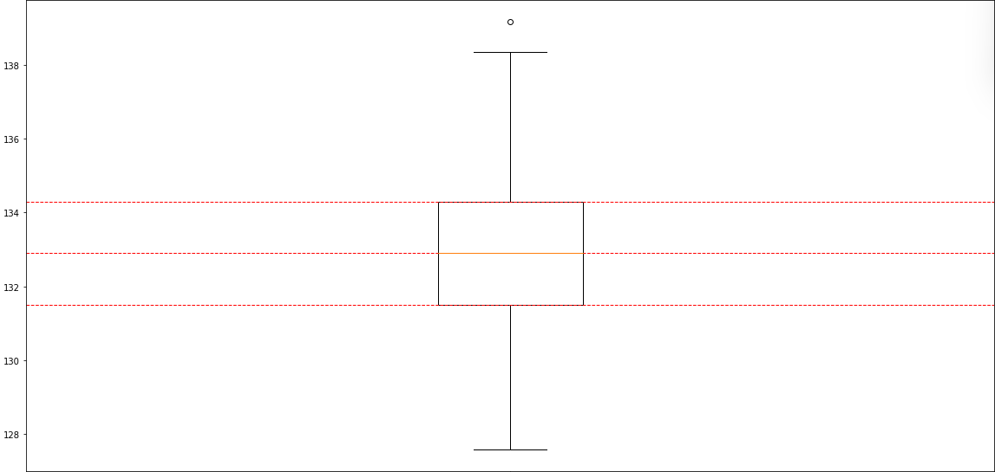
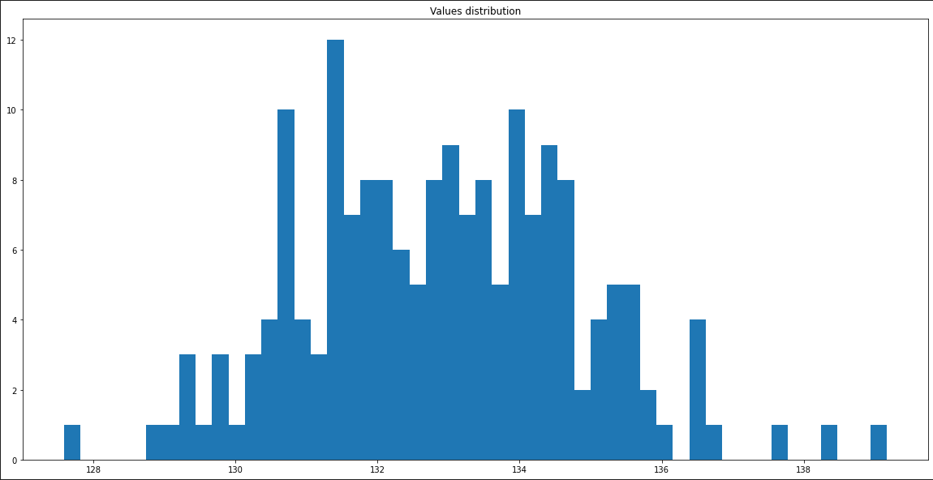
APPLYING THE METHOD TO THE SECOND VIDEO
The majority of values are between 129 and 135, For this video we can see that variance is low wish gives us an idea that the froth is stable.

Slide 22
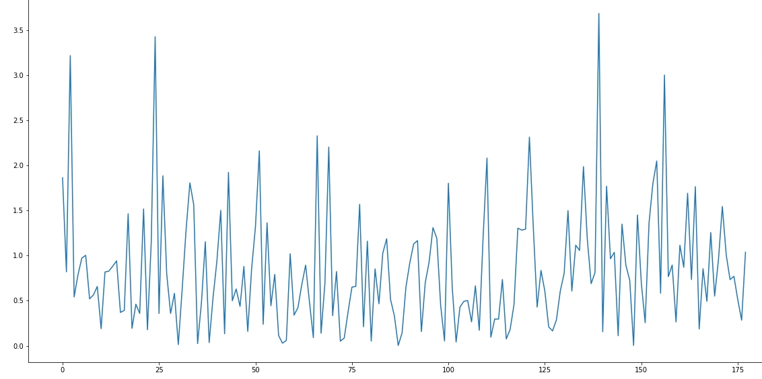
APPLYING THE METHOD TO THE SECOND VIDEO
The assumption that the froth is stable is still valid seeing this plot, the differences between values does not exceed 4, unlike the previous video the differences are high.

Slide 23
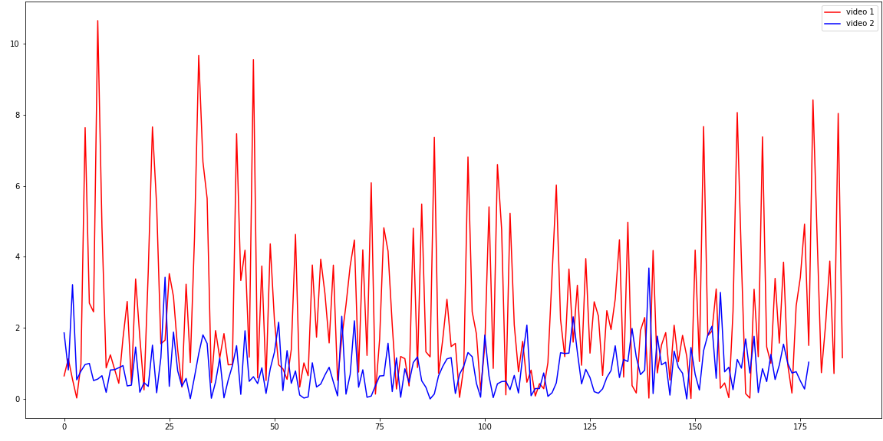
CONCLUSION FOR THE FIRST METHOD
As a conclusion, This method gives us a good idea how the froth is acting, and it's stability.
In this plot, we can see the values of differences between the two video and as a conclusion we can say that the froth on the video 2 is more stable

Slide 24
TRYING IMPROVEMENTS
Idea:
In computer vision, there are various techniques to reduce image noise, one of them is applying a smoothing filter then a sharpening filter.
Smoothing filter reduce the noise in the image and the sharpening filter brings up the clarity of the edges in the image
Contrast boosting an image means increasing the difference in intensity between the light and dark areas of the image.

Slide 25
TRYING IMPROVEMENTS: SHARPENING & BLURRING
After applying the filters to improve the method, the results yielded are quite similar to the previous method.
To conclude, the results are not satisfactory to excuse the slow time of execution.
For comparison: the Original method applied to the first video (video length 31 seconds) took 10.4s to execute on 4 cores 8 threads CPU running at 3.3Ghz, but it took 2 min 17s on the method with the blur and sharpening filters

Slide 26
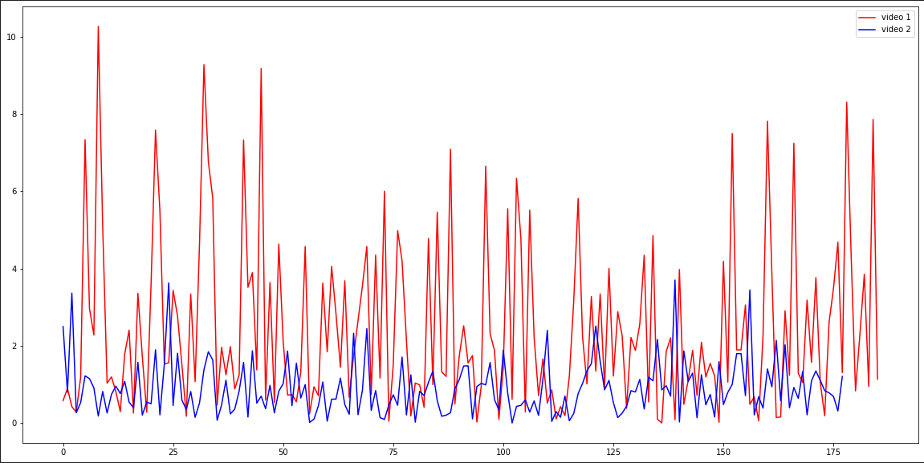
TRYING IMPROVEMENTS: SHARPENING & BLURRING
Video1 vs Video 2
This plot helps us better understand the difference between the two videos, We can see that the values of differences between average intensity values are higher in the video 1 compared to the video 2

Slide 27
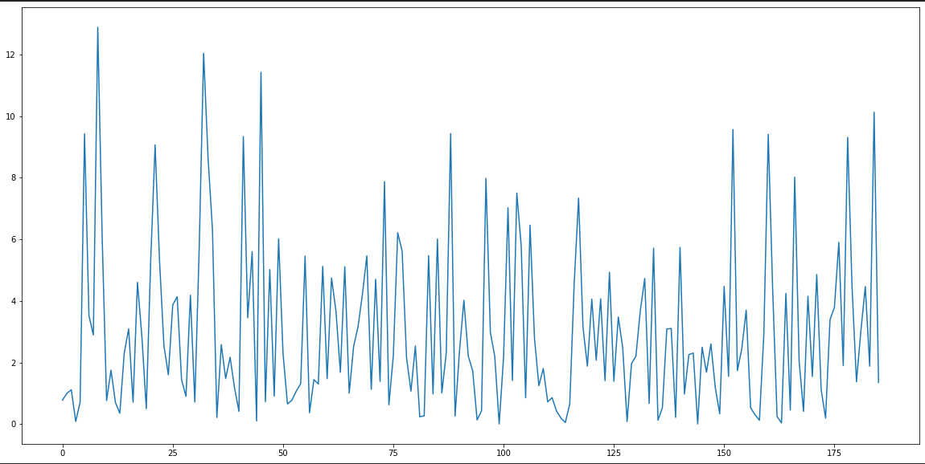
TRYING IMPROVEMENTS: CONTRAST BOOSTING
Video 1
Contrast Boosting the images increased the variance in this case. That's due to the boosted intensity value of the white and dark pixels.

Slide 28
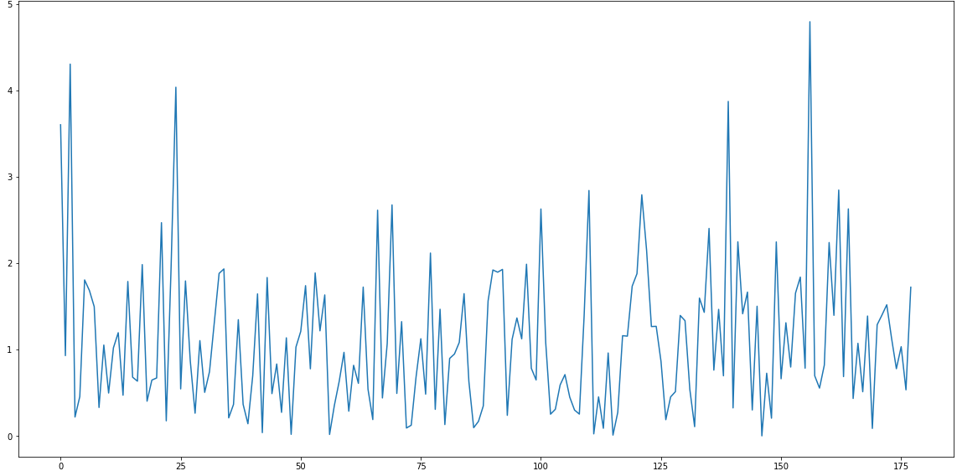
TRYING IMPROVEMENTS: CONTRAST BOOSTING
Video 2
The same story repeats on the second video, the variance value increased compared to the raw method.

Slide 29
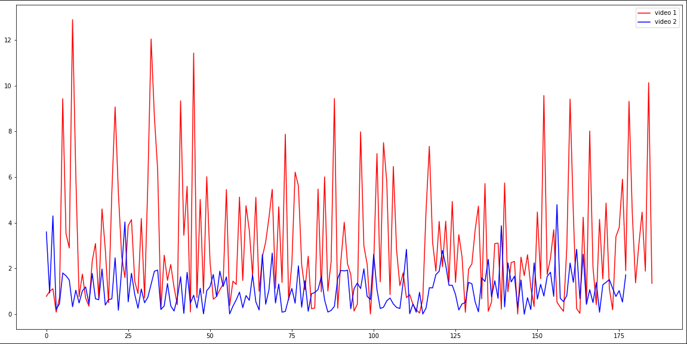
TRYING IMPROVEMENTS: CONTRAST BOOSTING
Video1 vs Video 2
This plot helps us better understand the difference between the two videos, We can see that the values of differences between average intensity values are higher in the video 1 compared to the video 2

Slide 30
COMPARISON BETWEEN THE ORIGINAL AND THE OTHER VERSIONS
In this slide, we are going to compare:
Average intensity method on raw images
Average intensity method on images with a blurring and sharpening filters
Average intensity method on contrast-boosted images
These results are obtained on the first video (length 31sec) using 4 cores 8 threads CPU clocked at 3.1 GHz and a 16Gb ram
Raw method
Execution time = 10.4sec
Median blur(7×7) and sharpening method
Execution time = 2 min 17sec
Contrast boost method
Execution time = 10.9 sec

Slide 31
COMPARISON BETWEEN THE ORIGINAL AND THE OTHER VERSIONS
These results are obtained on the Second video (length 29sec) using 4 cores 8 threads CPU clocked at 3.1 GHz and a 16Gb ram
Raw method: Execution time = 13.2sec
Median blur(7×7) and sharpening method: Execution time = 2 min 37sec
Contrast boost method: Execution time = 12.5 sec

Slide 32
METHOD BASED ON IMAGE SEGMENTATION
Main Idea:
The froth contains a variety of bubbles (small, medium, big), the intuition behind this approach is: if a big bubble is collapsed the number of small bubbles increases and that's because the big bubbles are usually filled with a number of bubbles inside.

