Slide 1
🧠
BrainDump AI
Capture your thoughts instantly — AI organizes the rest.

Slide 2
Team Members
Mobile Application Development ·
1
Eslam Mohamed AbdelRadi
2
Ahmed Waleed Mohammed
3
AbdelFattah ElSayed AbdelFattah
4
Khaled El Sayed Metwally

Slide 3
Today's Presentation
01
02
General Idea
UX Research
Problem, vision, and what BrainDump AI does
Survey, Empathy Map, Persona, Design System, Wireframes
03
04
Pain Points & Solution
Code Implementation
Concluded insights and our selected approach
5 live screens: Capture, Inbox, Tasks, Insights, Settings

Slide 4
The Problem: Mental Overflow
6,000+
thoughts/day
40%
forgotten in 24h
70%
lose ideas daily
When a thought occurs — the user faces 4 painful choices:
🧠
📱
💬
❌
Try to remember
Open a notes app
Text themselves
Do nothing
Forget 60% by tomorrow
30+ seconds, breaks focus
Messy, unorganized pile
Open loops → anxiety

Slide 5
Why Existing Solutions Fail
App
What It Does
Why It Fails
Google Keep
Quick notes
✗ No AI, just a pile of notes
Apple Notes
Text notes
✗ No categorization or priority
Notion
Everything tool
✗ Too complex, 30+ sec to capture
Todoist
Task manager
✗ Can't capture random thoughts
Voice Recorder
Records audio
✗ No transcription or analysis
WhatsApp (self)
Message yourself
✗ Gets buried, no organization
⚠ Common Flaw: All apps require the user to manually categorize, prioritize, and organize. The capture step is easy — the organization step is where every app fails.

Slide 6
Our Solution: BrainDump AI
3 steps to solve Mental Overflow
🎤
🤖
✅
01
02
03
Capture
AI Auto-Organization
Review & Act
Under 3 seconds
Instant
When ready
Voice tap or text type. Zero-friction input — open app and you're ready.
Categorize · Priority · Deadlines · Tags · Summaries — all automatic.
AI-organized inbox · Convert to tasks · View insights · Smart reminders.

Slide 7
UX Research — Phase 1 & 2
Phase 1 — Research
Phase 2 — Design
Survey: 50+ respondents on thought capture habits
Font: Poppins (headings) + Inter (body) — clean, modern
Key finding: 73% forget ideas within minutes
Colors: Royal Blue #2563EB · Purple #7C3AED · Emerald #10B981
Empathy Map: frustration with slow apps
Icons: Outline style — Mic, Bell, Checkmark, Bulb, Cart, Sparkles
Persona: Ahmed, 24, CS Student — needs quick capture during lectures
Wireframes: 5 screens — Capture, Inbox, Tasks, Insights, Settings

Slide 8
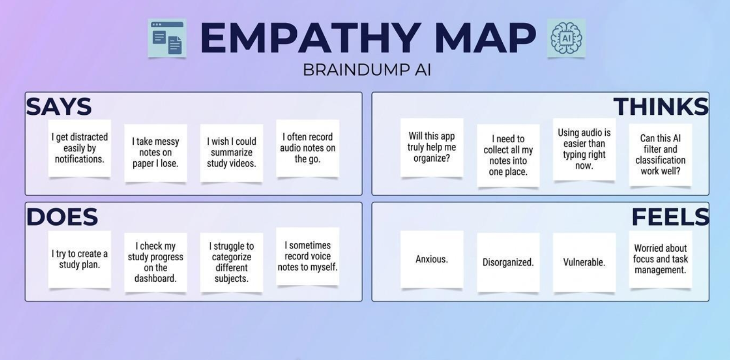
UX Research — Phase 1
Phase 1 — Research

Slide 9


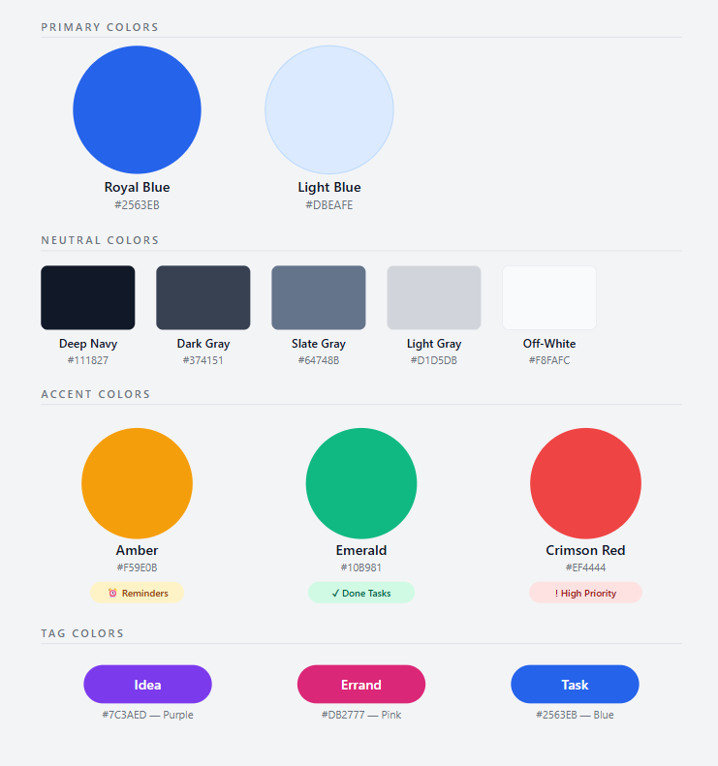
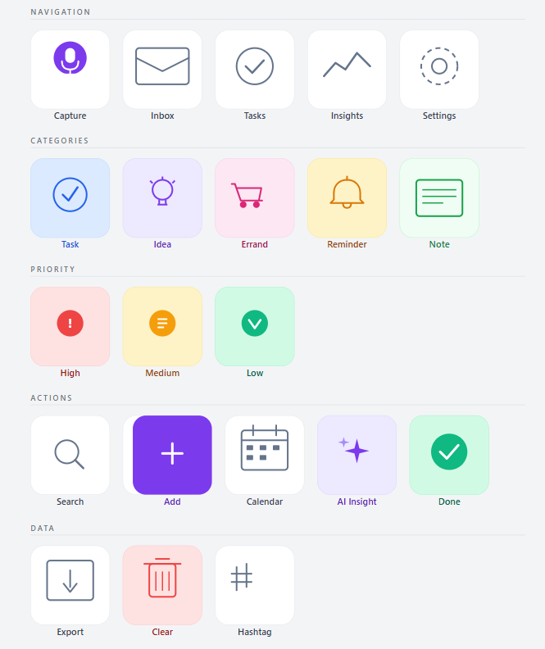
UX Research — Phase 2
Phase 2 — Design

Slide 10
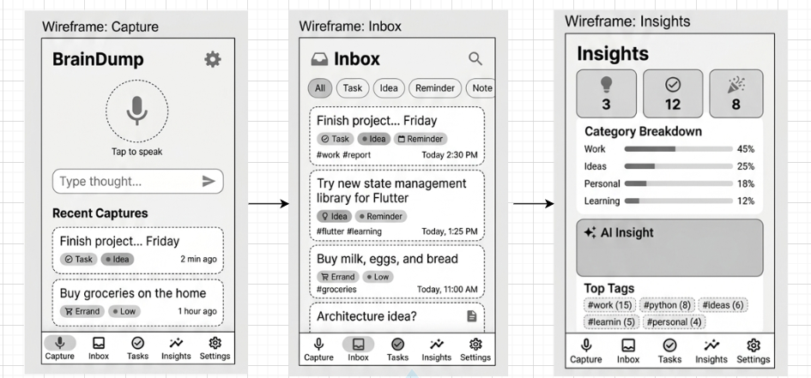
UX Research — Phase 2
Phase 2 — Design

Slide 11
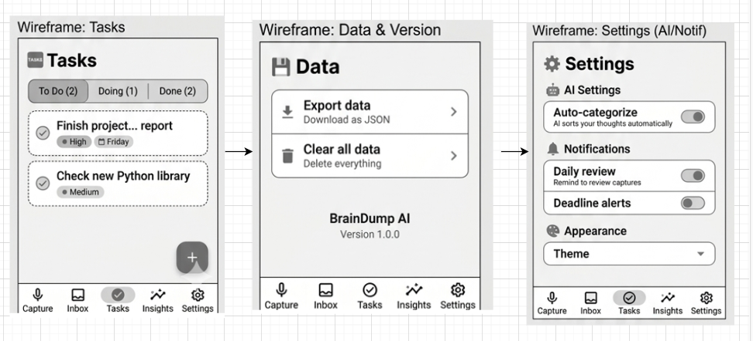
UX Research — Phase 2
Phase 2 — Design

Slide 12
Main Points & Selected Solution
Concluded Main Points
✓ Selected Solution
⏱ Capture takes too long (30+ seconds)
BrainDump AI was selected because:
✔ 3-second voice/text capture
✔ AI auto-categorization removes manual work
✔ Deadline extraction from natural language
✔ Kanban task board for action
✔ AI Insights for pattern awareness
No other app combines instant capture +
auto-organization in a single mobile app.
🗂 Manual organization is tedious
🔔 Deadlines buried in notes
😰 Open loops cause anxiety

Slide 13
Key Features
🎤
🤖
📥
Instant Capture
AI Auto-Organization
Smart Inbox
Voice or text in under 3 seconds
Category · Priority · Deadlines · Tags
AI-organized view with filters & search
✅
📊
🔔
Task Board
AI Insights
Smart Reminders
Kanban: To Do / Doing / Done
Weekly analytics & thought patterns
Auto-detected deadlines → notifications

Slide 14
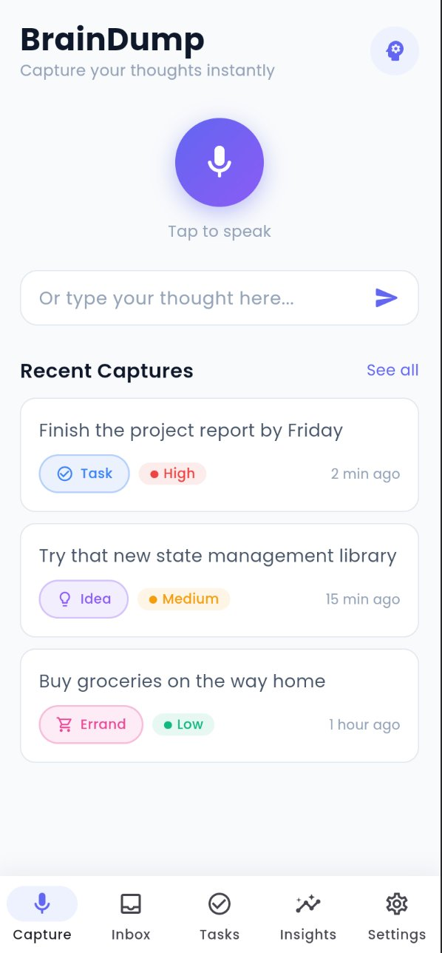
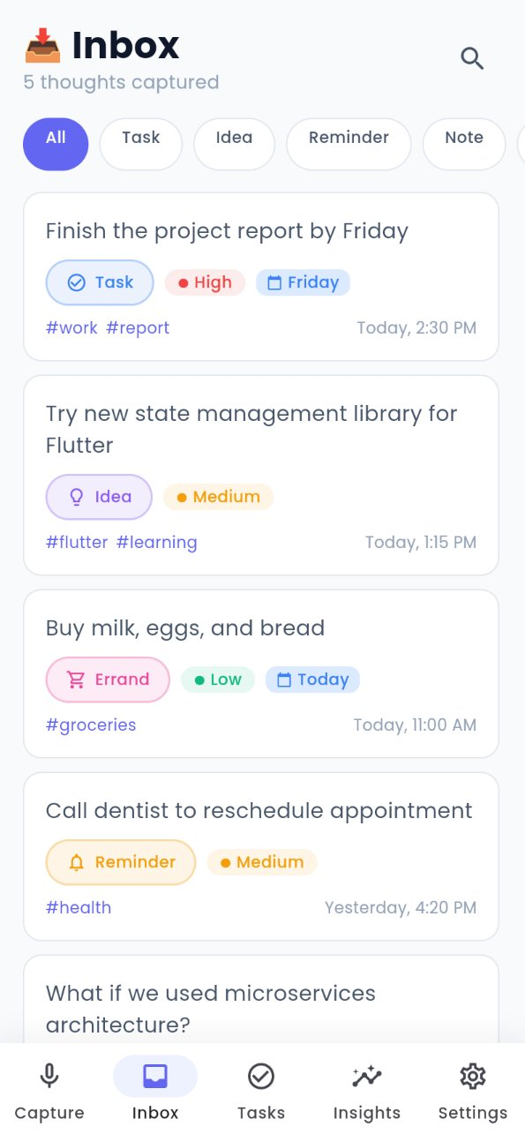
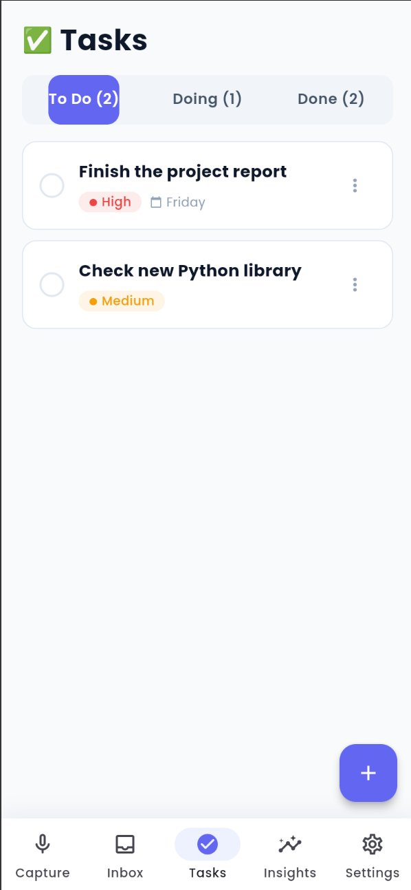
Code Implementation — Screens 1–3
Capture Screen
Inbox Screen
Tasks Screen
Voice/text input · Recent captures
AI-organized · Filters · Tags
Kanban board · To Do / Doing / Done

Slide 15
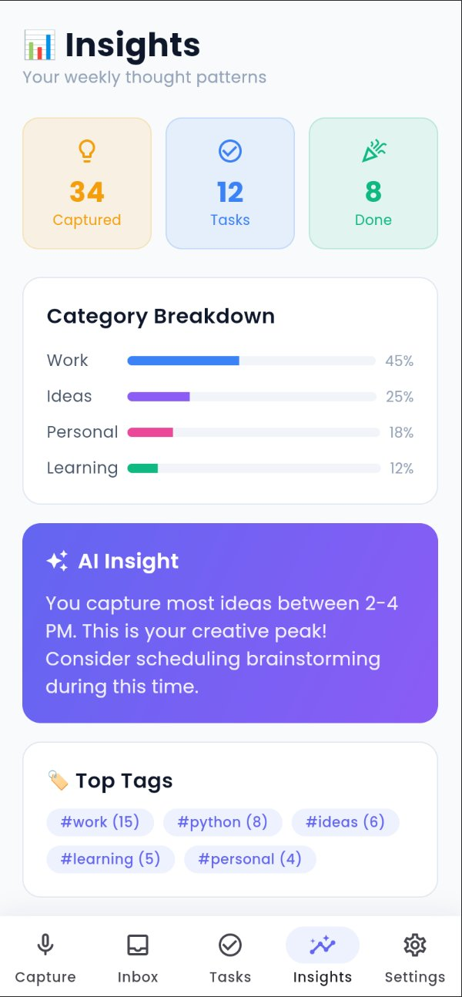
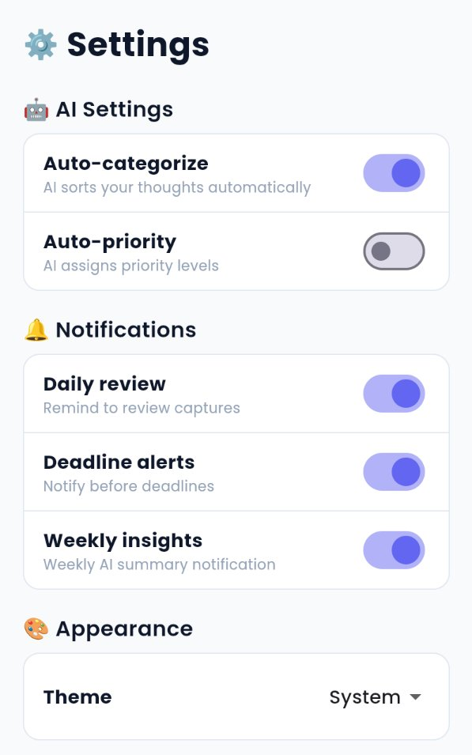
Code Implementation — Screens 4–5
Insights Screen
Settings Screen
Weekly analytics · AI Insight card · Top tags
AI toggle · Notifications · Appearance · Data

Slide 16
Technology Stack
📱
Flutter
Dart — Cross-platform mobile
🤖
Google Gemini
AI — Text analysis & categorization
🗣
Speech-to-Text
Android built-in voice recognition
🗄
SQLite
Local on-device storage
📊
fl_chart
Data visualization & charts

Slide 17
Success Metrics
< 3s
> 80%
> 90%
Capture time
AI categorization accuracy
Voice recognition accuracy
5+
> 50%
Captures per user/day
User retention at 3 months
Target Users: Students · Professionals · Creative Workers · Anyone with unprocessed thoughts

Slide 18
Thank You
BrainDump AI — Capture thoughts. Clear your mind.

