Slide 1
PWM
( Pulse Width Modulation )
Name : Ahmed atef tawfik mohamed

Slide 2
PWM
- Pulse Width Modulation (PWM) : is a technique by which the width of a pulse is varied while keeping the frequency constant.
-Why Pulse Width Modulation?
Microcontroller is a digital device where the logic output is 0 or 1 which mean that the digital output is either 0 volts or 5 volts.
In some microcontrollers the digital output is 0 volts or 3.3 voltss

Slide 3
Why Pulse width modulation ?
Majority of real time applications require analog input, for example
- DC motors
- audio devices
- analog waveforms
- dimming LEDS
- pumps
- hydraulics
- etc.

Slide 4
PWM funadamental elements
PWM signal consists of two funadamental elements:
- Frequency (Hz)
- Duty cycle

Slide 5
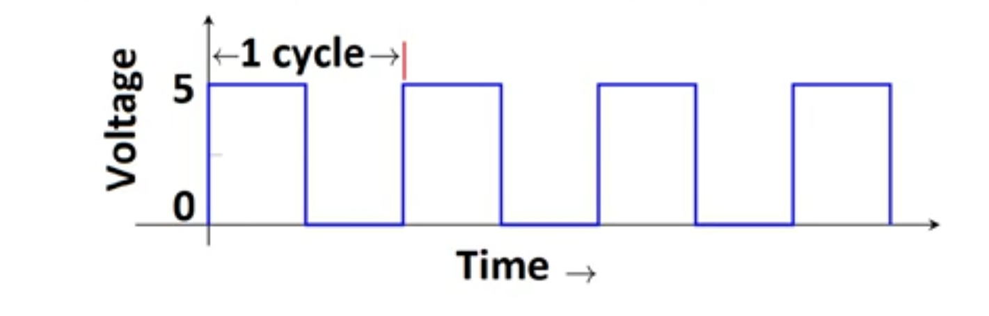
Frequency
Freqency is represented through the total number of cycles per one second

Slide 6
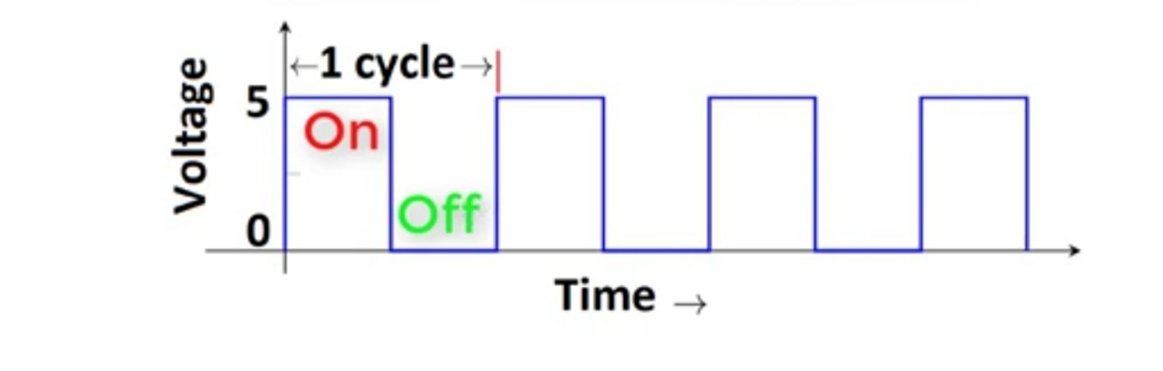
Duty cycle
Duty cycle is defined with respect to percentage or as a number between 0 and 1
Duty cycle = On time / 1 Cycle (On time + off time)

Slide 7
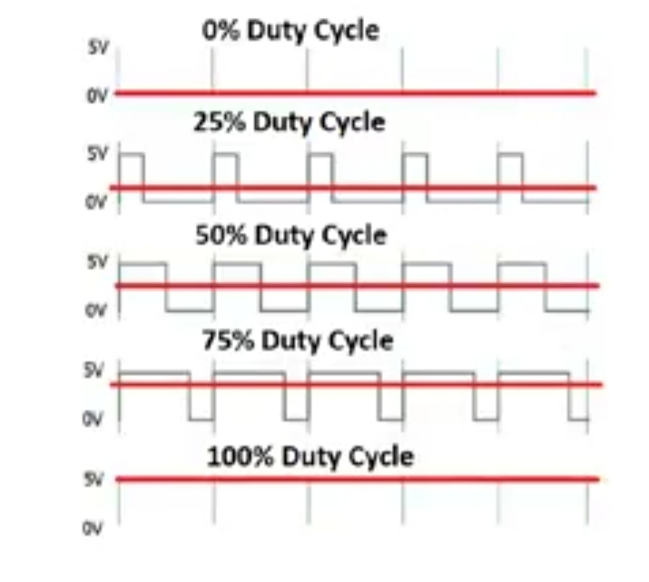
Duty cycle Example
Duty cycle = ON Timee / 1 Cycle (On time + Off time)

Slide 8
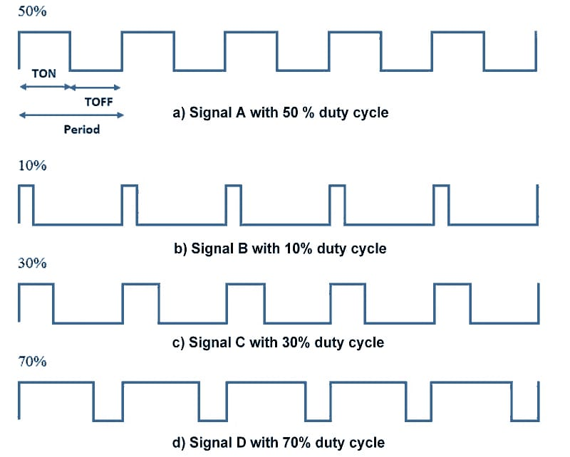
Duty cycle Example

