Slide 1

SkillGenome X
Inferring a Nation's True Skill DNA from Fragmented Real-World Signals
An ML-based prototype for latent skill inference
Ahmed Arshadul Haque

Slide 2
The Measurement Gap
Current methods for measuring national skills rely on degrees, certifications, surveys, and self-reported data. These metrics are static, incomplete, and fail to capture informal, emerging, and cross-domain skills.
The Core Challenge
Skills are latent and dynamic, whilst current systems attempt to measure them directly and retrospectively.
Meanwhile, real skill signals exist across platforms like open-source work, gig activity, and online learning, but this data is fragmented, noisy, and partially adversarial.
Policymakers and institutions lack a reliable way to understand actual capabilities, regional strengths, evolving skills, and structural gaps.

Slide 3

A Paradigm Shift in Skill Measurement
Fragmented Data
Latent Inference
Actionable Insight
SkillGenome X reframes skills as latent variables that must be inferred rather than explicitly measured. Using machine learning, the system learns compressed representations of skills from fragmented real-world behavioural data. These latent skill embeddings allow us to reconstruct underlying skill structures, identify hidden strengths, and analyse how skills distribute, evolve, and concentrate across regions over time.

Slide 4
Why This Matters Now
Credential Disconnect
Invisible Talent
Accelerating Change
Strategic Risk
Informal and rural talent remains completely invisible to traditional measurement systems.
Late detection of skill gaps creates national economic and security vulnerabilities.
Degrees and certificates do not reflect real capability or current proficiency in rapidly evolving fields.
Skill demand evolves faster than institutions can track or curricula can adapt.
You cannot design policy, education, or workforce strategy without visibility into real skills.

Slide 5





System Architecture
Data Collection
Real-world signals from platforms
Preprocessing
Noise reduction and normalisation
Inference Engine
ML-based latent skill extraction
Aggregation
Regional and temporal analysis
Insights
Interpretable visualisations
The focus is on inference and insight, not raw data reporting. Each stage transforms noisy signals into actionable intelligence.

Slide 6
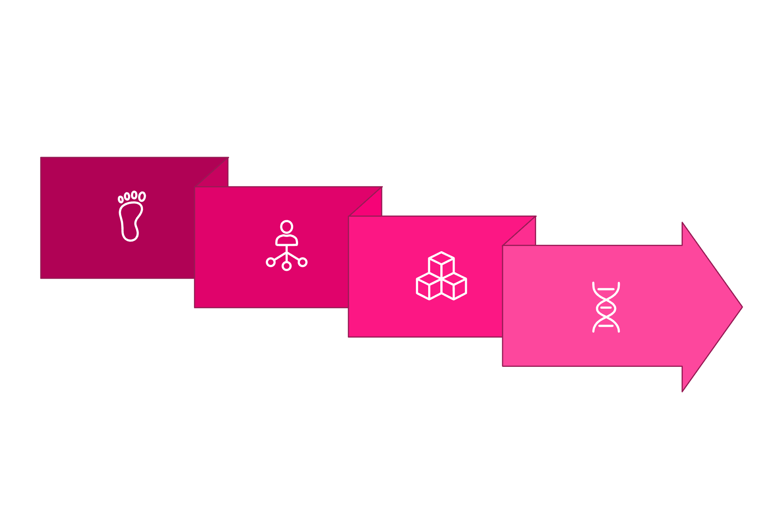




The Core Engine
Latent Skill Inference
Neural Encoding
Skills are not directly observable. The system uses a neural encoding model to learn latent skill embeddings from behavioural patterns whilst reducing noise and anomalous signals.
Skill Genome
These embeddings form the Skill Genome layer, representing underlying capability rather than surface-level activity. This approach captures tacit knowledge, informal expertise, and emerging competencies that traditional metrics miss entirely.
Behaviors
Latent Embeddings

Slide 7
From Inference to Impact
01
02
03
Regional Aggregation
Temporal Analysis
Gap Detection
Embeddings are aggregated region-wise to reveal talent clusters and geographical concentrations of specific skill sets.
Time-based analysis highlights emerging and declining skills, tracking how the skill landscape evolves quarter by quarter.
Distribution comparisons surface potential skill gaps, mismatches, and structural risks before they become critical.
Inference enables visibility; aggregation enables policy relevance.

Slide 8
Technical Feasibility
Deployment Considerations
Real Data Foundation
Data access is a deployment challenge, not a technical limitation. The architecture supports integration with multiple signal sources including:
Uses publicly available GitHub data as a primary signal source, demonstrating immediate viability.
Open-source contribution platforms
Freelance and gig economy activity
Online learning completion data
Professional community engagement
Validated Prototype
Prototype validated on limited-scale datasets with measurable accuracy in skill inference.
Scalable Architecture
System designed to scale seamlessly with additional real-world sources as they become available.

Slide 9
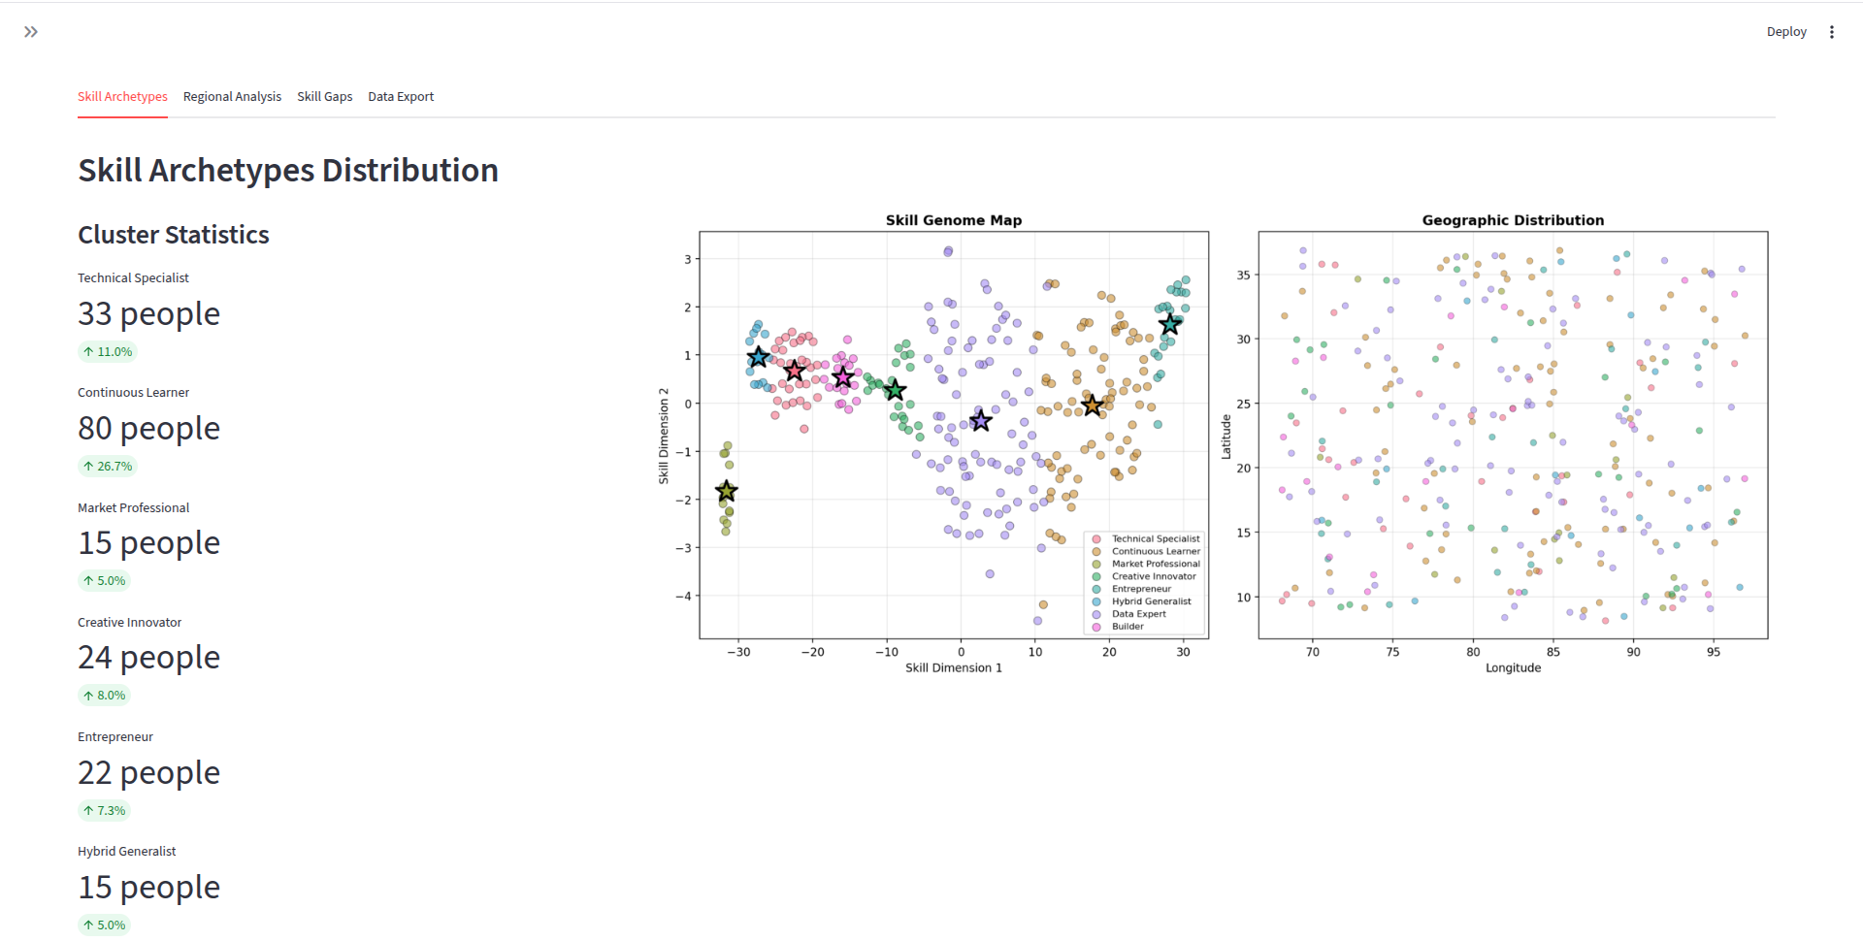
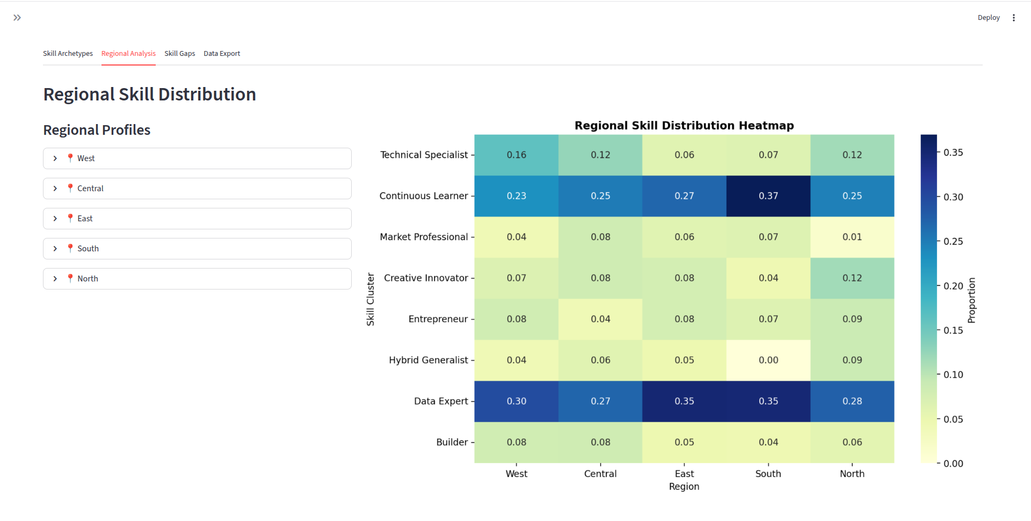
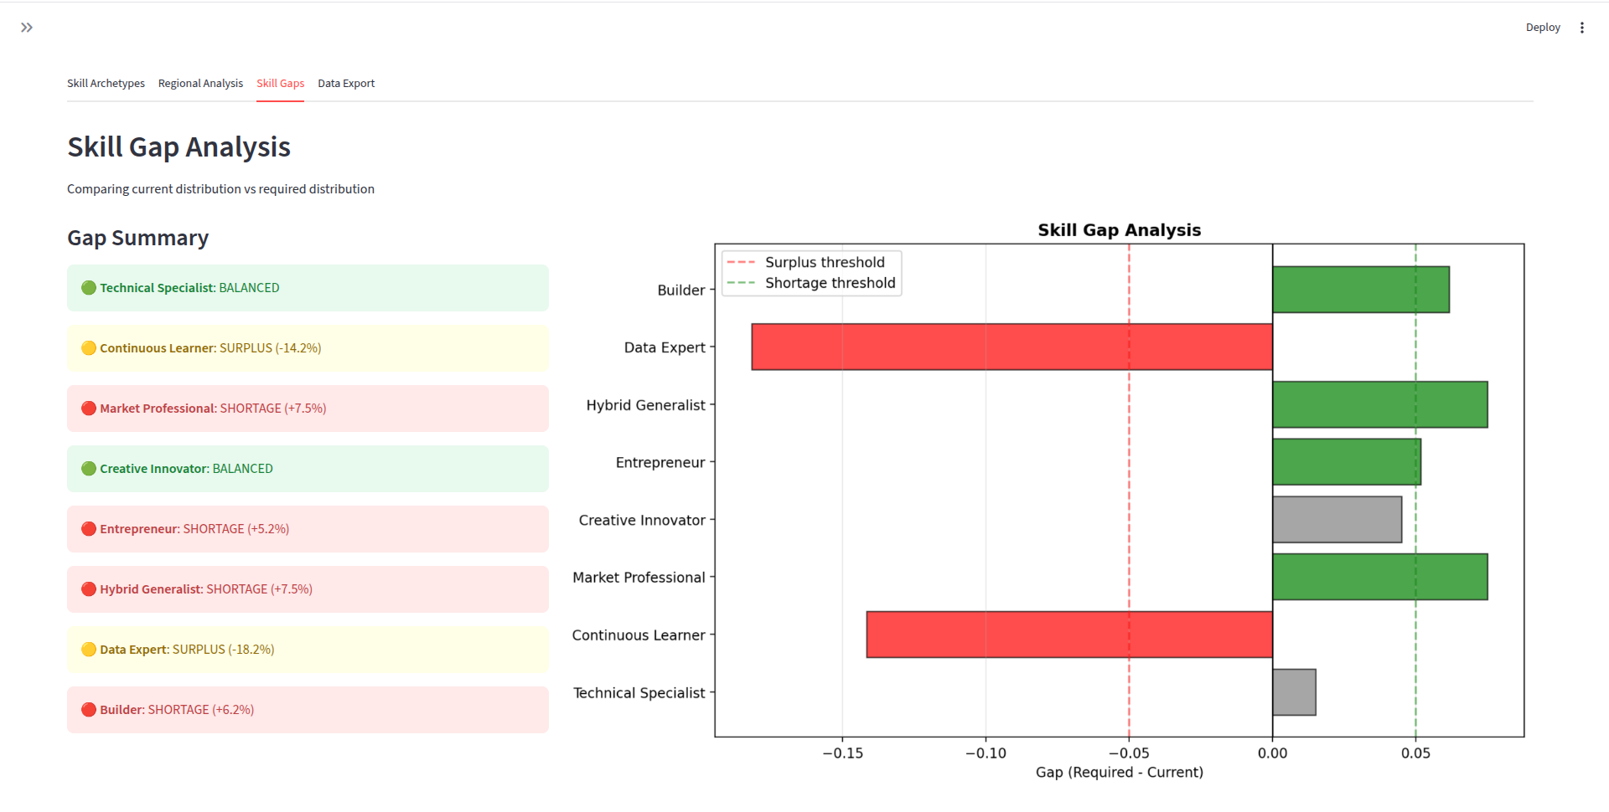
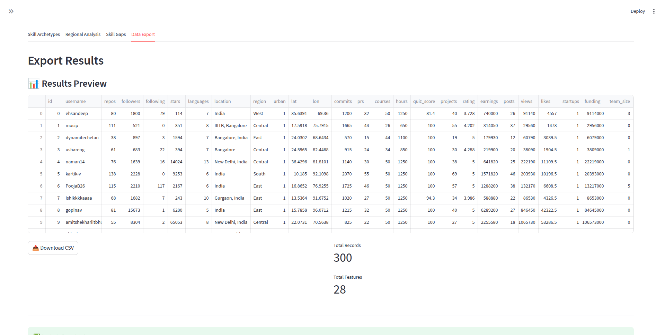
Interactive Demonstration

Slide 10
The Path Forward
SkillGenome X demonstrates how fragmented, noisy real-world data can be transformed into a coherent Skill Genome using machine learning. By shifting from credential-based measurement to inference-based understanding, the system enables earlier detection of strengths, gaps, and risks in a nation's skill landscape.
Core Insight
If skills are latent, inference is the only path forward.
Traditional measurement will always lag behind reality. Only inference can keep pace with change.
This approach provides policymakers, educators, and workforce strategists with unprecedented visibility into actual capabilities, not just documented qualifications. It reveals hidden talent, tracks emerging competencies, and identifies structural vulnerabilities before they manifest as national challenges.

