Slide 1






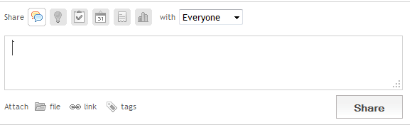
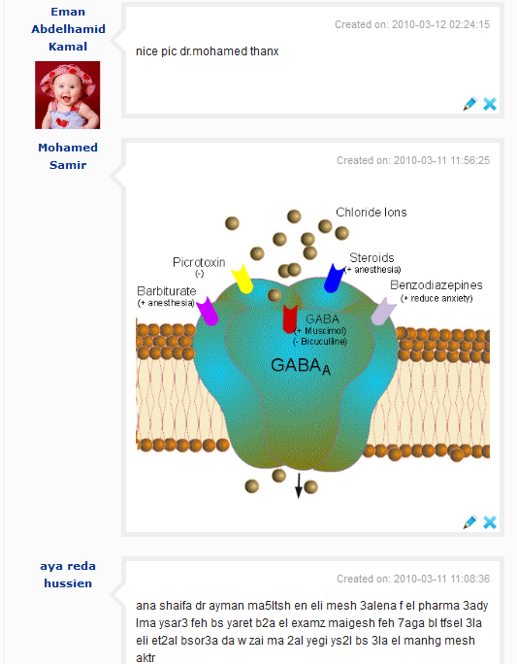
Schoolen
Home Profile Inbox Settings logout
Ain Shams Electrical Engineers 2012
Other Links Space
All
add:
Logic circuits
Neural
Introduction
Add tags:
Type in a chapter or course name…
Ads
Chapter1
Chapter2
Simulation
Hardware
Environmental impact of projects
footer

Slide 2
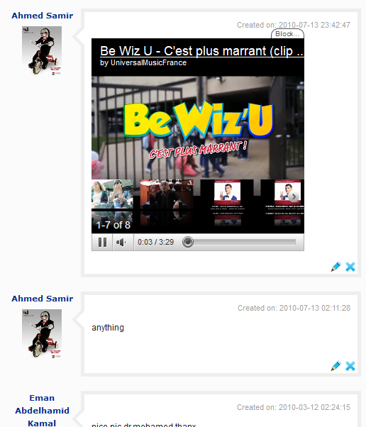
Schoolen
Home Profile Inbox Settings logout
Ain Shams Electrical Engineers 2012
Other Links Space
All
add:
Logic circuits
Neural
Introduction
Add tags:
Type in a chapter or course name…
Ads
Chapter1
Chapter2
Simulation
Hardware
Environmental impact of projects
footer

Slide 3
Schoolen
Home Profile Inbox Settings logout
Ain Shams Electrical Engineers 2012
Other Links Space
All
add:
Logic circuits
Neural
Introduction
Add tags:
Type in a chapter or course name…
Chapter1
Ads
Chapter2
Simulation
Hardware
Environmental impact of projects
footer

