Slide 1



Can Module Inside Tiva C
Ahmed Emad Ibrahim

Slide 2
Contents
Can Module Features Inside TM4C123GH6PM Launchpad MC
Description of Can module
Block Diagram of can module
Configuration of transmit and receive message objects
Transmission and Bus access in the can Network
FIFO buffer
Different modes of operation

Slide 3
Can module Features
Has two Can Units
Supports CAN protocol version 2.0 part A/B
Bit rates up to 1 Mbps
32 message objects with individual identifier masks for each unit
Disable Automatic Retransmission mode for Time-Triggered CAN (TTCAN) applications
Programmable loopback mode for self-test operation
Automatic transmission upon receiving remote frame
Programmable FIFO mode enables storage of multiple message objects
Attaches to an external CAN transceiver through the CANnTX and CANnRX signals

Slide 4
Description of Can module
Can Module consists of 3 different parts: 1- CAN protocol controller and message handler which transfers and receives the serial data from the CAN bus and passes the data on to the message handler then message handler loads this information into the appropriate message object. The message handler is also responsible for generating interrupts based on events on the CAN bus. 2- Message memory it is a set of 32 identical memory blocks that hold the current configuration, status, and actual data for each message object. These memory blocks are accessed via either of the CAN message object register interfaces. 3- CAN interface registers as the message memory is not directly accessible there are two set of interface registers and the two sets allow parallel access to the CAN controller message objects when multiple objects may have new information that must be processed In general, one interface is used for transmit data and one for receive data.

Slide 5
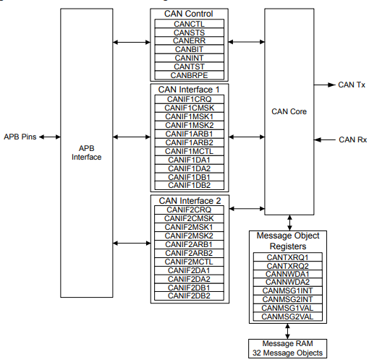
Block Diagram of can module

Slide 6
Initialization
Here is summary of steps of initialization of the CAN module
Set GPIO Alternate Function Select (GPIOAFSEL) register
Set the Init bit in CAN control register
Set the CAN bit timing register to adjust the baud rate
Configure each message object through the interface registers
To leave the initialization state, the INIT bit must be cleared

Slide 7
Configuring a Transmit Message Object
Use CANIFnCMASK register to specify write to interface registers
Set mask registers CANIFnMSK to specify which of the bits in the 29-bit or 11-bit message identifier are used for acceptance filtering
Set the ID of the message and the DIR of message object in the CANIFnARB registers
specify the data length of the message object , enable or disable interrupt ,set UMASK bit to enable mask bits in acceptance filter and set the RMTEN bit to o enable the TXRQST bit to be set on the reception of a matching remote frame in CANIFnMCTL register
Load the data in the interface registers CAN IFn Data
Program the number of the message object to be transmitted in the MNUM field in the CAN IFn Command Request (CANIFnCRQ) register
Finaly set the TXRQST bit in the CANIFnMCTL register

Slide 8
Transmission
Operation: If the internal transmit shift register of the CAN module is ready for loading, and if a data transfer is not occurring between the CAN Interface Registers and message RAM, the valid message object with the highest priority that has a pending transmission request is loaded into the transmit shift register by the message handler and the transmission is started after that bus access procedure occurs to take over the can network
Automatic Transmission feature: TM4C123GH6PM Launchpad MC have feature of enabling Automatic transmission upon receiving remote frame by setting the TXRQST bit automatically

Slide 9
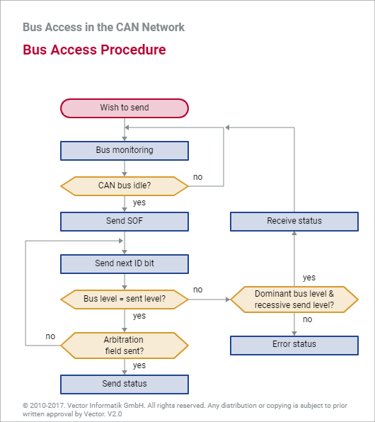
Bus access in the can Network

Slide 10
Configuring a Receive Message Object
Use CANIFnCMASK register to specify write to interface registers
Set mask registers CANIFnMSK to specify which of the bits in the 29-bit or 11-bit message identifier are used for acceptance filtering
Set the ID of the message and the DIR to be receive of message object in the CANIFnARB registers
specify the data length of the message object , enable or disable interrupt , set UMASK bit to enable mask bits in acceptance filter and clear the RMTEN bit in CANIFnMCTL register
Program the number of the message object to be transmitted in the MNUM field in the CAN IFn Command Request (CANIFnCRQ) register

Slide 11
FIFo buffer
TIVA C has a feature of Programmable FIFO mode enables storage of multiple message objects
Configuration: same as the configuration of a single receive message object except EOB bit in the CANIFnMCTL register
Concatenation feature: you can o concatenate two or more message objects into a FIFO buffer by setting the identifiers and masks of these message objects have to be programmed to matching values

Slide 12
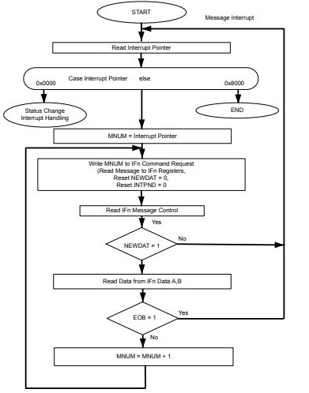
Message Objects in a FIFO Buffer

Slide 13
Test Mode
A Test Mode is provided which allows various diagnostics to be performed. Test Mode is entered by setting the TEST bit in the CANCTL register
various diagnostic modes can be obtained by configuring the TX[1:0], LBACK, SILENT and BASIC bits in the CAN Test (CANTST) register , Also you can monitor the RX bit signal in the CANTST register

Slide 14
Silent Mode
Silent Mode can be used to analyze the traffic on a CAN bus without affecting it by the transmission of dominant bits (Acknowledge Bits, Error Frames). The CAN Controller is put in Silent Mode setting the SILENT bit in the CANTST register. In Silent Mode, the CAN controller is able to receive valid data frames and valid remote frames, but it sends only recessive bits on the CAN bus and cannot start a transmission
Loopback Mode
Loopback mode is useful for self-test functions. In Loopback Mode, the CAN Controller internally routes the CANnTX signal on to the CANnRX signal and treats its own transmitted messages as received messages and stores them (if they pass acceptance filtering) into the message buffer. The CAN Controller is put in Loopback Mode by setting the LBACK bit in the CANTST register

Slide 15
Loopback Combined with Silent Mode
Loopback Mode and Silent Mode can be combined to allow the CAN Controller to be tested without affecting a running CAN system connected to the CANnTX and CANnRX signals. In this mode, the CANnRX signal is disconnected from the CAN Controller and the CANnTX signal is held recessive. This mode is enabled by setting both the LBACK and SILENT bits in the CANTST register.

Slide 16


