Slide 1
PRACH-Based Bistatic Target Detection and Localization using Sionna
Ahmed Esad Koçak

Slide 2
Origins of the Project
This project was originally Enes’ undergraduate project.
My contributions primarily focused on improvements and implementation of OFDM.

Slide 3
Objective
Our main objective is to combine Sensing and Communication.
We use PRACH preambles to first estimate the distance between the object and each transmitter, and then estimate the object’s location using multiple transmitters.
Preambles are used in PRACH (Physical Random Access Channel) for initial detection.

Slide 4
Key Challenges
Detection of nLOS and preventing false detection.
Extracting accurate delays from multipath reflections.

Slide 5
Tools
We design the 3D scene in Blender.
The remaining code was built on Jupyter Notebooks on Google Colab.
We utilized Sionna’s built in blocks, used NumPy functions as well.

Slide 6
Implementation
We design a 3D environment to simulate in Blender.
We place Transmitters and Receivers to the scene in Colab.
We can adjust the material properties; i.e. how much they reflect, refract etc.
We use this environment to obtain a channel using PathSolver block of Sionna Ray Tracing (RT). We derive the paths and their time of arrival. Using these values we derive the Channel Impulse Response (CIR)

Slide 7
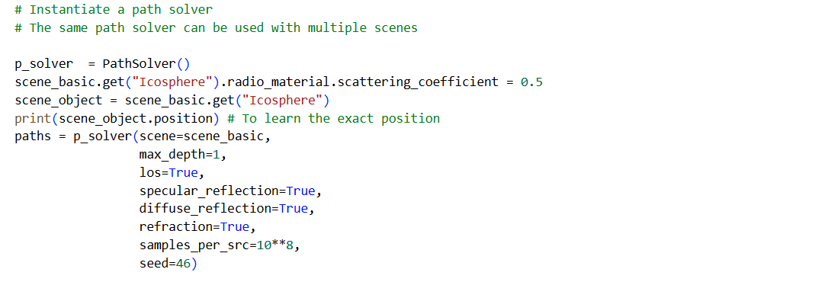
Implementation – Channel Modelling

Slide 8
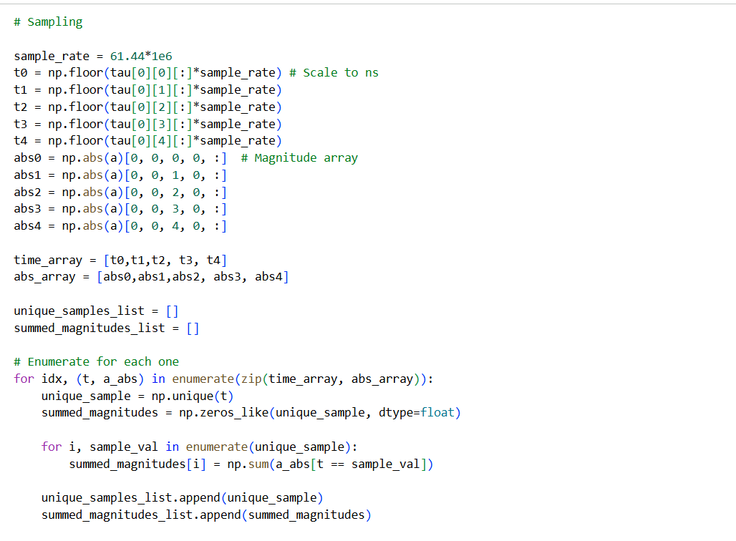
Implementation – Channel Modelling

Slide 9
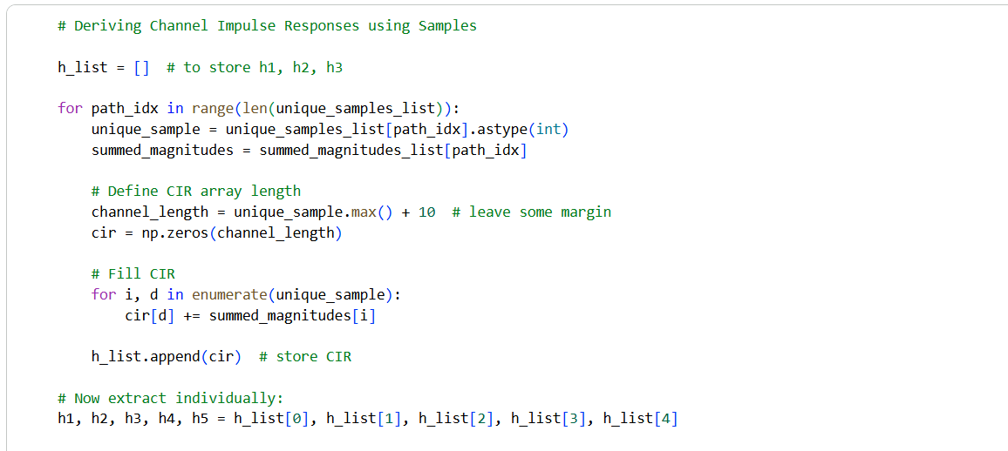
Implementation - Channel Modeling

Slide 10
Implementation – Preamble Generation
We generate preambles that will be transmitted.
We place the preambles to specific places using OFDM. We used tensors and NumPy functions.
Thus we obtained multiple signals with preambles in specific locations, that will give sharp peaks when detected.

Slide 11
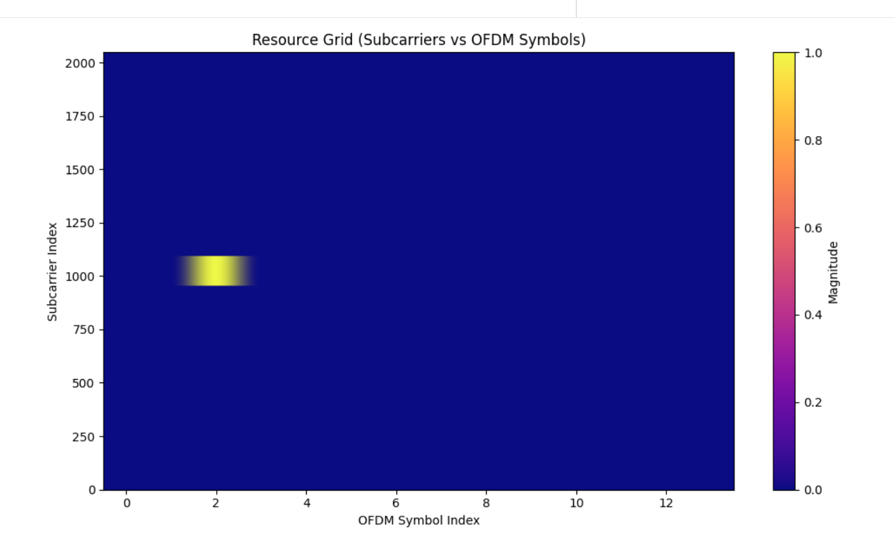
Implementation - Preamble Generation

Slide 12
Implementation - Signal Transmission
We create 5 preambles for 5 Transmitters. The sequence length and other parameters are not random, we used a specific preamble type.
We transmit each signal over a channel, each channel represents a Tx-Rx combination.
We observed two sharp peaks, first one being LOS (Line of Sight) and second one nLOS (non Line of Sight). We need to detect these peaks and their indices correctly.

Slide 13
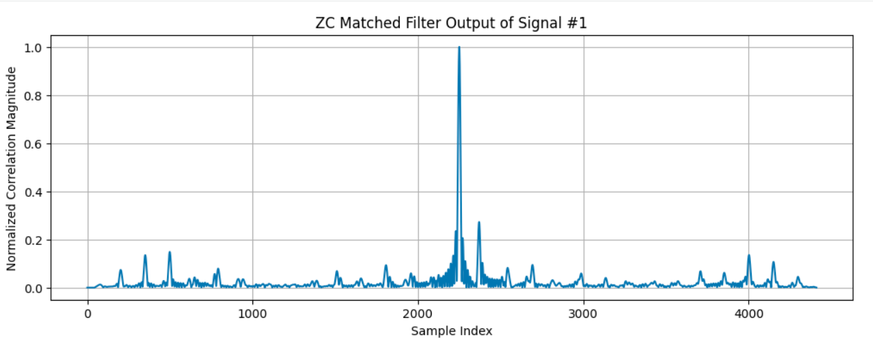
Implementation – Peak Detection

Slide 14
Implementation – Peak Detection
We implemented a peak detection algorithm in order to detect the two highest peaks, obtain their indices and estimate the distance.
Object distance to Tx = c*(nLOS index – LOS index)/sample rate

Slide 15
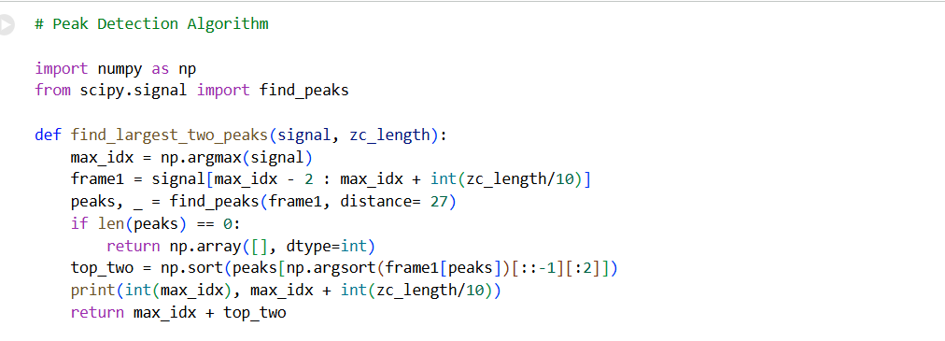
Implementation - Peak Detection

Slide 16
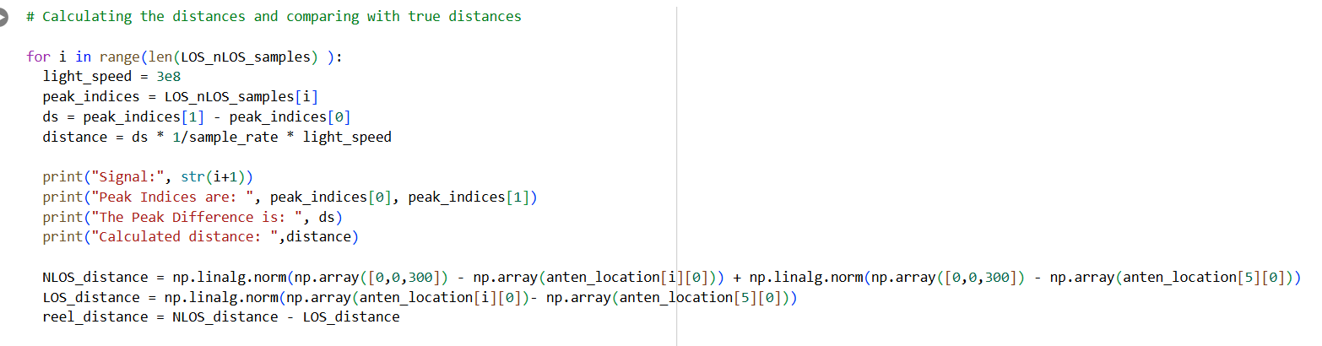
Implementation – Distance Estimation

Slide 17
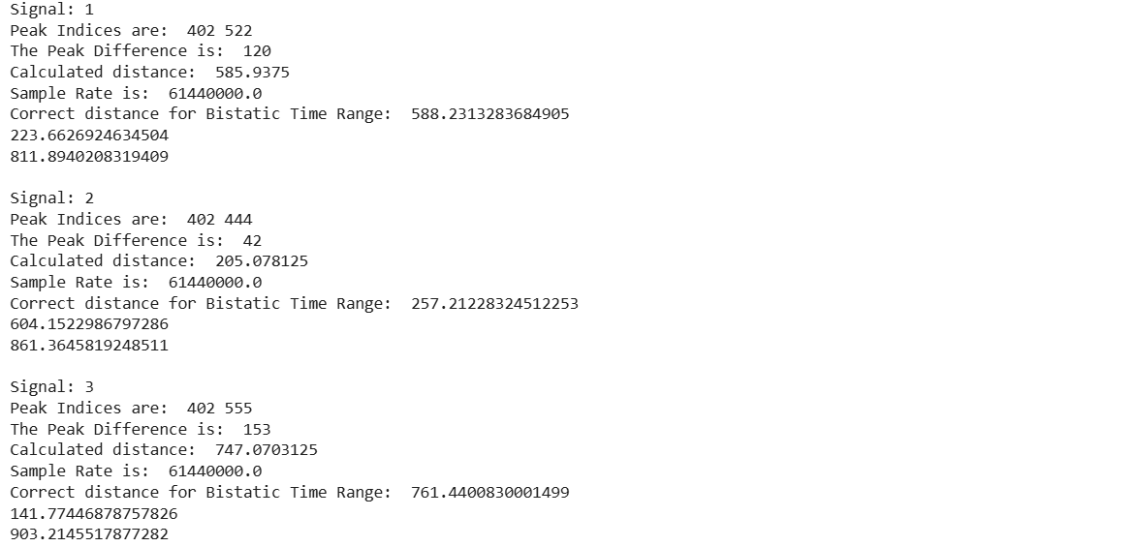
Implementation - Distance Estimation

Slide 18
Implementation - Localization
Then we use the 3 best (or more) results and use a localization algorithm.
We basically solve: Residual = |X - tx| + |X - rx| - total_length.
Because of the geometry we might get a mirrored solution depending on the initial guess, as long as its closer to real solution algorithm converges correctly.
We can use more Tx’s to ensure we get the correct solution (and more accurate).
Our object was at [0, 0, 300]

Slide 19
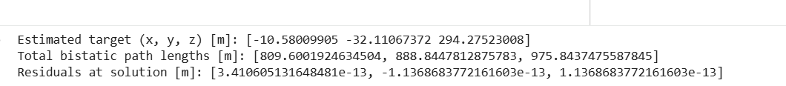
Implementation - Localization

Slide 20
Limitations
In practical situations, nLOS peak is extremely hard to detect. We used an optimal and very simple case.
We used 10^8 samples per src in PathSolver block, after a number computing time grew exponentially.
Even if we can get nLOS, we cannot be sure if we are detecting the correct object.
Project didn’t consider real time action; moving objects were not considered.

Slide 21
Future Developments
Considering multiple transmitters we can optimize for better estimations.
We can factor in the Doppler effect and consider moving objects.
Potentially, before experimenting in real life, we can build the environment in Blender and its material coefficients thus optimizing the experiment setting for a real life scenario.

Slide 22
Thank you for your attention…

