Slide 1
PRIVACY-FIRST HEALTHCARE
MedVault
An AI-powered secure patient data access auditor
Ahmed Furkhan | CS 5610 Web Development | MS CS, Northeastern University

Slide 2
THE PROBLEM
Portals hide who accessed your records
Patient portals let you view your data but never reveal who else looked at it, when, or why.
No visibility
You can read your records, but the access footprint behind them stays completely hidden.
Unreadable logs
Even when access logs exist, they're raw timestamps and IPs a patient can't interpret.
Anomalies unnoticed
Off-hours access or rapid view bursts slip by with no alerting and no explanation.

Slide 3
THE SOLUTION
Log it. Explain it. See it.
Every access is recorded, checked against rules, and explained in plain English.
1. Log it
Each record view is recorded with time, device, and access type - automatically.
2. AI explains it
Flagged events get a plain-English reason, a severity label, and a recommended action.
3. See it
A risk dashboard and per-record audit timeline show exactly who accessed what.

Slide 4
WHO IT'S FOR
Meet Maria - and her three needs
Maria manages a chronic condition and sees multiple providers. After each visit she wonders who accessed her records - and wants clear answers, not raw logs.
Story 1 - Manage my records
Register, log in, and create / view / edit / delete my own health records, private to my account.
Story 2 - Automatic audit trail
Every record view is logged automatically; I review a per-record timeline, filterable by date range.
Story 3 - Risk dashboard, explained
Odd-hours, new-device, and view-burst flags with a risk score - each explained in plain English.

Slide 5
WHAT IT DOES
Transparency, explained
AI-explained alerts
Each anomaly gets a plain-English reason, a severity badge, and a recommended next step.
Grounded AI assistant
Ask who accessed your records; answers come only from your real audit data, multi-turn.
Risk dashboard
Live risk score with off-hours, new-device, and view-burst counts, plus an access-vs-flags trend chart.
Access timeline
A per-record chronological audit trail, filterable by date range, with flagged events highlighted.
Records management
Full CRUD over your health records with fast search and pagination.
Private & secure
Passport auth, hashed passwords, sessions, same-origin (no CORS), no exposed secrets.

Slide 6
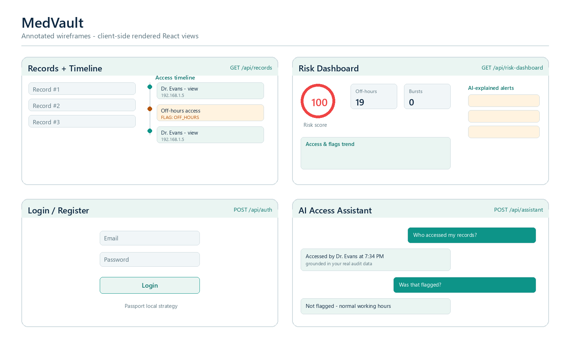
DESIGN & MOCKUPS
Client-side React views

Slide 7
HOW IT'S BUILT
A modern full-stack, within the rules
Frontend
React 18 (Hooks) + Vite - client-side rendering; Recharts (approved) for charts; Fetch API.
Backend
Node.js + Express (ES modules); Passport local strategy; express-session; bcrypt.
Database
MongoDB via the native driver (no Mongoose) - users, records, accessLogs; full CRUD on records.
AI integration
Rules decide what's suspicious (MongoDB aggregation); the LLM only explains flags in plain English.
Constraints
No CORS, axios, or Mongoose - same-origin via a Vite dev proxy and Express serving the built app.

Slide 8
WHAT I'M MOST PROUD OF
Grounded, actionable AI
A grounded AI assistant
It answers who-accessed-what from the user's real, aggregated audit data - multi-turn, and it refuses anything outside that scope instead of guessing.
Rules decide, AI explains
A MongoDB aggregation flags anomalies; the LLM only turns those flags into plain-English severity and action - it never decides what counts as suspicious.
Actionable, patient-first alerts
Every flag becomes a readable explanation with a color-coded severity badge and a concrete recommended next step for the patient.

Slide 9
HARDEST PART
Making the AI reliable
Grounding the AI in real numbers
Building the aggregation context so the assistant answers from real data - forcing valid JSON from the model, and caching only genuine AI output so a transient failure retries instead of sticking a fallback.
Same-origin, no CORS
The course bans CORS, so the app is same-origin: a Vite dev proxy in development and Express serving the built React app in production - keeping cookies and sessions working throughout.

Slide 10
DEMO
See it live
Live project
add your deployment URL here
GitHub repository
add your repository URL here
Demo video
add your video URL here

Slide 11
Thank you!
Questions welcome

